Slide 1
VQManager Enhancement Feb 2024
Cyber Essentials: Multi-Factor Authentication
Cyber Essentials: protection against brute-force password guessing.
Allowing delay to Assessment plan notifications.
Adding 'date created' and 'created by' fields to Report builder.
New report showing confirmation of OTJ hours.
Alter Activity log and Diary summary screens to increase clarity and add learner OTJ confirmation.
Add Learner OTJ confirmation date and comments to Diary and Activity log downloads.
Add notification for learners of new Calendar entries.
Allow Line Managers to upload files to Progress Reviews.
Add rows to Progress Review report to show which users signed off.
Shortcuts page for assessors.
Allow bulk deletion of assessment plan templates.
Allowing assessors to sign off OTJ records in bulk.

Slide 2
VQManager
Enhancements for EPA centres.
With this update, we have also added several enhancements for EPAO organisations using VQManager to manage End Point Assessment. If you are, or are considering becoming, an EPAO and would like to use VQManager, please do get in touch.

Slide 3
VQManager
Multi-Factor Authentication
We have added an option for clients who require Multi-Factor Authentication (MFA). When switched on, this requires the user to receive a one-time password (OTP) every time they log into VQManager.
This development won’t be added automatically to your centre but can be turned on for those organisations who require it.
There is a cost for this service. Please contact us for details.

Slide 4
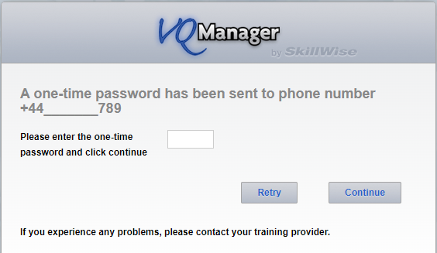
VQManager
If activated in an organisation, when logging in, the user will receive an OTP by mobile text message, and this will need to be entered as a part of the login process.
Users would log in using username and password as normal and then the page refreshes displaying this:

Slide 5
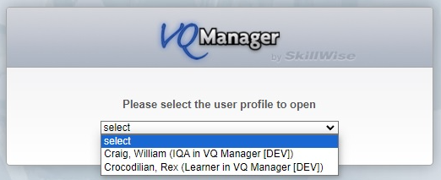
VQManager
If a user has multiple accounts that are linked together, and normally sees a drop-down at log in, this will appear after the OTP has been entered.

Slide 6
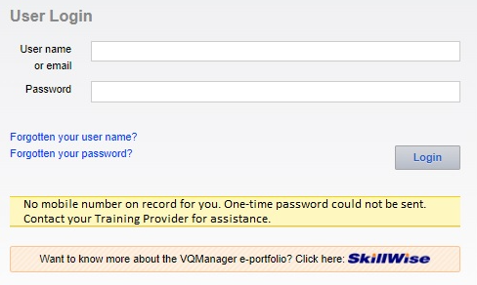
VQManager
Clicking ‘retry’ will take the user back to the log in screen to start again.
The limit for retrying after an incorrect entry of an OTP is five times, after which the user is taken back to the login page to start again with username and password.
A new OTP is sent for every request. If there is no mobile phone number recorded for the user, the system will notify them of this issue:

Slide 7
VQManager
In this instance, Admin users will be able to edit the user profile to enter a mobile number.
Clients who require MFA switching on will need a valid mobile phone number in all their user accounts so this field MUST be populated for all users prior to any go live date. You may wish to factor in some preparation time before setting this up in your organisation.
As previously mentioned, there is a cost for this service, please contact us for details.

Slide 8
VQManager
Cyber Essentials: protection against brute-force password guessing.
As per the CE requirements VQM now records failed login attempts and temporarily locks the use of a username for twenty minutes, if more than ten failed login attempts were made with the same username, during the preceding five minutes. Any further attempts at using that username are rejected without further processing. These parameters are required by CE.
After twenty minutes, the account will unlock, and the user will be able to try again.

Slide 9
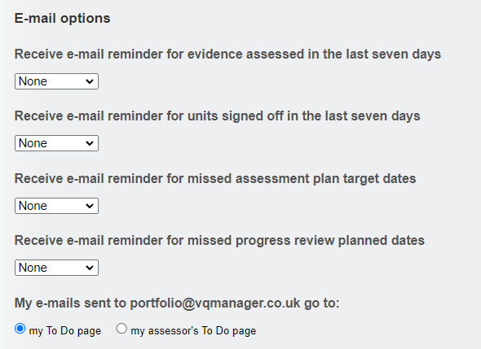
Allowing delay to Assessment plan notifications.
Instead of a learner being sent an email reminder the day after an assessment plan due date, you can now delay this notification by 14 days if you wish.
If you would prefer a 14-day delay to the current automated one (see above, sends email the day after the assessment plan becomes missed/overdue), please do contact us to implement this change.

Slide 10
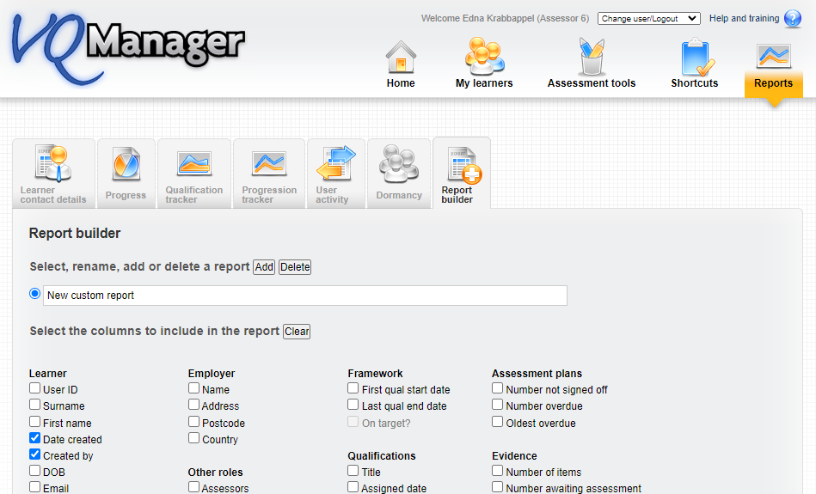
Adding 'date created' and 'created by' fields to Report builder.
We have added the following categories in the Learner section of the Report builder.
Date created
Created by (this field indicates the name and user ID of the Administrator who set the account up).

Slide 11
VQManager
When included in the report, the columns look like this.

Slide 12
VQManager
New report showing confirmation of OTJ hours.
We have created a new report which shows confirmation of OTJ hours, so you are able to easily see what will pass audit. The report is similar to the Progress Review report in layout and is available to IQAs, EQAs, Centre Admins, OSU and line managers / employers.
It draws together all the records from the Activity log and the Diary tabs, so it doesn’t matter which tab you actually use for recording OTJ hours.

Slide 13
VQManager

Slide 14
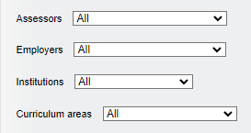
VQManager
It has several filters. Assessors, Employers, Custom filter 2 (here shown as Institution) and Custom filter 1 (here shown as Curriculum Area).
And has View and Download options.

Slide 15
VQManager
Once the report is being viewed, it displays these columns, with additional columns to the right to accommodate all the OTJ records:
All the entries and hours claimed appear in each column and individual entries will show:
n/a in the end date row for entries from the Activity log.
n/a where no confirmation request has been sent.
n/a where no Line Manager is assigned to the learner.
'Requested' will show where a confirmation request is outstanding.

Slide 16
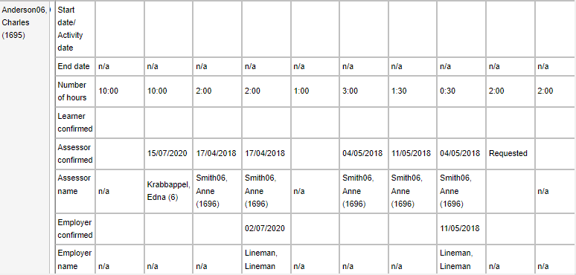
VQManager
Here is an example, showing the rows displayed for each OTJ entry:
1 2 3 4 5 6 7 8 9 10

Slide 17
VQManager
Alter Activity log and Diary summary screens to increase clarity and add learner OTJ confirmation.
In the Activity log and Diary tables, it is sometimes difficult to see the difference between bold and normal text for the OTJ hours confirmation information, so we have changed the way this is displayed.
There are three people who can confirm the hours so there are three lights, learner, assessor and line manager (employer).
A solid blue circle indicates that that user has confirmed the hours.
Blue edging around a grey circle indicates a request has been sent and is pending confirmation.
A grey circle indicates no confirmation has been requested.

Slide 18
VQManager

Slide 19
VQManager
Any records from before we introduced learner confirmation will show as 'confirmation not requested' for the learner.
Where a learner doesn't have a line manager (employer) assigned, the corresponding entry in the key, and icons in the table, will be hidden.
The role names in the key will adjust as per the centre settings i.e. line manager / employer.

Slide 20
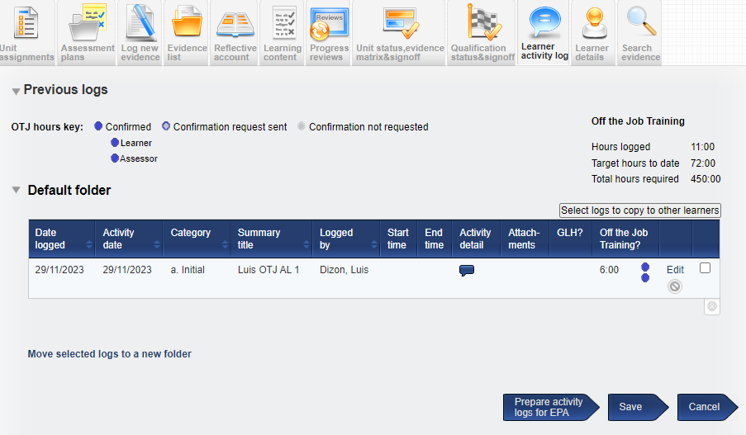
VQManager
Add Learner OTJ confirmation date and comments to Diary and Activity log downloads.
Since we've added learner confirmation to OTJ records, we have also ensured this information has been included in the EPA downloads too.
Here is an example from an activity log:
.

Slide 21
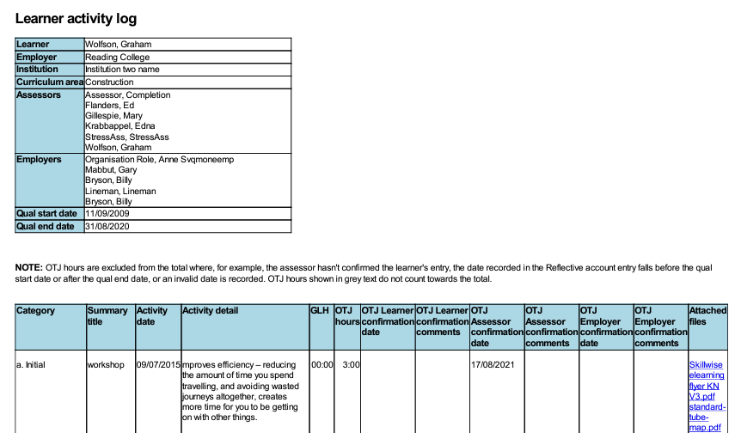
VQManager

Slide 22
VQManager
Add notification for learners of new Calendar entries.
We have added a new notification to the learner’s To Do tab to notify them when someone adds a new entry to their Calendar.
The learner would see a new table on the To Do list indicating Calendar entries logged by others in the last 30 days.

Slide 23
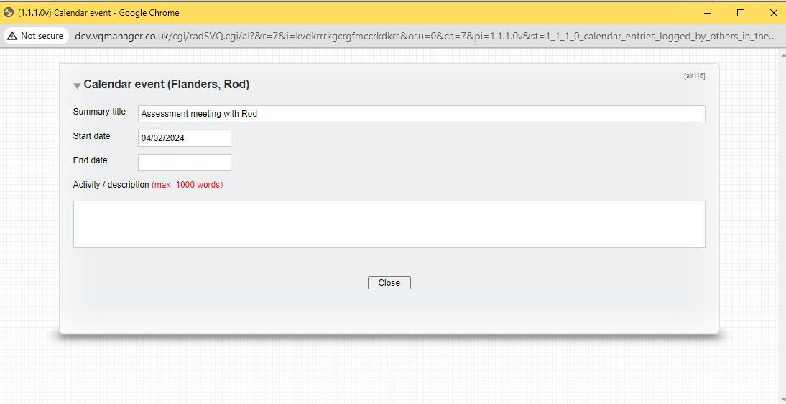
VQManager
Clicking on 'view' opens the calendar entry in question for the learner to view.

Slide 24
VQManager
Just as a quick reminder, once a calendar entry has been created for a single learner, it can be duplicated across to other learners if required.
This function is also available in the Activity Log area, where entries can be copied from one learner to others including the OTJ hours claimed.

Slide 25
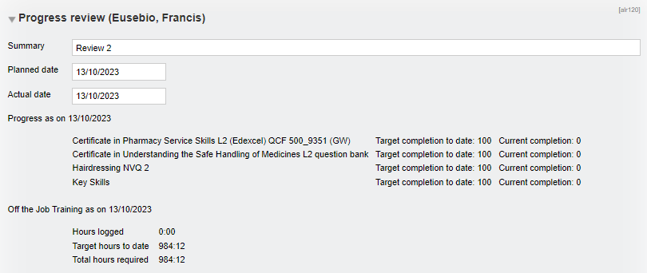
VQManager
Allow Line Managers to upload files to Progress Reviews.
Previously line managers were only able to add comments to the progress reviews, they are now able to upload files too.

Slide 26
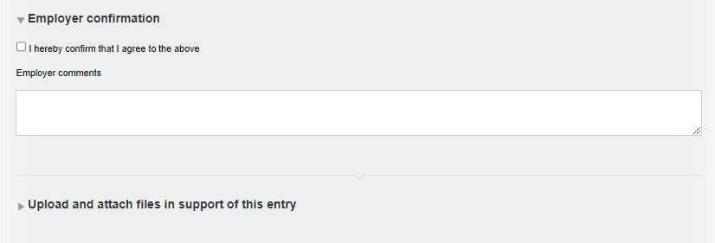
VQManager
The uploading of files works in the same way as it does for other users and areas of the system.

Slide 27
VQManager
Add rows to Progress Review report to show which users signed off.
It is now possible to see the name of the person who signed off a progress review in the progress review report.

Slide 28
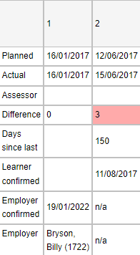
VQManager
The name which appears is the name of the assessor who confirms the review in the “actual date” field.
Kari North

Slide 29
VQManager
The name of the line manager (employer) who also confirms the review is now visible - if this is applicable.
The new rows in this report appear in the on screen and downloadable versions as you would expect.

Slide 30
VQManager
Shortcuts page for assessors.
We have now added a Shortcuts page for Assessors.
Please contact us if you would like this set as the assessor’s landing page, the first page your assessors will see when they log in.

Slide 31
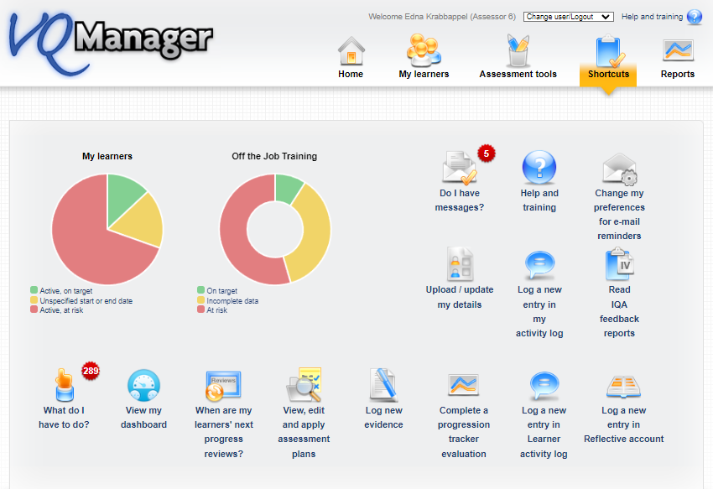
VQManager
The layout is similar to the existing Shortcuts page for the line managers and learners.

Slide 32
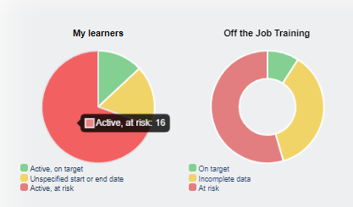
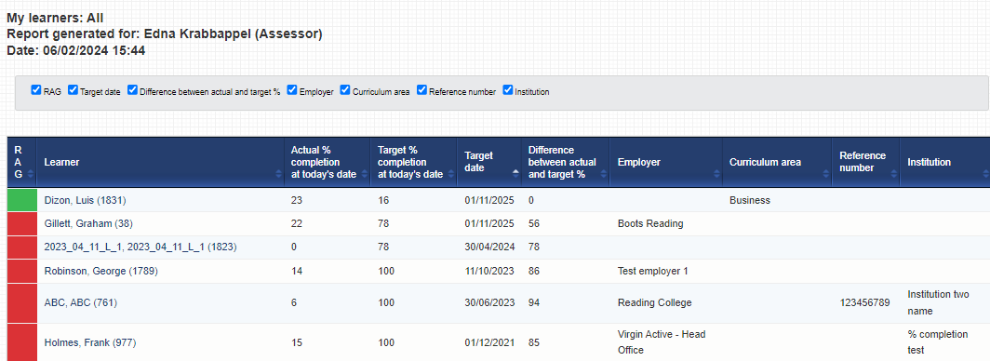
VQManager
Clicking on the graphs will take the assessor to the Dashboard.

Slide 33
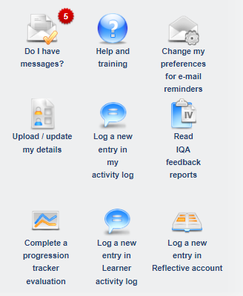
VQManager
Clicking on the icons will take the assessor to the relevant page.

Slide 34
VQManager
Allow bulk deletion of assessment plan templates.
Assessors are now able to delete assessment plan templates in bulk. This is useful to clear up old templates that aren’t being used any more.
Assessment plans assigned to learners are not affected by this – the function only removes templates you won’t be assigning to learners in future.

Slide 35
VQManager
On the View, edit or apply single plan templates tab, you could previously click on “Apply” “Delete” “Edit” and “View” to complete that action for that specific plan.
This new function allows assessors to select several plans using the new tick box and delete in one go.

Slide 36
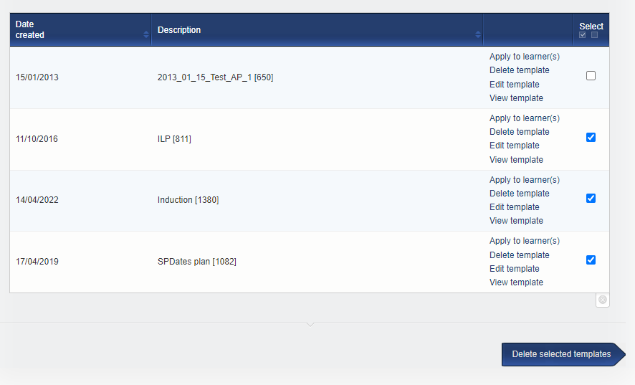
There is also the usual “select all” option in the blue area within the table if required:

Slide 37
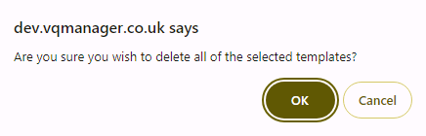
VQManager
After selecting the templates they’d like to remove, the assessor clicks the Delete selected templates button at the bottom of the page.
When this is selected, a pop up appears to double-check the decision. Click OK to delete, Cancel to return to the page.

Slide 38
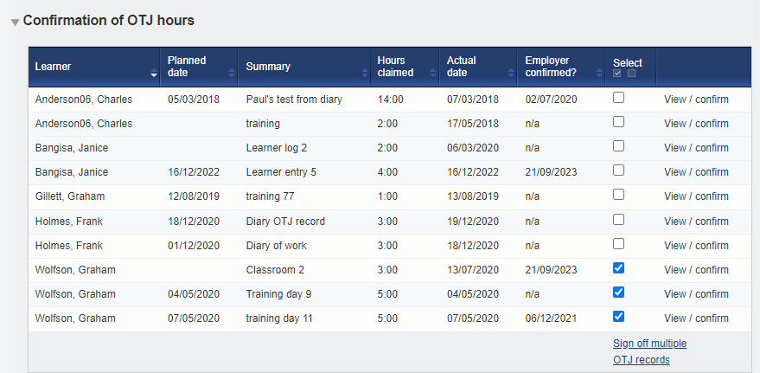
VQManager
Allowing assessors to sign off OTJ records in bulk.
Assessors are now able to sign off OTJ records in bulk.
In the Confirmation of OTJ hours table on the To Do tab, there is a new tick box allowing the assessor to select multiple entries.

Slide 39
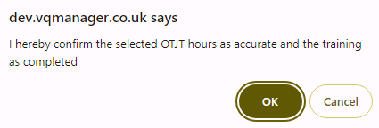
VQManager
The assessor then selects the hyperlink Sign off multiple OTJ records and a pop up appears:

Slide 40
VQManager
We have also added a new column Hours claimed into the To do table so the assessor is able to see at a glance what is being claimed for.

Slide 41
Did you know?
You can sign off multiple units as an assessor and as an IQA?
You can sign off multiple assessment plans at once?
You can share assessment plans between assessors (using your CA role)?
You can assign multiple assessment plans to multiple learners?
You can bulk map criteria addressing assessment plans when logging evidence?
You can set notes in the progress review area to remind assessor what to cover?
You can alter settings so only the assessor can alter the learner’s personal details rather than the learner themselves?
You can make the Shortcuts page a default “landing page” for the learners and employers?
You can see learner and assessor activity – what they did and when?
You can share a sampling plan with another IQA if one leaves your organisation?
Assessors can export evidence, activity log summary and Diary summary for EPA?
You can build your own reports?
Assessors can run a skill scan for your learners throughout their course?
You can use the bulk edit function to perform multiple tasks at once?

Slide 42
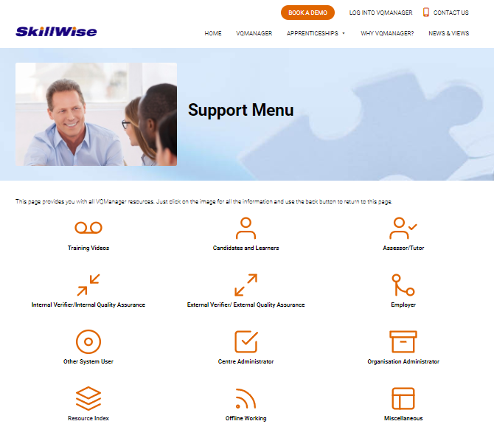
VQManager
www.SkillWise.net/support
We have an extensive support and training area for all users. You will find video and PDF documents to help you use all functionality within VQManager.
.

Slide 43
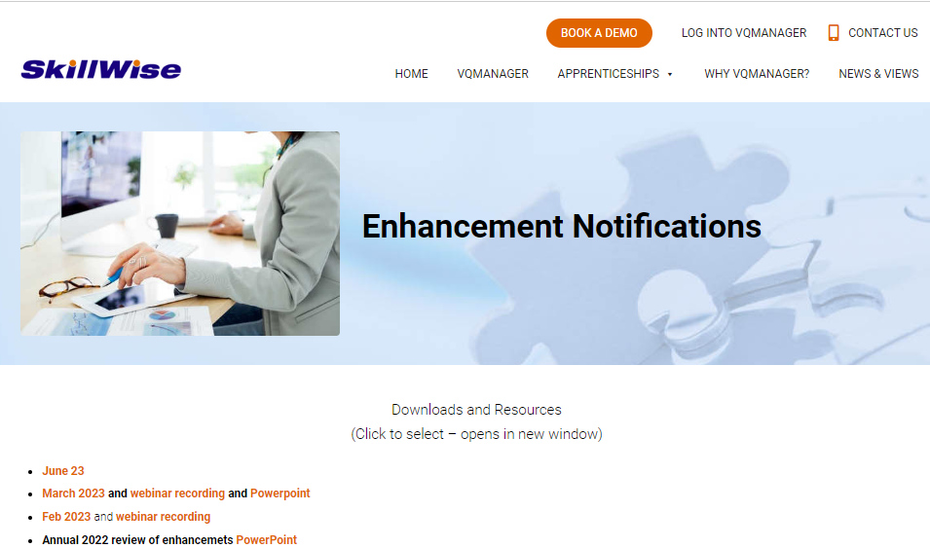
VQManager
www.SkillWise.net/support
This presentation can be found on the Enhancement Notifications page:
.
And also on the Functionality and Enhancements Webinars page – see next slide:
.

Slide 44
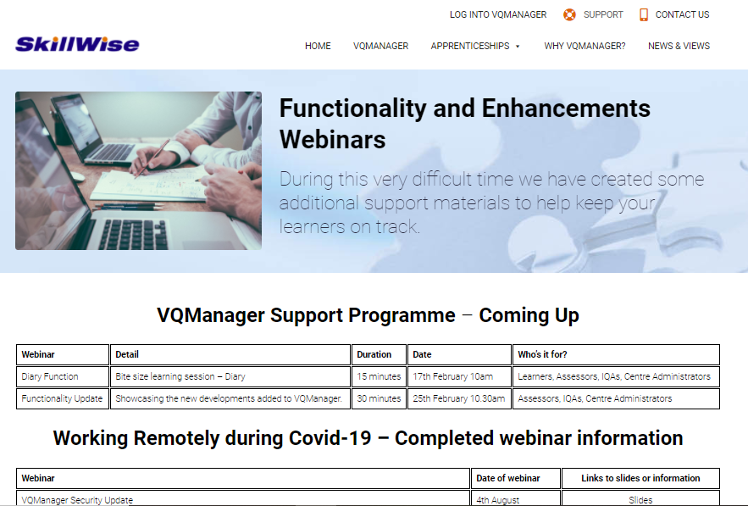
VQManager
www.skillwise.net/support
This page also indicates when we will be holding more webinars to support you.
.

