Slide 1
VQManager
Development Suggestions 2023

Slide 2
VQManager
A place somewhere in the learner’s record where we can make notes about the learner and keep confidential information that would not be shared with either the employer and/or the learner, as selected.
The tutor/assessor, IQA and CA can have a full overview.
Examples of information which may be stored:
If we suspect the learner is plagiarising
A place to make discretionary notes.
An area to store safeguarding concerns, EHCP’s (Education, Health and Care plan) etc.
Notes:
Corgi and Kent

Slide 3
VQManager
Make the file upload area into a drag/drop area, rather than selecting files individually.
If you would like this development it would be additional i.e. as well as, not instead of.
Notes:
SW Councils

Slide 4
VQManager
A place to record attendance to learning where we can link to criteria
In some organisations learners and employers must complete a timesheet to evidence learners have attended their work placement.
A key to be completed could have codes like:
A for Absent, S for Sick, P for Present.
The employer would sign the document and date.
Questions:
Does it need to remain editable and creatable by learner, employer and assessor?
Do you need to invite other parties to contribute.
Who are the other parties? Assessor/learner/IQA/Expert Witness?
Notes:
Kent and N2S

Slide 5
VQManager
Question banks be linked to Assessment criteria and mapped.
This would likely include an additional step/button where the assessor to confirm that mapping is required.
Multiple choice questions – where less than 100% is required for a pass, only questions answered correctly will be mapped.
Notes:
N2S

Slide 6
VQManager
Applying question bank (qualification) “units” to multiple learners at once
Several units can be assigned to one learner in one go already, this development is to allow either one unit to be assigned to several learners in one action or several units to be assigned to several learners in one action.
Notes:
N2S

Slide 7
VQManager
The IQA process and possibility of collating all reports and sampled evidence items at the summative qual sign off stage.
This is to assist the IQA when submitting final comments – acts as a reminder of what had taken place on that specific portfolio, similar to how evidence feedback is pulled into the IQA report section.
We could look at links instead of pulling in all previous comments as this data would likely be too big.
This would probably work similar to viewing the assessment plans from Log evidence, i.e. a link and a pop up.
Notes:
Probation

Slide 8
VQManager
An initial assessment tool within VQM which could be completed prior to starting a qualification/apprenticeship.
The current Progression Tracker (PT) doesn’t allow you to assess a starting point within VQM until the qualification has been assigned to the learner and then the measuring is specifically against a qualification or standard. We need to gauge progression against the wider skills and personal outcomes for Ofsted and not just a single qualification.
Add the ability to set our own questions, a mixture of quantitative and qualitative questions.
As in the PT, need to the option of 1,2 or 3 parties to be involved (L A LM)
Add a comments box for the tutor and employer review and maybe just tick boxes for the learner.
Would need full details on the content of this. Concrete examples are needed to work a design from. Any client voting for this will need to send an example (this is be mentioned again in the Survey Monkey voting form).
Notes:
Kent

Slide 9
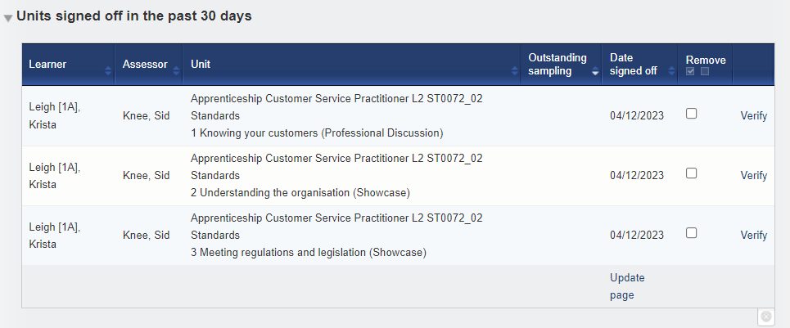
VQManager
Add a new column to the unit sign off notification table on the To Do tab to let the IQA know if the learner has also signed off the Unit.
Currently there is only a column to view assessor sign off.

Slide 10
VQManager
Increase the word limit on evidence description box. Currently 1000 words.
Do you use Word and drop the content in (just in case your WiFi is unstable) or do you always type into the box?
Notes:
Kent

Slide 11
VQManager
An’ auto save function’ or alternatively having a save button next to/within the description of evidence box to encourage people to save as they go
Some people have lost lengthy descriptions when either forgetting to go to the bottom of the page, getting called away or updates happening etc
A good tip to share in the meantime is to always write any long pieces of text in Word or similar, and then paste them into the web page when you are happy with them. (as per previous slide)
This would need to be limited to certain text boxes in the system.
Auto save has many issues associated with it and we think the extra save button is more reliable and a better design.
Notes:
Nush

Slide 12
When ticking the criteria, it is easy to accidently tick criteria in the wrong unit as the slight change in text isn’t obvious, it would be great if they could be separated by a line/space when everything is dropped down, so it is easier to see.
Only the word ‘unit’ is in bold, not the actual unit number so it’s easy to scroll past. A suggestion would be to make the unit numbers bold as well, and/or adjust the text size for the unit titles.
For a tip, we would recommend users open one unit at a time. This way, it’s much easier to see where they are.
There is an ‘open all’ at the top but it opens all units so we could add an “open all” for just the unit at the end of that row.
Notes:
Nush

Slide 13
VQManager
Create a drop down to display the activity detail rather than opening as a pop up.
Last year we created a hover over for the descriptive text of an AL entry to save going into each separate entry to view what you have written
What we currently see:
Question:
Would this also need to include OTJ comments which is recorded in a separate box (will require another column).
Notes:
Nush

Slide 14
VQManager
Add column for date of last OTJ submission to OTJ report
Notes:
Metadata

Slide 15
VQManager
A function to allow the sharing of documents into the File Library from Teams.
Question:
Does this replace saving and uploading?
To implement this, we would need to know what sort of files they are, what the file extension is, etc.
We don’t use Teams so will need some volunteers to help us is this is selected for development

Slide 16
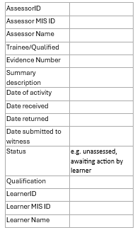
VQManager
Report showing which evidence was returned to the learner for further work at some point in its history.
Report showing list of evidence and the status of each (this is pretty much a download of the Evidence list so may be pretty big).
I have combined these two requests as they are very similar.
Notes:
SW Councils

Slide 17
VQManager
Development/reinstatement of the App.
Question:
Does/did anyone use it?
It was discontinued this year. We have only had one enquiry since it was removed.

Slide 18
VQManager
Include a RPL calculator which supports the onboarding process.
The calculator would allow you to work the price out of the apprenticeship based on prior learning.
Question:
Where is this currently done, in MIS or elsewhere?
This is again something we would need to see an example of what this calculation is, what the inputs and outputs are, etc. to be able to design something. Clients voting for this need to be prepared to work with us on it.
Notes:
Stockton

Slide 19
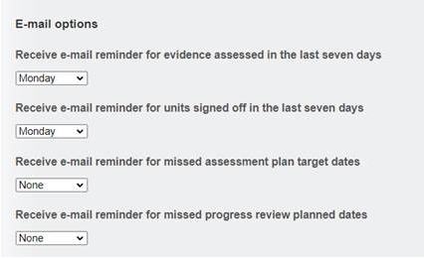
VQManager
Add email notification of up and coming progress reviews for both assessor and learner.
Currently have an email notification for both only when a date has passed:
Also add a To do notification for learner with up and coming review

Slide 20
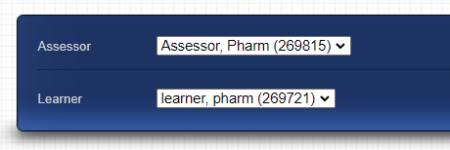
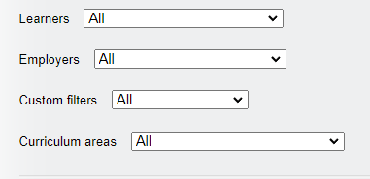
VQManager
Add filtering in the learner drop-downs area by cohort (other filter) in the assessor view

Slide 21
VQManager
Is there a less time-consuming way to deal with Emails awaiting further processing, then having to go in and sort one by one?
Because its already a two-step task, choose the learner, choose the area to drop the information into and therefore has the potential to lead to mistakes which would be irreversible. We could do a bulk edit where you work on one learner at a time, and one thing they want to process the mail into (evidence, activity log, progress review…) but tbh we don’t think this wouldn’t really be any quicker than the current process.
Because you can’t offer tailored, individual feedback doing things that way especially when it comes to evidence may not be good practice.
What do people think?
Notes:
Itchen

Slide 22
VQManager
When assessment planning, is there a better way to make learner more aware of the range as often work must go back because they have not included these.
Assessment plans only link to criteria, not Range. If you want to reference Range, currently you need to put that in the Notes of the plan.
This development is asking for range to be included for selection in APs.
Notes:
Itchen

Slide 23
VQManager
When signing off a unit automatically sign off completed assessment plans (plans where the criteria has all been met).
One of the core principles of VQManager, that is that a human being is in charge of marking things and signing them off. This is to ensure the integrity and accuracy of assessment. Assessment plans however may not be a critical part of that philosophy, what do you all think?
One thing to consider is that APs can cross units, so any AP that does this would not be able to be signed off.

Slide 24
VQManager
Question: When a learner logs OTJ, should the box to request LM confirmation be auto-ticked, as it is now, or default to not ticked?
Are users happy with how it is? Do they all want it to default to ‘off’ as we did for one client? Or do we need a proper centre switch to deal with different ways of working?
Notes:
OEA

Slide 25
VQManager
Question: Would you like learners to be able to reference individual criteria in the evidence description by, for example, there being something to click by each item in the qual tree that would copy the criterion number into the description box, allowing them to then add text around it?
This isn’t a fully formed idea, in terms of how it would work if just to gauge your thoughts on whether this would be useful
Notes:
BCOT

Slide 26
VQManager
Question: Multi-factor authentication at sign in.
We don’t currently have multi-factor authentication available on the system. We are cautious about implementing it, because it can make it difficult for users to access the system, generate support issues, and be a barrier to user engagement.
We have a number of clients who have Cyber Essentials certification, and we are currently going through the process of getting it ourselves. Consulting with those other clients, we found that multi-factor authentication needs to be switched on where it is available, but it isn’t necessary that all web-based software you use has it.
What do you all think?
Notes:
BCOT

