Slide 1
VQManager
VQManager 2023 User Group Agenda
Welcome
What’s new since last year?
Artificial Intelligence – how will it affect me?
What do you want us to develop in the next round?
Voting and conclusion

Slide 2
VQManager
Annual Review of Enhancements
2023

Slide 3
VQManager
Preventing IQA sign off of qual until assessor and learner have contributed to sign off page.
Add OTJ summary to Diary and Activity log tabs
Adding learner confirmation to OTJ hours records
Add column to show how many hours claimed in 'Confirmation of OTJ hours' table on assessor To Do list
Show Range description in evidence matrix
Add current progress to 'Add new progress review' pane
Add assessor name to Assessment plan table
Adding view of all assigned content in Gap Analysis report
Add learner's name to VQManager Network for Assessors
Making 'curriculum area' mandatory when adding a new learner to VQManager
Adding pop-up notification to 'save and create evidence' button in Diary
Unit sign off page - split sampled dates and verified dates into separate columns.
Add table to Assessor To Do list showing new Line Managers assigned to their learners
Increase mouse-over area on Activity log.
Add a comments box in evidence where a trainee assessor can comment privately to the qualified assessor.
Note to remind users to complete the Activity date when logging OTJ in the Activity log.
Add a Notes section to Employer details.
Add table to assessor Info tab showing evidence IQA'd in last 30 days.
Introduce password strength meter, and force users to change weak passwords – learners.
Changes to Dashboard OTJ report
Adding opt-in e-mail notification for line managers of upcoming progress reviews
Adding an opt-in notification for assessors of evidence returned
New 'Learner activity' report
Allow assessor to delete evidence in certain states from To Do list
Progress reviews - 'Request learner to confirm' auto selected
Add a mouse-over in the To Do list to show evidence Summary description
Add a ‘sort’ arrow to the 'status' column in the Assessment plan list
Showing which units are mandatory in Unit assignment tab
Allow content emailed into the system to be added to the existing evidence (paused)
Add centre switch to choose where OTJ are recorded.
Updating notification e-mails with custom centre text
Adding an icon for Help and Training
Adding 'Help and Training' icon to learner Shortcuts page
Shortcuts for Line Managers
Add note to IQA and EQA comments box in evidence to make it clear learner can't see these
MCQ - Allowing for questions that require more than one answer
Adding ability for Centre Admin to create Messages for other users in their centre
Password security - Maintaining access to user accounts in training centres
Adding to categories for report builder to create bespoke reports in VQM - phase 2

Slide 4
VQManager
Enhancements
Feb 2023

Slide 5
VQManager
Adding an icon for Help and Training
To help users spot the Help and training link in the top right of VQManager pages, we have added an icon there. This is visible on all pages, for all users, regardless of whether the other tab icons are switched on or not.

Slide 6
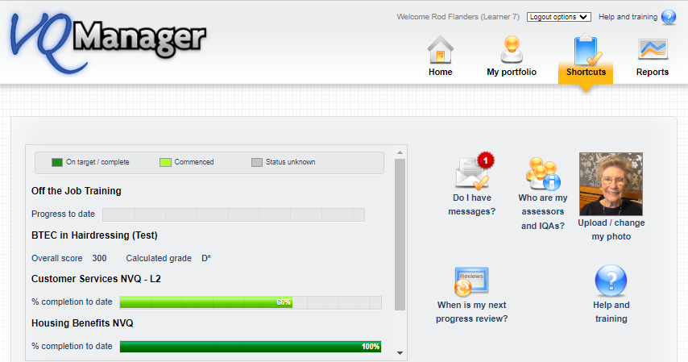
VQManager
Adding 'Help and Training' icon to learner Shortcuts page
For ease and clarity, we have added a new icon for Help and Training on the learner’s Shortcuts tab. This is in addition to (and not replacing) the top right-hand link Help and Training which will continue to be available and visible on every page regardless of user as per the previous development.

Slide 7
VQManager
The new icon will lead directly the learner section of our Help pages.

Slide 8
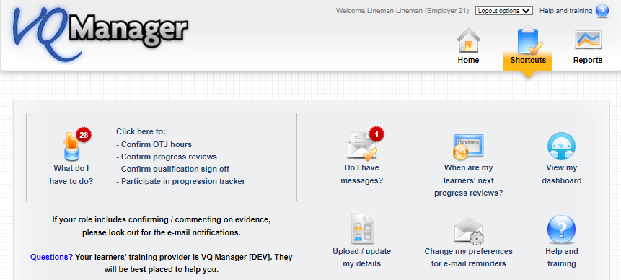
VQManager
Shortcuts for Line Managers
Following on from the success of our Shortcuts page for the learners, we have built one for Line Managers/Employers too.
The red rosette on each icon indicates how many items need attention on that page.

Slide 9
VQManager
The area below will take the LM/Employer to the To do tab to complete any outstanding tasks.

Slide 10
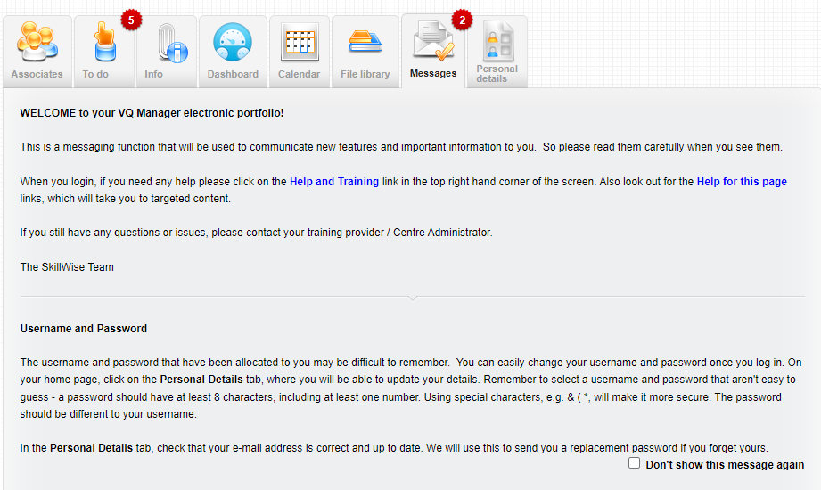
VQManager
If there are any important messages for the LM/Employer, this icon will take them to the Messages tab.

Slide 11
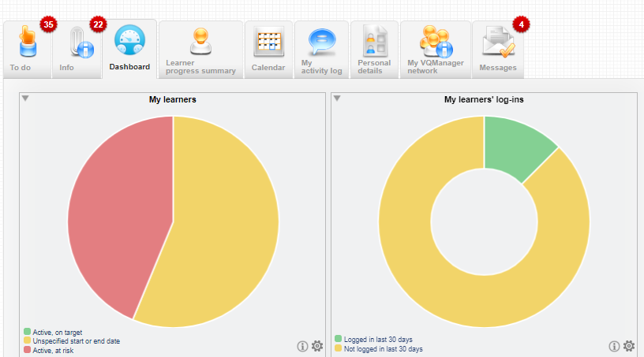
VQManager
This icon will take the LM/Employer to the Dashboard tab to see instant reports regarding the learner’s progress and activity.

Slide 12
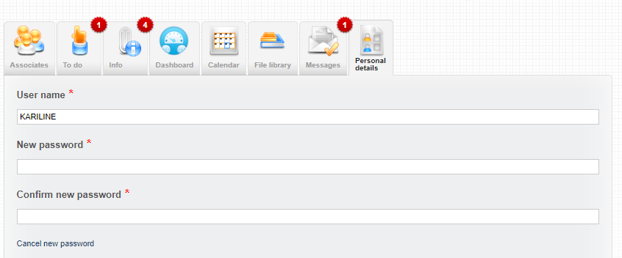
VQManager
This icon will take the LM/Employer to the Personal Details tab where they can change their password or amend contact details.

Slide 13
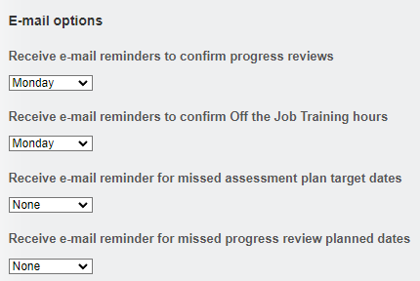
VQManager
This icon will go to the same page as above (Personal details) but automatically scroll to the bottom to take the LM/Employer to the section where they can amend their email preferences:

Slide 14
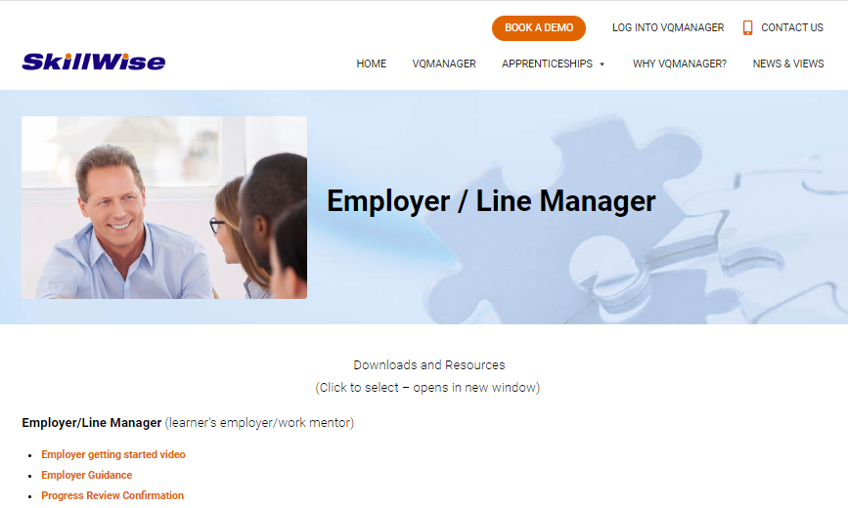
VQManager
This icon will take the LM/Employer to the Support area, as per the top Help and Training link. The difference between this link and the one in the top right of each screen is that it takes the user directly to the LM/Employer support section.

Slide 15
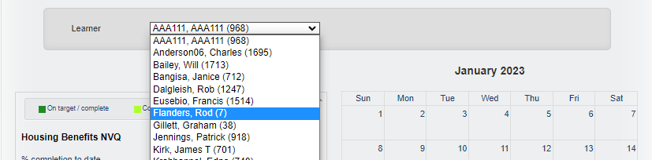
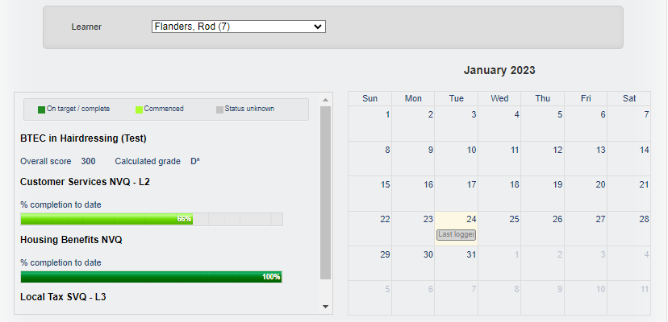
VQManager
Lower down the page on the Shortcuts tab, the LM/Employer can view progress and activity related to their learner(s). Many LMs/Employers are only linked to one learner, but for those who have more than one, they can use the drop-down to switch between learners and refresh the view.

Slide 16
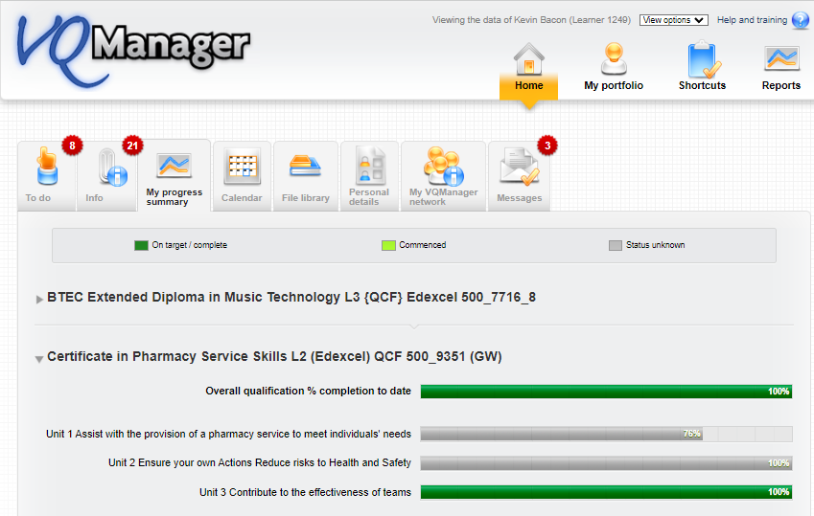
The LM/Employer can click on the area below to view more detailed progress. The link takes them to the learner’s e-portfolio where unit progress can also be viewed.

Slide 17
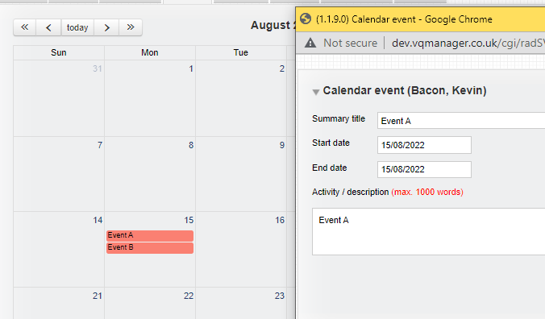
VQManager
If the LM/Employer clicks in the calendar area, they can view the entries in more detail:
The link takes them to the Calendar in the learner’s e-portfolio where entries can be opened by clicking on them.

Slide 18
VQManager
The Shortcuts tab is automatically available for every LM/Employer but as with the learner, there is a switch to make the Shortcuts page the landing page for them when they log in. This means when they log in they will land on this page every time rather than the Messages or To do tab so everything they need to see and do is clear to see.
If you would like this switching on, please drop us a message.

Slide 19
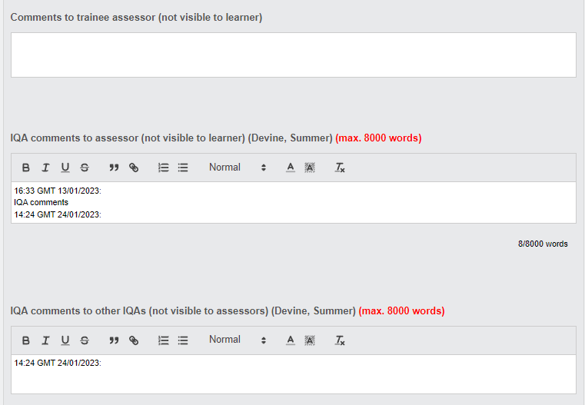
VQManager
Add note to IQA and EQA comments box in evidence to make it clear learner can't see these
We have added a note to the IQA and EQA comments boxes in Evidence to make it clear to users that learners can't see these comments. This reflects the message above the other boxes on this page.

Slide 20
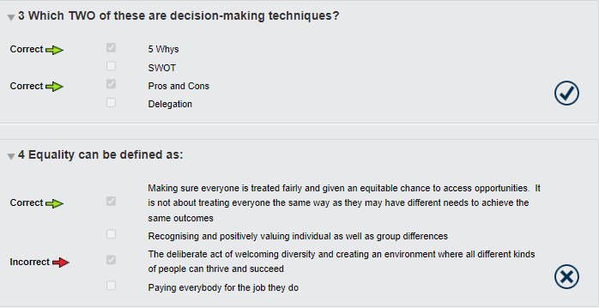
VQManager
MCQ - Allowing for questions that require more than one answer
The e-learning function has been updated to include multiple-choice questions that ask for more than one answer to be ticked. For example:

Slide 21
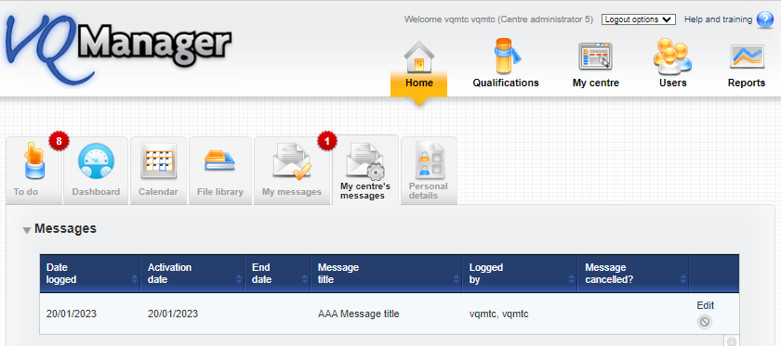
VQManager
Adding ability for Centre Admin to create Messages for other users in their centre
Centre Admins can now create messages for the Messages tab for all their users themselves. There is a new tab located in Home called My centre’s messages

Slide 22
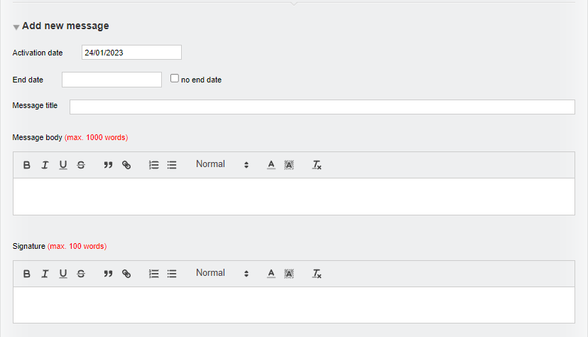
VQManager
At the bottom of the page is an area where a new message can be added – Add new message.

Slide 23
VQManager
The 'activation date' will default to today's date but can be altered.
The admin can set an end date or tick the box to leave this field blank.
We have included separate fields for the title, body and signature of the message. These fields are all compulsory. Messages are easier for users to read and understand if they have a clear title, and information on who the message is from (this could be a person, a department or an organisation).

Slide 24
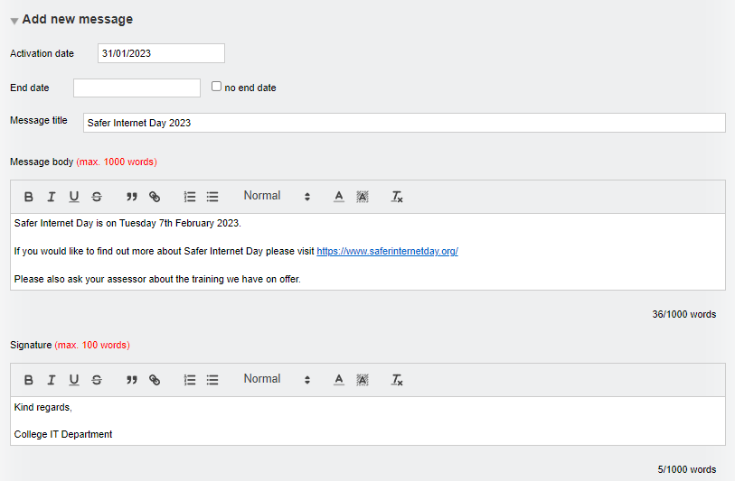
VQManager
A completed message might look like this:

Slide 25
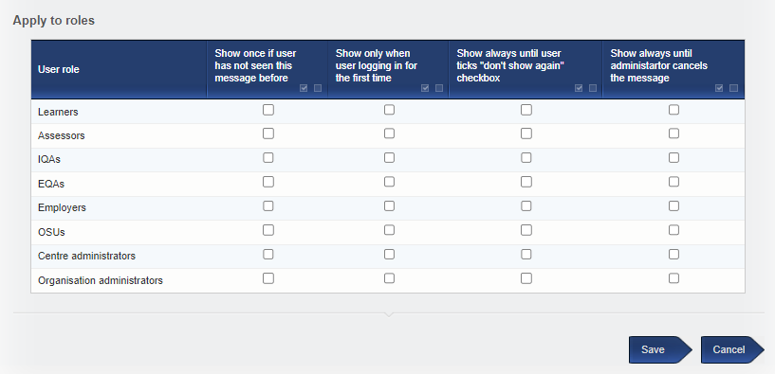
VQManager
Below these fields is a section where the admin can select which users will receive the message. They will be able to select one option per row for each user role. There are 'select all' options for ease of use.

Slide 26
VQManager
Messages remain editable after they are saved, so admins can update any details or correct mistakes as necessary.
The Centre Admin can open a message from the table by selecting Edit

Slide 27
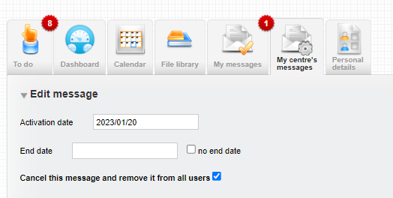
VQManager
To cancel a message, the admin should open the message in this way and tick the box ‘Cancel this message and remove it from all users’.
Messages where an end date has been set will be automatically cancelled at the end of the day selected.

Slide 28
VQManager
Clicking 'cancel' and saving will give a pop-up 'are you sure' message.
Messages that have been cancelled in this way, or that have passed their end date, can be deleted by an admin. Messages which are currently ‘live’ cannot be deleted.
We have completed the first part of this development which is to build the function. The second part will include the ability to add images to the messages if you think this is needed too.

Slide 29
VQManager
Password security - Maintaining access to user accounts in training centres
As part of our security drive, for all training centres there will be no visible access to the passwords for the training users. For ease, users will be able to enter the username in the password field and be granted access.
UN sid@trainingcentre
PW sid@trainingcentre
Existing passwords will still work, so if you have any of those saved, this won’t be a problem.
This function only applies to training centres and cannot be applied to live centres.

Slide 30
VQManager
Adding to categories for report builder to create bespoke reports in VQM - phase 2
The Report builder released last November is for assessors, IQAs, Employers, OSU and Centre Administrators to create and save their own, bespoke reports.
The function allows for:
unlimited number of bespoke reports for each user
option for adding new reports
option for deleting a report

Slide 31
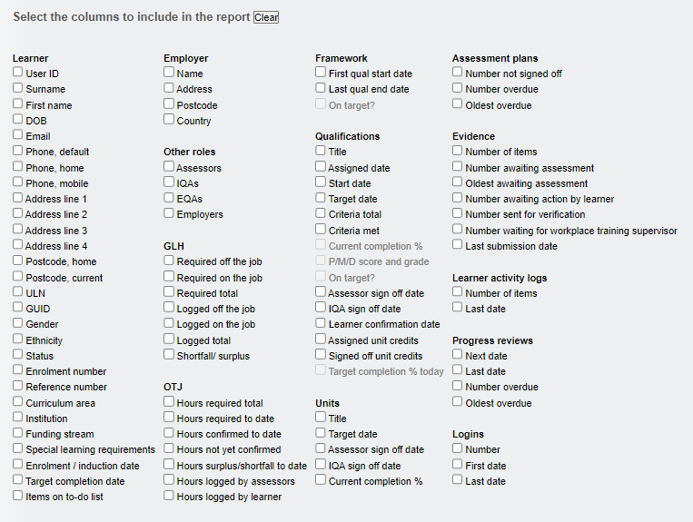
VQManager
This release has made many more categories available for selection in your bespoke reports:
Categories that are still greyed out (5) will be made available in a future release.

Slide 32
VQManager
Enhancements
March 2023

Slide 33
VQManager
Adding opt-in e-mail notification for line managers of upcoming progress reviews
We have added an opt-in e-mail for Line Managers, to let them know when a progress review is coming up.
The notification is located in the Personal Details Tab alongside other opt in notifications.

Slide 34
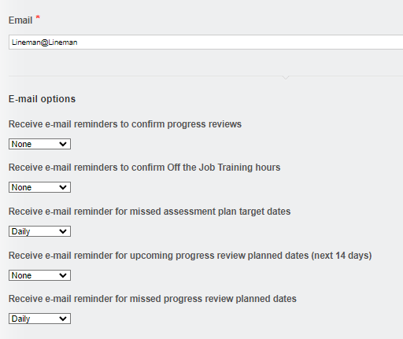
VQManager
It has the same options as the other reminders in this category.
Here are the full details of the email summary notifications:
https://skillwise.net/wp-content/uploads/2023/02/Email-Summary-Notifications-V3.pdf

Slide 35
VQManager
Adding an opt-in notification for assessors of evidence returned
We have added a new opt-in notification e-mail for assessors. This notification lets them know about any evidence on the To Do list that has been returned by either the learner or the IQA for further work. There is already one for new, unassessed evidence, so this is in addition to that one.

Slide 36
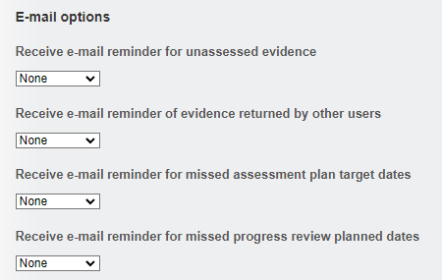
VQManager
It has the same options as the other reminders in this category.

Slide 37
VQManager
New 'Learner activity' report
We have added a new Learner activity report, along the same lines as the Assessor activity and Line manager activity reports. It is located in Reports then User Activity. It shows the following actions in the system over a chosen period of time.
Adding, editing and deleting Learner Activity Log entries
Adding, editing and deleting Diary entries
Progress review confirmation
Assessment plan confirmation
Unit sign off confirmation
Qual sign off confirmation
Editing and completion of Progression Tracker evaluations
Editing and completion of Learning content / questions (including MCQ scores in the notes)
Logging and editing evidence
To avoid confusion, we have renamed the existing report that used to be called ‘Learner activity’ to ‘Learner unit progress’. There are no changes to that report other than the name.

Slide 38
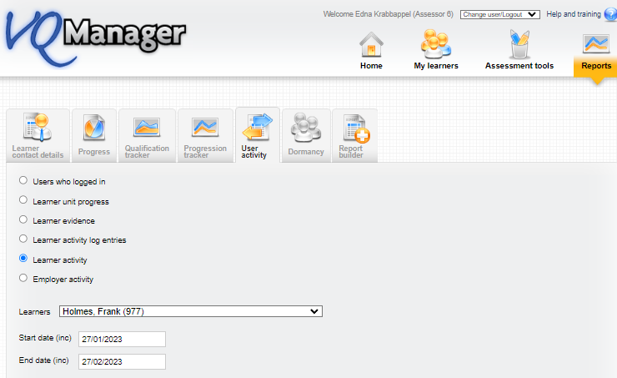
VQManager

Slide 39
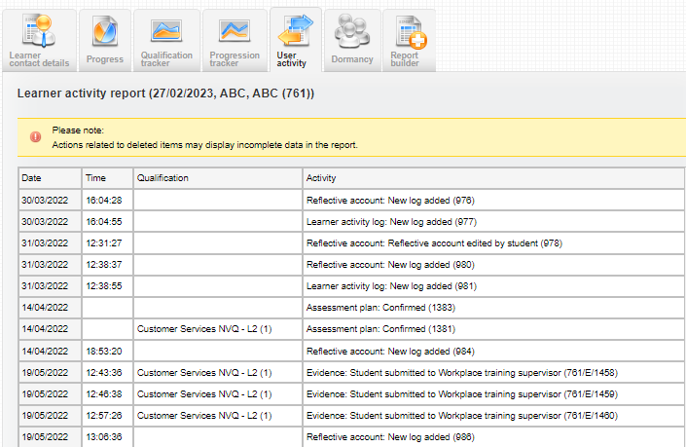
VQManager
It has the usual 'view' and 'download' options.

Slide 40
VQManager
Allow assessor to delete evidence in certain states from To Do list
Assessors are now able to delete evidence directly from the To Do list, where it hasn't already been assessed.
This new function applies to assessors only, and only to evidence in the Unassessed evidence and Unsubmitted evidence tables on the To do tab.

Slide 41
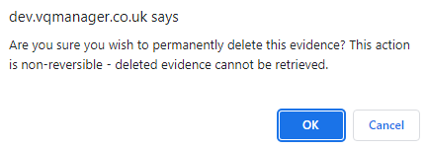
VQManager
The usual pop-up warning appears when you select the delete icon each time.
Please be very careful when doing this as is the case with all evidence deletions, they are non-reversible; deleted evidence cannot be retrieved.

Slide 42
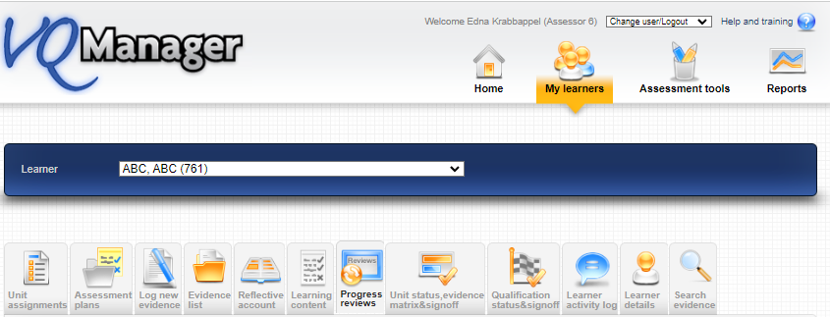
VQManager
Progress reviews - 'Request learner to confirm' auto selected
When creating or editing Progress reviews, the tick box to request learner confirmation will be automatically ticked, provided these users haven’t already confirmed the review. Assessors can still de-select this option before saving if it is not required.

Slide 43
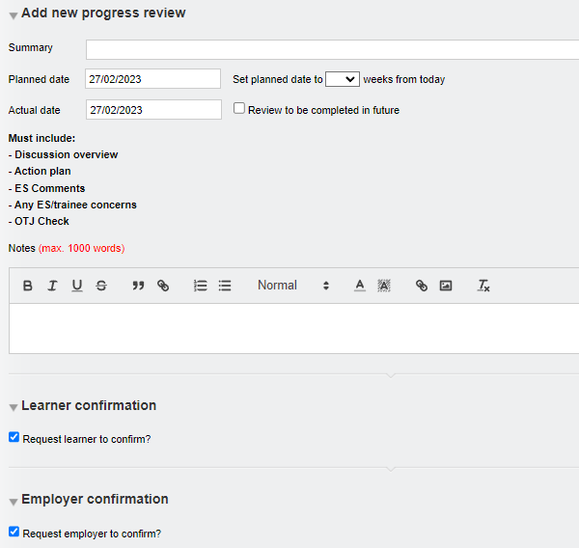
VQManager
This auto-select function will also be applied to the line manager/employer request box, where the learner has a line manager/employer assigned.

Slide 44
VQManager
Add a mouse-over in the To Do list to show evidence Summary description
We have added a function whereby users can now view the Summary description of evidence from the To Do list, so they can see the title of the piece of evidence without having to open it.

Slide 45
VQManager
The user can hover over the evidence number and the title (summary description) of that piece of evidence appears.

Slide 46
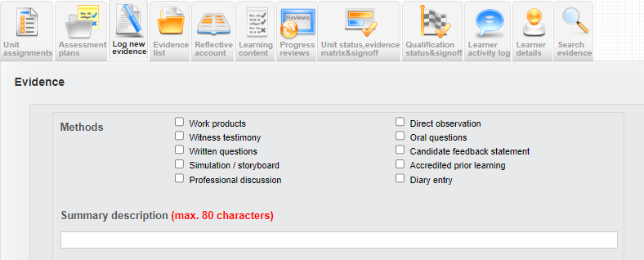
VQManager
The Summary description field displayed is located here on the Log new evidence tab.
Top Tip
If the learner has more than one assessor/teacher, a great idea would be to ask the learner to include the initials of the assessor within the title of the evidence. Using this new function, the assessors/teachers can hover over the evidence number and see the summary description and also their own initials to see instantly who has perhaps set the work or who is the most appropriate person to assess/mark that piece of work. An assessment plan reference number could also be quoted for ease.

Slide 47
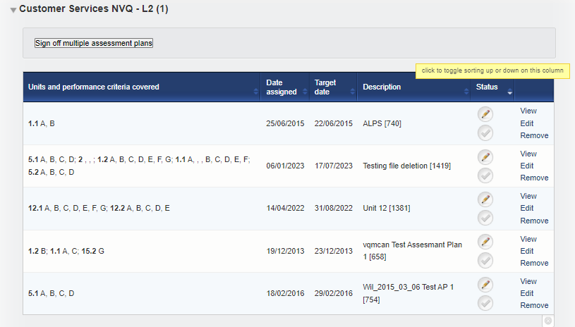
VQManager
Add a ‘sort’ arrow to the 'status' column in the Assessment plan list
We have added a ‘sort’ arrow to the assessment plan table in the Status (signed off / not signed off). This is available for all users with this table.

Slide 48
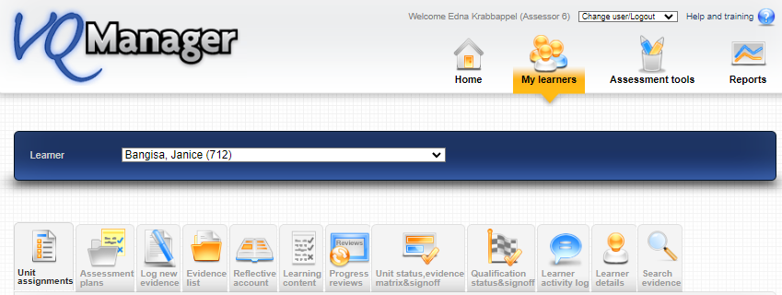
VQManager
Showing which units are mandatory in Unit assignment tab
We have added a column to the Unit assignments tables to show which units are mandatory, according to the rules of combination.

Slide 49
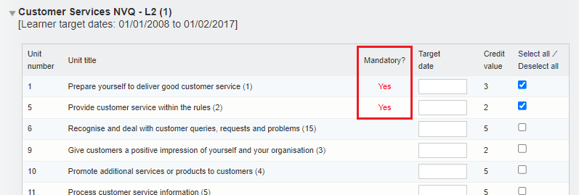
VQManager
Note: This is different to the default units. Mandatory units are those required in order to pass, according to the official rules of combination for the qualification. Clients can set up their own lists of default units for their learners, which may include a mixture of mandatory and optional units. Information on the default units function is here:
https://skillwise.net/wp-content/uploads/2019/08/Org-Admin-adding-default-units-to-qualifications.pdf

Slide 50
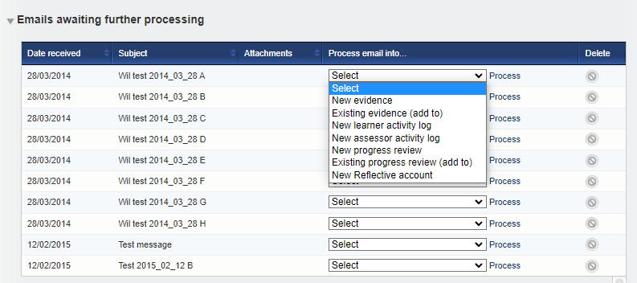
VQManager
Allow content emailed into the system to be added to the existing evidence
You are now able to e-mail evidence into the system and add it to an existing evidence item. Evidence will only appear as an option if the evidence is with the user in question for editing at the time.
Select Existing evidence (add to) from the Process email into options and then select Process.

Slide 51
VQManager
From here it will allow you to select Learner:
Then Evidence: only evidence available to be edited will be shown here.

Slide 52
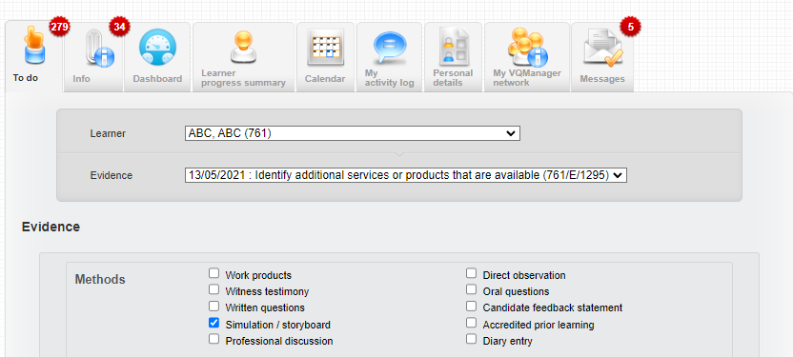
VQManager
Select the evidence and the page will refresh, dropping all elements of the email into the existing version –
Description
Any attachments

Slide 53
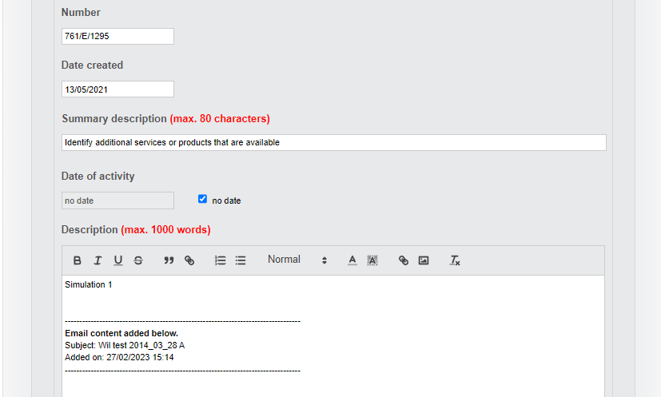
VQManager
The system will add a note at the top of the added content, to show where it’s come from.

Slide 54
VQManager
Save using the normal save options:
Here are the details of the full emailing in functionality:
https://skillwise.net/wp-content/uploads/2019/08/Assessor-emailing-into-the-e-portfolio-V2.pdf

Slide 55
VQManager
Add centre switch to choose where OTJ are recorded.
We have two areas for recording OTJT hours, the Diary tab and the Activity log tab. Some users have found this confusing, so we have added a centre switch with different options.
The options within the switch are:
Log OTJ in Diary only
Log OTJ in Activity log only
Log OTJ in both Diary and Activity log
The default setting remains the third option, that hours can be added to both areas, since that is what we have now.

Slide 56
VQManager
For either of the first two switches, the Diary or Activity log tabs would still be available to use but for the tab not selected, the area for logging OTJ would be hidden for all users.
For backwards compatibility, you will still see the OTJ column in the summary table, where there are entries there. Where there are no entries, it will hidden along with the section to log OTJ hours.
Here are the details of the full OTJ Training Functionality:
https://skillwise.net/wp-content/uploads/2022/12/Off-the-job-training-V2.pdf
If you would prefer to only allow OTJ to be added on one tab or the other, please let us know along with your preference.

Slide 57
VQManager
Updating notification e-mails with custom centre text
To help users, and make the notifications clearer to them, we have added the custom naming conventions to them. Some of the customisable names are:
User roles (learner, assessor, IQA, EQA, OSU, Expert witness, Line Manager) Off the job training Assessment plan Verification
So now, any email notifications which go out, will reflect the naming conventions in your centre.

Slide 58
VQManager
VQManager June 2023 Enhancement Webinar

Slide 59
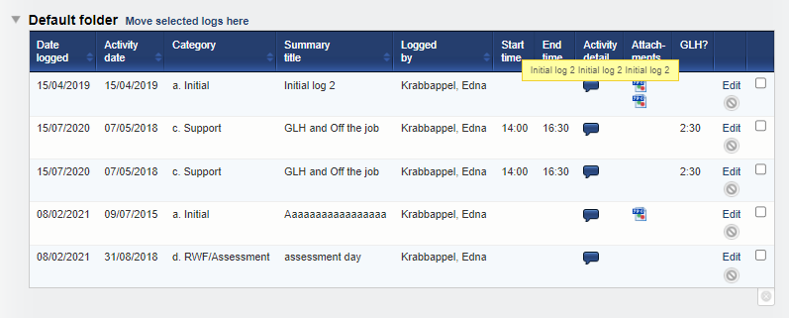
VQManager
Increase mouse-over area on Activity log.
When using the mouse-overs in the Activity log, we have increased the selected area in order for the pop up to stay on screen long enough to read it. Previously you had to be really accurate with your mouse to get it to remain.

Slide 60
VQManager
Add a comments box in evidence where a trainee assessor can comment privately to the qualified assessor.
We have added a new comments box for the trainee assessors to be able to write comments in evidence that is aimed at the qualified assessor. As indicated, these comments are hidden from the learner, but visible to IQAs and EQAs.
As with all the comments boxes, the box is editable when the trainee assessor 'has' the evidence to work on.
To find out more about this function, please select this link: https://skillwise.net/wp-content/uploads/2022/12/Off-the-job-training-V2.pdf

Slide 61
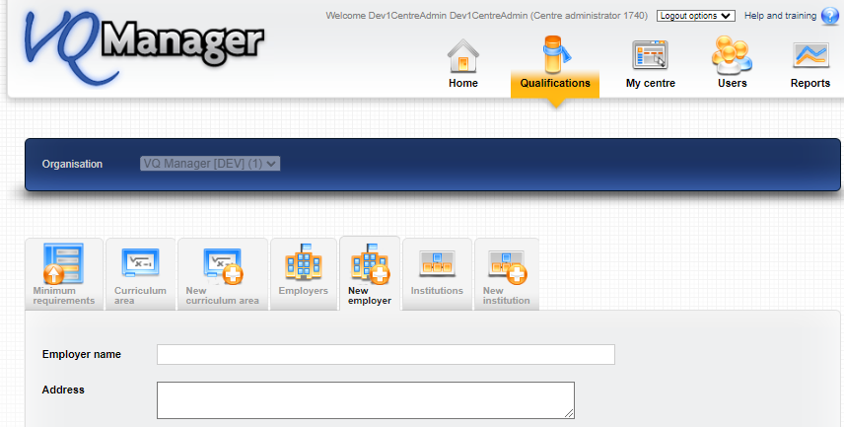
VQManager
Add a Notes section to Employer details.
In the Employer information tab, we have added a free text box should you wish to add notes.

Slide 62
VQManager
Add table to assessor Info tab showing evidence IQA'd in last 30 days.
In the Info tab, we have added a table for the assessor that shows evidence IQA'd in the last 30 days.

Slide 63
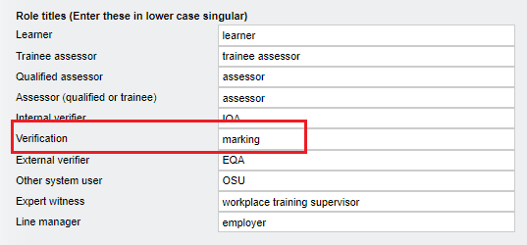
VQManager
The text for this new column will change depending on the centre setting, so most centres will show ‘Date of verification’. The screen shot below reflects the centre setting I used which calls verification “marking”.

Slide 64
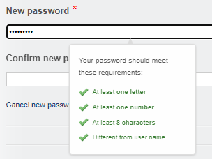
VQManager
Introduce password strength meter, and force users to change weak passwords – learners.
We have changed the centre setting so all learners will be requested to set a strong password. They will not be able to save their profile without complying with the password requirements below.
This requirement has already been applied to newer clients, so the change will only affect long-established clients.
All other roles have already had the requirement to choose strong passwords implemented previously in VQManager. The learner role is the last one to be completed.
For more information regarding setting strong passwords, please follow this link.
https://skillwise.net/wp-content/uploads/2023/05/Passwords-W3W.pdf

Slide 65
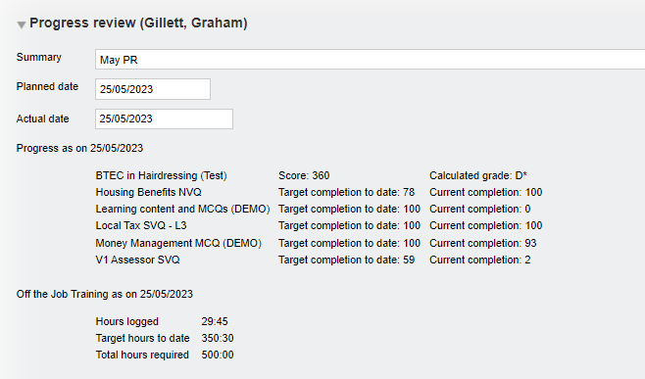
VQManager
Add information to the Progress review around progress.
In addition to the current completion to date information available after a progress review has been saved, we have added target completion to date too.

Slide 66
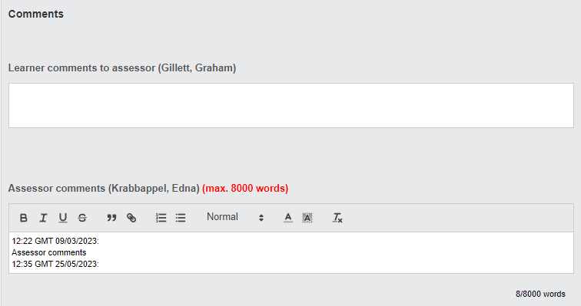
VQManager
Adding user name to all comments boxes
We have now ensured that the username always displays next to the comments boxes throughout VQManager.
Previously there were instances where the commenters name was not recorded. This enhancement ensures this is not the case moving forward.

Slide 67
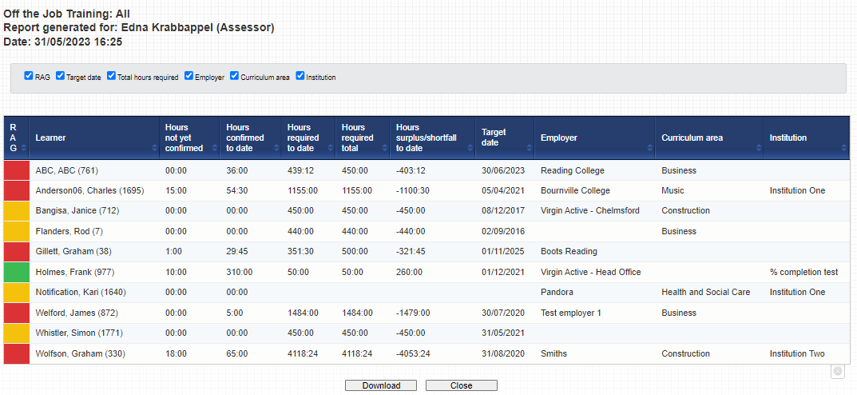
VQManager
Changes to Dashboard OTJ report
To bring the Dashboard report in line with the other OTJ reports, we have changed the title of the 'Hours logged to date' to 'Hours confirmed to date'?
We have also added the 'Hours not yet confirmed' and 'Hours surplus/shortfall to date' columns.

Slide 68
VQManager
Enhancements
Nov 2023

Slide 69
VQManager
Preventing IQA sign off of qual until assessor and learner have contributed to sign off page.
Qualification status and sign off tab, when an IQA is signing off a qualification, if the assessor and learner haven't signed off the qualification, a notification will appear warning the IQA about this. The IQA would be prevented from proceeding with qualification sign off until the other users have contributed. This development has no bearing on any Line Managers / Employers in the system.
This enhancement is a centre switch and has not automatically been added to your centre. If you would like this switching on, please contact us.

Slide 70
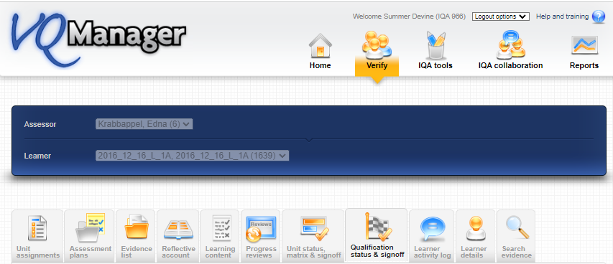
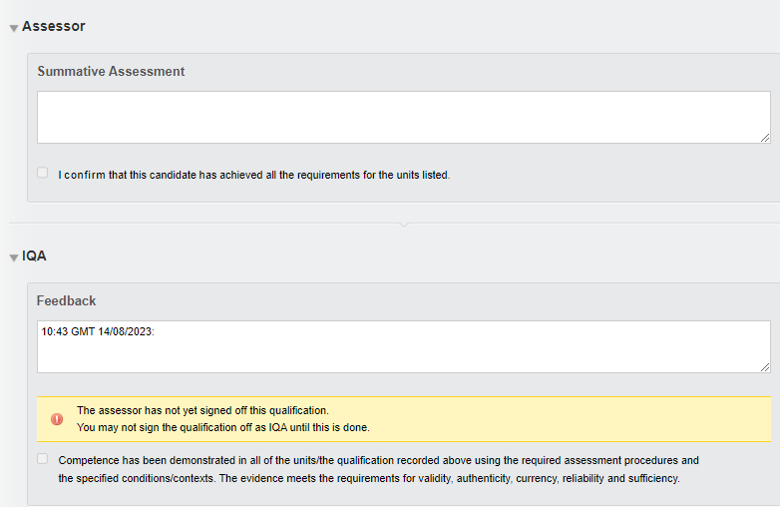

Slide 71
VQManager
Add OTJ summary to Diary and Activity log tabs
We have added a summary of Off the Job (OTJ) progress when users are looking at both the Diary (Reflective account in the example below) and Learner activity log summary pages.
This will only show for learners who have OTJ switched on.
If the centre has had a switch applied so that OTJ can only be logged in the Diary, it will not show in the Learner activity log, and vice versa.

Slide 72
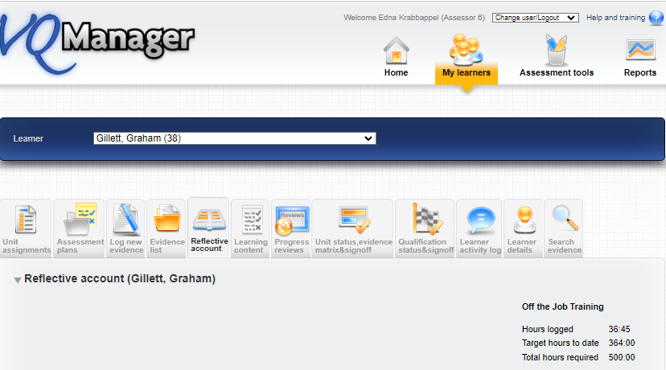
VQManager
Diary

Slide 73
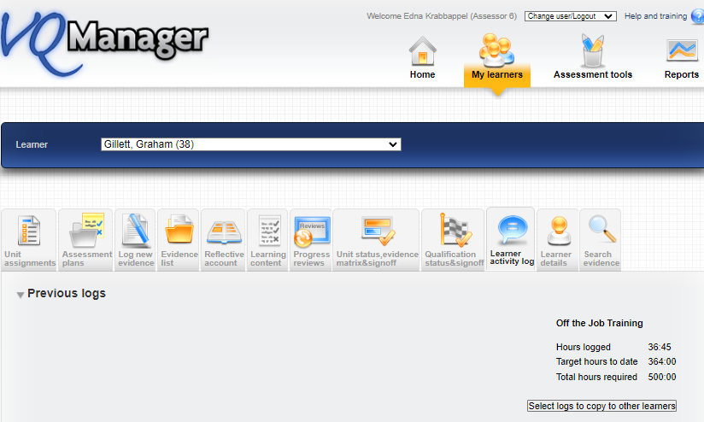
VQManager
Activity Log

Slide 74
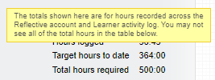
VQManager
It shows the total across both these tabs where clients are recording hours on both the Diary and Learner activity log. We have added a mouse-over to indicate this.

Slide 75
VQManager
Adding learner confirmation to OTJ hours records
We have added the ability for learners to confirm logged OTJ hours. This applies equally to the Diary and Learner activity log entries.
When an assessor is creating a record, there is now an additional confirmation box for them to tick to request learner confirmation. This box is ticked by default, but the assessor can remove the tick if they choose.

Slide 76
VQManager

Slide 77
VQManager
This will trigger a notification on the learner's To Do tab.
When they open the OTJ record, the learner will have a tick box and a comments box.

Slide 78
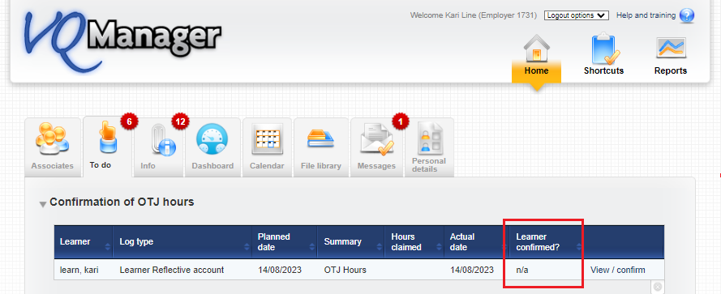
VQManager
On the Line manager’s To Do tab, we have added a column to the Confirmation of OTJ hours table to show if the learner has confirmed the hours or not, as well as displaying this information when they open an individual record.

Slide 79
VQManager
When a learner is creating a record, there is a tick box and comments box for them. The confirmation box is ticked by default, but the learner can un-tick it if they choose.

Slide 80
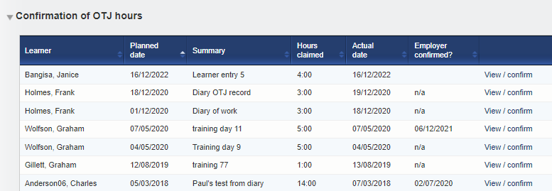
VQManager
Add column to show how many hours claimed in 'Confirmation of OTJ hours' table on assessor To Do list
We have added a column in the table for Confirmation of OTJ hours sign off on the To Do tab to show how many hours are being claimed for in the requests. This development is visible for the assessors and line managers / employers too.

Slide 81
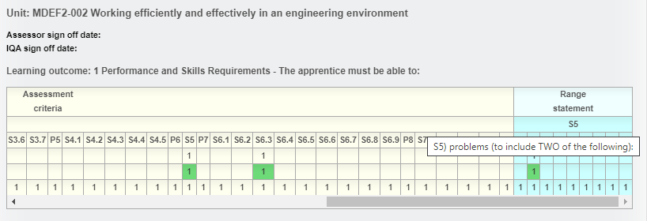
VQManager
Show Range description in evidence matrix
We have added a row to the evidence matrix on the Unit status, evidence matrix and signoff tab to display the Range section headers. For many qualifications, this field includes information on how many Range items from each group need to be covered.
The Range information is visible as a mouse-over, with the text appearing in the same way the method, criteria etc mouse-overs work.

Slide 82
VQManager
Where the Range section doesn’t have a number/letter, we’ve added asterisks to indicate to users that there's something there they can view.

Slide 83
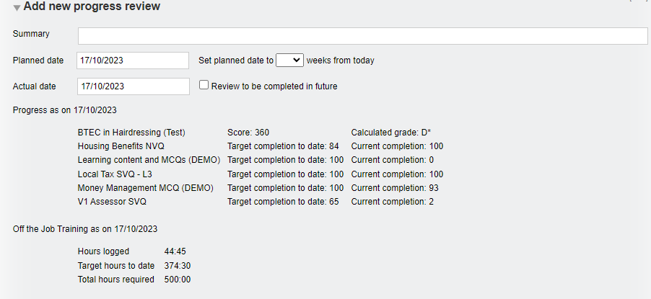
VQManager
Add current progress to 'Add new progress review' pane
On the Progress review tab, we have added an area which displays current progress so assessors can view this when they are completing a review (rather than just afterwards when a review is saved), since it may be relevant to what they might write. The information shows progress for all qualifications assigned to the learner as well as OTJ hours (if applicable).
It appears in the Add new progress review section and also on opening a pre-set review.

Slide 84
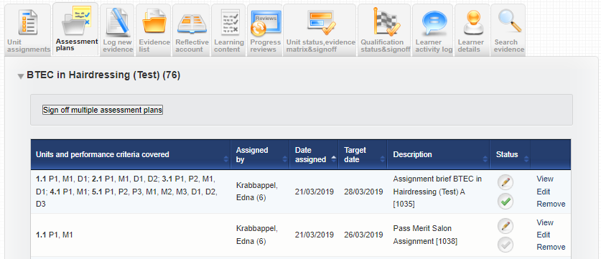
VQManager
Add assessor name to Assessment plan table
In the Assessment plans tab, we have added the name of the assessor who assigned the assessment plan into the summary table. This will assist learners in knowing who to ask if they have a question about the plan.

Slide 85
VQManager
Adding view of all assigned content in Gap Analysis report
In the Gap analysis report, we have made two changes.
We have now included the Range and Knowledge and understanding (where applicable) into the report.
Range statement (where applicable)

Slide 86
VQManager
Knowledge and understanding (where applicable)

Slide 87
VQManager
We have added the option to view the whole qualification as well as just the gaps. The default setting is 'show gaps only' but there is now an option to elect ‘Open all and show gaps’.

Slide 88
VQManager
When selecting Show gaps only, the criteria is slightly larger text, highlighted in purple and is bold:

Slide 89
VQManager
When displaying Open all and show gaps, the criteria already met (according to the minimum requirements) will display in black in light text and as before, the gaps will display in slightly larger text, will be purple and is in bold text.

Slide 90
VQManager
For units that have been signed off by an assessor, no gaps will show. This applies to both the Show gaps only and the Open all and show gaps views. In the Show gaps only view, where there are no gaps for a unit, the unit title only is displayed. Titles for learning outcomes with no gaps are hidden from view. This is also applicable in the Range and K&U area (where relevant).
The downloadable version of the Gap Analysis report will still show gaps only.

Slide 91
VQManager
Just as a reminder, this report replicates information which can be found in the Log new evidence tab under the Criteria met section.

Slide 92
VQManager
Add learner's name to VQManager Network for Assessors
For assessors, we have added a column to show which learners other assessors are linked to in the My VQManager network tab.

Slide 93
VQManager
For assessors, we have added a column to show which learners other Line Managers / Employers are linked to in the My VQManager network tab.
For centres where IQAs are linked directly to learners, we have added the new column to the IQA table on this tab as well.
It is only relevant to centres set up in this way and will not be visible for anyone else.

Slide 94
VQManager
Making 'curriculum area' mandatory when adding a new learner to VQManager
When adding a new learner, if you are required to complete the curriculum area drop down section to attribute a learner to one area or another, we are now able to make this field mandatory. A pop up appears preventing the administrator from saving the new learner profile without completing that field. This is only applied to newly created learners, not when editing an existing learner.
If this is applicable to your organisation and you would like this switching on, please drop us a message as this has not been automatically applied to your centre.

Slide 95
VQManager

Slide 96
VQManager
Adding pop-up notification to 'save and create evidence' button in Diary
We have added a new pop-up notification especially for learners when saving a Diary entry. Quite often they accidently select the Save and create evidence option in error. This pop up will warn them this is going to happen and if this is an error, help guide them in the right direction.
We have also increased the size of the font on the Save button, so it emphasised Save over the Save and create evidence button.

Slide 97
VQManager
We have also increased the size of the font on the Save button, so it emphasised Save over the Save and create evidence button when saving for the first time or when editing the entry.

Slide 98
VQManager
Unit sign off page - split sampled dates and verified dates into separate columns.
We have split the IQA sampled dates and the IQA sign off dates for units so they are now displayed in separate columns, for clarity. The IQA sampled column is of course used for both "sampled" and "not sampled".

Slide 99
VQManager
Add table to Assessor To Do list showing new Line Managers assigned to their learners
Assessors are now notified when a new Line Manager is associated with a learner the assessor is working with. This works in a similar way to the existing table notifying of any new learners assigned to the assessor.

Slide 100
VQManager
Unless specified, all of these enhancements have been automatically added to VQManager for you.

Slide 101
VQManager
What are we currently working on?
8183 Add report showing confirmation of OTJ hours
8182 Alter Activity log and Diary summary screens to increase clarity and add learner OTJ confirmation
8180 Add Learner OTJ confirmation date and comments to Diary and Activity log downloads
8179 Add notification to learners of new Calendar entries
8178 Allow Line Managers to upload files to Progress Reviews
8177 Add rows to Progress Review report to show which users signed off
8176 Create Shortcuts page for assessors
8174 Allow bulk deletion of assessment plan templates
8173 Allowing assessors to sign off OTJ records in bulk
8159 Adding minimum requirements information to Gap Analysis report

Slide 102
VQManager
What are we currently working on?
The items under development for users using VQManager as an EPA system are:
8190 Add a centre switch to prevent learners receiving e-mails about evidence
8189 Add new learner fields, qual fields and Custom filter 2 reference to Report Builder
8188 Bulk update of new learner fields
8187 Add reference number field to Custom filter 2
8186 Adding fields to Qualification Options that Org Admin can edit
8185 Adding fields to EPA section of learner profile
tba Allowing IQAs to download a document showing all the feedback reports written for a given assessor

Slide 103
VQManager
Did you know?
You can sign off multiple units as an assessor and as an IQA?
You can sign off multiple assessment plans at once?
You can share assessment plans between assessors (using your CA role)?
You can assign multiple assessment plans to multiple learners?
You can bulk map criteria addressing assessment plans when logging evidence?
You can set notes in the progress review area to remind assessor what to cover?
You can alter settings so only the assessor can alter the learner’s personal details rather than the learner themselves?
You can make the Shortcuts page a default “landing page” for the learners and employers?
You can see learner and assessor activity – what they did and when?
You can share a sampling plan with another IQA if one leaves your organisation?
Assessors can export evidence, activity log summary and Diary summary for EPA?
You can build your own reports?
Assessors can run a skill scan for your learners throughout their course?
You can use the bulk edit function to perform multiple tasks at once?

Slide 104
VQManager
www.SkillWise.net/support
We have an extensive support and training area for all users. You will find video and PDF documents to help you use all functionality within VQManager.
.

Slide 105
VQManager
www.SkillWise.net/support
This presentation can be found on the Enhancement Notifications page:
.
And also on the Functionality and Enhancements Webinars page – see next slide:
.

Slide 106
VQManager
www.skillwise.net/support
This page also indicates when we will be holding more webinars to support you.
.

