Slide 1
VQManager
Enhancements
Nov 2023

Slide 2
VQManager
Preventing IQA sign off of qual until assessor and learner have contributed to sign off page.
Add OTJ summary to Diary and Activity log tabs
Adding learner confirmation to OTJ hours records
Add column to show how many hours claimed in 'Confirmation of OTJ hours' table on assessor To Do list
Show Range description in evidence matrix
Add current progress to 'Add new progress review' pane
Add assessor name to Assessment plan table
Adding view of all assigned content in Gap Analysis report
Add learner's name to VQManager Network for Assessors
Making 'curriculum area' mandatory when adding a new learner to VQManager
Adding pop-up notification to 'save and create evidence' button in Diary
Unit sign off page - split sampled dates and verified dates into separate columns.
Add table to Assessor To Do list showing new Line Managers assigned to their learners

Slide 3
VQManager
Preventing IQA sign off of qual until assessor and learner have contributed to sign off page.
Qualification status and sign off tab, when an IQA is signing off a qualification, if the assessor and learner haven't signed off the qualification, a notification will appear warning the IQA about this. The IQA would be prevented from proceeding with qualification sign off until the other users have contributed. This development has no bearing on any Line Managers / Employers in the system.
This enhancement is a centre switch and has not automatically been added to your centre. If you would like this switching on, please contact us.

Slide 4
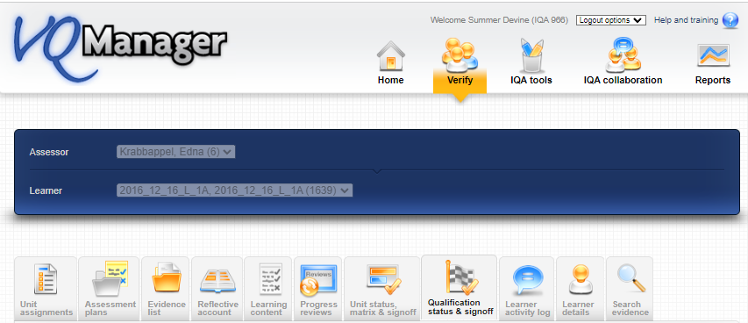
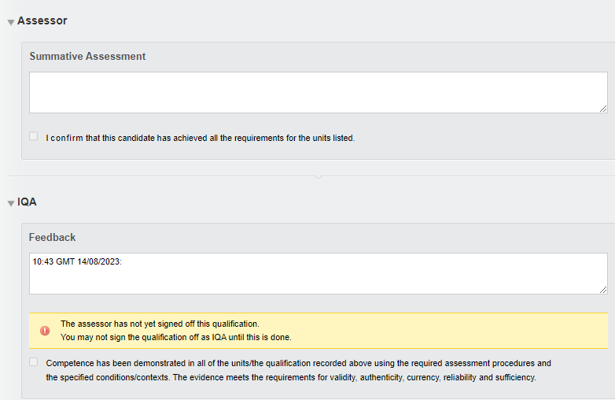

Slide 6
VQManager
Add OTJ summary to Diary and Activity log tabs
We have added a summary of Off the Job (OTJ) progress when users are looking at both the Diary (Reflective account in the example below) and Learner activity log summary pages.
This will only show for learners who have OTJ switched on.
If the centre has had a switch applied so that OTJ can only be logged in the Diary, it will not show in the Learner activity log, and vice versa.

Slide 7
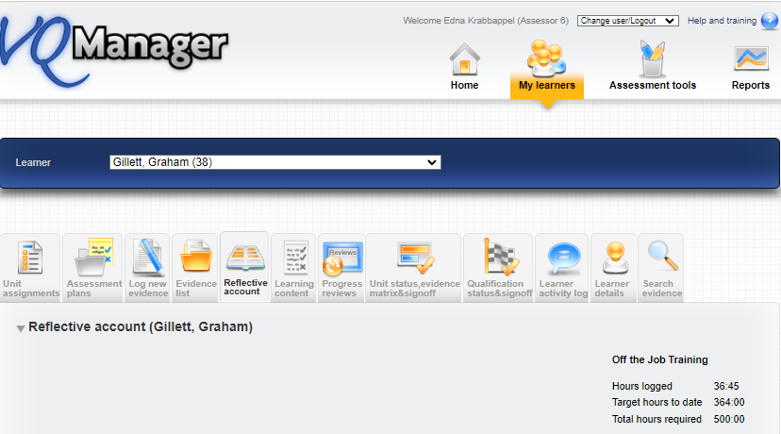
VQManager
Diary

Slide 8
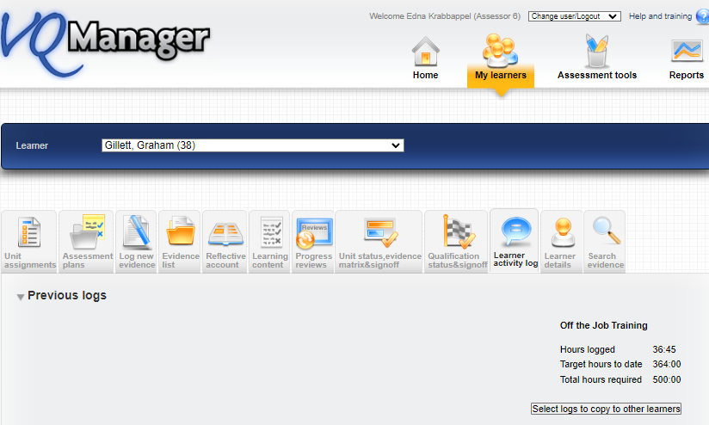
VQManager
Activity Log

Slide 9
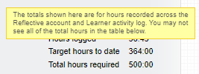
VQManager
It shows the total across both these tabs where clients are recording hours on both the Diary and Learner activity log. We have added a mouse-over to indicate this.

Slide 10
VQManager
Adding learner confirmation to OTJ hours records
We have added the ability for learners to confirm logged OTJ hours. This applies equally to the Diary and Learner activity log entries.
When an assessor is creating a record, there is now an additional confirmation box for them to tick to request learner confirmation. This box is ticked by default, but the assessor can remove the tick if they choose.

Slide 11
VQManager

Slide 12
VQManager

Slide 13
VQManager
This will trigger a notification on the learner's To Do tab.
When they open the OTJ record, the learner will have a tick box and a comments box.

Slide 14
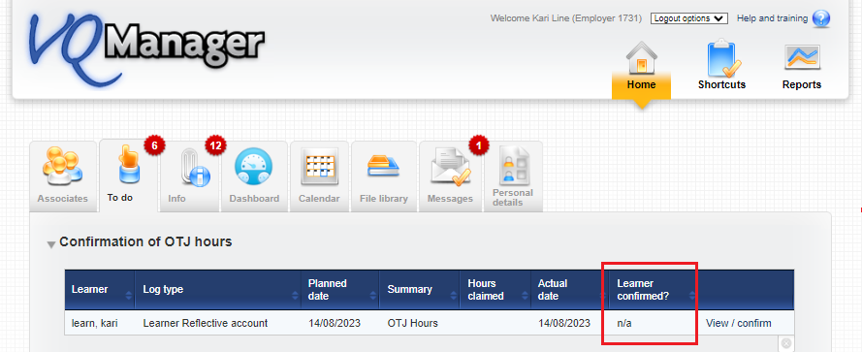
VQManager
On the Line manager’s To Do tab, we have added a column to the Confirmation of OTJ hours table to show if the learner has confirmed the hours or not, as well as displaying this information when they open an individual record.

Slide 15
VQManager
When a learner is creating a record, there is a tick box and comments box for them. The confirmation box is ticked by default, but the learner can un-tick it if they choose.

Slide 16
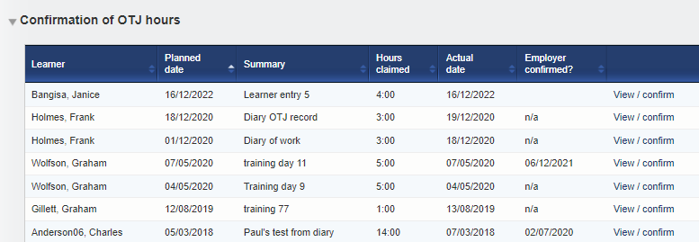
VQManager
Add column to show how many hours claimed in 'Confirmation of OTJ hours' table on assessor To Do list
We have added a column in the table for Confirmation of OTJ hours sign off on the To Do tab to show how many hours are being claimed for in the requests. This development is visible for the assessors and line managers / employers too.

Slide 17
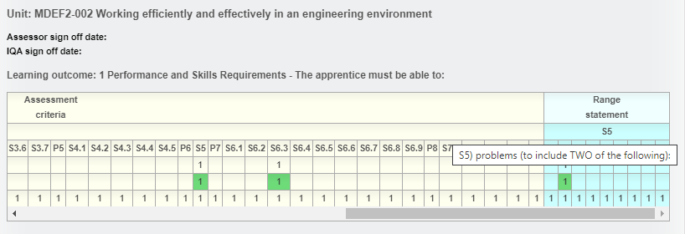
VQManager
Show Range description in evidence matrix
We have added a row to the evidence matrix on the Unit status, evidence matrix and signoff tab to display the Range section headers. For many qualifications, this field includes information on how many Range items from each group need to be covered.
The Range information is visible as a mouse-over, with the text appearing in the same way the method, criteria etc mouse-overs work.

Slide 18
VQManager
Where the Range section doesn’t have a number/letter, we’ve added asterisks to indicate to users that there's something there they can view.

Slide 19
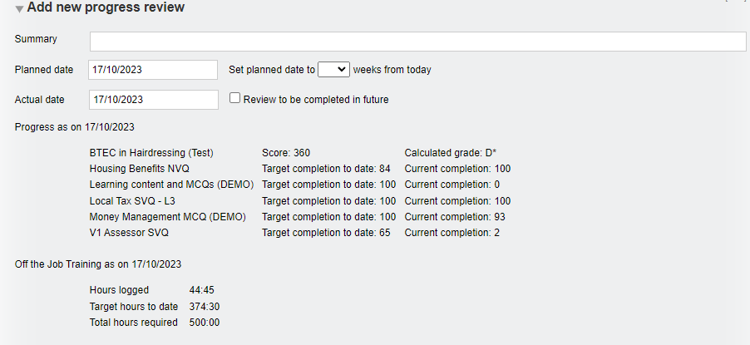
VQManager
Add current progress to 'Add new progress review' pane
On the Progress review tab, we have added an area which displays current progress so assessors can view this when they are completing a review (rather than just afterwards when a review is saved), since it may be relevant to what they might write. The information shows progress for all qualifications assigned to the learner as well as OTJ hours (if applicable).
It appears in the Add new progress review section and also on opening a pre-set review.

Slide 20
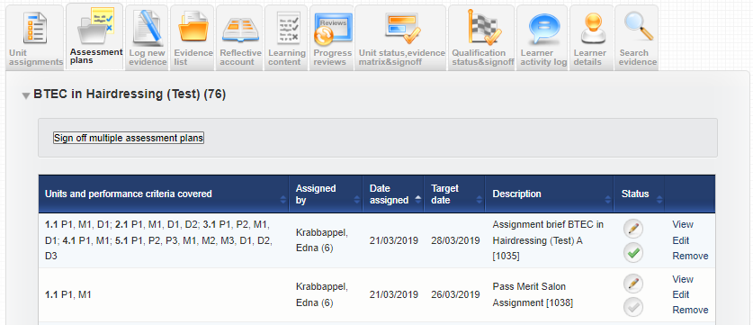
VQManager
Add assessor name to Assessment plan table
In the Assessment plans tab, we have added the name of the assessor who assigned the assessment plan into the summary table. This will assist learners in knowing who to ask if they have a question about the plan.

Slide 21
VQManager
Adding view of all assigned content in Gap Analysis report
In the Gap analysis report, we have made two changes.
We have now included the Range and Knowledge and understanding (where applicable) into the report.
Range statement (where applicable)

Slide 22
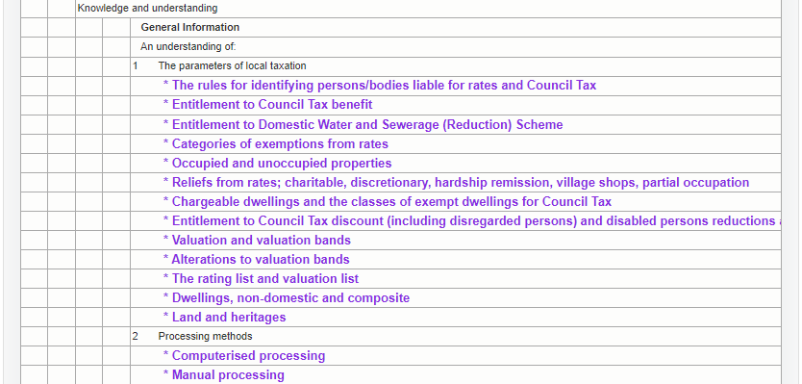
VQManager
Knowledge and understanding (where applicable)

Slide 23
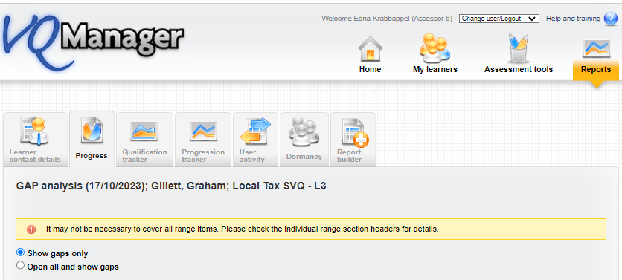
VQManager
We have also added the option to view the whole qualification as well as just the gaps. The default setting is 'show gaps only' but there is now an option to elect ‘Open all and show gaps’.

Slide 24
VQManager
When selecting Show gaps only, the criteria is slightly larger text, highlighted in purple and is bold:

Slide 25
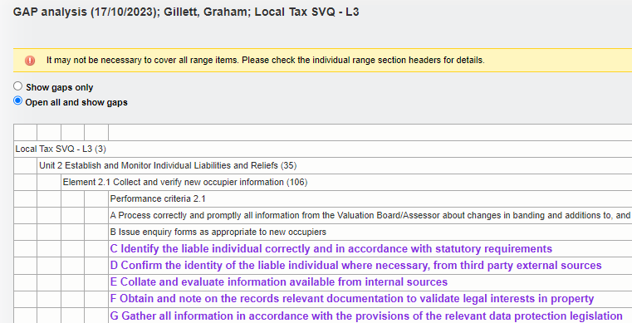
VQManager
When displaying Open all and show gaps, the criteria already met (according to the minimum requirements) will display in black in light text and as before, as with Show gaps only - the gaps will display in slightly larger text, will be purple and is in bold text.

Slide 26
VQManager
For units that have been signed off by an assessor, no gaps will show. This applies to both the Show gaps only and the Open all and show gaps views. In the Show gaps only view, where there are no gaps for a unit, the unit title only is displayed. Titles for learning outcomes with no gaps are hidden from view. This is also applicable in the Range and K&U area (where relevant).
The downloadable version of the Gap Analysis report will still show gaps only.

Slide 27
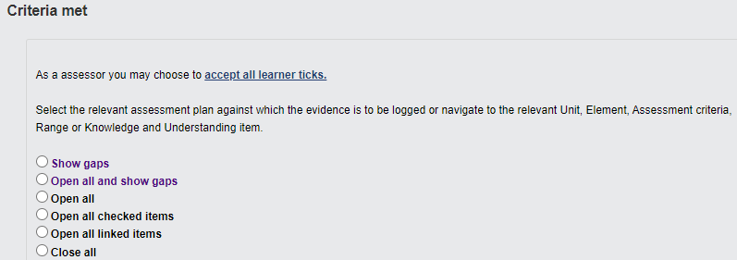
VQManager
Just as a reminder, this report replicates information which can be found in the Log new evidence tab under the Criteria met section.

Slide 28
VQManager
Add learner's name to VQManager Network for Assessors
For assessors, we have added a column to show which learners other assessors are linked to in the My VQManager network tab.

Slide 29
VQManager
For assessors, we have added a column to show which learners other Line Managers / Employers are linked to in the My VQManager network tab.
For centres where IQAs are linked directly to learners, we have added the new column to the IQA table on this tab as well.
It is only relevant to centres set up in this way and will not be visible for anyone else.

Slide 30
VQManager
Making 'curriculum area' mandatory when adding a new learner to VQManager
When adding a new learner, if you are required to complete the curriculum area drop down section to attribute a learner to one area or another, we are now able to make this field mandatory. A pop up appears preventing the administrator from saving the new learner profile without completing that field. This is only applied to newly created learners, not when editing an existing learner.
If this is applicable to your organisation and you would like this switching on, please drop us a message as this has not been automatically applied to your centre.

Slide 31
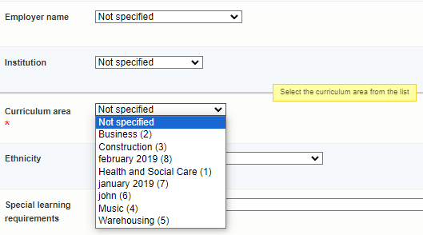
VQManager

Slide 32
VQManager
Adding pop-up notification to 'save and create evidence' button in Diary
We have added a new pop-up notification especially for learners when saving a Diary entry. Quite often they accidently select the Save and create evidence option in error. This pop up will warn them this is going to happen and if this is an error, help guide them in the right direction.

Slide 33
VQManager
We have also increased the size of the font on the Save button, so it emphasised Save over the Save and create evidence button when saving for the first time or when editing the entry.

Slide 34
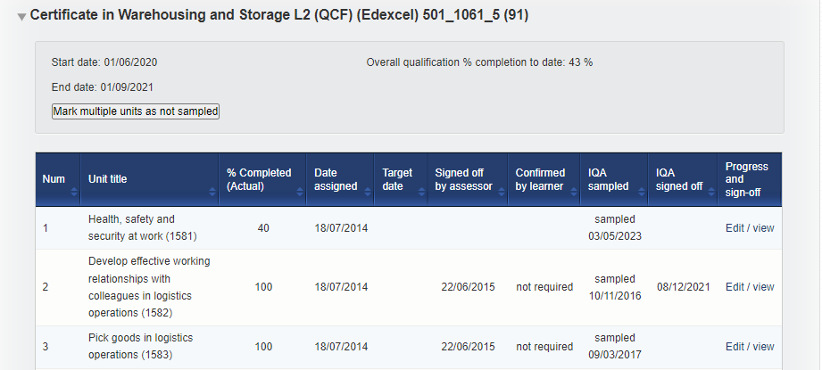
VQManager
Unit sign off page - split sampled dates and verified dates into separate columns.
We have split the IQA sampled dates and the IQA sign off dates for units so they are now displayed in separate columns, for clarity. The IQA sampled column is of course used for both "sampled" and "not sampled".

Slide 35
VQManager
Add table to Assessor To Do list showing new Line Managers assigned to their learners
Assessors are now notified when a new Line Manager is associated with a learner the assessor is working with. This works in a similar way to the existing table notifying of any new learners assigned to the assessor.
The table is called New employers associated with learners (last 30 days)

Slide 36
VQManager
Unless specified, all of these enhancements have been automatically added to VQManager for you.

Slide 37
VQManager
Did you know?
You can sign off multiple units as an assessor and as an IQA?
You can sign off multiple assessment plans at once?
You can share assessment plans between assessors (using your CA role)?
You can assign multiple assessment plans to multiple learners?
You can bulk map criteria addressing assessment plans when logging evidence?
You can set notes in the progress review area to remind assessor what to cover?
You can alter settings so only the assessor can alter the learner’s personal details rather than the learner themselves?
You can make the Shortcuts page a default “landing page” for the learners and employers?
You can see learner and assessor activity – what they did and when?
You can share a sampling plan with another IQA if one leaves your organisation?
Assessors can export evidence, activity log summary and Diary summary for EPA?
You can build your own reports?
Assessors can run a skill scan for your learners throughout their course?
You can use the bulk edit function to perform multiple tasks at once?

Slide 38
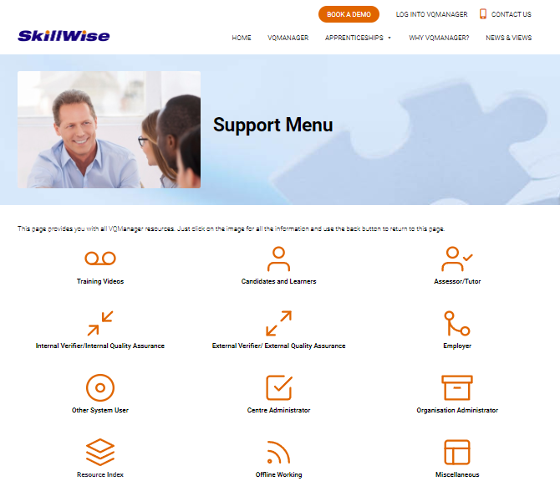
VQManager
www.SkillWise.net/support
We have an extensive support and training area for all users. You will find video and PDF documents to help you use all functionality within VQManager.
.

Slide 39
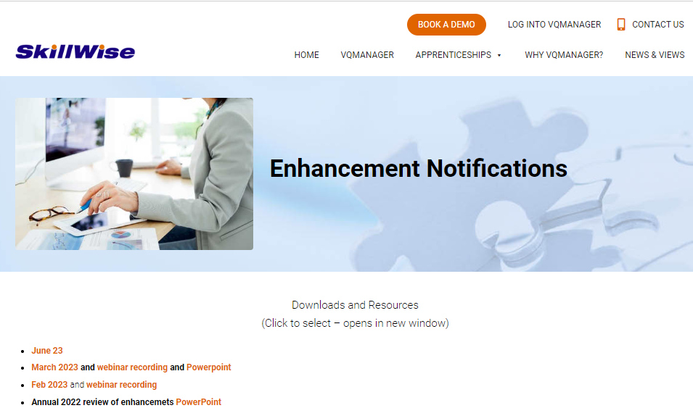
VQManager
www.SkillWise.net/support
This presentation can be found on the Enhancement Notifications page:
.
And also on the Functionality and Enhancements Webinars page – see next slide:
.

Slide 40
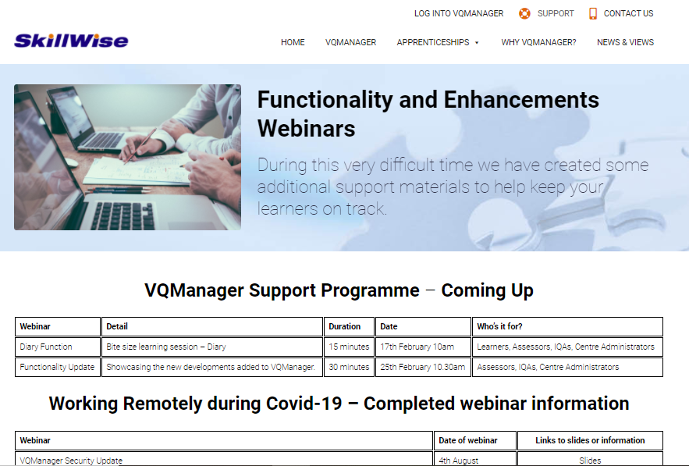
VQManager
www.skillwise.net/support
This page also indicates when we will be holding more webinars to support you.
.

