Slide 1
VQManager
VQManager June 2023 Enhancement Webinar

Slide 2
VQManager
This webinar contains information regarding:
Increase mouse-over area on Activity log.
Add a comments box in evidence where a trainee assessor can comment privately to the qualified assessor.
Note to remind users to complete the Activity date when logging OTJ in the Activity log.
Add a Notes section to Employer details.
Add table to assessor Info tab showing evidence IQA'd in last 30 days.
Introduce password strength meter, and force users to change weak passwords – learners.
Add information to the Progress review around progress.
Adding username to all comments boxes.
Changes to Dashboard Off The Job report.

Slide 3
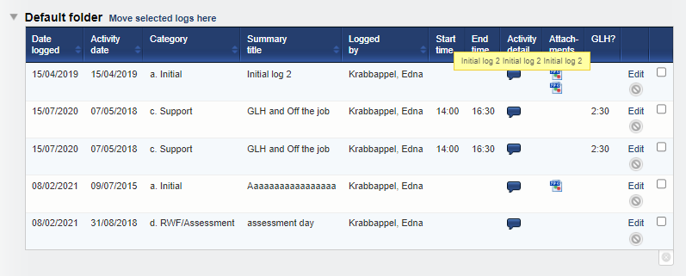
VQManager
Increase mouse-over area on Activity log.
When using the mouse-overs in the Activity log, we have increased the selected area in order for the pop up to stay on screen long enough to read it. Previously you had to be really accurate with your mouse to get it to remain.

Slide 4
VQManager
Add a comments box in evidence where a trainee assessor can comment privately to the qualified assessor.
We have added a new comments box for the trainee assessors to be able to write comments in evidence that is aimed at the qualified assessor. As indicated, these comments are hidden from the learner, but visible to IQAs and EQAs.
As with all the comments boxes, the box is editable when the trainee assessor 'has' the evidence to work on.
To find out more about this function, please select this link: https://skillwise.net/wp-content/uploads/2022/12/Off-the-job-training-V2.pdf

Slide 5
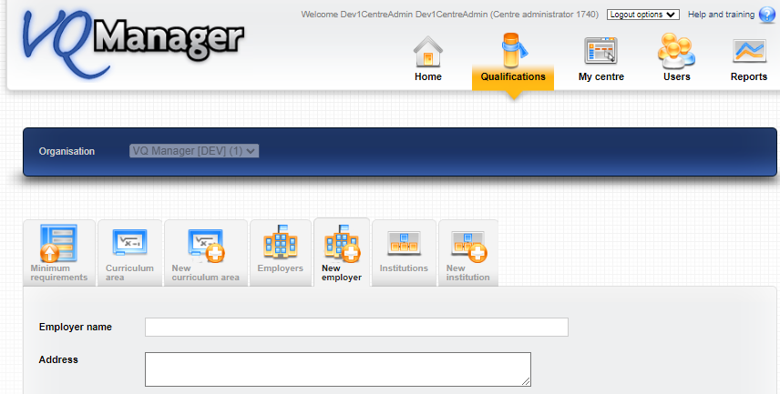
VQManager
Add a Notes section to Employer details.
In the Employer information tab, we have added a free text box should you wish to add notes.

Slide 6
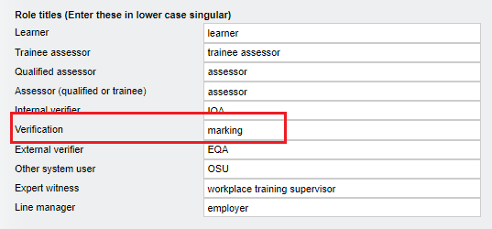
VQManager
Add table to assessor Info tab showing evidence IQA'd in last 30 days.
In the Info tab, we have added a table for the assessor that shows evidence IQA'd in the last 30 days.
The text for this new column will change depending on the centre setting, so most centres will show ‘Date of verification’. The screen shot below reflects the centre setting I used which calls verification “marking”.

Slide 7
VQManager

Slide 8
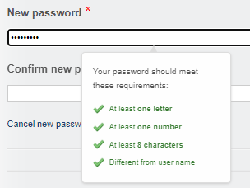
VQManager
Introduce password strength meter, and force users to change weak passwords – learners.
We have changed the centre setting so all learners will be requested to set a strong password. They will not be able to save their profile without complying with the password requirements below.
This requirement has already been applied to newer clients, so the change will only affect long-established clients.
All other roles have already had the requirement to choose strong passwords implemented previously in VQManager. The learner role is the last one to be completed.
For more information regarding setting strong passwords, please follow this link.
https://skillwise.net/wp-content/uploads/2023/05/Passwords-W3W.pdf

Slide 9
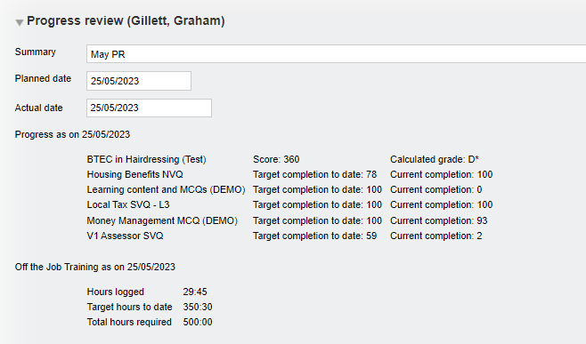
VQManager
Add information to the Progress review around progress.
In addition to the current completion to date information available after a progress review has been saved, we have added target completion to date too.

Slide 10
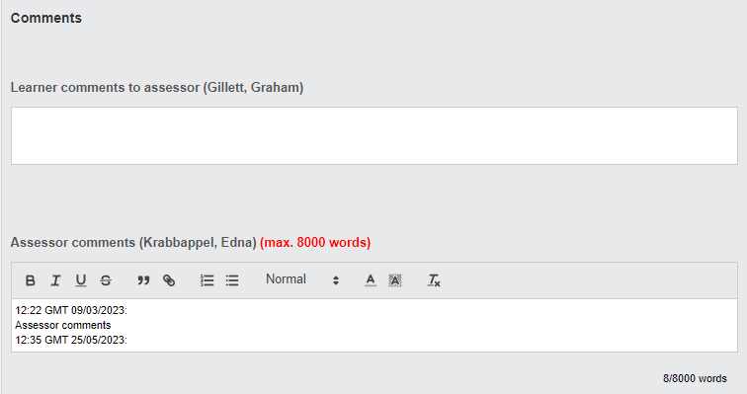
VQManager
Adding user name to all comments boxes
We have now ensured that the username always displays next to the comments boxes throughout VQManager.
Previously there were instances where the commenters name was not recorded. This enhancement ensures this is not the case moving forward.

Slide 11
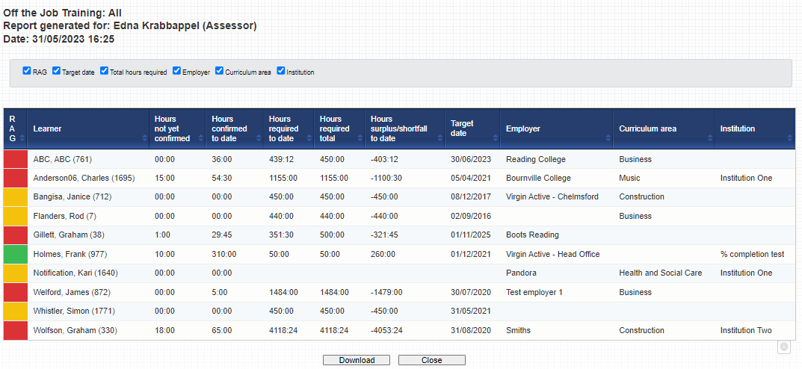
VQManager
Changes to Dashboard OTJ report
To bring the Dashboard report in line with the other OTJ reports, we have changed the title of the 'Hours logged to date' to 'Hours confirmed to date'?
We have also added the 'Hours not yet confirmed' and 'Hours surplus/shortfall to date' columns.

Slide 12
VQManager
All of these enhancements have been automatically added to VQManager for you.

Slide 13
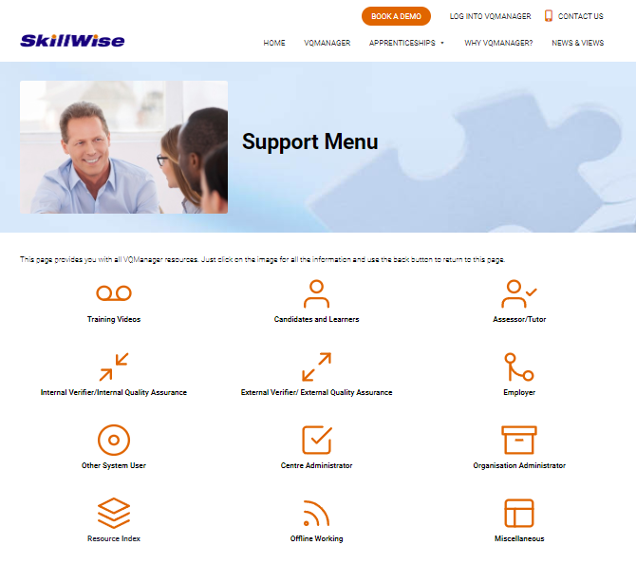
VQManager
www.SkillWise.net/support
We have an extensive support and training area for all users. You will find video and PDF documents to help you use all functionality within VQManager.
.

Slide 14
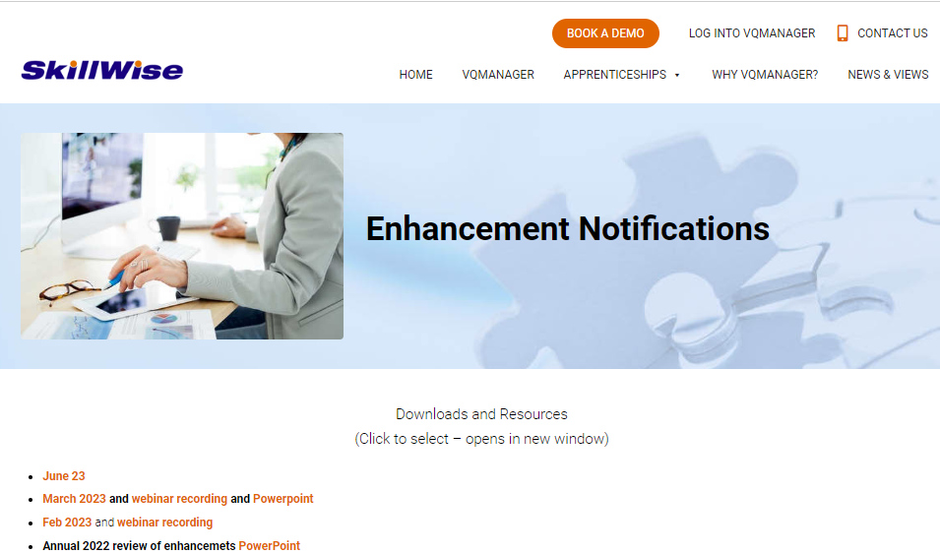
VQManager
www.SkillWise.net/support
This presentation can be found on the Enhancement Notifications page:
.
And also on the Functionality and Enhancements Webinars page – see next slide:
.

Slide 15
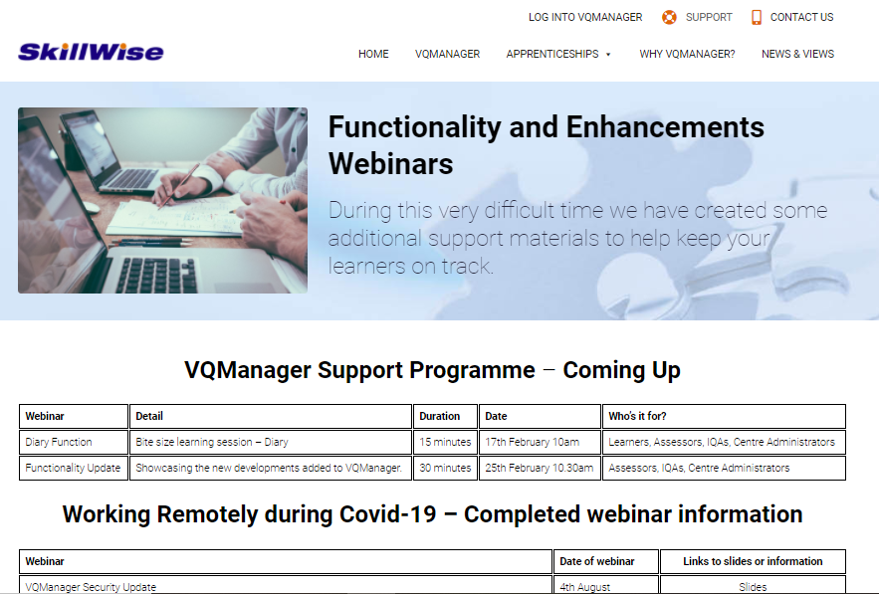
VQManager
www.skillwise.net/support
This page also indicates when we will be holding more webinars to support you.
.

