Slide 1
VQManager
Enhancements
March 2023

Slide 2
VQManager
Adding opt-in e-mail notification for line managers of upcoming progress reviews
We have added an opt-in e-mail for Line Managers, to let them know when a progress review is coming up.
The notification is located in the Personal Details Tab alongside other opt in notifications.

Slide 3
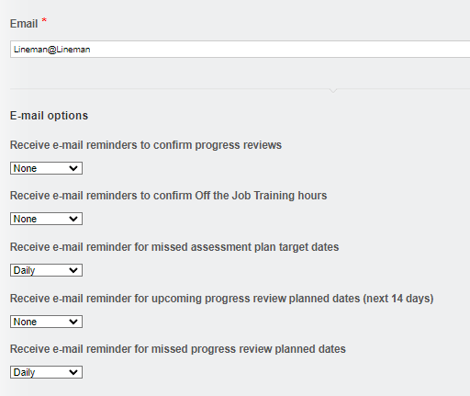
VQManager
It has the same options as the other reminders in this category.
Here are the full details of the email summary notifications:
https://skillwise.net/wp-content/uploads/2023/02/Email-Summary-Notifications-V3.pdf

Slide 4
VQManager
Adding an opt-in notification for assessors of evidence returned
We have added a new opt-in notification e-mail for assessors. This notification lets them know about any evidence on the To Do list that has been returned by either the learner or the IQA for further work. There is already one for new, unassessed evidence, so this is in addition to that one.

Slide 5
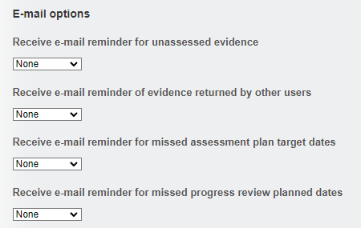
VQManager
It has the same options as the other reminders in this category.

Slide 6
VQManager
The email is very similar to the other opt in options and would look like this:
Dear VQManager assessor,
You have evidence item(s) returned to you on the To-do tab of your Home page which require your attention.
Please log in to VQManager (www.vqmanager.co.uk) to assess this evidence.
Note that there may also be other evidence or tasks in various stages of progress which also require processing on your To do tab.
To stop receiving this email, please change your preferences on the Personal details tab once you have logged in to VQManager.
Kind regards
Evidence 458/E/247 “evidence summary description text” submitted on 15/02/2010 by builder, tom
Evidence 18678/E/987 “evidence summary description text” submitted on 16/06/2017 by Becket, Thomas
Please note that this is a notification email only and any replies to this email address will not be answered. If you have a query regarding this email or any aspect of VQManager, please contact your Centre Administrator directly.

Slide 7
VQManager
New 'Learner activity' report
We have added a new Learner activity report, along the same lines as the Assessor activity and Line manager activity reports. It is located in Reports then User Activity. It shows the following actions in the system over a chosen period of time.
Adding, editing and deleting Learner Activity Log entries
Adding, editing and deleting Diary entries
Progress review confirmation
Assessment plan confirmation
Unit sign off confirmation
Qual sign off confirmation
Editing and completion of Progression Tracker evaluations
Editing and completion of Learning content / questions (including MCQ scores in the notes)
Logging and editing evidence
To avoid confusion, we have renamed the existing report that used to be called ‘Learner activity’ to ‘Learner unit progress’. There are no changes to that report other than the name.

Slide 8
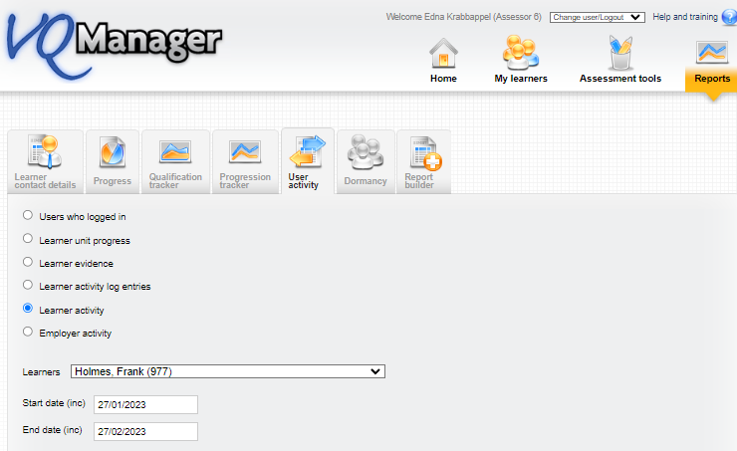
VQManager

Slide 9
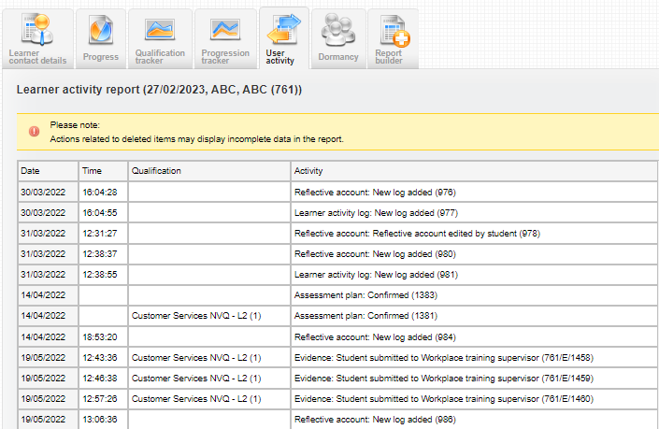
VQManager
It has the usual 'view' and 'download' options.

Slide 10
VQManager
Allow assessor to delete evidence in certain states from To Do list
Assessors are now able to delete evidence directly from the To Do list, where it hasn't already been assessed.
This new function applies to assessors only, and only to evidence in the Unassessed evidence and Unsubmitted evidence tables on the To do tab.

Slide 11
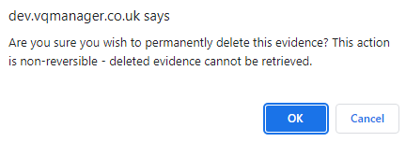
VQManager
The usual pop-up warning appears when you select the delete icon each time.
Please be very careful when doing this as deletions are non-reversible; deleted evidence cannot be retrieved.

Slide 12
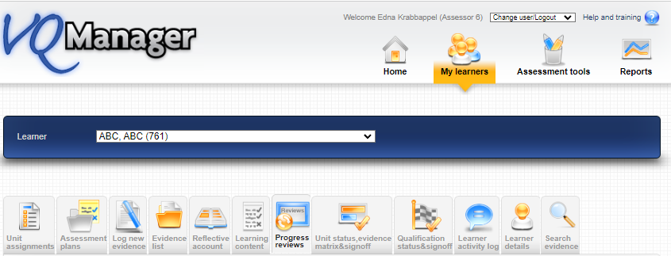
VQManager
Progress reviews - 'Request learner to confirm' auto selected
When creating or editing Progress reviews, the tick box to request learner confirmation will be automatically ticked, provided these users haven’t already confirmed the review. Assessors can still de-select this option before saving if it is not required.

Slide 13
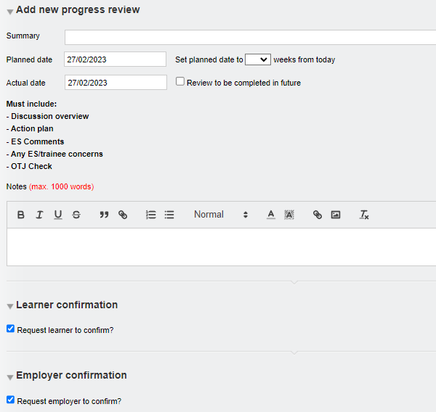
VQManager
This auto-select function will also be applied to the line manager/employer request box, where the learner has a line manager/employer assigned.

Slide 14
VQManager
Add a mouse-over in the To Do list to show evidence Summary description
We have added a function whereby users can now view the Summary description of evidence from the To Do list, so they can see the title of the piece of evidence without having to open it.

Slide 15
VQManager
The user would hover over the evidence number and the title (summary description) of that piece of evidence appears.

Slide 16
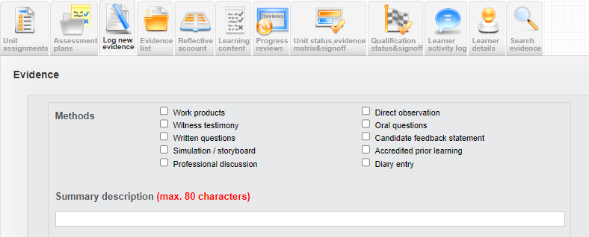
VQManager
The Summary description field displayed is located here on the Log new evidence tab.
Top Tip
If the learner has more than one assessor/teacher, a great idea would be to ask the learner to include the initials of the assessor within the title of the evidence. Using this new function, the assessors/teachers can hover over the evidence number and see the summary description and also their own initials to see instantly who has perhaps set the work or who is the most appropriate person to assess/mark that piece of work. An assessment plan reference number could also be quoted for ease.

Slide 17
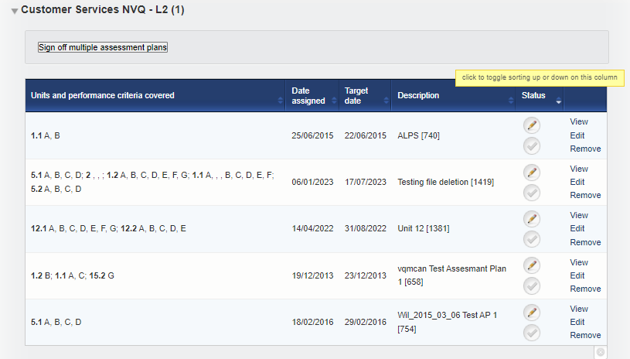
VQManager
Add a ‘sort’ arrow to the 'status' column in the Assessment plan list
We have added a ‘sort’ arrow to the assessment plan table in the Status (signed off / not signed off). This is available for all users with this table.

Slide 18
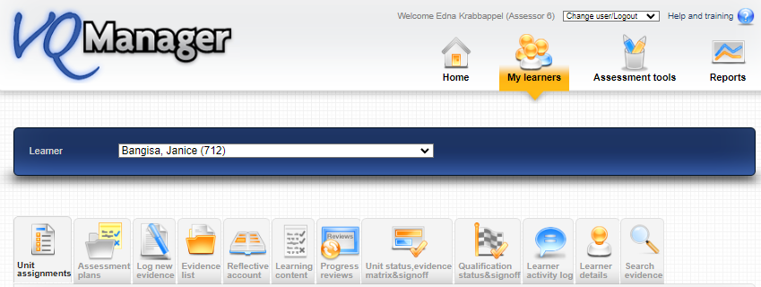
VQManager
Showing which units are mandatory in Unit assignment tab
We have added a column to the Unit assignments tables to show which units are mandatory, according to the rules of combination.

Slide 19
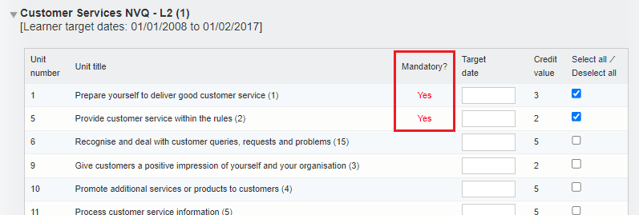
VQManager
Note: This is different to the default units. Mandatory units are those required in order to pass, according to the official rules of combination for the qualification. Clients can set up their own lists of default units for their learners, which may include a mixture of mandatory and optional units. Information on the default units function is here:
https://skillwise.net/wp-content/uploads/2019/08/Org-Admin-adding-default-units-to-qualifications.pdf

Slide 20
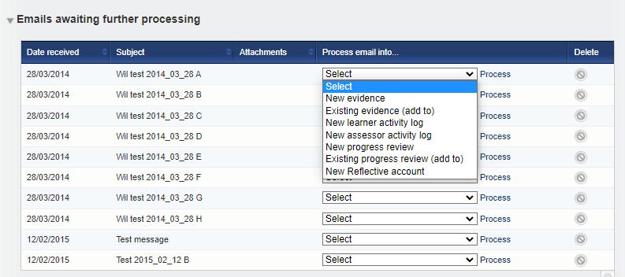
VQManager
Allow content emailed into the system to be added to the existing evidence
You are now able to e-mail evidence into the system and add it to an existing evidence item. Evidence will only appear as an option if the evidence is with the user in question for editing at the time.
Select Existing evidence (add to) from the Process email into options and then select Process.

Slide 21
VQManager
From here it will allow you to select Learner:
Then Evidence: only evidence available to be edited will be shown here.

Slide 22
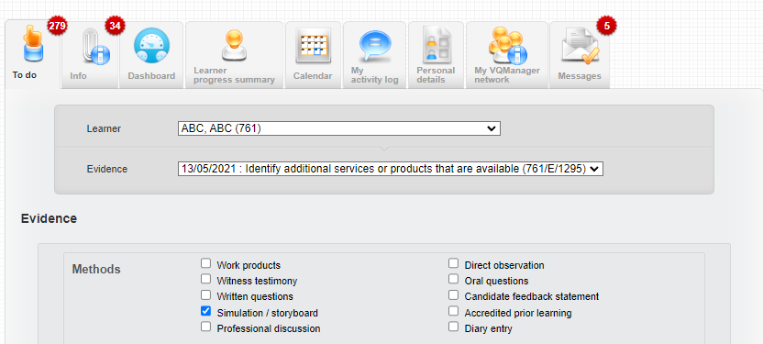
VQManager
Select the evidence and the page will refresh, dropping all elements of the email into the existing version –
Description
Any attachments

Slide 23
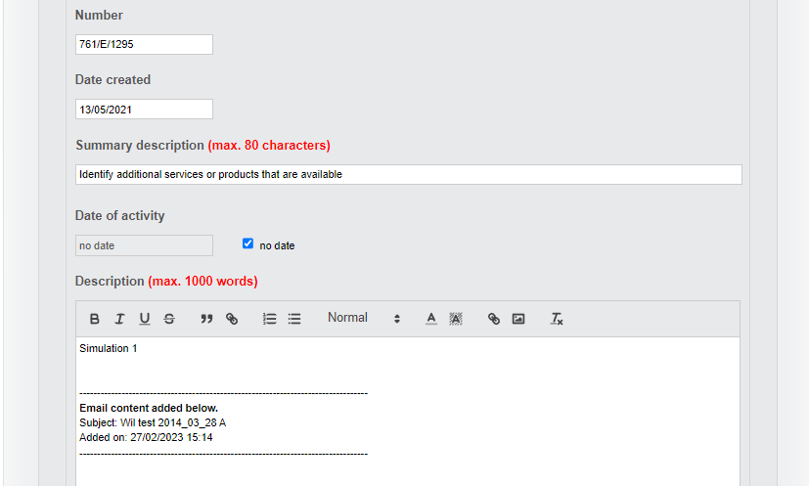
VQManager
The system will add a note at the top of the added content, to show where it’s come from.

Slide 24
VQManager
Save using the normal save options:
Here are the details of the full emailing in functionality:
https://skillwise.net/wp-content/uploads/2019/08/Assessor-emailing-into-the-e-portfolio-V2.pdf

Slide 25
VQManager
Add centre switch to choose where OTJ are recorded.
We have two areas for recording OTJT hours, the Diary tab and the Activity log tab. Some users have found this confusing, so we have added a centre switch with different options.
The options within the switch are:
Log OTJ in Diary only
Log OTJ in Activity log only
Log OTJ in both Diary and Activity log
The default setting remains the third option, that hours can be added to both areas, since that is what we have now.

Slide 26
VQManager
For either of the first two switches, the Diary or Activity log tabs would still be available to use but for the tab not selected, the area for logging OTJ would be hidden for all users.
For backwards compatibility, you will still see the OTJ column in the summary table, where there are entries there. Where there are no entries, it will hidden along with the section to log OTJ hours.
Here are the details of the full OTJ Training Functionality:
https://skillwise.net/wp-content/uploads/2022/12/Off-the-job-training-V2.pdf
If you would prefer to only allow OTJ to be added on one tab or the other, please let us know along with your preference.

Slide 27
VQManager
Updating notification e-mails with custom centre text
To help users, and make the notifications clearer to them, we have added the custom naming conventions to them. Some of the customisable names are:
User roles (learner, assessor, IQA, EQA, OSU, Expert witness, Line Manager) Off the job training Assessment plan Verification
So now, any email notifications which go out, will reflect the naming conventions in your centre.

Slide 28
VQManager
All these enhancements (unless specified) have been automatically added to VQManager for you.

Slide 29
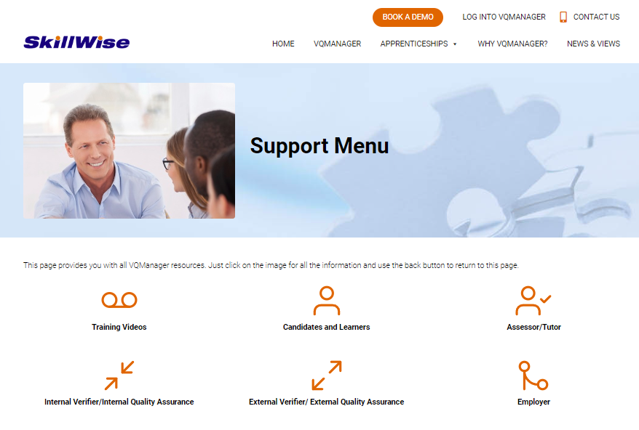
VQManager
We have an extensive support and training pages for all users. You will find videos and PDF documents to help you use all functionality available within VQManager.
.

Slide 30
VQManager
Did you know…? we had a new page where we are storing the
Did you know…? Information?
Notifications appear every month with a new top tip both in the website and on your messaging tabs.
.
https://skillwise.net/support/support-index/did-you-know/

Slide 31
VQManager
We have a page indicating when we will be holding more webinars to support you.
.
https://skillwise.net/support/additional-support/

Slide 32
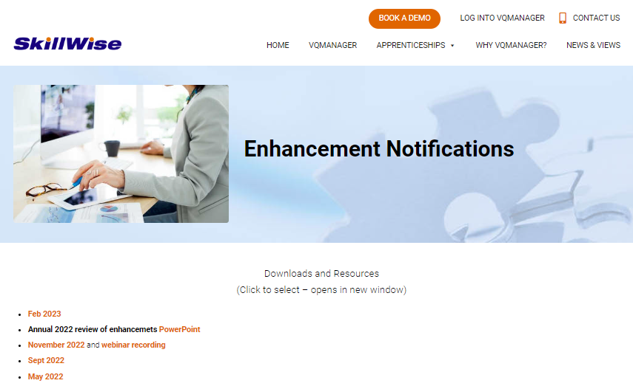
VQManager
We have a dedicated page in the support area for all enhancements we release.
.
https://www.skillwise.net/support/enhancement-notifications//

Slide 33
VQManager
www.skillwise.net/support
We have a dedicated support page for troubleshooting.
https://www.skillwise.net/support/troubleshooting-index/

