Slide 1
VQManager
Enhancements Sept 2022

Slide 2
VQManager
Allow users to add entries to the learner Calendar
Users are now able to add events to Learner Calendars. This involves the following changes to the system:
Learners can add entries to their own Calendar
Assessors can add entries to the learner Calendar, and copy them to other learner Calendars
We have added the learner Calendar to the Employer view, so they can also add entries and copy them to learners they are associated with. (OSU remains a “view only” type of user so cannot add entries)
We have added the learner Calendar to the Centre Admin view, so they can add entries and copy them to other learner Calendars

Slide 3
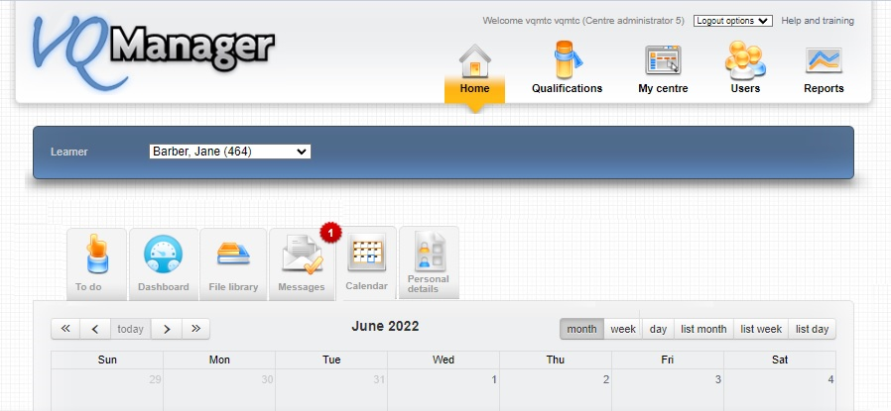
VQManager

Slide 4
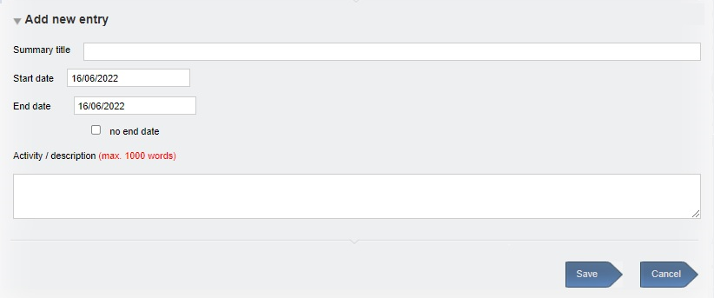
VQManager
New entries will have a title, a start date, an end date (optional), and a description (optional). They can be edited by the user who created them.

Slide 5
VQManager
Entries created by users will all appear as the same colour (Salmon) no matter who created them, with the title as set by the user showing in the Calendar view.

Slide 6
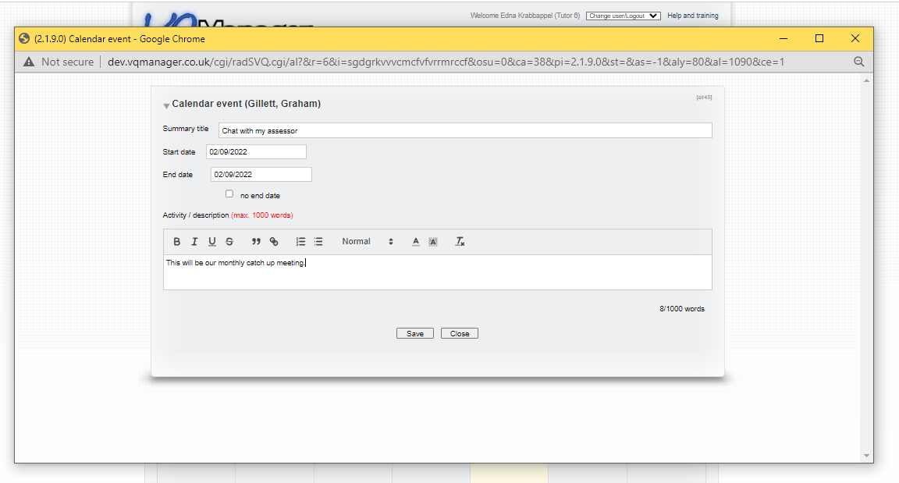
VQManager
Clicking on this entry will open a pop out showing the details.

Slide 7
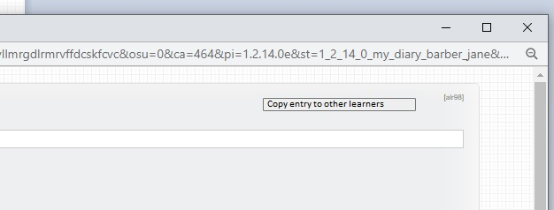
VQManager
A link to copy the entry to other learners will now appear top right for all these users except the learner.

Slide 8
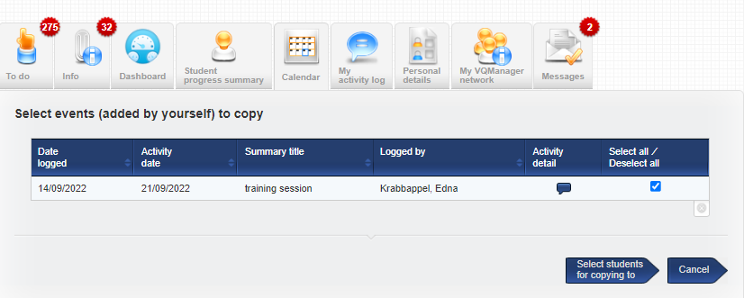
VQManager
Select the event to copy:
Users can copy events they have added to the Calendar themselves, but not events added by others.

Slide 9
VQManager
When sharing you will be offered the normal filtering options, by Qual, Employer organisation, Curriculum area, Custom filter. (This is the same format as copying an Activity Log entry to other learners).

Slide 10
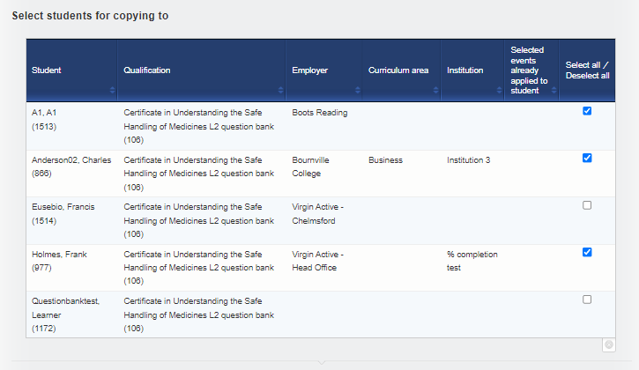
VQManager
Select the learner(s) to copy to, and click the ‘copy’ arrow at the bottom of the page:

Slide 11
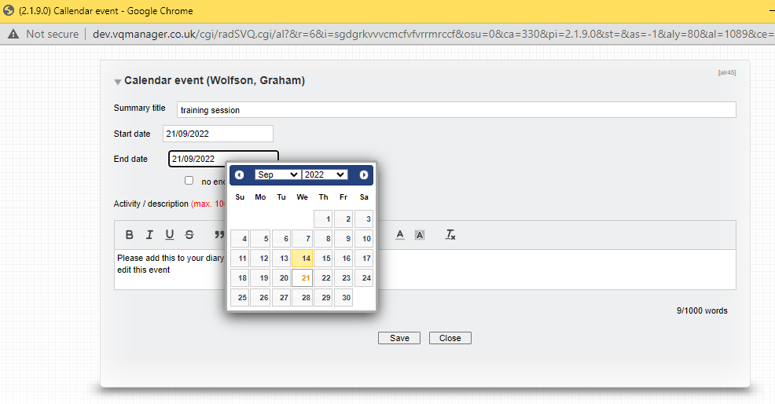
VQManager
When the page refreshes the event has been copied to the learners:
You can open the event by selecting it and also edit it further if required:

Slide 12
VQManager
Add 'IQA comments to learner' box to evidence
This development has not been automatically added to your centre. Please read the below and if it is applicable, please get in touch and we will switch this function on for you.
We have added a new comment box to allow the IQA to add comments to the evidence that are intended for learners. Everyone will be able to see these comments - learner, assessor, IQA, EQA.
Evidence will still be routed in the normal way, e.g. if the IQA leaves comments to the learner about additional work, they will need to send the evidence back to the assessor, who will then pass it on to the learner. There is no option for IQAs to send evidence directly to learners. This ensures the assessor is never ‘locked out’ of the process, but remains actively involved.

Slide 13
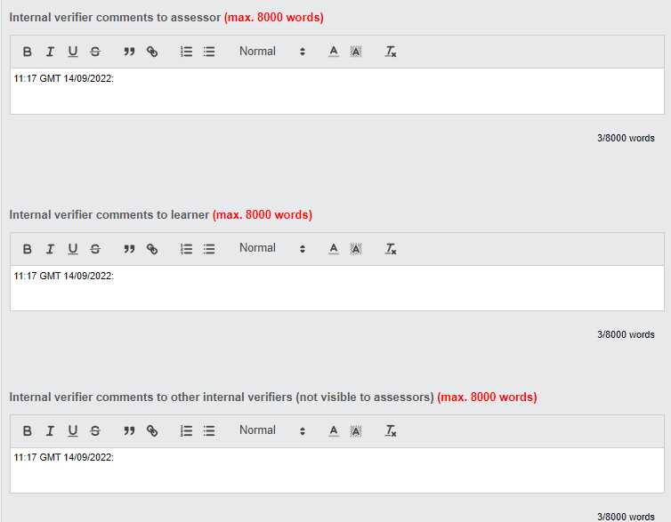
VQManager

Slide 14
VQManager
A new Info tab notification table for learners will show any entry for any piece of evidence where the IQA has left comments for the learner, regardless of whether the evidence is then signed off, or if it's returned to the assessor. It will stay on the list for 30 days, or until the learner removes it.
There is also a similar table for assessors on the Info tab. They will also get a To Do notification if the evidence is returned to them for action by the IQA, but this will not happen if the evidence has been signed off.

Slide 15
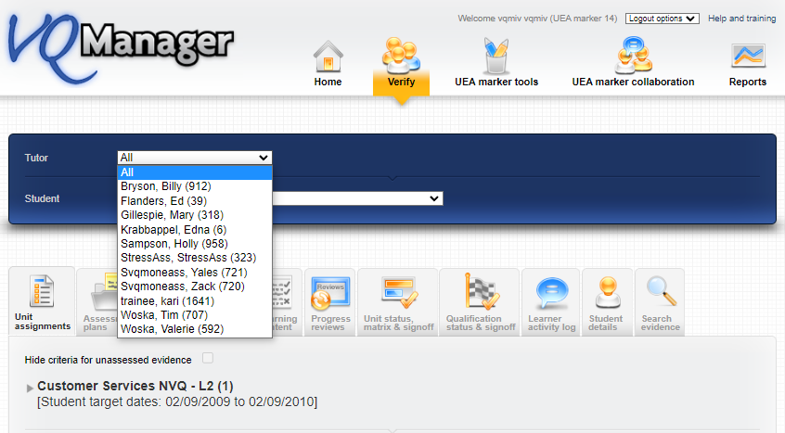
VQManager
“All' option for IQAs in Assessor drop-down in Verify page
We have added an option for “All” assessors to be selected in the Verify tabs. This will make it much easier to identify a learner to verify without having to check which assessor is linked to which learner.

Slide 16
VQManager
Add a new Message type
Currently all of our message types on the Messages tab disappear at some point. We have added a message type that stays on screen until it's cancelled by us.
Current types are:
1 = Show once if user has not seen this message before
2 = Show once only when logging in for the first time
3 = Show always until user ticks 'don't show again' checkbox
We have added:
4 = Show always until cancelled by admin
A message of type 4 would always show on screen for users. There is a tick box for the user to mark the message as read. This will cancel the notification so the red rosette on the Messages tab will disappear (or the number on it will be reduced by one, if there’s more than one message).

Slide 17
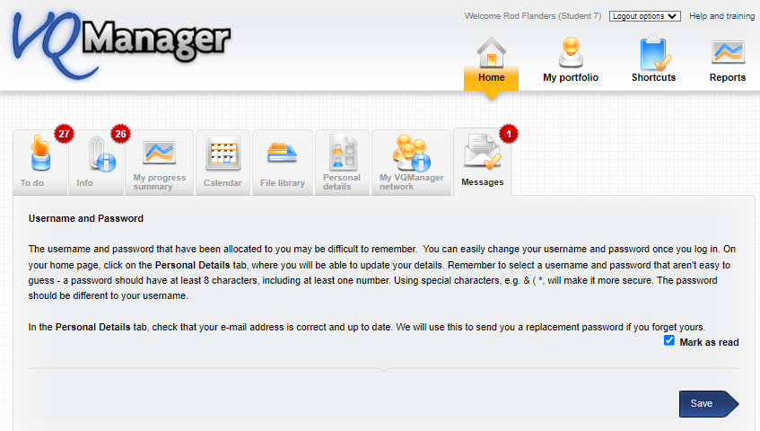
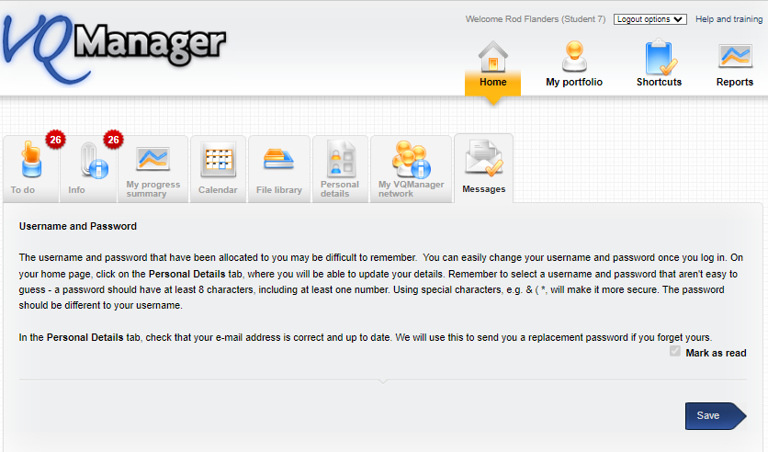
VQManager
Ticket and rosette has disappeared.

Slide 18
VQManager
Add reports to Centre Admin Dashboard
To improve visibility, we have added the following three reports to the Centre Admin Dashboard namely:
All Learners
Progress Reviews
Off the Job Training

Slide 19
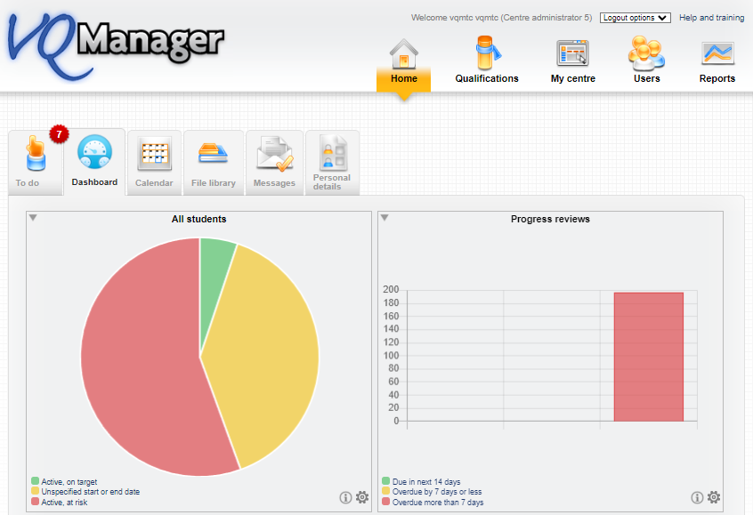
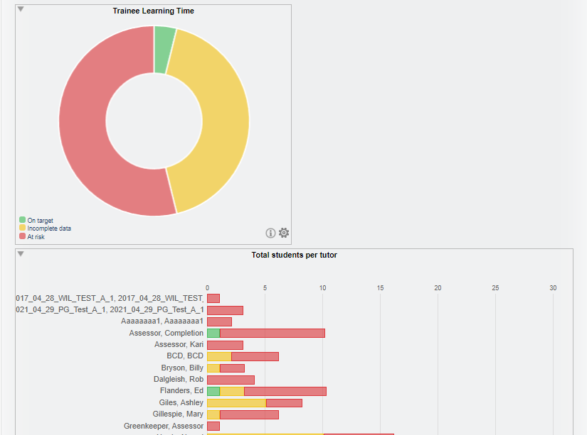

Slide 20
VQManager
Add an option for MCQs to hide the result from the learner altogether
This development is only applicable if you are using the e-Learning function, and have multiple choice questions (MCQs) set up. If you want this option switched on for a new or existing MCQ, please let us know.
We have added an extra switch in our e-Learning area whereby the system does not report achievement of an MCQ test to the learners at all. Results will be communicated to the learner outside the system.
Where this is switched on, the learner would see the following on completion of an MCQ:

Slide 21
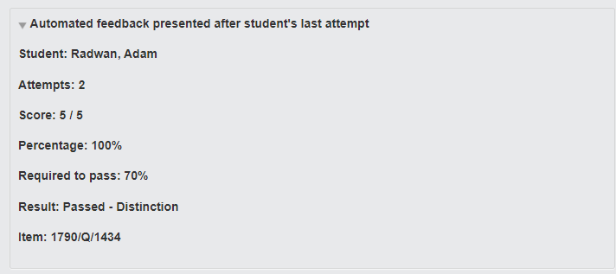
VQManager
There is no change to the view for others, they would still see the results displayed in the normal places.
The standard results pane looks like this:
If this applicable to you, please get in touch and we will switch this function on for you.

Slide 22
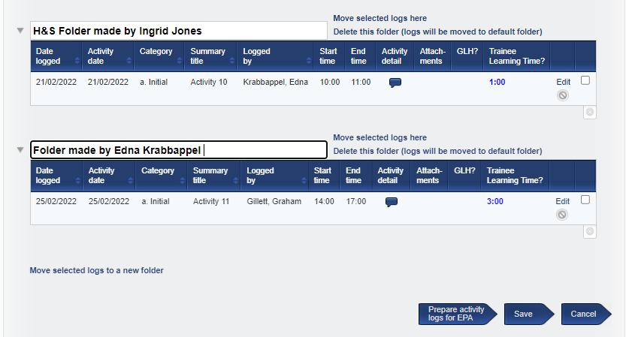
VQManager
Allow sorting of Learner Activity Log into folders
We have added a new function to the Activity log area for sorting this tab into folders, like you can with the file library.
It has been designed so that learners, assessors and IQAs have the ability, in the Learner activity log, to create and name folders, and move entries between folders.
Folders are created in the same way as they are for the file library:
This may be really useful where a learner is moving on to a second qualification or year two of an apprenticeship for example.

Slide 23
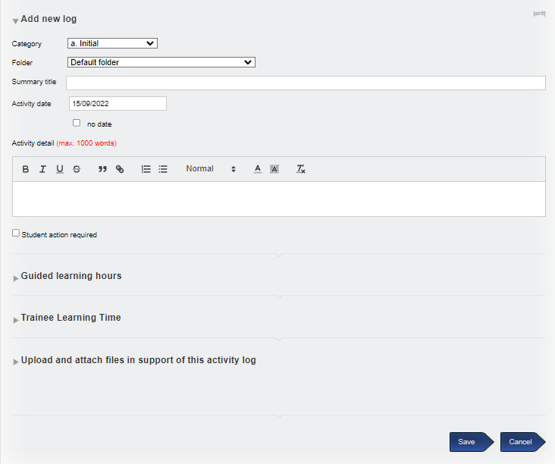
VQManager
When creating a new log, there is a new option to select the folder that the creator would like the new log adding to:

Slide 24
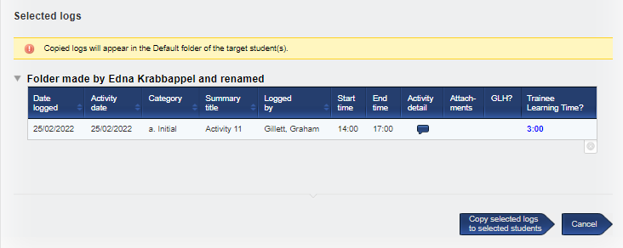
VQManager
All users except learners are able to copy the logs to other learners. If you copy a log, it will always appear in the recipient learner’s default folder. This is to take account of the fact that each learner’s folder structure may be unique.
There is a note to remind sharers of this aspect.

Slide 25
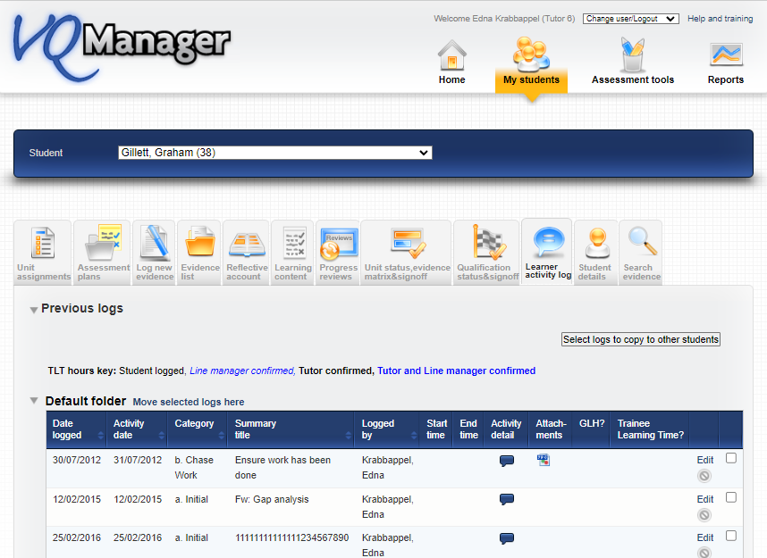
VQManager

Slide 26
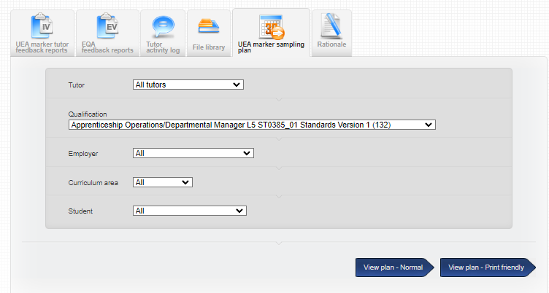
VQManager
Add assessor and qualification name to the Sampling plan
Previously when an IQA selects 'all assessors' in the sampling plan, the assessors' names don't show in the plan making it difficult to see which assessor is associated with which learner. We have now included the assessor name in all views of the sampling plan, like it is in the sampling plan report.

Slide 27
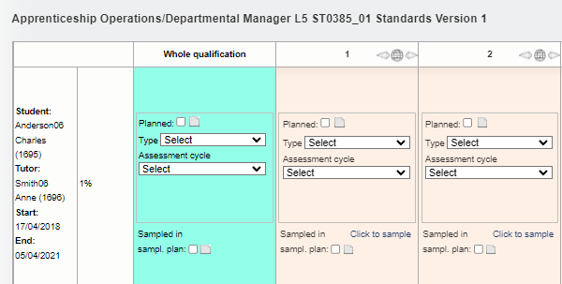
VQManager
This shot also shows where we have also added qualification title at the top of the sampling plan, in line with the sampling plan report.

Slide 28
VQManager
Apart from the two highlighted, all of these enhancements have been automatically added to VQManager for you.

Slide 29
VQManager
Reminder about the location of Support:

Slide 30
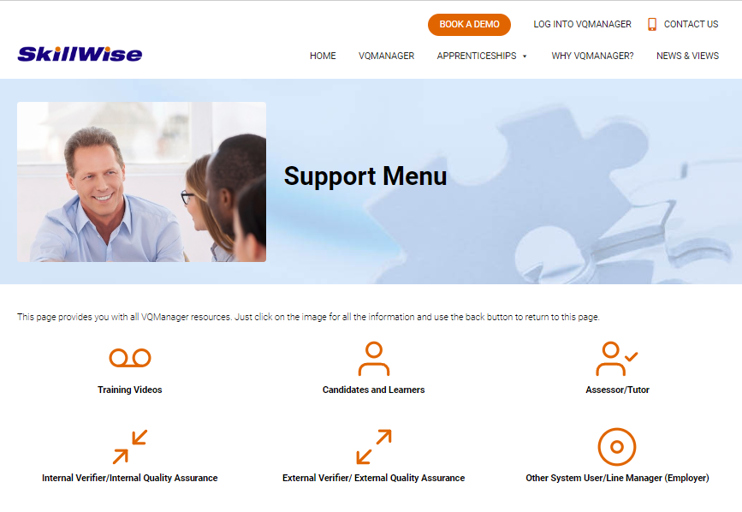
VQManager

Slide 31
VQManager

