Slide 1

User Group 2022

Slide 2
Hello!
Thank you for joining us today. We know it’s a bit frustrating not meeting in person, we do like to see and chat with you all but on the flip side, Paul does like to hug.
If technology allows, please can we ask you switch your cameras on so we can see your lovely faces.
We would really like this session to be as interactive as possible however it is really easy to talk over one another. So to prevent this happening, with you cameras on, if you raise your hand we will then invite you to go ahead.
This session is being recorded but for our benefit only to help with note taking. It’s not for public release.

Slide 3
Terminology
Learners = students, apprentices, trainees
Assessors = tutors, lecturers, teachers
IQA = Quality Manager, IV
Employer = Line Manager

Slide 4
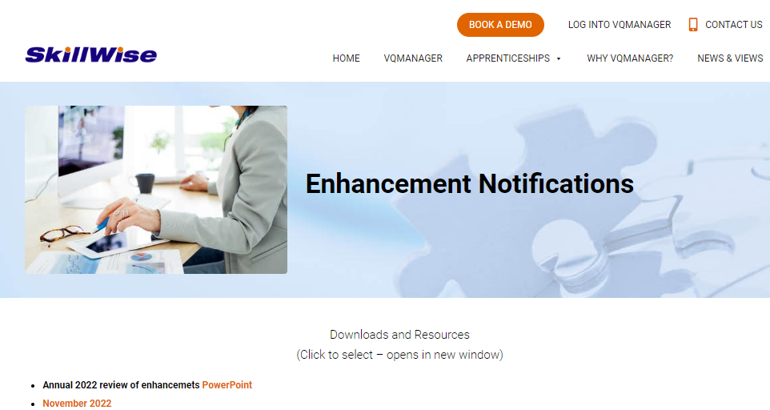
Developments since last year.
I have only included developments from December 2021 to today. I held a webinar early December last year to cover everything developed until that point. The PPT can be found here:

Slide 5
The below developments were released last week
There is a webinar to discuss these updates this Thursday 17th Nov at 10.30am Please let me know if you would like an invite to attend the session
Creating or editing a learner’s date of birth.
'Archiving' Activity Log categories
Adding a report builder to create bespoke reports in VQM
Notification to learner, assessor and employer when OTJ isn't progressing

Slide 6
Today’s Discussion
We are not taking any new suggestions today, but here are the ideas we would like to discuss with you and then ask for your votes at the end of the session:

Slide 7

Create a page on Facebook for learners to direct message SkillWise to give feedback/suggestions and share experiences
S College

Slide 8

Create a messaging system built into VQM which allows assessors and learners to correspond either on a 1:1 basis or as a group/cohort.
K

Slide 9
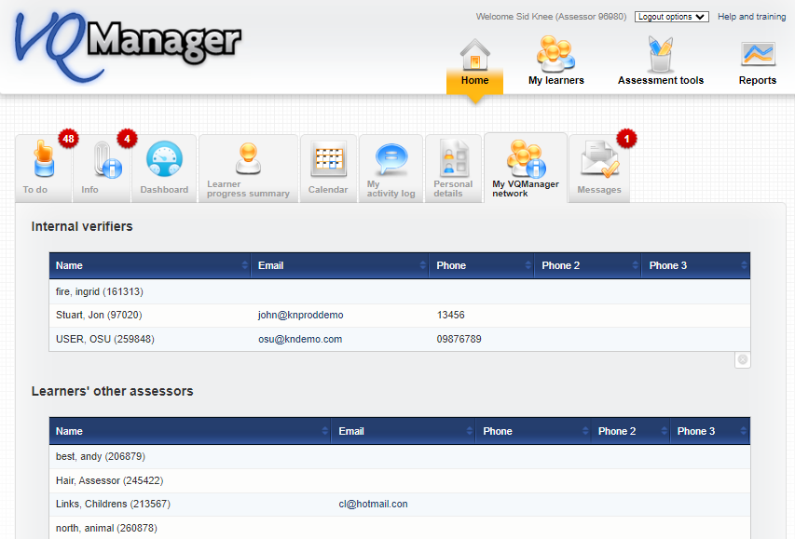
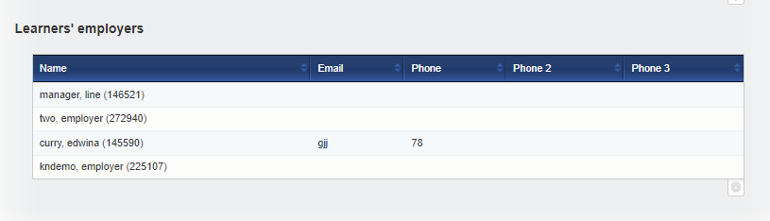
Expand My VQManager network tab for assessors and IQAs to indicate who is associated with who.
Currently just lists people in network but can’t easily see which employer is linked with which learner for example This would be for assessors and IQA

Slide 10
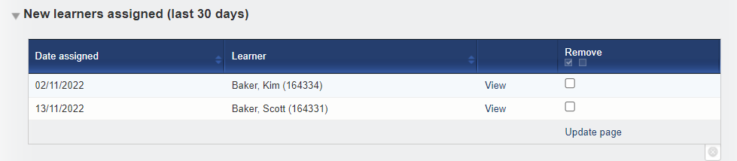
Add an alert for the assessor to let them know a new employer has been associated with one of their learners
Similar to the one below to indicate new learner has been assigned to the assessor

Slide 11
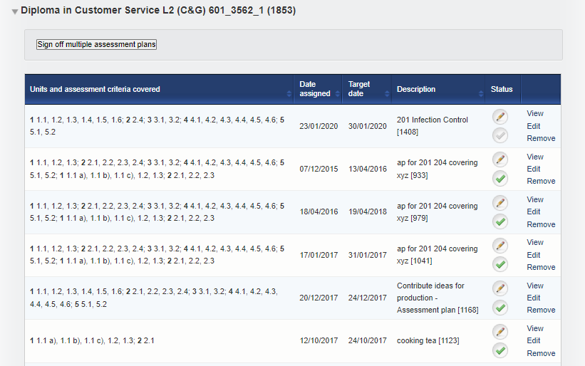
Add a sort arrow to the “Status” column assessment plan table
There is currently a sort arrow for all other columns. Fulfils the need to sort the signed off assessment plans with those still live.
S College

Slide 12
In assessment plan table on Assessment Plan tab add a column for lecturer/assessor name to show who assigned the plan.
Make this information visible in the To Do “Up and coming assessment plans” table too
S College

Slide 13
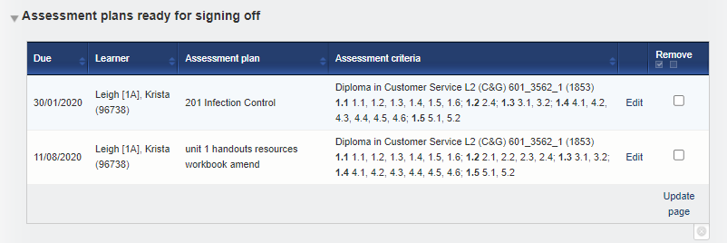
Bulk signing off of assessment plans
You may wish to consider range if this is applicable to your qualifications before you vote for this one.
S and N Colleges

Slide 14
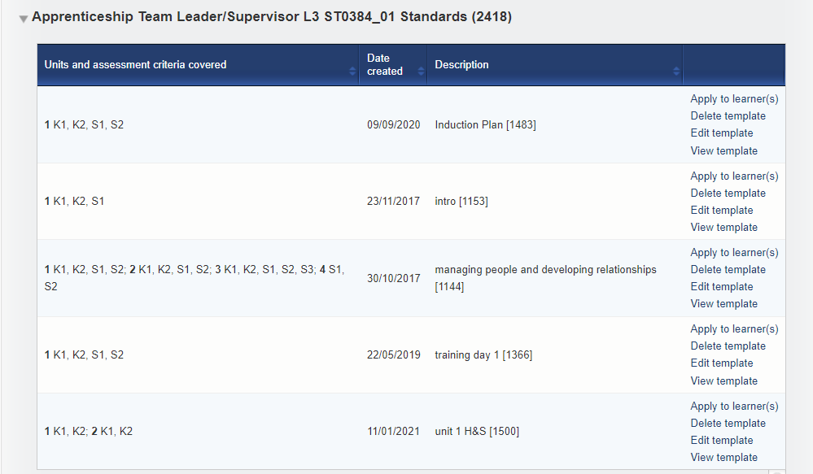
Bulk deleting of assessment plan templates
Need to be sure that no learners are currently using any of the plans due to be deleted. Files attached to these plans will be deleted making the plans incomplete.
K

Slide 15
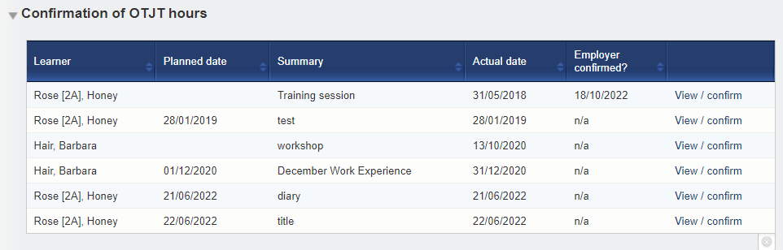
Allow either the employer or the assessor to confirm OTJ hours
Would this work for everyone?
N College

Slide 16
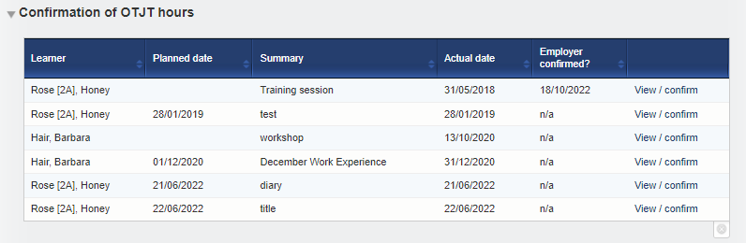
Bulk signing off OTJ entries
Do you need to confirm each on separately?
N College

Slide 17
Confirmation of OTJ hours in table in To Do tab - add column to indicate how many hours are being claimed in this view
N College

Slide 18

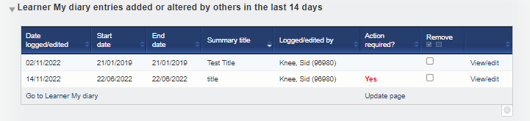
Where an OTJ entry has been added by the assessor, add a box for learners to confirm that they agree with the Off-The-Job hours for that entry.
We have been advised that although it is not stated in the funding guidance this is coming up in Audit and Ofsted sessions – learners need to confirm the hours.
We already have this for action and comments:
S Part

Slide 19
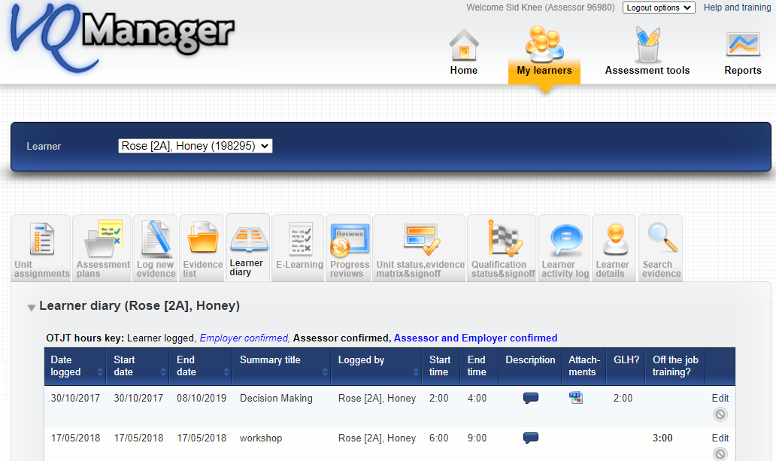
Add a summary box of OTJ hours needed/hours achieved on the tab under the table – Activity Log and Diary tabs
Similar to this summary box
N College

Slide 20
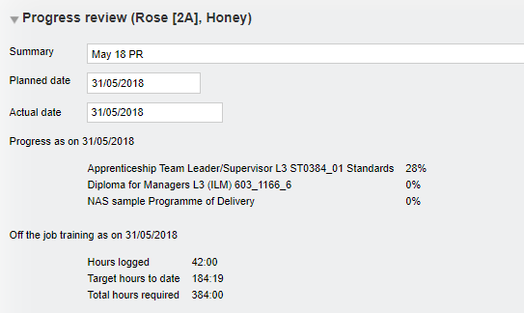
See current progress on the Progress Review tab so when you are creating a new progress review this is visible.
This information is visible after you have saved the review when you open that review but would be helpful to see it beforehand too.

Slide 21

When a progress review is generated – add to the info displayed, be able to see the % progress against actual %
Both OTJ and qualification?

Slide 22
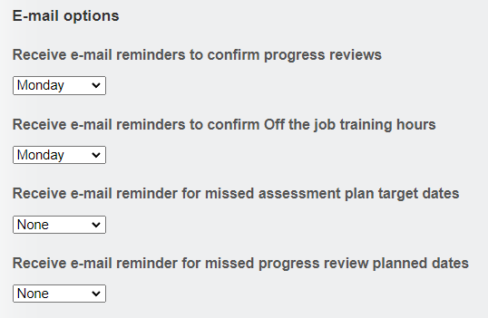
Add email notification for employers in Personal Details to advise of up and coming progress review.
We already have this, should this be an Info notification?

Slide 23
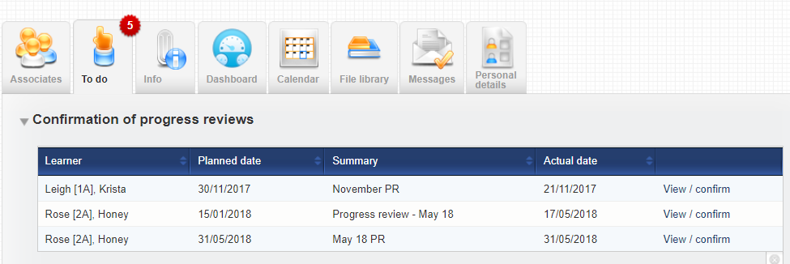
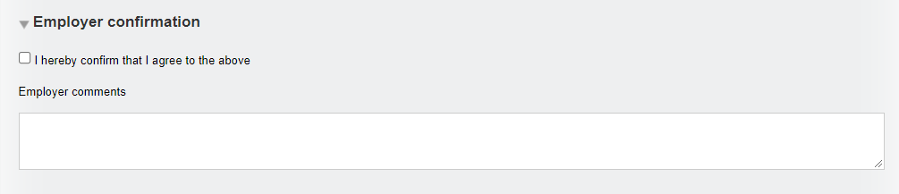
Allow employer to upload files to progress reviews Currently can only do this:

Slide 24


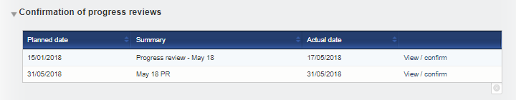
Add a default setting in Progress Review tab to auto-tick learner’s confirmation and contribution

Slide 25
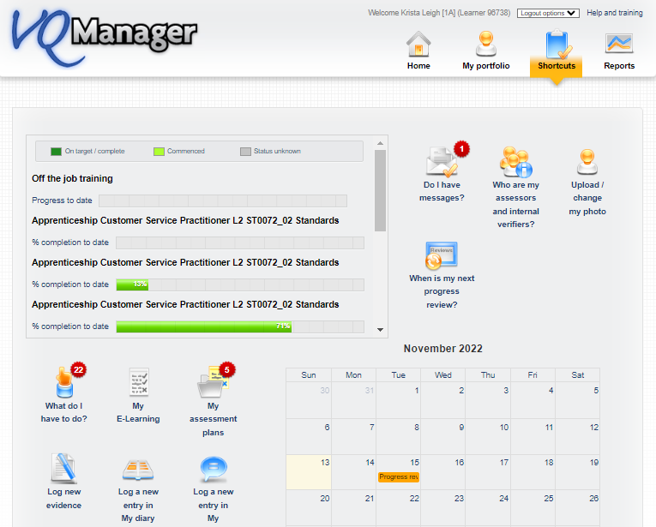
Create Shortcuts page for the assessor
(employer in next block of development)

Slide 26
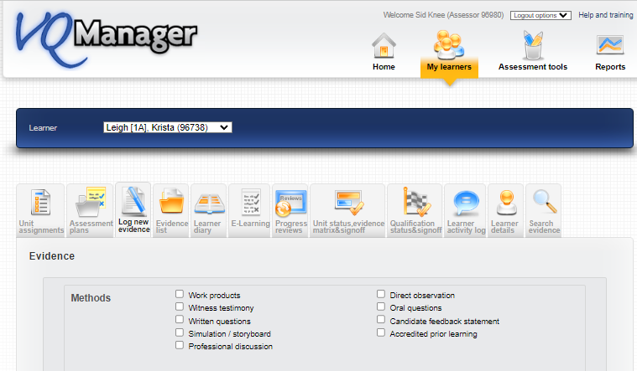

Allow bulk assigning of a piece of evidence to several learners

Slide 27
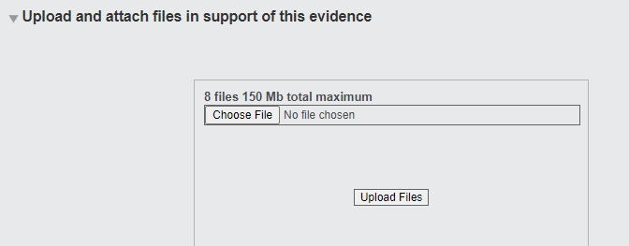
Increase file upload number – VQM with currently accept 8 at a time.
The maximum file size 150Mb will stay the same
N College

Slide 28
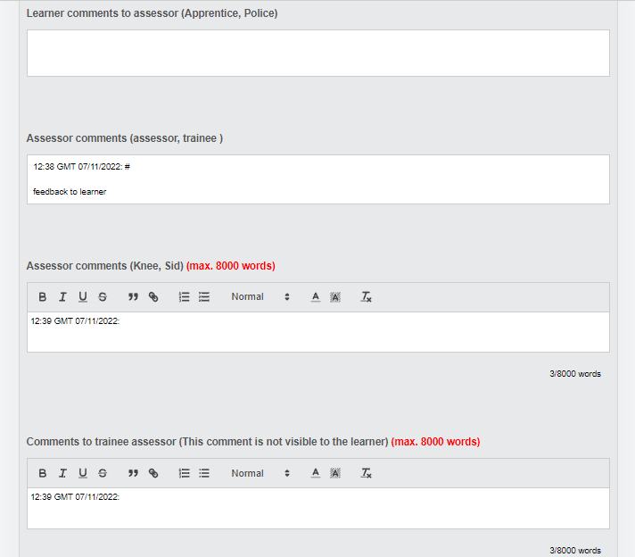
Add function to allow trainee assessors to comment to their countersigner without the learner seeing this.
The qualified assessor can already privately comment on feedback to the trainee assessor
This development is about the trainee responding without the learner seeing.
P S

Slide 29
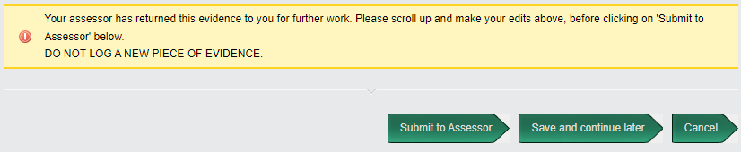
Add the option of sending evidence to a witness from the assessor role or perhaps be able to return the evidence to learner to submit to witness, if the learner doesn’t do this on first submission.
Kis

Slide 30
New report to show, for each unit, if any piece of evidence has been returned to the learner at any stage
It is just the unit marked to say that some evidence was referred so that their EQA can select a sample that includes a mix of units with evidence that were passed first time and units with evidence that were returned at any point.
Kis

Slide 31
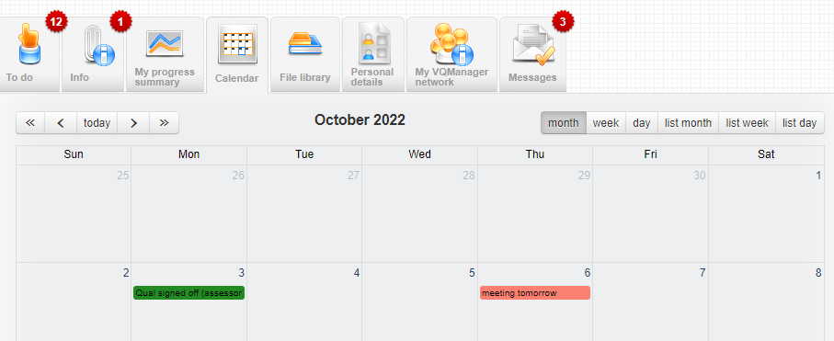
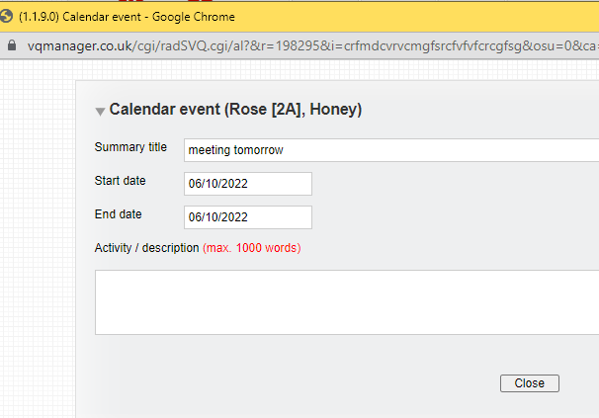
Allow learner to edit calendar entry created by someone else – with audit trail of edits
Learners can currently create an event themselves but not edit others. So are system generated and they will remain un-editable
S College

Slide 32
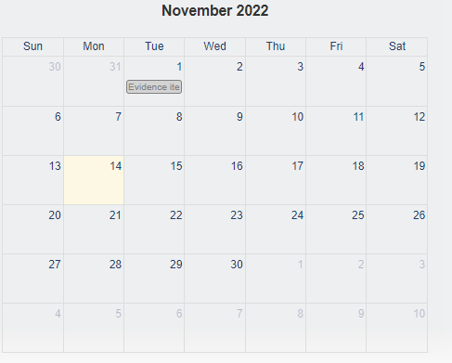

Add learner notification for new calendar entries.
Is this email or To do? (In shortcuts calendar shows 6 week view)

Slide 33
Learner’s Calendar, tasks some tasks to be sent to their employer via email – Outlook
If this isn’t possible, notification via email and also To Do tab – what do you want notifications of PR AP, anything else?
K

Slide 34
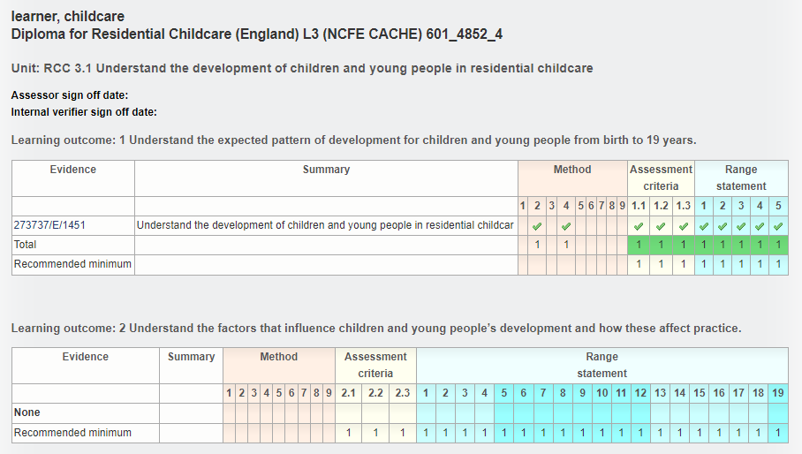
Show how many Range items need to be hit in Evidence Matrix view
C Mar

Slide 35
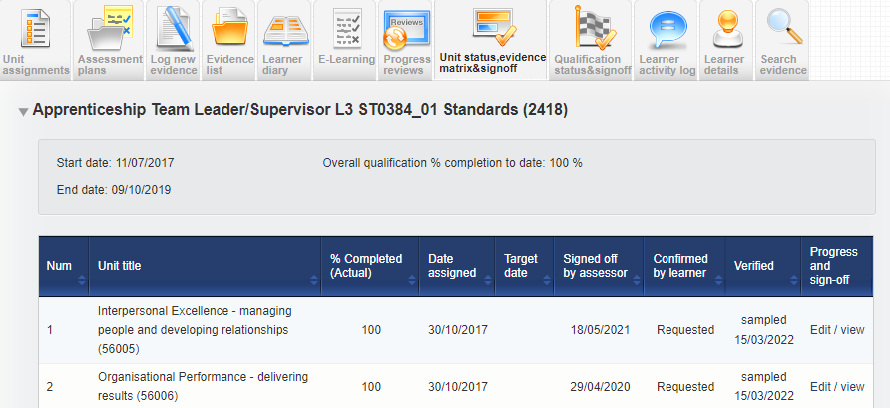
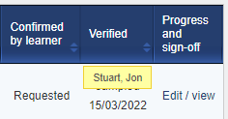
On Unit status matrix & sign off page, add a new column for “Unit sampled details” rather than in the same column as “Unit sign off”.
What details are required? Feedback or who signed off or date. Space may again be an issue
P S

Slide 36
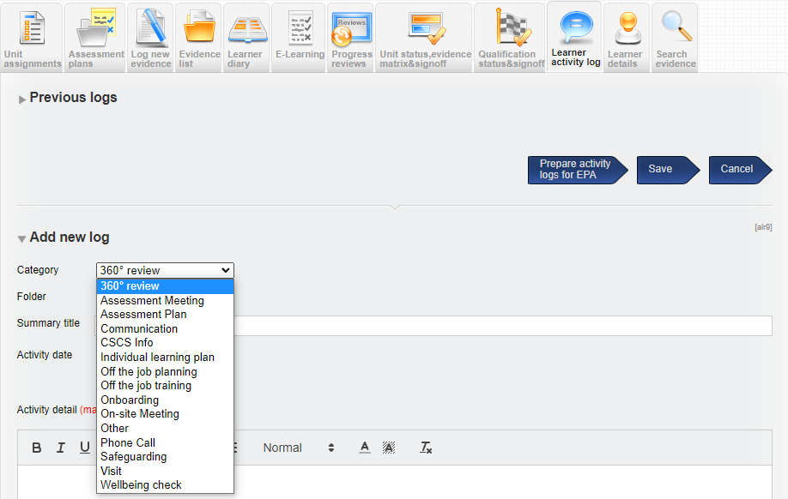
Add Activity Log to Employer role
What might you use it for? Adding OTJ for example?
B Sky

Slide 37
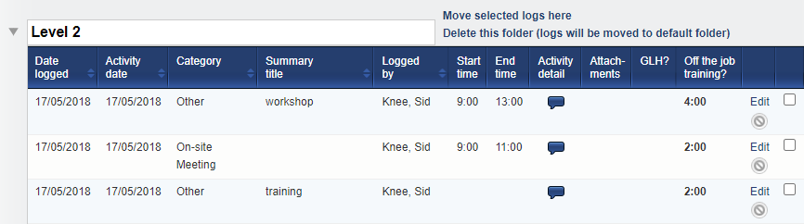
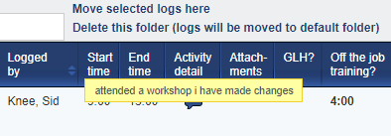
Add “Comments” column and then add hover over on the Learner Activity Log to make it easier to read the comments without having to open the entry.
Assessor OTJ Comments are not in the table already – so is a twostep development - may be tricky width space available.
P S

Slide 38

Change font colour and boldness in key for Activity Log and Diary
Not distinct enough especially the black bold and not bold
N College

Slide 39
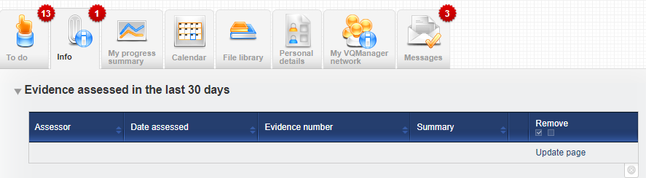
Create notification in Info tab for assessor for any evidence IQA’d in last 30 days
Similar to this one for learners
K

Slide 40
When feedback added to a learner’s piece of work by the assessor, for this to be listed on the learner’s To Do tab, requesting a read and comment
(in the same way IQA feedback report goes to tutors)
Currently a notification appears in Info tab – add a tick in that table rather than keeping evidence in the workflow holding it up?
K

Slide 41
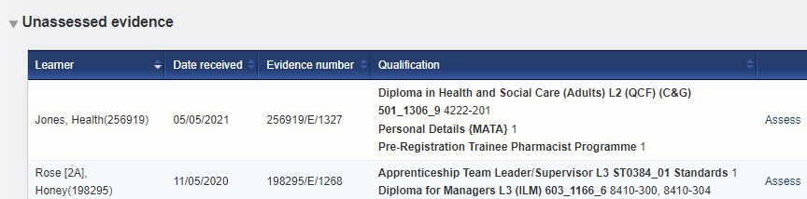
Show evidence description instead of qualification name in To Do list tables – this change would involve replacing qualification name and criteria met
There is very little space so this development would be a substitution of one thing for the other – can we have a show of hands which is the most important info.

Slide 42
Allow evidence to be deleted by the assessor from the “Unassessed evidence” table on the To Do tab
May still need a pop up – “are you absolutely sure” – as there may be a higher instance of accidental deletions which CANNOT be retrieved if implemented
N College

Slide 43
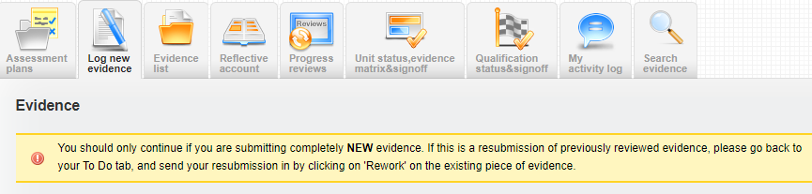
Improve wording around the button on the Diary tab regarding “save and create evidence” button at the bottom.
Perhaps add a pop-up “are you sure you want to save and create evidence”?
Add a new warning on the page when through to Log new evidence saying “are you sure you want to create evidence? If not scroll to the bottom and select cancel
This is an existing one many clients already use – if could be adapted to incorporate the diary issue if this is a problem for your organisation
N College

Slide 44
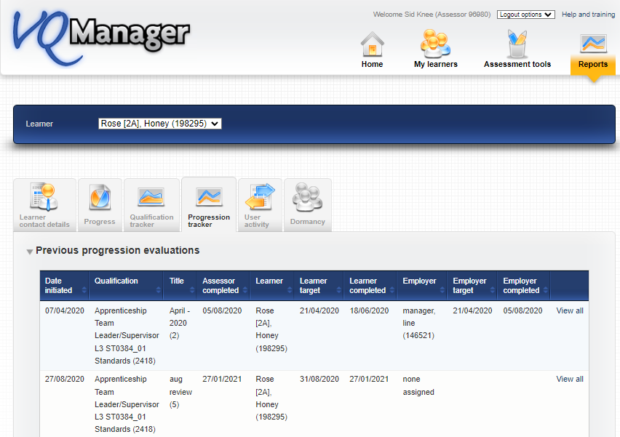
A skills scan embedded in to a tab, which allows for a mix of types of questions, similar to MS Forms, which can cover both KSBs for the programme and wider skills – do more than the existing Progression Tracker function
Still 1-10 ratings? Or something else? The progression tracker is limited to one qual.
K

Slide 45
Personal Development Plan in a new tab - similar to the Progress Review tab - populated with development needs rather than evidence against the qualification
K

Slide 46
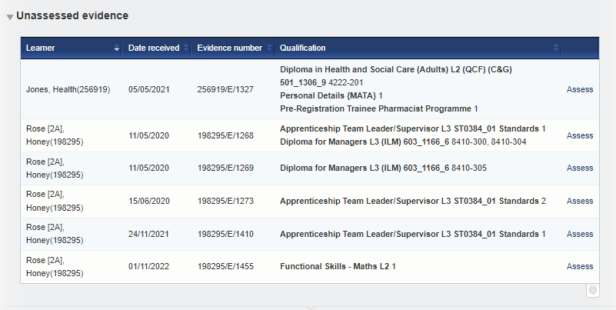
Be able to separate lecturers/tutors from assessors so learners submit work to one or the other.
Temporary work around - initials of appropriate person in title of evidence or assessment plan
S College

Slide 47

Add the extra filter option to the top of pages e.g. cohort. To allow better filtering of many learners assigned to the assessor
Cohort is just an example of the naming of that extra filter.
N College

Slide 48
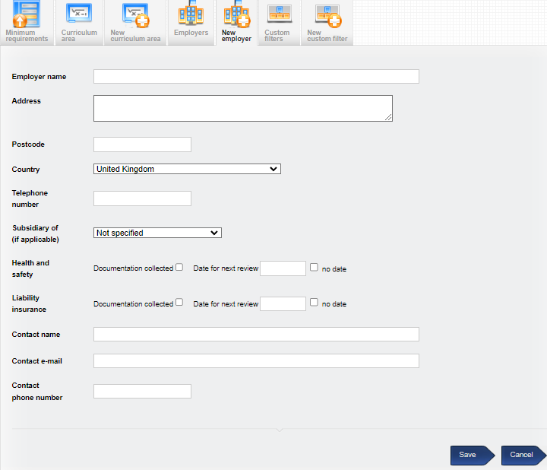
Add a Notes section to the Employer page for Centre Admin
Do you need to upload any documents?
W Training

Slide 49
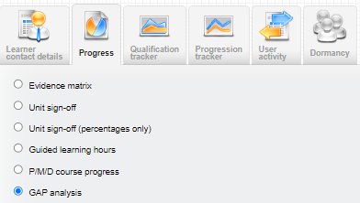
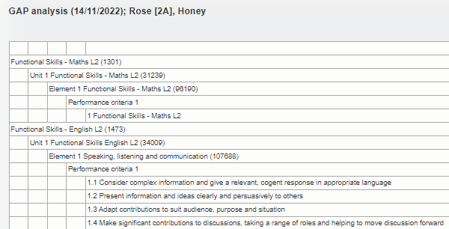
On Gap Analysis report – click “All” so all criteria for the whole qualification can be displayed (as opposed to just the gaps)- for all units selected.
Is this another report - i.e. all criteria rather than a gap analysis or is it all criteria and the gaps highlighted in another colour?

Slide 50
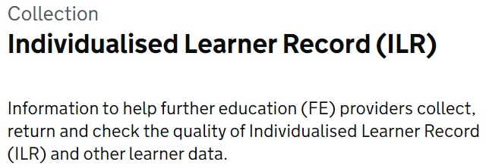
Individualised Learner Record (ILR)
Just to put this into perspective, for us this is a massive development. If this was an absolute must, it is unlikely that we would complete any other UG developments at all next year.
Does anyone have an MIS which integrates with the ILR and looking for VQ to integrate with the MIS We have an API and can chat to you offline regarding this.
H

Slide 51
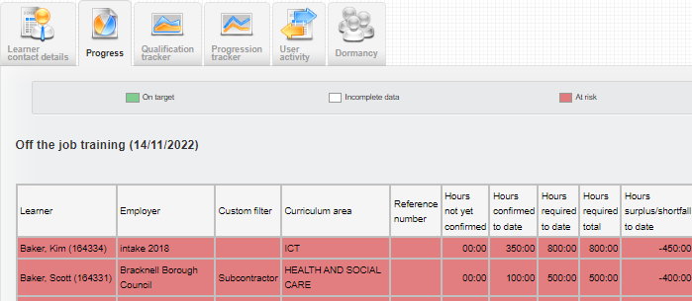
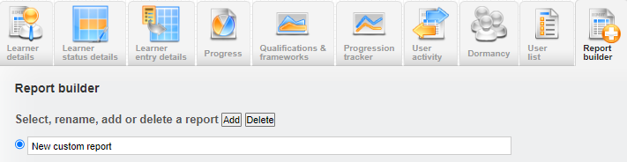
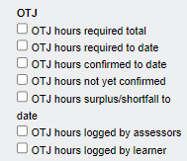
New report tracking what OTJ entries had been confirmed by the employer and the learner in both Diary/Activity Log tabs.
Bespoke?
S Part

Slide 52
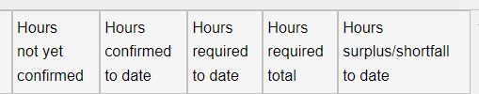
Make titles on OTJT reports consistent
K

Slide 53
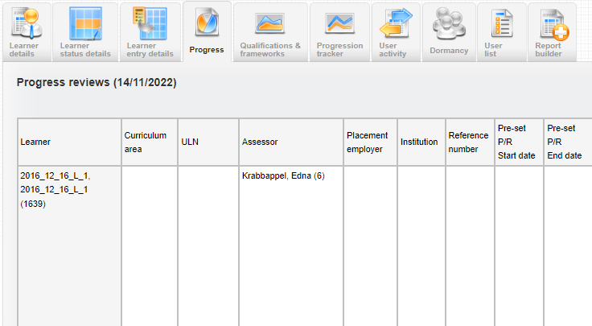

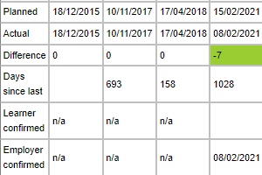
Add to the existing Progress Review report to track who has signed off Progress Reviews.
Currently no hover-over or one particular assessors name
S Part

Slide 54
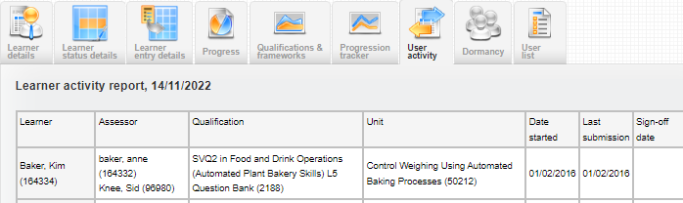
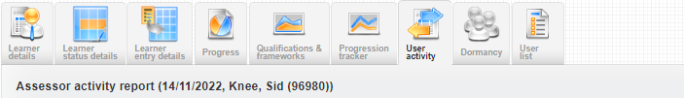
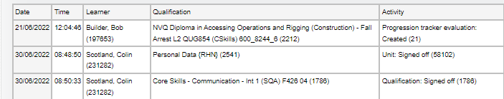
Create a Learner Activity report. The same layout as the Assessor Activity report and available in bespoke reports
Currently have this:
This is the proposal:
B Sky

Slide 55
E-Learning
We are looking at particular interactive technology for the learning content units only – Parcel Wave Fire Safety Awareness
MCQ and SAQ units are not affected at all.
Our dilemma is that e-learning is slowly being rolled out but to invest in this technology we need some commitment of use from you.
Our questions are: will you be using the e-learning in VQManager? Would something like this sway your commitment?

Slide 56
VQManager
Any Questions regarding what you have seen today?

Slide 57
VQManager
All vote now!

Slide 58
VQManager
Thank you
☺

