Slide 1
VQManager
How to involve the employer

Slide 2
VQManager
We see that from both operational and inspection perspectives, involving the Employer with the learner’s journey – and being able to prove that you have involved the Employer – is becoming increasingly important to providers.

Slide 3
VQManager
In this session, we will show you how VQManager enables the Employer to:
Participate in periodic three-way learner progression tracking assessments
Add comments to and sign off learner progress reviews
Confirm and add comments to Off the Job Training hours
View dashboard-style reports showing learner progress, frequency of log-ins, OTJT hours and progress reviews
Confirm qualification sign-off and add comments
Add calendar entries for a learner and share with other learners they are linked to

Slide 4
VQManager
The employer can participate in periodic three-way learner progression tracking assessments
Amongst many other things, Ofsted requires three things from Training Providers:
The need to track progress and show ‘value added’ as the learner works through their qualification.
Evidence that the learner is at the right level for the qualification they are starting for funding purposes
Evidence where the employer is contributing to the learner’s apprenticeship

Slide 5
VQManager
The Progression Tracker function allows learners, assessors and employers to show a ‘rating’ against the criteria for a qualification/standard, to show an initial competence level and also any advancement whilst on programme.
The tab is located in the Reports area and is visible for all users.

Slide 6
VQManager
Evaluations are initiated and completed on an ad hoc basis, with the assessor deciding how many to do and when.

Slide 7
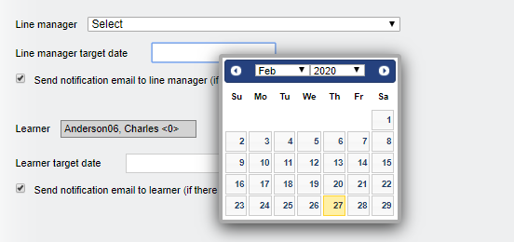
VQManager
The assessor enters a due date in the date field for both the employer and the learner.
A notification via email is automatically sent to the employer and the learner.
This will also post a notification on the target users’ To Do lists. These notifications will show red if the ‘due date’ has passed.

Slide 8
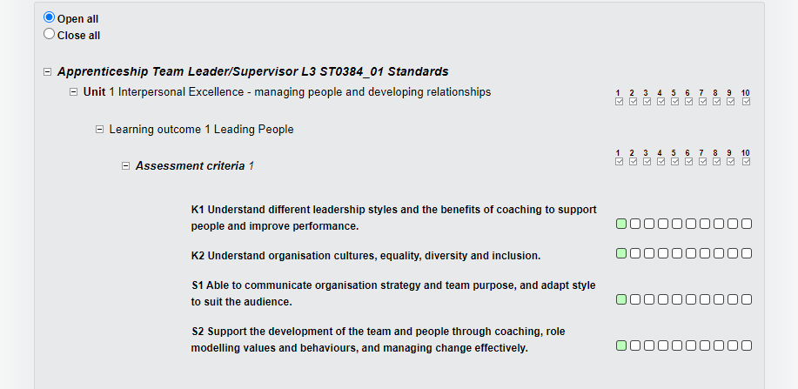
VQManager
When the employer selects the link in their To Do tab, the evaluation opens up displaying a qualification tree which then allows the employer to rate their employee’s competence.

Slide 9
VQManager
They can do this in three ways:
Rate at unit level – by clicking on the level they believe their learner is at – this will then populate the criteria boxes with that number for every criteria within that unit
Rate at learning outcome level - in exactly the same way. Click on the number they believe their learner is at – this will then populate the criteria boxes in that learning outcome with that number
Select a number against each individual criteria This allows more flexibility in terms of assigning a different grade to each criteria

Slide 10
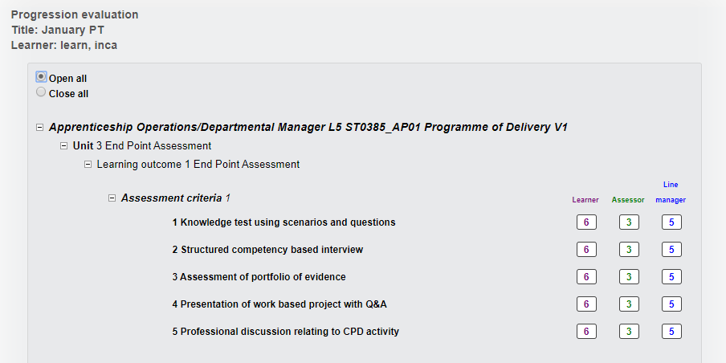
VQManager
Viewing the Progression tracker evaluations when complete by all contributors:

Slide 11
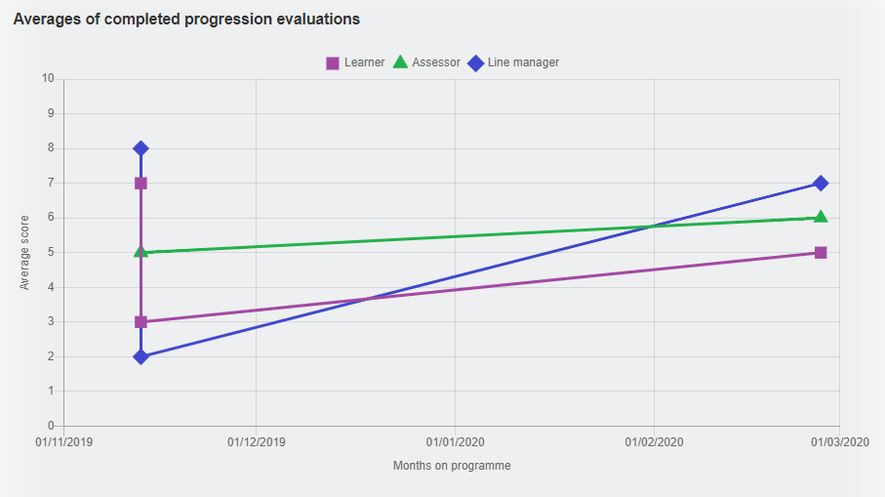
VQManager
The results of the evaluations are also available in a graph format.
This is where you can clearly evidence the data for Ofsted, start point, progress whilst on programme.
The different colours represent the different contributors.

Slide 12
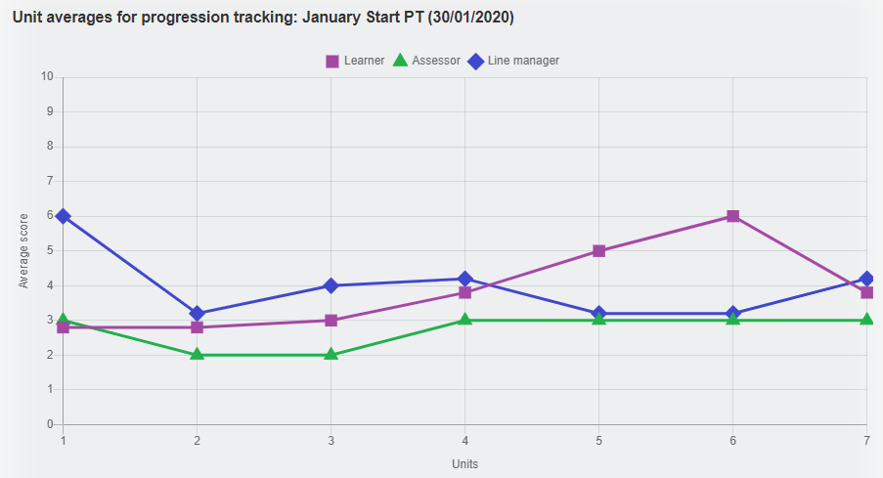
VQManager
By clicking on the individual data points in the graph, it is possible to drill down further and see the results of a single evaluation as a graph, again with separate coloured lines for learner, assessor and employer:

Slide 13
VQManager
The employer can contribute to and sign off learner progress reviews

Slide 14
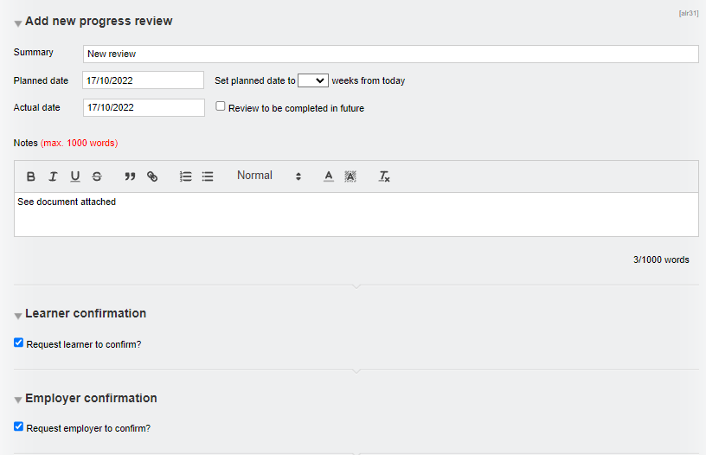
VQManager
When a Progress Review is completed by the assessor, the assessor can request that both the learner and the employer read and confirm the review and also add comments.

Slide 15
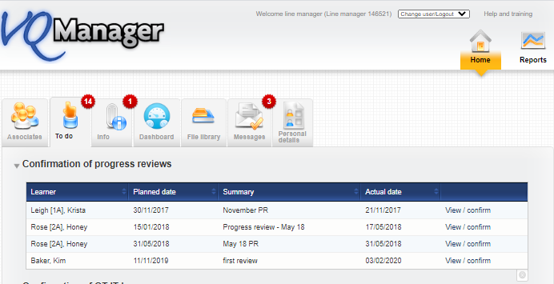
VQManager
On the To Do tab in the Home area this lists all of the progress reviews that the employers needs to confirm for their learners. The overdue ones will appear in red.

Slide 16
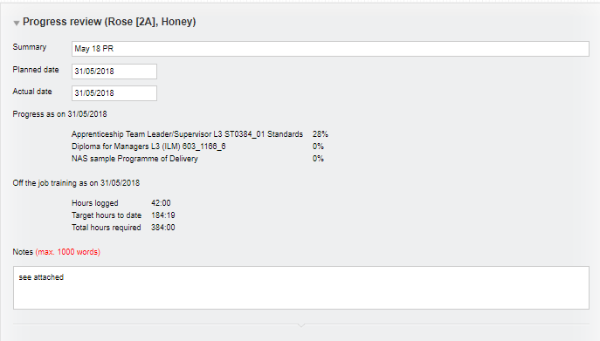
VQManager
The employer selects the hyperlink on the right View/confirm to open the review, read it and add their comments.

Slide 17
VQManager
The employer can confirm and add comments to Off the Job Training hours (OTJT)

Slide 18
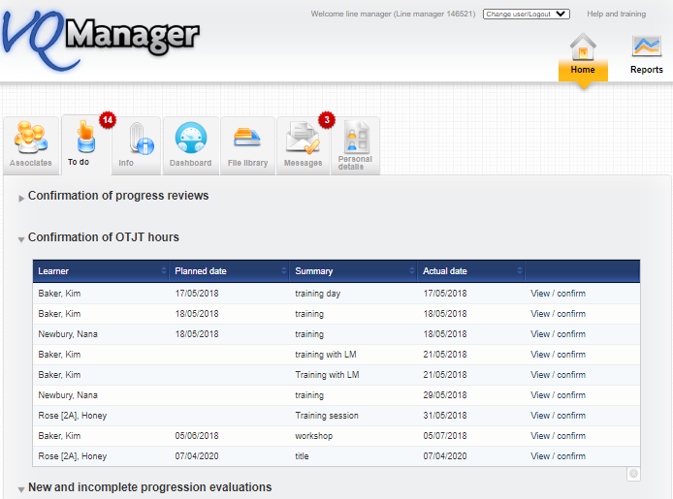
VQManager
The employer may be asked to confirm off the job hours that the learner is claiming to have completed. If asked to do so, the employer will receive an email notification and a To Do tab notification in VQManager to view and confirm these hours.
Click on the View/confirm hyperlink to open up the entry.

Slide 19
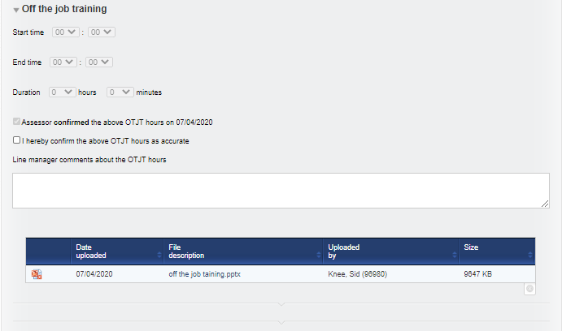
VQManager
The OTJ hours may have been added to either the Diary – see below:

Slide 20
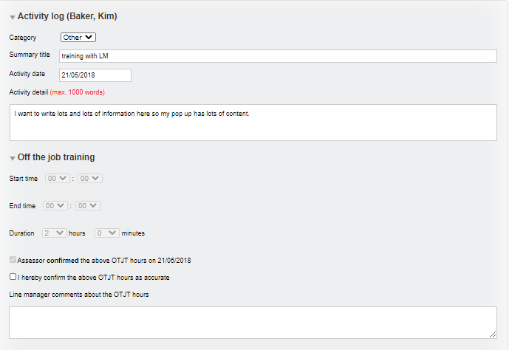
VQManager
Or to the Activity log – see below:

Slide 21
VQManager
The employer can view dashboard-style reports showing:
Learner progress
Frequency of log-ins
OTJT hours
Progress reviews

Slide 22
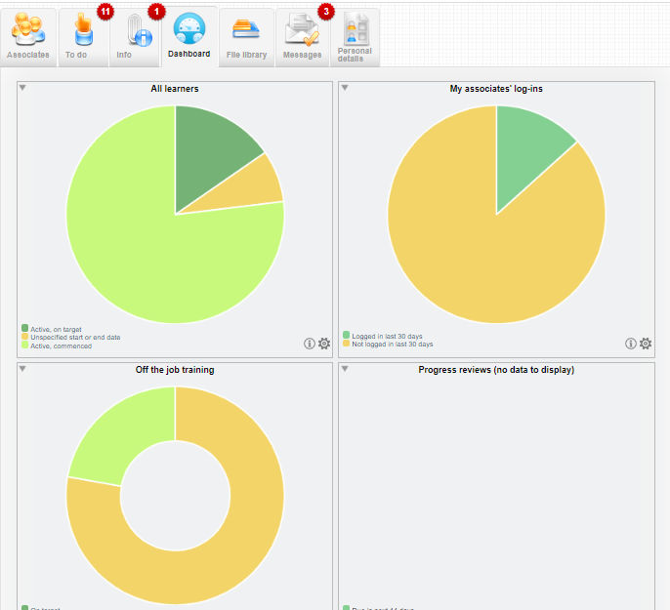
The employer can click in the light or dark green or amber areas to report on those learners.

Slide 23
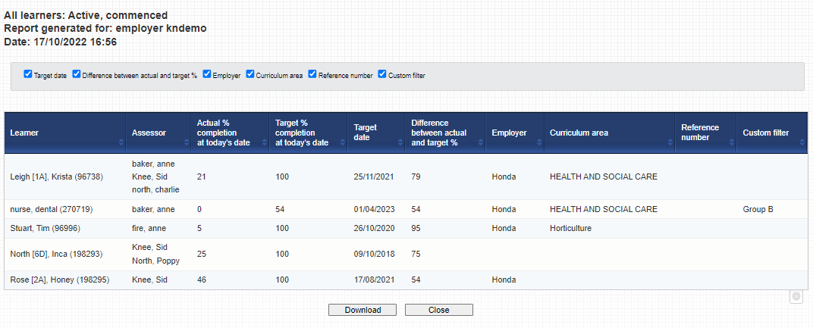
The employer can click in the light (commenced) or dark green (on target) or amber areas (not yet started) to report on just those learners.

Slide 24
The employer can click in the white area and they will see all of their learners.

Slide 25
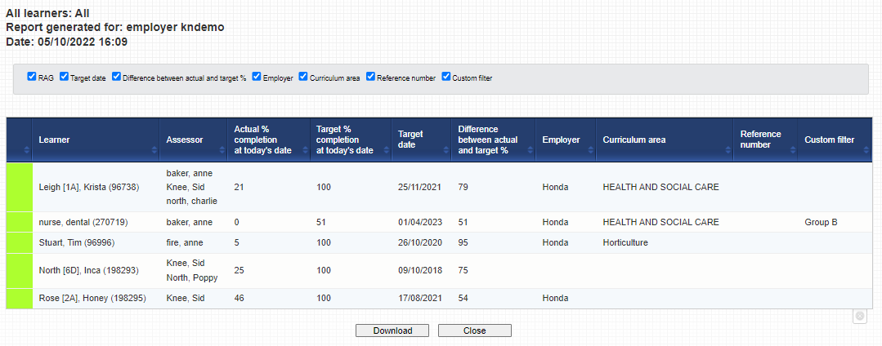
Click in the white area and the employer will see progress for all of their learners.

Slide 26
VQManager
The employer can confirm qualification sign-off and add comments

Slide 27
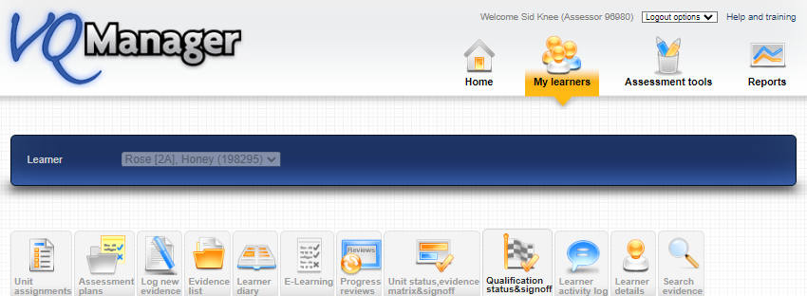
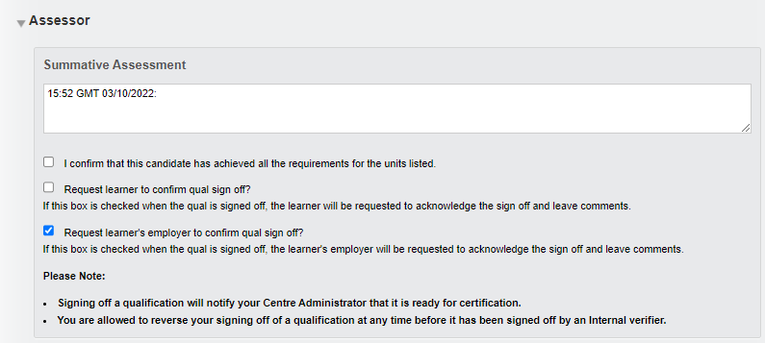
VQManager
When signing off a qualification, the assessor can elect not only for the learner to add comments, but for the employer too

Slide 28
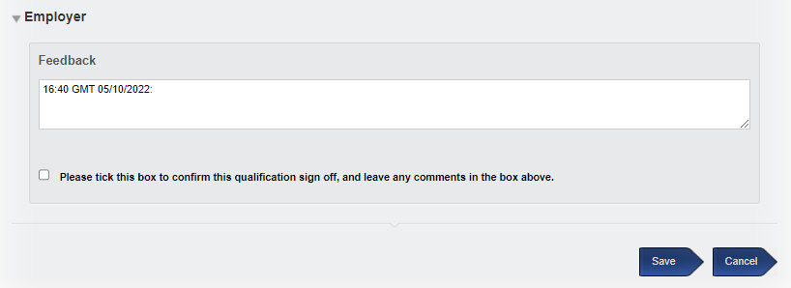
VQManager
The employer will get a notification in the To Do tab to open the Qualification sign off page and confirm with a tick and add comments.

Slide 29
VQManager
The employer can add calendar entries for a learner and share with other learners they are linked to

Slide 30
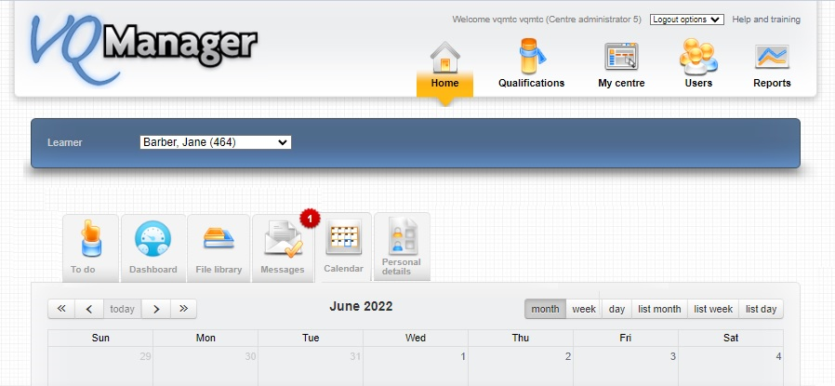
VQManager
The learner’s Calendar tab is located in Home for the employer

Slide 31
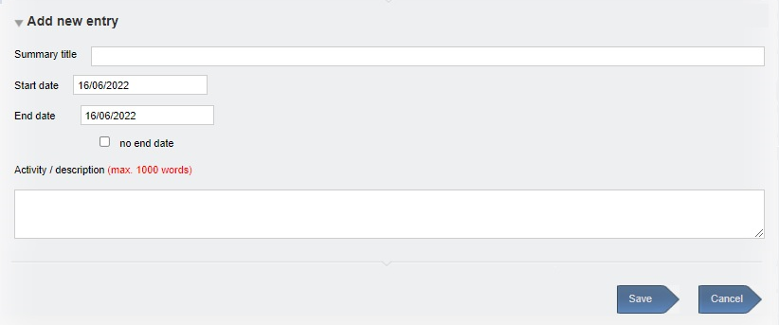
VQManager
New entries will have a title, a start date, an end date (optional), and a description (optional).

Slide 32
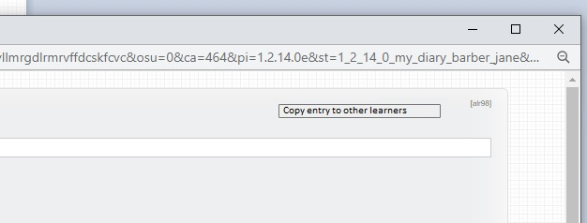
VQManager
The employer can copy the entry to other learners via the link and copy it to copy other learners they are supervising.

Slide 33
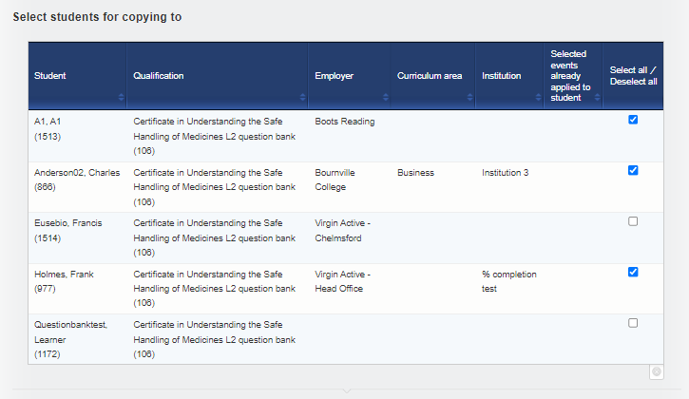
VQManager
They select the learner(s) to copy to, and click the ‘copy’ arrow at the bottom of the page:
When the page refreshes the event has been copied to the other learners.

Slide 34
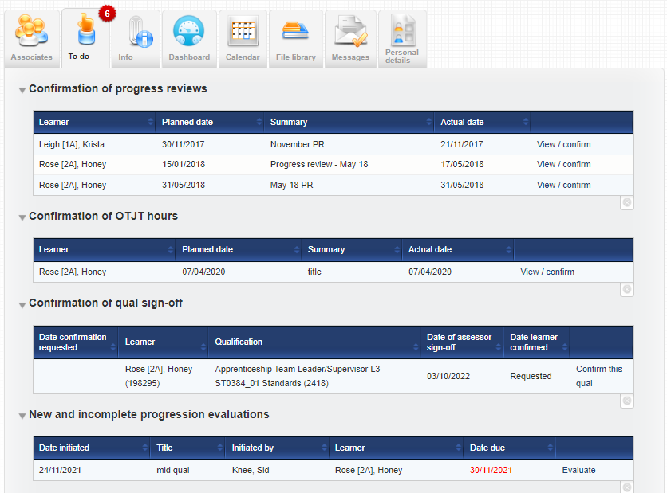
VQManager
What my employer’s To Do tab may look like

Slide 35
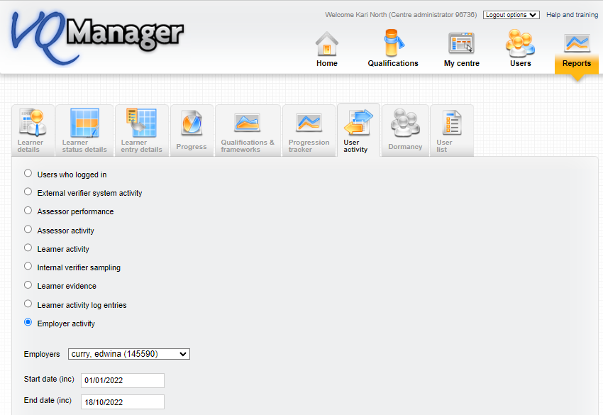
VQManager
What activity has my employer completed in VQManager?

Slide 36
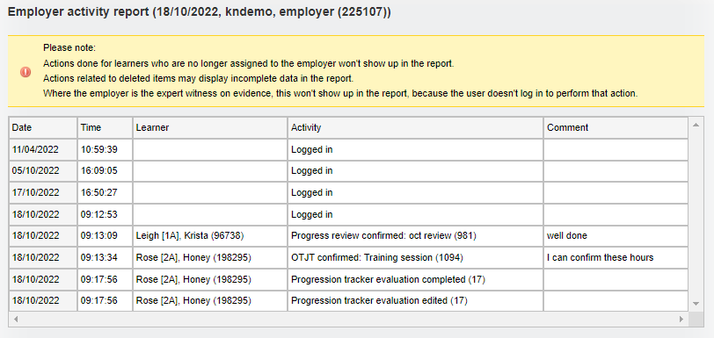
VQManager
What activity has my employer completed in VQManager?

Slide 37
VQManager
Reminder about the location of Support:

Slide 38
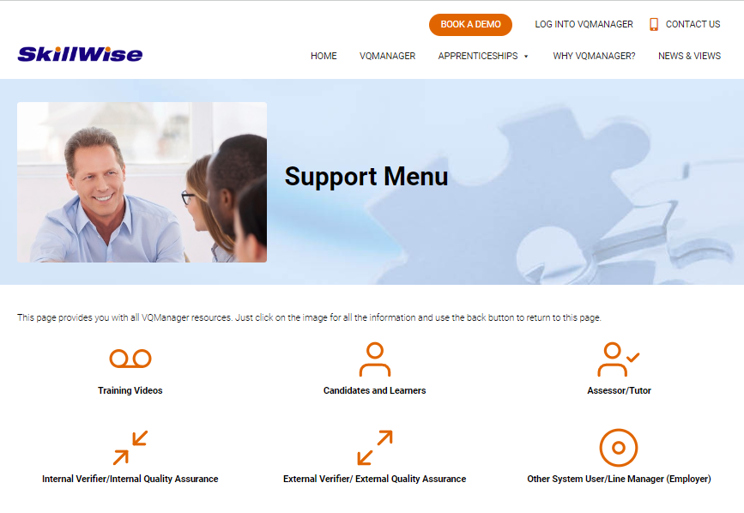
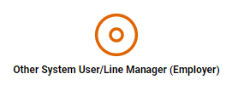
VQManager
Select support for employers:

Slide 39
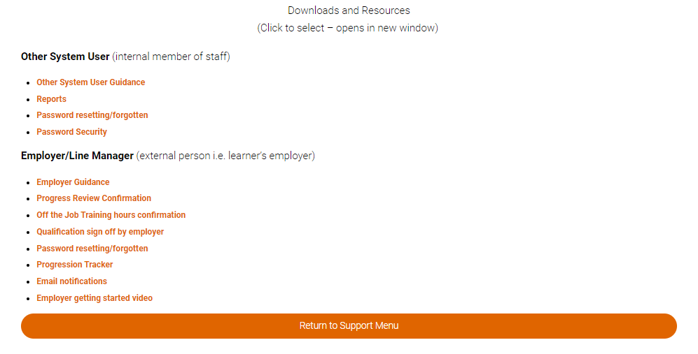
VQManager

