Slide 1
VQManager
VQManager May 2022 Enhancement
Webinar

Slide 2
VQManager
This webinar contains information regarding:
Learner shortcuts page
Adding learner photo
Making the title of the Off the Job Hours function editable
Adding notification to learners when a Diary entry needs action
Adding fields to the Employer area, and viewing these in the Learner details tab

Slide 3
VQManager
Learner Shortcuts page
To make navigation easier for the learners, we have added a new tab to allow learners to view all the most important information on the one tab, Shortcuts. From there, the different links will take the learner to the different tabs.
The Shortcuts page will be available for all learners, but if you wish, we can set your centre so this is the first page they see when logging in. Please contact us with the date you’d like the change and we will implement this for you. This will help limit confusion should you wish to communicate this change to your learners prior to us making the adjustment.

Slide 4
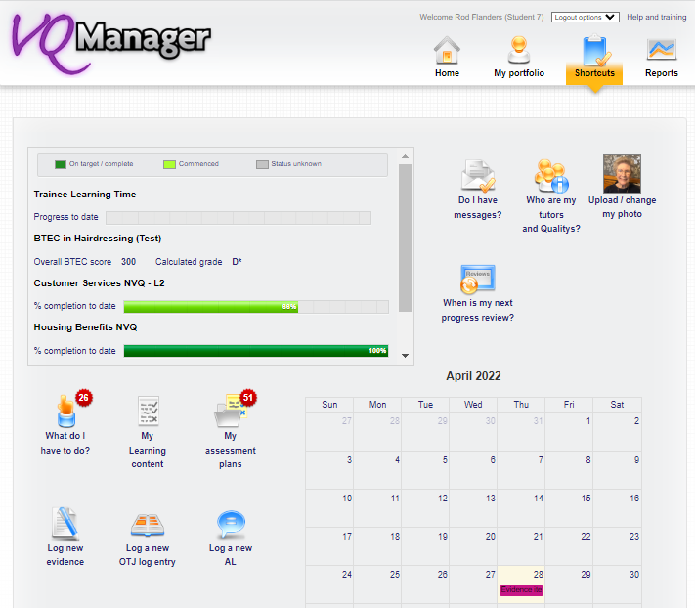
VQManager
Learner Shortcuts page

Slide 5
VQManager
Learner shortcuts page
Progress against qualifications/standards can be viewed top left. Where several qualifications and Standards may be assigned to the learner, the grey scroll bar on the right allows the learner to view all progress. If applicable, OTJ hours are also visible – in this example above, it has been renamed Trainee learning time. (See our development later –should you too wish to change the Off the Job Hours title in your centre). Click on the image and the learner is taken to the My progress summary tab.

Slide 6
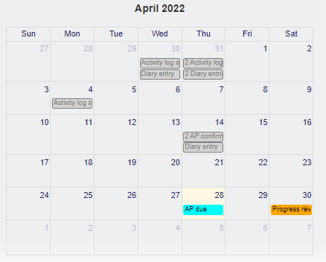
VQManager
Learner shortcuts page
Bottom right has the calendar and shows any activity which has been undertaken in the current month, as well as the dates of scheduled Progress reviews, Assessment plan target dates and unit target dates. These last 3 are shown in colour, to highlight them. Click on the image and the learner is taken to the Calendar tab.

Slide 7
VQManager
Learner shortcuts page
Top right is the option to add a photograph. (See next development for details on how this works.)
When the learner has a photo attached to their profile, a thumbnail of that will show here, as illustrated below.

Slide 8
VQManager
Learner shortcuts page
Alongside the calendar, these following links will always be visible:
Takes the learner to the Messages tab
Takes the learner to the My VQManager network tab

Slide 9
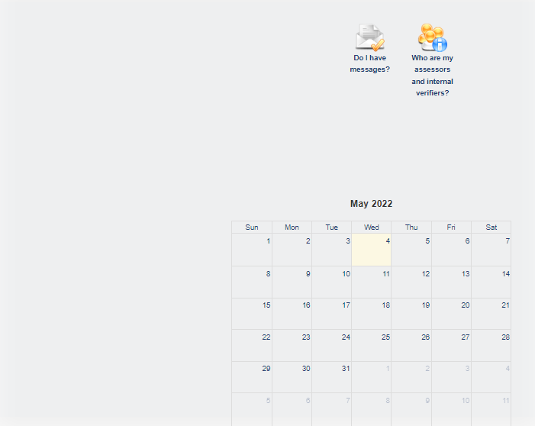
VQManager
Learner shortcuts page
This is an example of the minimum details which will be displayed when no other functionality is switched on.

Slide 10
VQManager
Learner shortcuts page
All other links only show if you currently have them switched on in your centre set up. If you have custom names set up for any of these functions, the Shortcuts page will match that, as well.
Takes the learner to the To do tab
Takes the learner to the Log new evidence tab
Takes the learner to the Progress review tab

Slide 11
VQManager
Learner shortcuts page
Takes the learner to the Learning content tab
Takes the learner to the Assessment plan tab
Takes the learner to the Diary tab
Takes the learner to the Activity Log tab

Slide 12
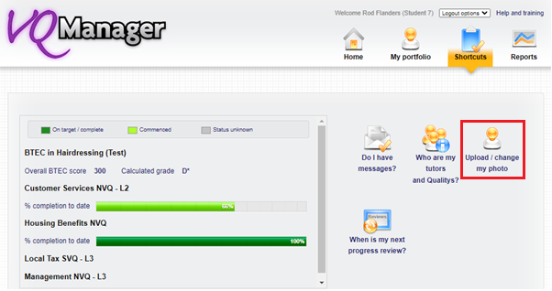
VQManager
Adding learner photo
In addition to the development above, the learner can now upload a photo of themselves.
On the new Shortcuts tab, select Upload/change my photo

Slide 13
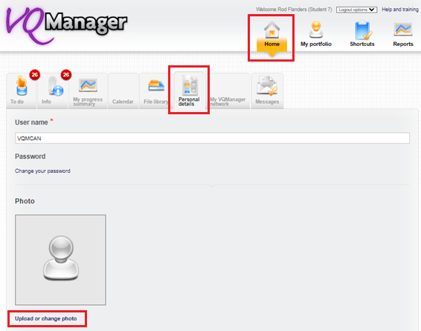
VQManager
Adding learner photo
When the learner selects Upload/change my photo, they are taken to the Personal details tab where the learner can upload a photo of him/herself.
The learner can also click directly on the Personal details tab on the Home menu if they prefer.

Slide 14
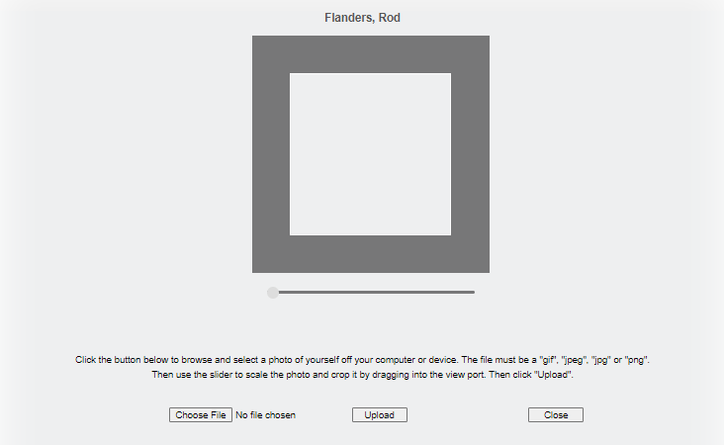
VQManager
Adding learner photo
By selecting Upload or change photo the learner can add a photo from their device in exactly the same way they would add attachments to evidence or attach a document to an email.
S/he will be first need to click on Choose file

Slide 15
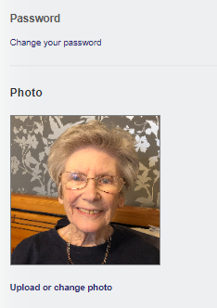
VQManager
Adding learner photo
The image can be resized by dragging the button along the bar underneath, and centred by clicking and dragging the photo. Once the user is happy, they should click on Upload. This will close the pop up and return them to the Personal details page. They will need to scroll down to the bottom of that page and click on Save.
The image can be changed if required.

Slide 16
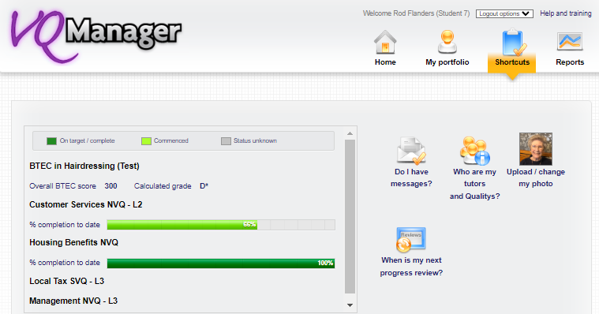
VQManager
Adding learner photo
When you return to the Shortcuts tab, the picture will now be in place of the previous icon.

Slide 17
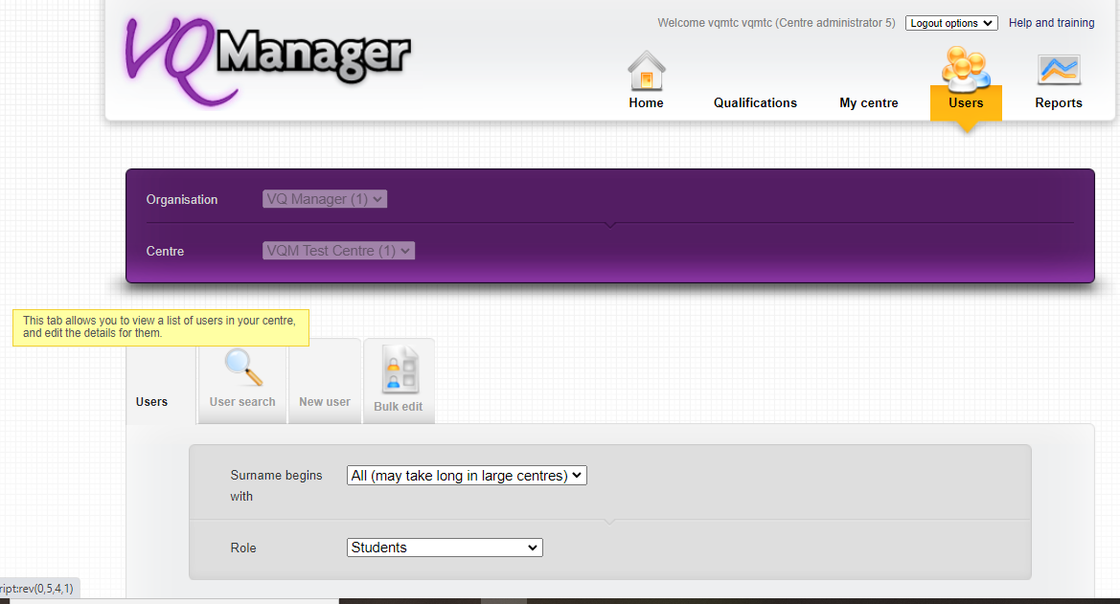
VQManager
Adding learner photo
The Centre Admin is also able to add, remove or change the learner’s picture. This allows flexibility on who does this job, and enables the Centre Admin to remove any inappropriate content quickly if necessary.
For the Centre Admin, the picture is included in the User profile and can be added at the point of creation or edited at a later date.

Slide 18
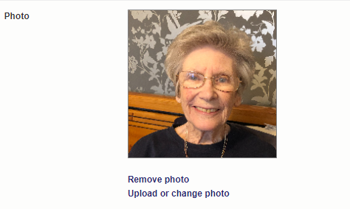
VQManager
Adding learner photo

Slide 19
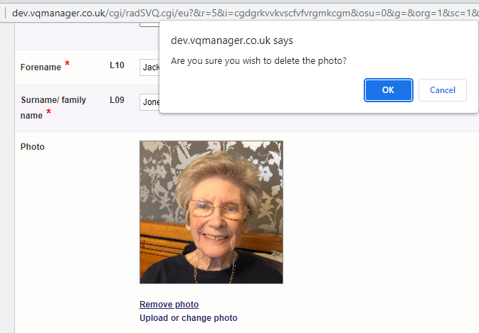
VQManager
Adding learner photo
Below is an example of where the CA has selected Remove photo. A pop up asks for confirmation before removal.

Slide 20
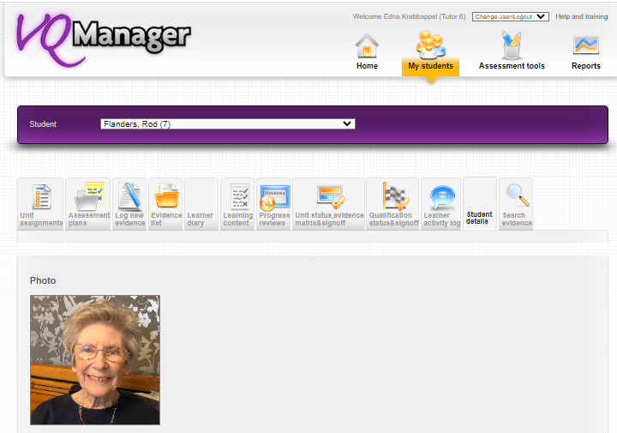
VQManager
Adding learner photo
The photo is visible for the assessor, IQA and EQA in the Learner details tab.
The Employer (line manager) can view the learner photo when viewing the learner’s e-portfolio, if they click on either the Personal details or Shortcuts page.

Slide 21
VQManager
Making the title of the Off the Job Hours function editable
As mentioned above, the title of the Off the job function can now be renamed. The change will apply to the Diary, Activity log, To Do list and Progress Summary, and the names on all the relevant reports too.
Please contact us if you should like this to be renamed at all

Slide 22
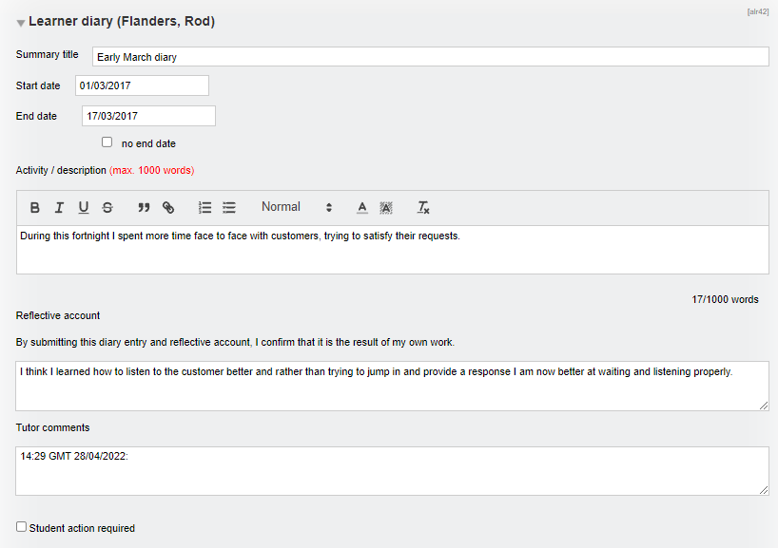
VQManager
Adding a notification to learner when a Diary entry needs action
Currently if a diary entry has been added or edited by someone else, the user receives a notification of this. To make this notification more helpful, especially if action has been highlighted, a new field at the bottom will allow the assessor to notify the learner that action is required.

Slide 23
VQManager
Adding a notification to learner when a Diary entry needs action
The learner will see the usual notification on their To Do list with a new column Action required?
The assessor’s tick will be cleared when the learner edits and saves the item, meaning that the assessor can re-tick ‘action required’ if they are wanting the learner to do subsequent work on the diary entry.

Slide 24
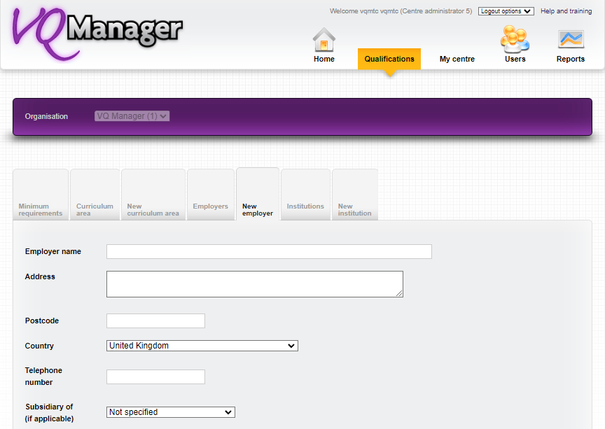
VQManager
Adding fields to the Employer area, and viewing these in Learner details tab
In the New employer tab accessed by either the Org Admin or Centre Admin we have added some additional fields. They can be completed for new employers and also edited for existing employers

Slide 25
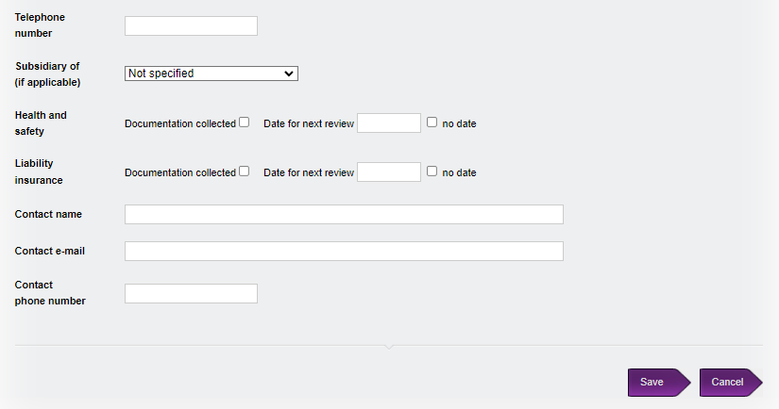
VQManager
Adding fields to the Employer area, and viewing these in Learner details tab
The new fields are:
Health and safety (date can be set for a reminder for review)
Liability Insurance (date can be set for a reminder for review)
Contact name at employer
Contact email at employer
Contact telephone number at employer

Slide 26
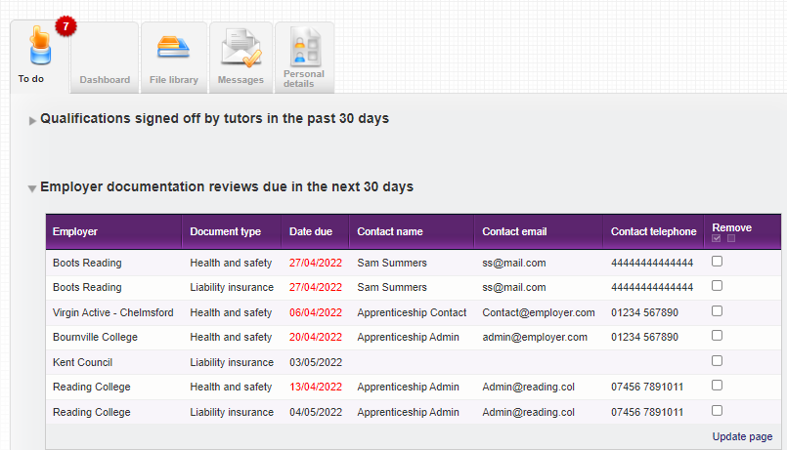
VQManager
Adding fields to the Employer area, and viewing these in Learner details tab
The Centre Admin will receive a reminder on the To Do tab in a new table if either of the Health and safety or Liability Insurance document review is due in the next 30 days. The date will turn red when the reviews become overdue.

Slide 27
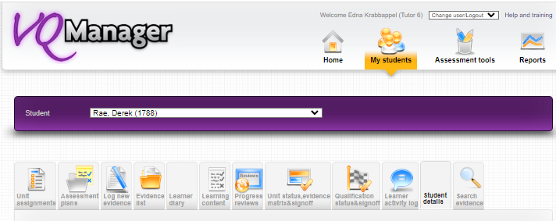
VQManager
Adding fields to the Employer area, and viewing these in Learner details tab
The assessor and also the IQA are able to see this new employer information in the Learner details tab.

Slide 28
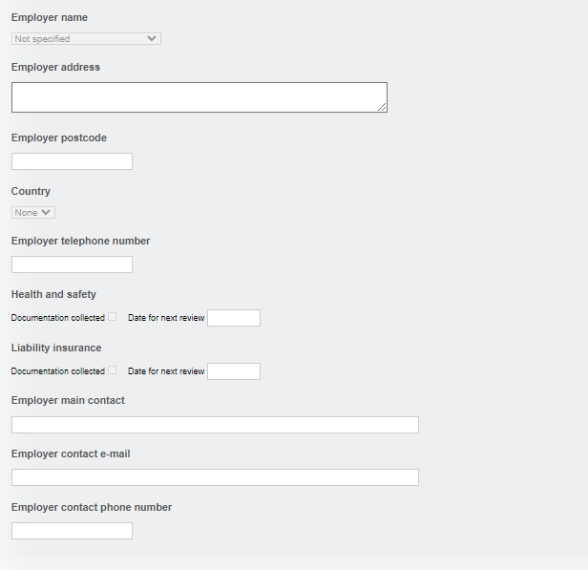
VQManager
Adding fields to the Employer area, and viewing these in Learner details tab

Slide 29
VQManager
All of these enhancements have been automatically added to VQManager for you, with the exception of re-naming the Off the Job Hours function, which will remain as now unless you request a change.

Slide 30
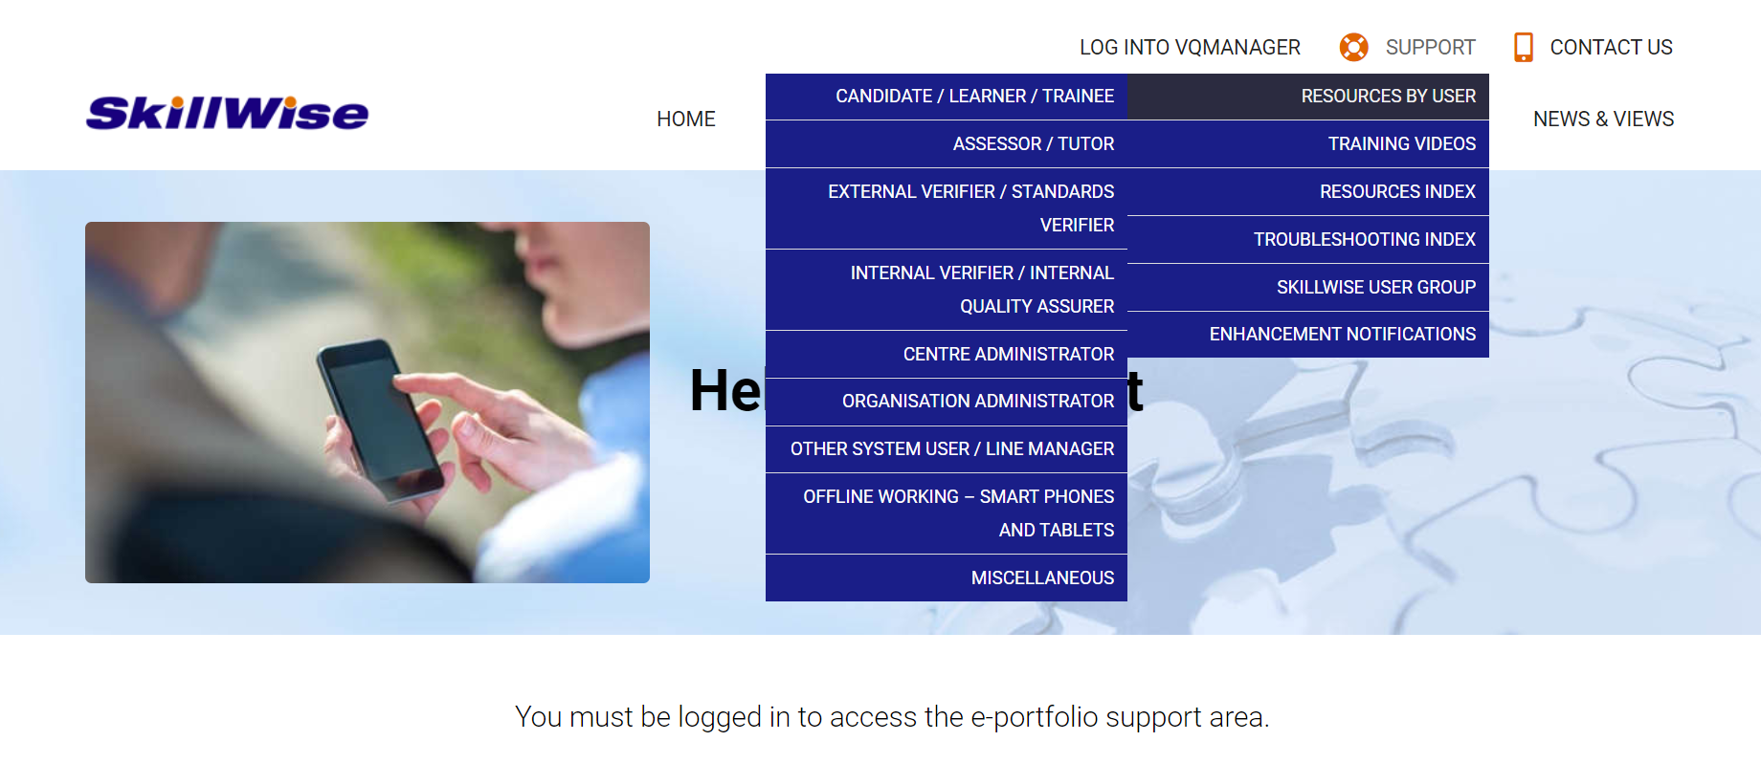
VQManager
www.SkillWise.net/support
We have an extensive support and training area for all users. You will find video and PDF documents to help you use all functionality within VQManager.
The password is solution.
.

Slide 31
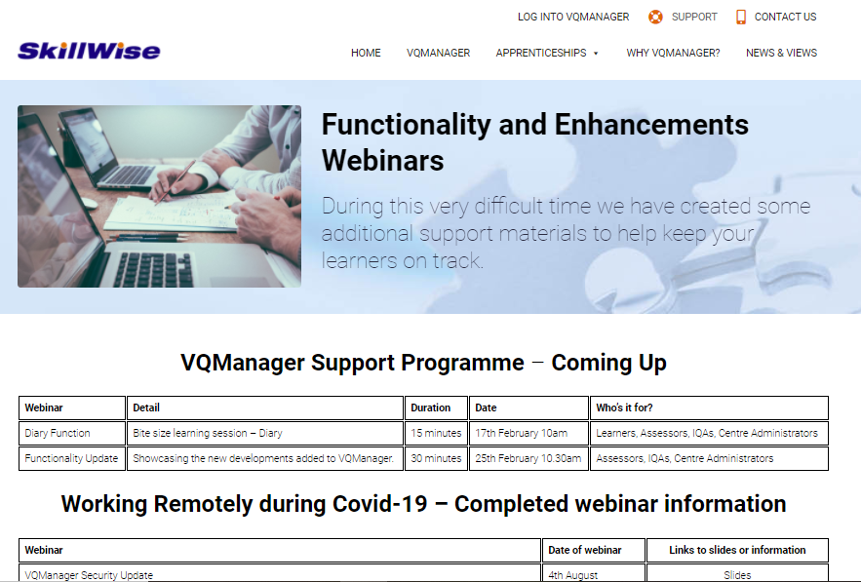
VQManager
www.skillwise.net/support
The page in the support area indicates when we will be holding more webinars to support you.
.
https://www.skillwise.net/support/additional-support/

