Slide 1
VQManager
IV/IQA Sampling Plans

Slide 2
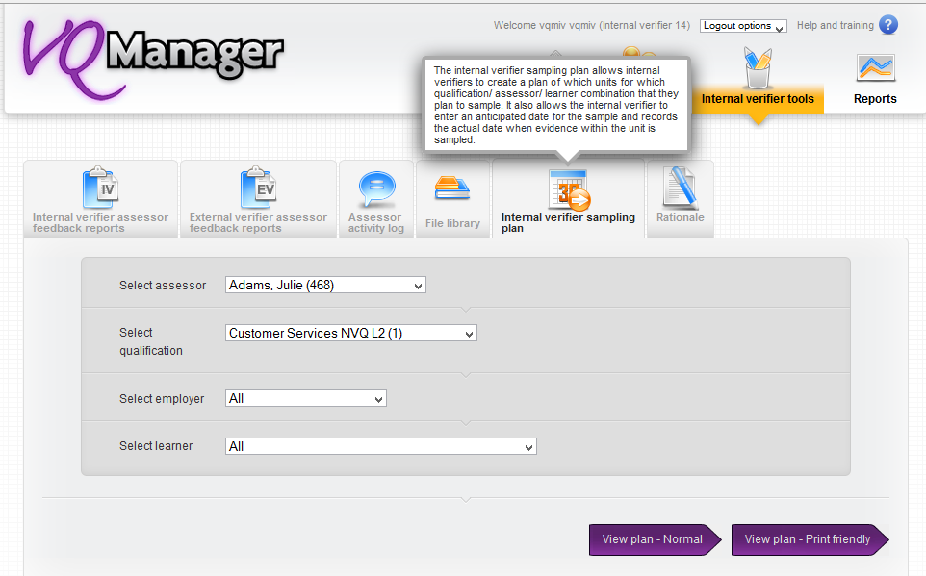
VQManager
IV/IQA Sampling Plans
The IV sampling plan is located in the Internal verifier tools tab

Slide 3
VQManager
IV/IQA Sampling Plans
A sampling plan can be set using the dropdown selectors in the grey area and can be filtered by:
Assessor
Qualification
Employer
Curriculum area
Learner.
You can also select “All” assessors to allow you to create a sampling plan for all assessors managing a particular qualification. Please be aware this may take a few seconds to load as the plan created will be larger than normal.

Slide 4
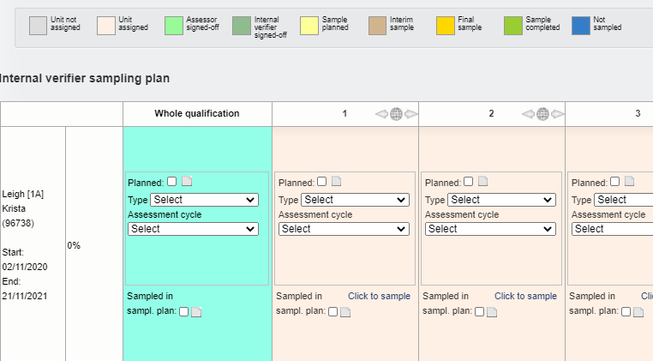
VQManager
IV/IQA Sampling Plans
Once the sampling plan is open the first column is fixed so that the learner’s name is always visible. The unit number is repeated throughout the document so if you scroll down this too will always remain visible.
Tip: Click in any box and use the keyboard’s arrows to navigate up or down, left or right. There is no need to scroll to the bottom to use the grey scroll bar to move left or right.
There is a key to quickly highlight the different stages the plan has reached.

Slide 5
VQManager
IV/IQA Sampling Plans
The sampling plan is divided into two areas. The first area (identified in turquoise) allows for a plan to be submitted which is learner specific but not unit specific.

Slide 6
VQManager
IV/IQA Sampling Plans
Select Planned and click in the field to the right, a pop up appears to enable a date to be specified for the planned sample.

Slide 7
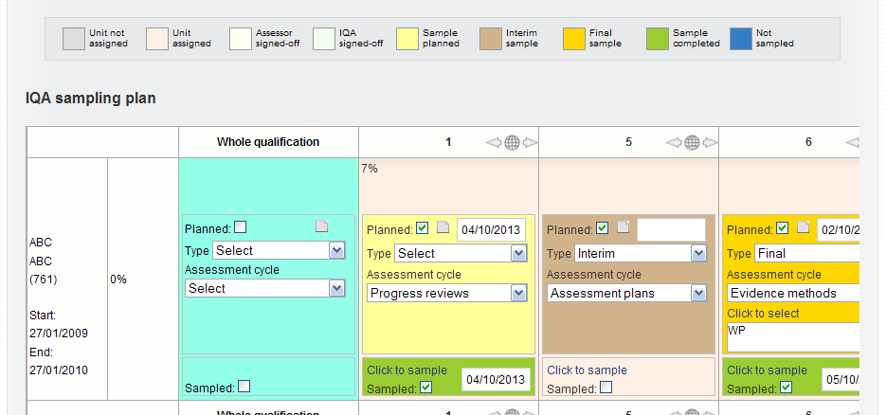
VQManager
IV/IQA Sampling Plans
Using the Type drop down, select either Interim or Final.
The sampling plan has different colours for interim versus final sampling. There is a third colour for situations where neither interim nor final has been selected.

Slide 8
VQManager
IV/IQA Sampling Plans
Sampling from the Whole qualification area:
From the Assessment Cycle select one of the following:
Evidence methods
Assessment plans
Progress reviews
Observation of assessor
Sampling strategy
Other (see notes)

Slide 9
VQManager
IV/IQA Sampling Plans
If Evidence methods is selected you are then able to Click to select and then select one or more methods from the new pop up (modelled on your centre’s Log evidence tab).

Slide 10
VQManager
IV/IQA Sampling Plans
If Other, (see notes) is selected, please use the notes area to stipulate your intentions. The notes icon changes to include writing if notes have been added so it is easy to identify whether notes have been added or not when closed.

Slide 11
VQManager
IV/IQA Sampling Plans
Always make sure you Save any additions or changes you make.
You will see a pop up advising you that any additions or changes you have made have been saved.

Slide 12
VQManager
IV/IQA Sampling Plans
Sampling a specific unit:
If you intend to sample a specific unit, the process and all the options are exactly the same:
Select the unit
Add a date
Select interim or final
Select assessment cycle option
Add notes if required
Save

Slide 13
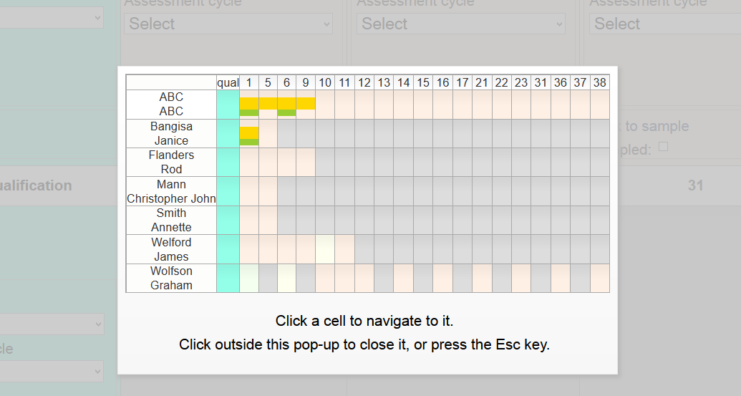
VQManager
IV/IQA Sampling Plans
Click on the world icon in the top right hand corner of each unit to activate the zoom out.
By clicking in a specific cell the pop up will close and you will be taken directly to that cell.

Slide 14
VQManager
IV/IQA Sampling Plans
For an IV with many learners, it's hard for you to keep track of all the dates you've put in the sampling plan, so you run quite a risk of overlooking planned dates and thus falling foul of the awarding body.
There is a built in reminder on the IV home page (very much like the one which reminds learners of overdue assessment plan dates) which shows the IV sampling that is due within the next 5 days. If you overshoot this date the reminder turns red.

Slide 15
VQManager
IV/IQA Sampling Plans
To go to the unit to be sampled, select the Sample link and the unit to be sampled will appear by way of the Unit status, evidence matrix and signoff tab.

Slide 16
VQManager
IV/IQA Sampling Plans
Scroll down and this page also has a Sampling notes section which pulls through all the notes you may have made on the sampling plans (e.g. it's an interim sample, and that you intend to sample Observations).
The page also includes a Sampled check box and date selector for the actual sampled date and these dates save back into the sampling plan. This saves you having to go back to the sampling plan to indicate that they have sampled.

Slide 17
VQManager
IV/IQA Sampling Plans
If you sign off the unit at the same time….
On this page there is a check box when you sign a unit off called unit not sampled. This allows you to sign off the units without declaring that you have checked all the content.
When you tick the unit not sampled box when signing off a unit, the lower part of the sampling plan unit box goes blue automatically. This will allow you to look at the sampling plan and know that if the unit is signed off that it has not actually been sampling/verified.

Slide 18
VQManager
IV/IQA Sampling Plans
When you have sampled it, the reminder disappears from the home page.
If you see the reminder but the intended sampling is no longer relevant, you can Remove it from the reminder list although the sampling plan view continues to show your recorded intention.

Slide 19
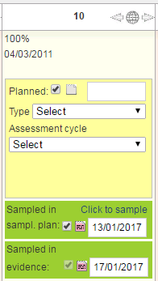
VQManager
IV/IQA Sampling Plans
Automatically updating sampling plan when evidence signed off by IQA/IV
There is a section within the sampling plan sampled in evidence which automatically updates the plan when a piece of evidence is sampling for that unit. It is located below the existing Sampled in sampling plan section which populates when you Click to sample hyperlink .
These two sections function independently of each other and are easy for the IQA/IVs to view. By putting them in separate boxes, it shows users which dates were manually entered, and which were placed there by the system. Sampled in sampl. plan for manual dates, and Sampled in evidence for automated dates.

Slide 20
VQManager
IV/IQA Sampling Plans
To view the details of what has been sampled in these two areas, select the notes icon.

Slide 21
VQManager
IV/IQA Sampling Plans
When a piece of evidence is sampled and units are ticked as sampled within the evidence, dates are added to the Sampled in evidence section in the sampling plan against all of the selected units.

Slide 22
VQManager
IV/IQA Sampling Plans
When a piece of evidence is sampled but NO units are ticked as sampled within the evidence – nothing is recorded in the sampling plan.

Slide 23
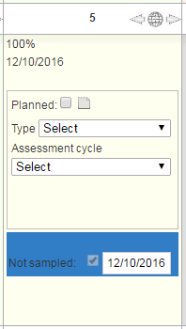
VQManager
IV/IQA Sampling Plans
The only exception to Unit sign off is if unit not sampled is selected at unit sign off, because that does go into the sampling area at the bottom. .

Slide 24
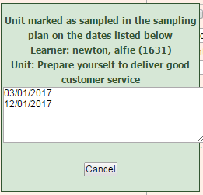
VQManager
IV/IQA Sampling Plans
The most recent date is displayed in the summary view but all previous dates can be viewed by clicking the notes icon to view the audit trail. This includes the most recent date as well, for clarity.
We know that an IQA/IV may need to verify a unit in the sampling plan more than once and this is possible without losing the information around the previous sampling. Multiple sampling events in the sampling plan plus audit trail is available, but currently limited to one sampling per IV/learner/unit per day. See screenshot below for how the system records and displays multiple manual sampling dates.

Slide 25
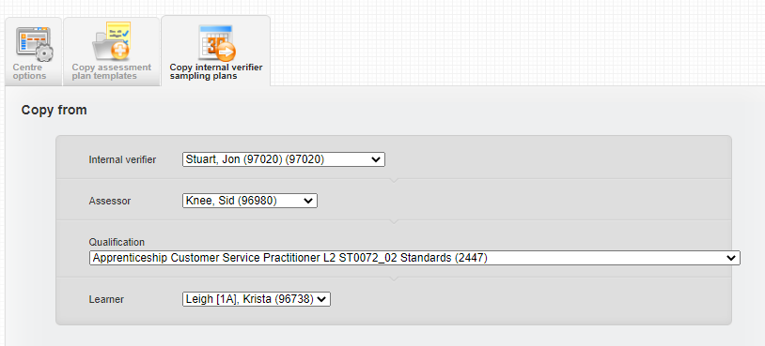
VQManager
IV/IQA Sampling Plans
Copying of sampling plan from one IQA to another
The Centre Admin is able to copy the sampling plans from one IQA to another, for example in the situation where an IQA leaves and their work needs to go to someone else. It is important to note this this function copies the original plan and the original plan remains in place with the previous owner.
The copying is done at Centre Admin level in the My Centre tab, Copy IV sampling plan.

Slide 26
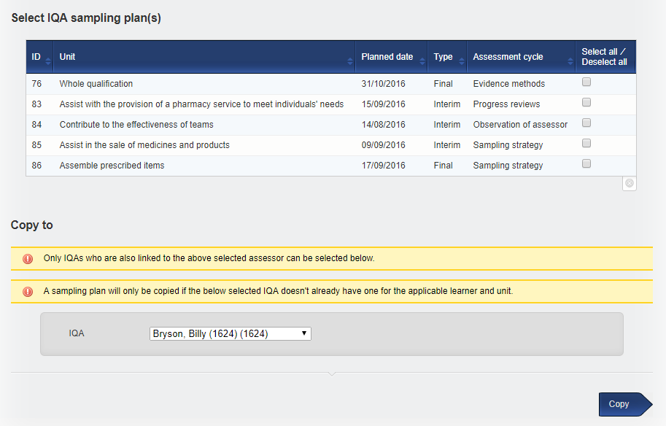
VQManager
IV/IQA Sampling Plans
The CA is able to use the selectors in Copy from, select all assessors, or just one the from selector and then select the IQA to copy to (this will only ever be one person, not many).
The idea is not to set anything in stone, but to allow one person's plan to be passed to another without having to manually copy the entries. Both parties now have a plan and neither plan interacts with the other.

Slide 27
VQManager
IV/IQA Sampling Plans
Note:

