Slide 1
VQManager
IV/IQA Rationale

Slide 2
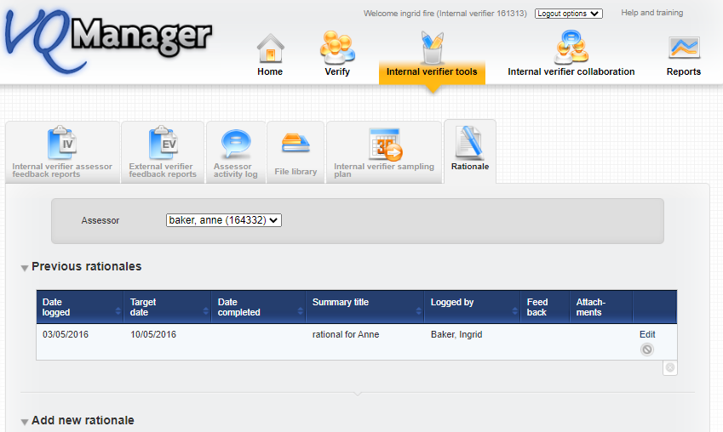
VQManager
IV/IQA Rationale
A Rationale can be defined as a record of quality assurance intentions and is associated with a specific assessor who is linked to the IV/ IQA.
The Rationale tab can be found under the main menu option IQA/IV tools (depending on how your centre is structured). The Rationale tab is the furthest right.
The rationale is not visible to the assessor.

Slide 3
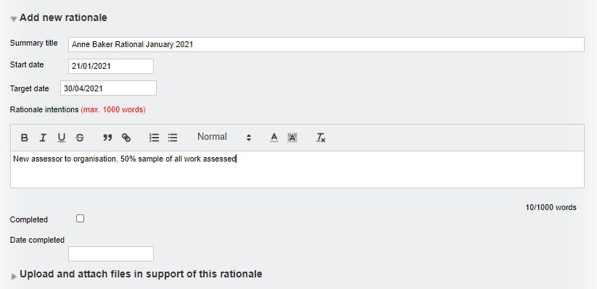
VQManager
IV/IQA Rationale
To create a new rationale go to Add new rationale

Slide 4
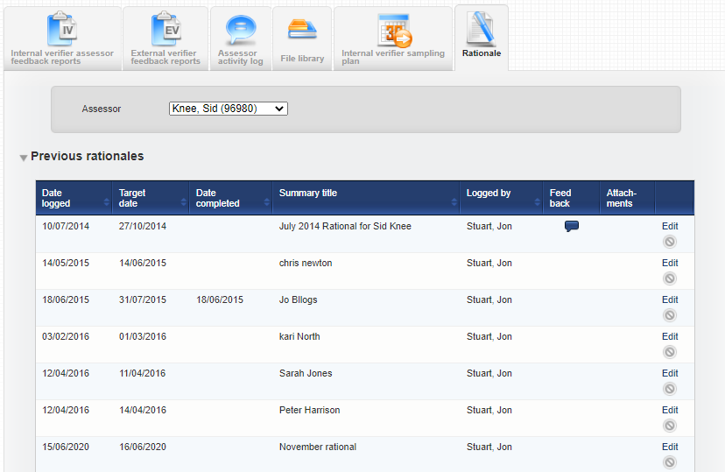
VQManager
IV/IQA Rationale
Once saved, all existing rationales associated with the Assessor selected appear in a summary table which is visible once the Assessor has been selected. If the assessor is a shared one, all IQA/IVs associated with the assessor can view the rationale.

Slide 5
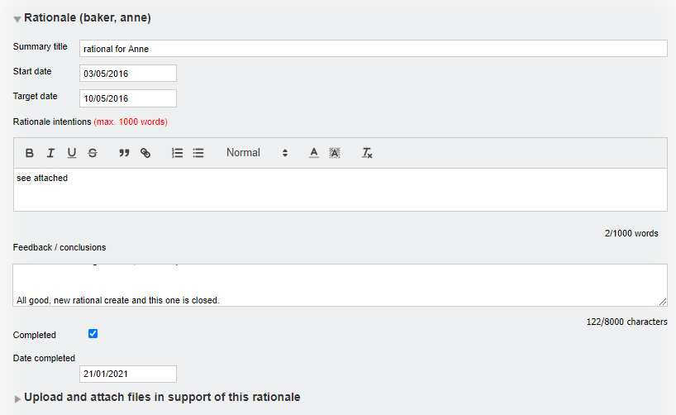
VQManager
IV/IQA Rationale
To edit/complete an existing rationale select Edit and the rationale will open

Slide 6
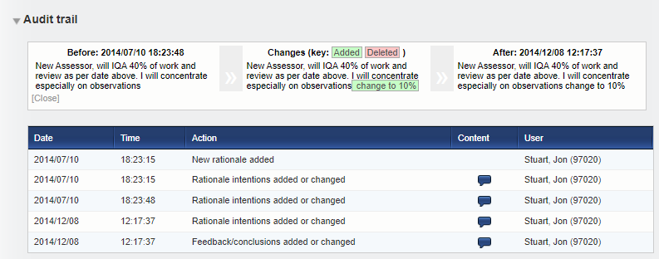
VQManager
IV/IQA Rationale
All activity associated with a Rationale is tracked to provide a complete audit trail and can be found at the bottom of each existing Rationale once opened.
Changes can be seen by clicking on the Content speech bubble icon and are displayed above the Audit trail table (see image below).
Added (new) content is highlight in green.
Deleted content is highlighted in pink.

