Slide 1
VQManager
VQManager Feb 2021 Enhancement
Webinar

Slide 2
VQManager
This webinar contains information regarding:
Adding a note to Progress Review tab to remind users what to write – centre switch
To Do tab, Progress Review links to open specific Progress Review pop up
Allowing CA to alter a pre-set sequence of Progress Reviews - removing previous set without creating a new one
Preventing users selecting an end date that is before the start date in the Diary
Changing centre so that assessors can edit learner's personal details and learners can’t - centre switch
Making sure Evidence list defaults to 'all'
Adding a link for users to tick all criteria in an assessment plan
Changing column headings in Progress Review report for clarity
Adding filter by role to user lists - Admins and OSU
Showing on screen where Activity Log has already been copied to a learner
Showing IQA dates in evidence matrix for units ticked as being sampled

Slide 3
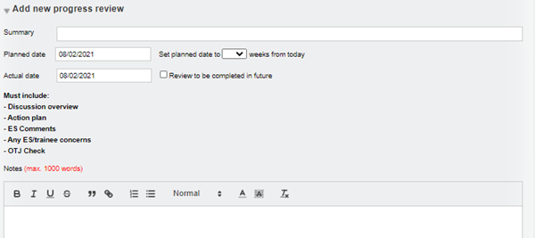
VQManager
Adding a note to Progress Review tab to remind users what to write – centre switch
We have added a centre switch so that a text field can be populated to instruct assessors in the Progress Review tab to remind them what information they need to gather. The script will be created by the centre – (it will be the same for all assessors) and will be added behind the scenes by SkillWise.
Here is an example of a text box which has been created. The additional text is only visible to the assessor when creating a new review, or completing a pre-set review.

Slide 4
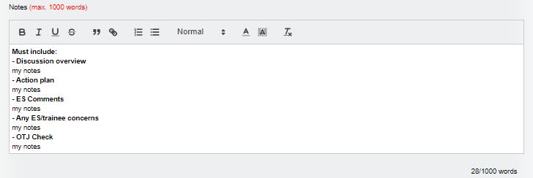
VQManager
Adding a note to Progress Review tab to remind users what to write – centre switch
In the below slide, I have copied the text and dropped it into the Notes field to create categories for easy completion. This is just a suggestion.

Slide 5
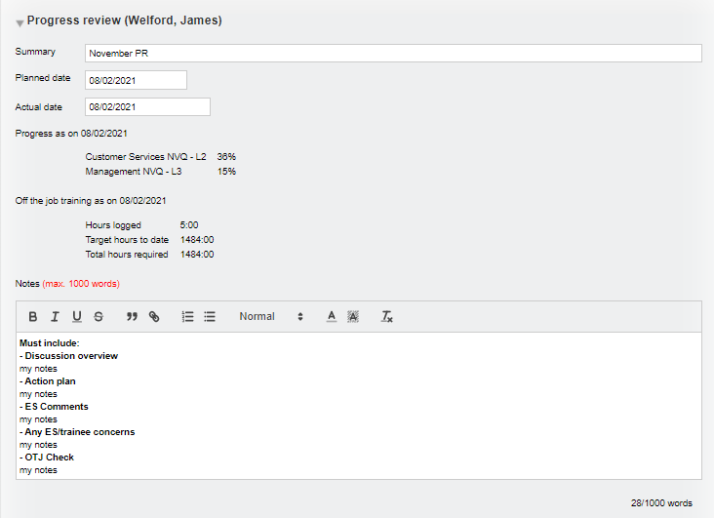
VQManager
Adding a note to Progress Review tab to remind users what to write – centre switch
Once the review is saved, the text box disappears:
This development is available upon request. Please contact us to have your text inserted into the Progress review area.

Slide 6
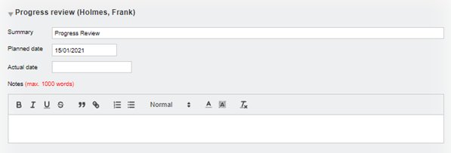
VQManager
To Do tab, Progress Review links to open specific Progress Review pop up
In order to assist assessors in completing pre-set progress reviews the hyperlink reminder on the To Do tab for the assessor has changed. This will hopefully prevent assessors from creating a duplicate by using the Add new review area, instead of filling in the pre-planned one.
The hyperlink now reads Edit rather than View on the To Do list for upcoming and overdue reviews. Instead of going to the Progress review tab in My learners, Edit instead opens a pop-up of the pre-planned review in question for the assessor to complete.

Slide 7
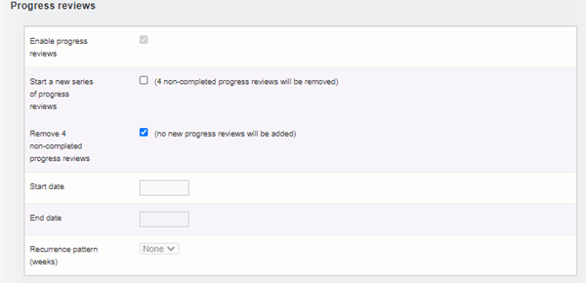
VQManager
Allowing CA to alter a pre-set sequence of Progress Reviews - removing previous set without creating a new one
We have added a second scenario when removing pre-set Progress reviews in the User tab. Currently the system requires you to add a new set when removing an old one, but we realise this isn’t always the case. You can now delete an old series and save those changes without setting up a new set of reviews.

Slide 8
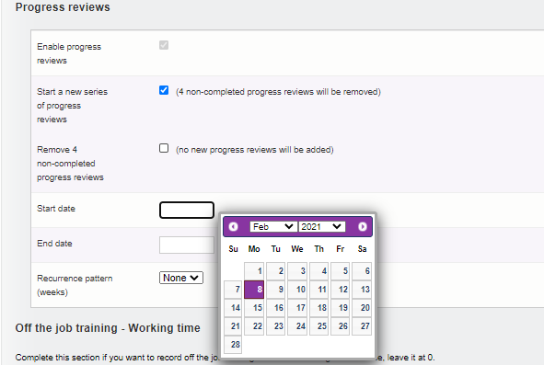
VQManager
Allowing CA to alter a pre-set sequence of Progress Reviews - removing previous set without creating a new one
The dates and recurrence pattern fields will only be activated and required if Start new… is selected.

Slide 9
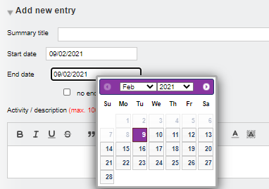
VQManager
Preventing users selecting an end date that is before the start date in the Diary
In the Diary, there has been a small adjustment to prevent mistakes being made. You cannot now add an end date that is before the start date. Being able to do this previously affected the OTJ calculations and we want to eliminate this problem.
When selecting an End date, dates before the Start date are now greyed out in the calendar selector.

Slide 10
VQManager
Changing centre so that assessors can edit learner's personal details and learners can’t - centre switch
Some learners have been changing or not entering accurately their Personal details information into the system. We have added a switch so that if you would like to disable the ability for your learners to alter their own details, and instead allow the assessors to do this, this can now be changed. If switched, in the Learner details tab the assessor is be able to edit the following fields:
Title
Name
Date of birth
Gender
Home postcode
Address
Current postcode
Country of domicile
Phone numbers
E-mail address
Other fields are completed by a Centre Admin, as now.

Slide 11
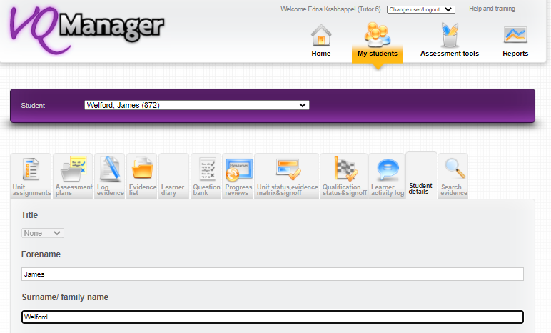
VQManager
Changing centre so that assessors can edit learner's personal details and learners can’t - centre switch
This development is available upon request. Please contact us to have this changed for your organisation.

Slide 12
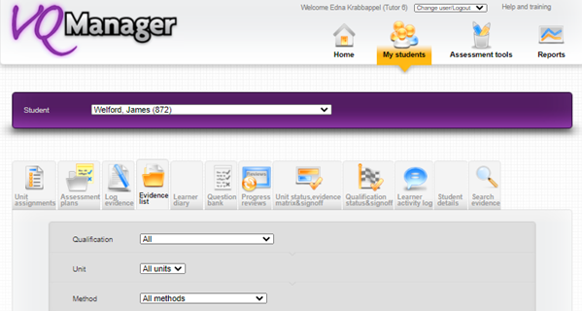
VQManager
Making sure Evidence list defaults to 'all'
We have improved the Evidence list page so that it now always initially displays with the All option in the dropdowns. Client feedback has shown, especially with learners, that where filters are applied by virtue of previously visited pages, users were missing items that potentially needed their attention.

Slide 13
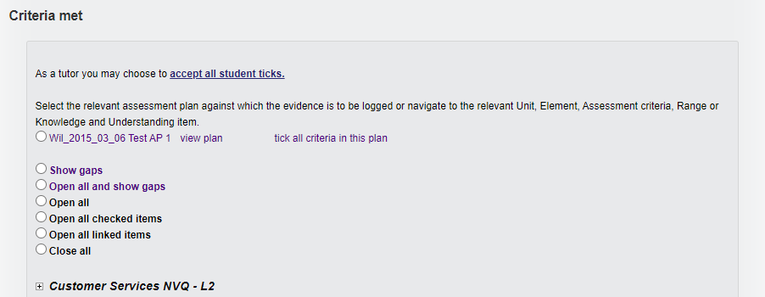
VQManager
Adding a link for users to tick all criteria in an assessment plan
There is now a new link in the Log evidence page in the Criteria met section to speed up the logging of evidence against assessment plans. This is available to both learners and assessors. Clicking on tick all criteria in this plan will populate all of the criteria the selected plan covers. This is visible for both learners and assessors.

Slide 14
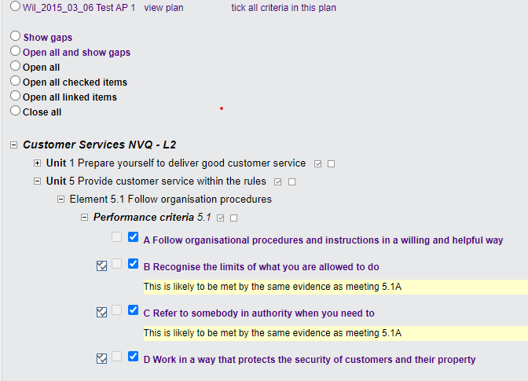
VQManager
Adding a link for users to tick all criteria in an assessment plan
Clicking on the new link also opens up the qualification tree to display all the ticked criteria.

Slide 15
VQManager
Adding a link for users to tick all criteria in an assessment plan
Users can still change the criteria ticks (untick any not met or tick additional criteria if required), prior to saving the evidence. They can also select more than on assessment plan in a single evidence record. This function works in the same way as the existing quick tick function.

Slide 16
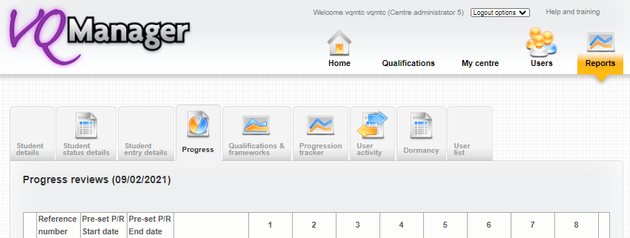
VQManager
Changing column headings in Progress Review report for clarity
We have altered the headings for the start and end date columns in the Centre Admin’s Progress review report. Start date becomes Pre-set P/R start date and End date becomes Pre-set P/R end date. This is to avoid confusion with the qualification start and end dates, which are not included in this report.

Slide 17
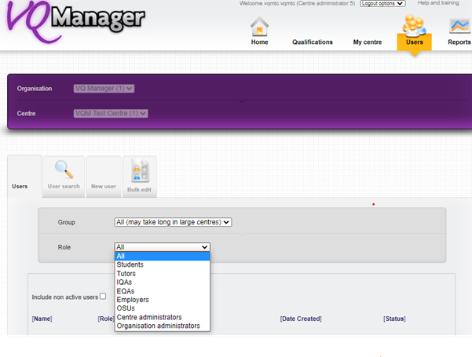
VQManager
Adding filter by role to user lists - Admins and OSU
We have added a Role filter in the Users list for Centre and Org Admins. This will make it easier to navigate this list, and quicker to find the user you are looking for.

Slide 18
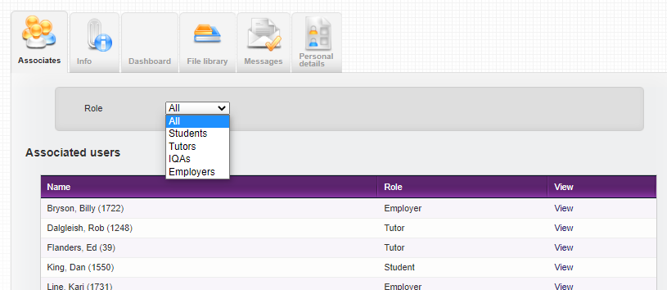
VQManager
Adding filter by role to user lists - Admins and OSU
A similar filter is available to Other System Users.

Slide 19
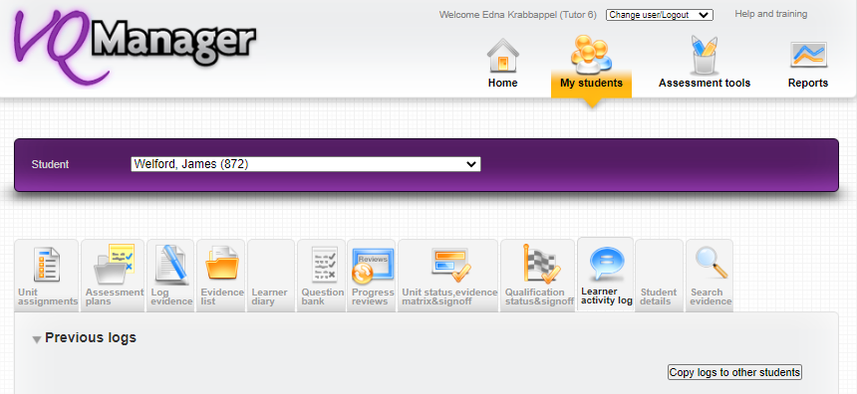
VQManager
Showing on screen where Activity Log has already been copied to a learner
This development is a small amendment to the sharing of Activity logs we completed last time. We had already prevented the same log being copied to the same learner more than once and now this is shown on the page itself. It is similar to the assigning assessment plans notifications.
Select Copy logs to other students link

Slide 20
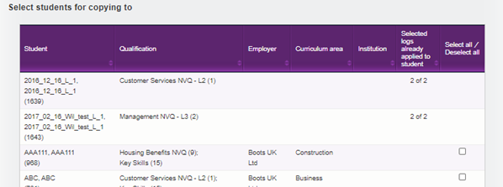
VQManager
Showing on screen where Activity Log has already been copied to a learner
Select the log/s to copy:
Now the system not only won’t allow you to share the log twice, but also shows you, of the logs to share, how many that learner has already been given.

Slide 21
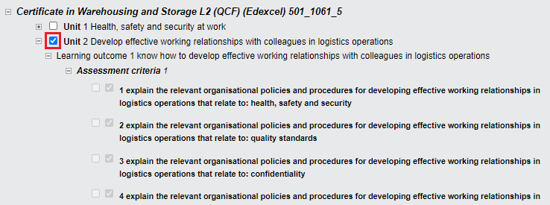
VQManager
Showing IQA dates in evidence matrix for units ticked as being sampled
Where a piece of evidence covers criteria from several units, the IQA may only have looked at the evidence with regards to one or some of those units when sampling. This improvement allows that to be seen in the Evidence matrix, as well as the Sampling plan.
Where the IQA ticks a unit as sampled in the evidence

Slide 22
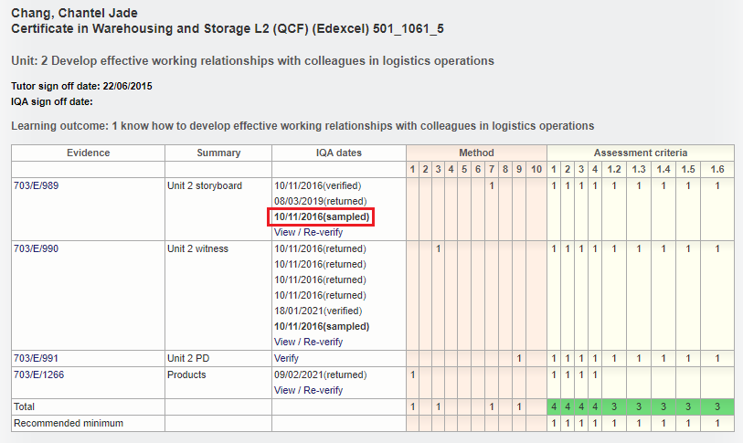
VQManager
Showing IQA dates in evidence matrix for units ticked as being sampled
A sampled date is now shown in the Evidence matrix, alongside the dates of each interaction of the IQA with this evidence. If the IQA has interacted with the evidence more than once, the earliest sampling date is displayed.

Slide 23
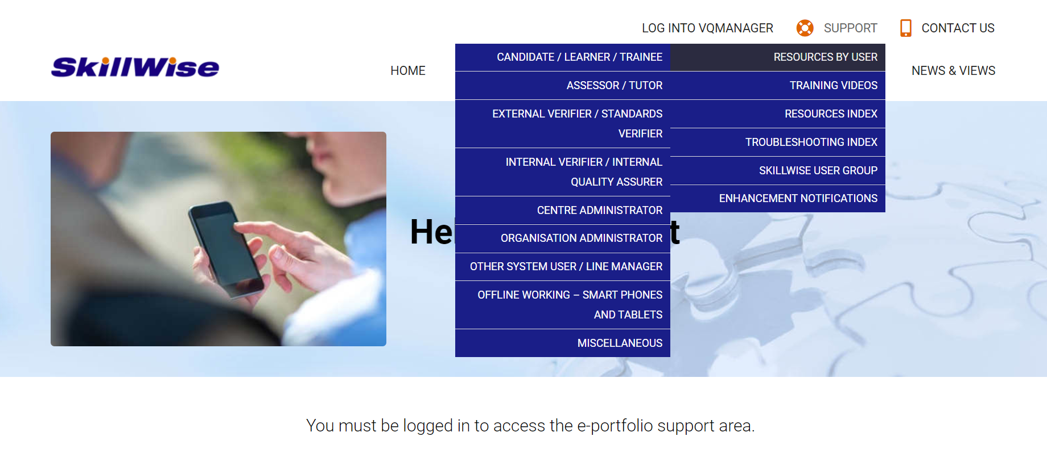
VQManager
www.SkillWise.net/support
We have an extensive support and training area for all users. You will find video and PDF documents to help you use all functionality within VQManager.
The password is solution.
.

Slide 24
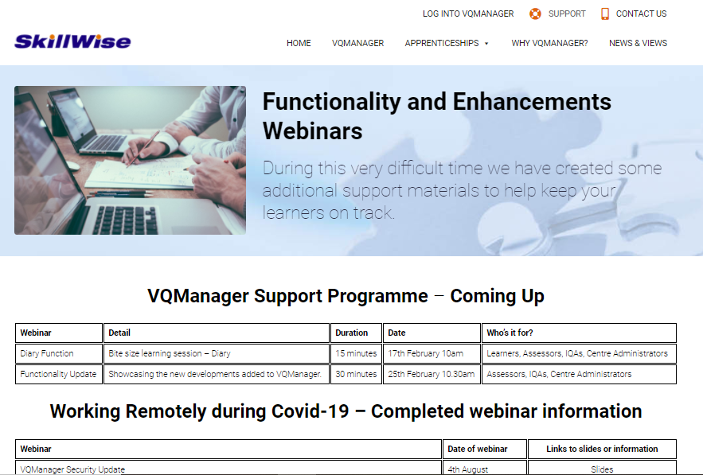
VQManager
www.skillwise.net/support
The page in the support area indicates when we will be holding more webinars to support you.
Our next webinar is Wednesday 10th March 10am and will be highlighting Off the Job Training.
.
https://www.skillwise.net/support/additional-support/

