Slide 1
VQManager
Off the Job Training

Slide 2
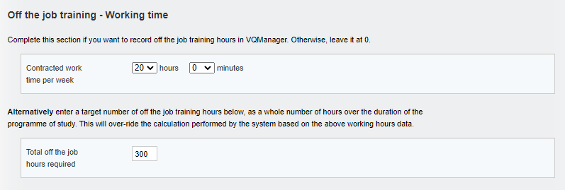
VQManager
Off the Job Training
The Apprenticeship Standard learners are required to show they have spent 20% of their paid working time completing off-the-job training.
The off the job training fields will only appear in VQManager when the Centre Admin populates “working time” in the field in the learner user profile, i.e. the function is hidden for all users it is not relevant to.

Slide 3
VQManager
Off the Job Training
Using the first option, the system uses the working hours, and the start and end dates for the learner, to work out total off-the-job hours required for the learner over the course of their study. (hours per week x 0.2) x no. of weeks between start and end date.
Annual leave is not subtracted from this calculation. This provides a ‘buffer’ to make sure learners are fulfilling the 20% with some time to spare. 20% is a minimum requirement
Target start date for OTJT is the earliest of the start dates for the qualifications assigned, and target end date is the last of the end dates for the qualifications assigned.
Only hours entered in between the qualification start and end date will be added to the calculation. – i.e, in the above example between 07/02/19 and 03/02/20

Slide 4
VQManager
Off the Job Training
Because a calculated target is not always appropriate (in the case of working irregular hours, absences through illness etc), as an alternative you can simply type in the target for any individual learner.

Slide 5
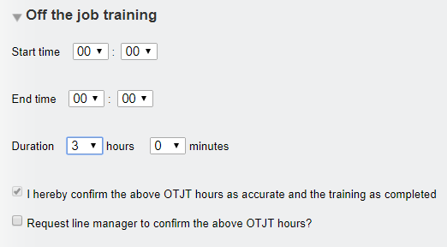
VQManager
Off the Job Training
The Function for recording off the job training is located in both the Diary and Learner Activity Log for the assessor and the learner.
OTJT duration can be recorded in hours and minutes. Start and end times can also be recorded if required, but are not essential.
It does not matter which tab you enter this detail on in respect of VQManager, they both contribute to the total hours to date and also total hours required.

Slide 6
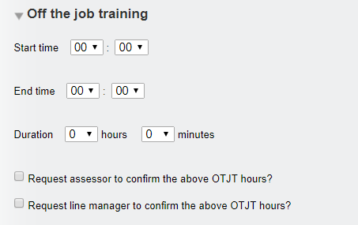
VQManager
Off the Job Training
Learners when completing this section are able to send a request to both the assessor and Line Manager to confirm the hours when they log them.
This request generates a To Do list item for the assessor and the Line Manager and also an email in addition for the Line Manager.

Slide 7
VQManager
Off the Job Training
When an assessor completes the OTJT section, the declaration “I hereby confirm the above OTJT hours as accurate and the training as completed” appears and is automatically ticked. The assessor's confirmation tick implies that the hours are correct and the training is completed and hence the hours can be added to the total.
Where a Line Manager is assigned to the learner, the assessor is able to send a request to the Line Manager to confirm the hours is required by ticking the appropriate box. This request generates an email and a To Do list item for the Line Manager.
As both an assessor and a learner it is possible to go into an existing record and request Line Manager confirmation, if this wasn’t done at the time the record was first created.
The Line Manager confirmation element will be hidden where no Line Manager is assigned to the learner.

Slide 8
VQManager
Off the Job Training
VQManager reports the following throughout the system
Total hours required
Total hours achieved (and confirmed by assessor) to date
Total hours not yet confirmed by assessor
Shortfall hours against target hours

Slide 9
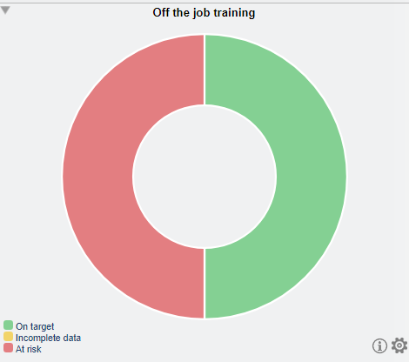
VQManager
Off the Job Training
Activity Log table Diary table My progress summary
Dashboard Learner progress summary

Slide 10
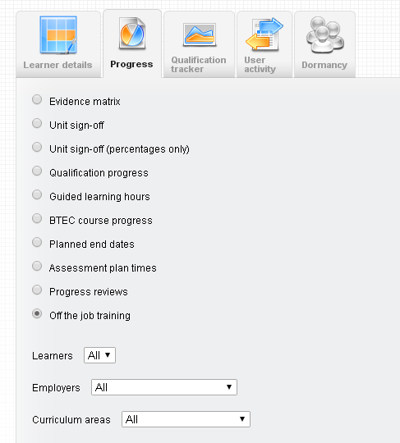
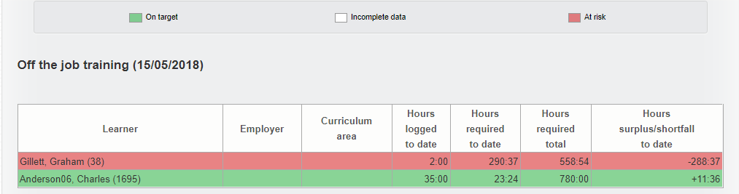
VQManager
Off the Job Training
In the Reports / Progress tab, there is a report for the OTJT. This is available for assessors, IQAs, EQAs, OSUs, Line Managers and Centre Admins. There is a filter for learner, curriculum area and employer.

Slide 11
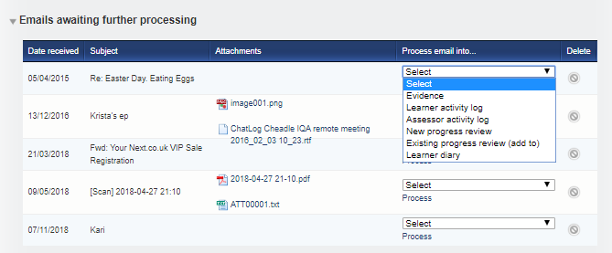
VQManager
Emailing in Off the Job Training
The “emailing in” function can also be used with OTJT for both the learner and the assessor
Learner
Assessor
Emails can be sent to VQManager and the email arrives in a table on the To Do tab entitled: Emails awaiting further processing and can be added to:
Learner activity log
Learner diary.

Slide 12
VQManager
Off the Job Training
Extending a learner’s end date – where and what might be the consequences with VQManager?
Please note: - only hours entered in between the qualification start and end date will be added to the calculation. – i.e, in the below example between 07/02/19 and 03/02/20
So if you need to add more hours beyond the learner’s end date, you will need to adjust the end date in the learner’s profile. This will not affect the total number of hours required if you use the second version of recording the OTJ hours:

