Slide 1
VQManager
Emailing into VQManager

Slide 2
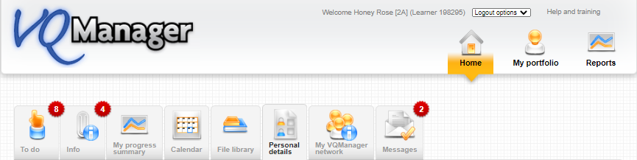
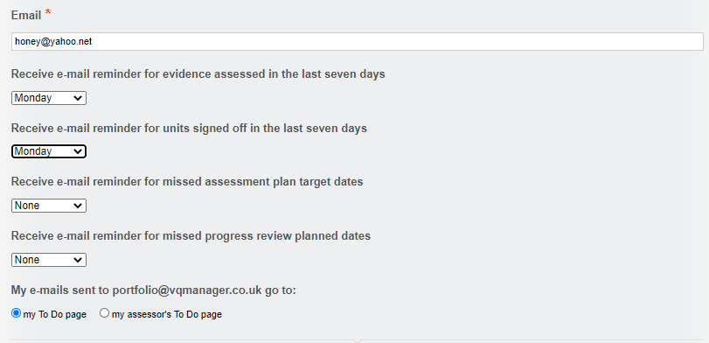
VQManager
Emailing into VQManager
Emails can be sent to VQManager by the assessor or by the learner. The default switch is that whoever sends the email, receives the email in their To Do tab so that they can process it.
This default setting can be changed in the learner’s Personal details tab if required.
In this area, you also need to check that the email address from which you are sending emails into VQManager is correctly set up in the system. The email needs to be the same as the one on the device you are emailing into.

Slide 3
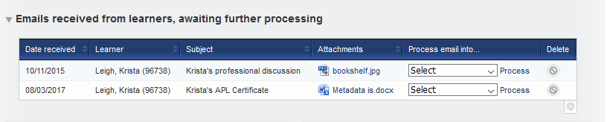
VQManager
Emailing into VQManager
To send an email into VQManager, the email address is: portfolio@vqmanager.co.uk
The email arrives in a table on the To Do tab entitled: Emails awaiting further processing both for the assessor and the learner.
For assessors: if the learner has changed their settings so that emails are sent to you instead of to themselves, they will appear in this table:

Slide 4
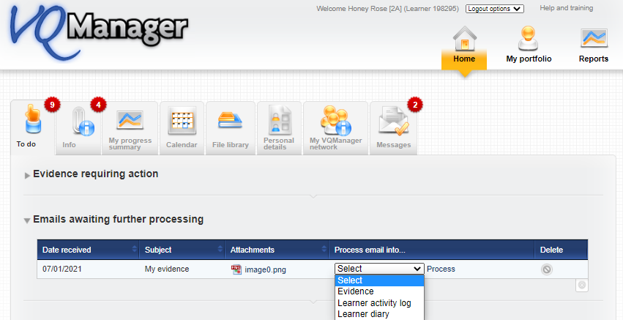
VQManager
Emailing into VQManager
Learners: on the To Do in Emails awaiting further processing, click on the Process email into to provide the options available to you.
You have three options:
Evidence
Learner activity log
Learner diary

Slide 5
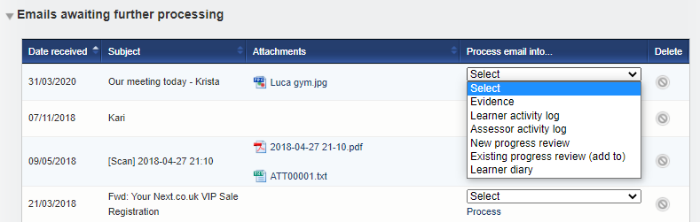
VQManager
Emailing into VQManager
As an assessor you have six options:
Evidence
Learner activity log
Assessor activity log
New Progress Review
Existing progress Review (add to)
Learner Diary

Slide 6
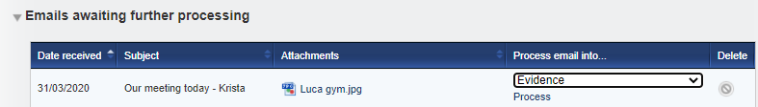
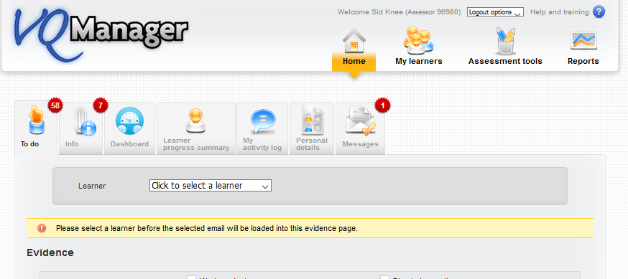
VQManager
Emailing into VQManager
Process into Evidence
Once you have selected the Evidence option link a Log evidence form will appear.
As an assessor you will need to select the learner’s name from the drop down box in the grey area and the email and the email attachment will appear. Hint: Always include the learner’s name in the title of the email when creating it. This step is not required for the learner

Slide 7
VQManager
Emailing into VQManager
From your email:
The subject line becomes the Summary of evidence description
The body of the email becomes the Description of evidence
Any attachments are automatically added to page.
Complete the form:
Add a method(s)
Map the criteria as required
Note: all fields are editable if you need to change anything
When you are finished, save the evidence and it will be added to the Evidence list.

Slide 8
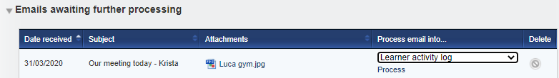
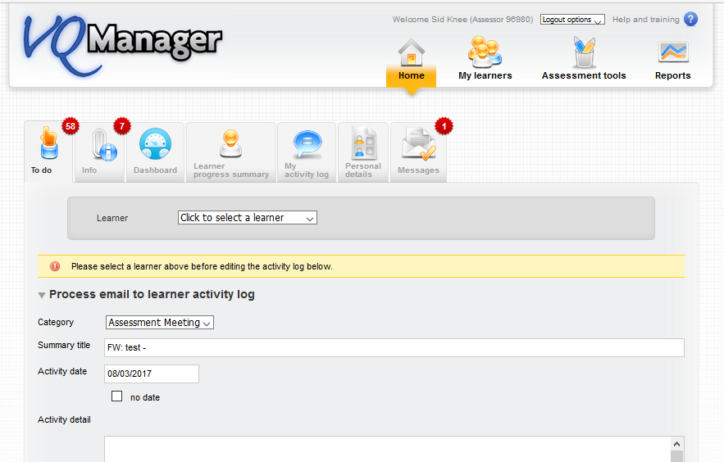
VQManager
Emailing into VQManager
Process in Learner activity log
For the assessor, select the learner. Again the fields prepopulate but remain editable until you save so you can add more information if required.

Slide 9
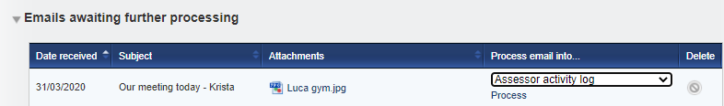
VQManager
Emailing into VQManager
Process in Assessor activity log (assessor only)
Again the fields prepopulate but remain editable until you save so you can add more information if required.

Slide 10
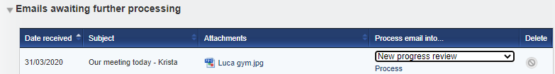
VQManager
Emailing into VQManager
Process in New progress review (assessor only)
If you select New Progress Review, a new page opens for you to select the learner and the fields populate again. When complete click save at the bottom.

Slide 11
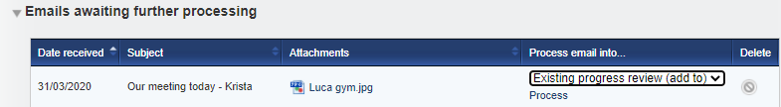
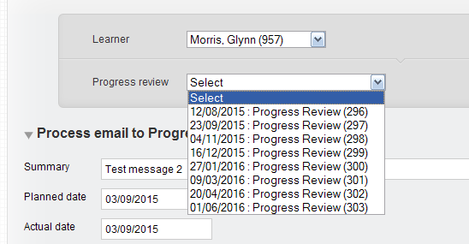
VQManager
Emailing into VQManager
Process in Existing progress review (assessor only)
If you select Existing progress review, the page asks you to select the learner and the review you want to add to. Complete the form in the same way and click save at the bottom.

Slide 12
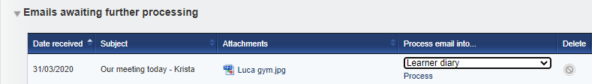
VQManager
Emailing into VQManager
Process in Learner diary
Again the fields prepopulate but remain editable until you save so you can add more information if required.

Slide 13
VQManager
Emailing into VQManager
Note:
Remember that the email that is received by VQManager must be sent from the same email address that is in the Personal details tab. The email must be sent to portfolio@vqmanager.co.uk.
You will get a notification to let you know that the email send was successful or if it was rejected. If you are not receiving these emails, please check that the email address in your Personal details tab (accessed from the Home page) is the one you are sending the email from (see image on slide 2).

