Slide 1
VQManager
Each slide has voice commentary if required.
Select the loudspeaker icon top left corner to reveal the audio control

Slide 2
VQManager
VQManager May 2020 Enhancement
Webinar

Slide 3
VQManager
This webinar contains functionality information about:
Enhancements:
End Point Assessment (EPA) Export
Improving information to users around assessment plan confirmation
Change of wording to encourage better assessment plan use
Changing user status from ”Disabled” to “On hold”

Slide 4
VQManager
End Point Assessment (EPA) Export
Introduction
To facilitate the EPA process for Apprenticeships, we have developed a new function. This will offer VQManager users a choice of downloading a PDF or creating a link so they can share evidence with the EPAO. This will avoid the need for an EPA to log into VQManager, and also the need to download and save evidence items individually.
Prior to starting this process, the assessor should work with the learner to identify the pieces of evidence they will be submitting. Where a ‘clean’ version is required, free from unnecessary attachments and signs of the process of improvement and re-submission, the assessor can use the ‘re-use evidence’ function to create this.
Evidence selections made during this process are saved, and can be edited, so everything doesn’t have to be in place before you start this process for the first time.

Slide 5
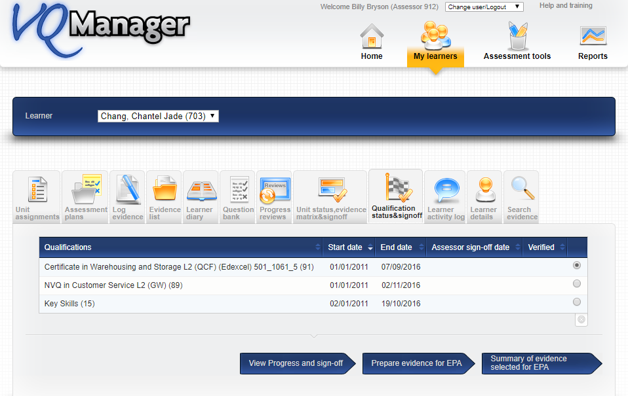
VQManager
Preparing evidence for EPA
A new option ‘prepare evidence for EPA’ is available to assessors, under the My learners >> Qualification Status and Sign Off tab.
On this page you select the qualification the evidence needs to be extracted from.

Slide 6
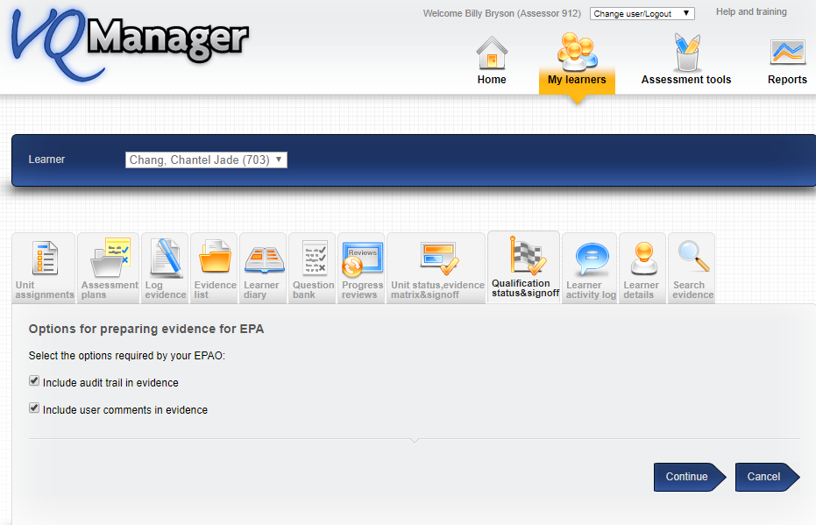
VQManager
The new “Prepare evidence for EPA” arrow button will open a new page, where the assessor can select what should be included in the evidence they are submitting.
Some EPAOs require audit trails and user comments whilst others don’t. This step is to allow the assessor to personalise the download. Options at this point are whether to include the audit trail, and whether to include user comments on the evidence. The default option is that these selections remain unticked unless selected by the assessor.
These options can be edited at any time.

Slide 7
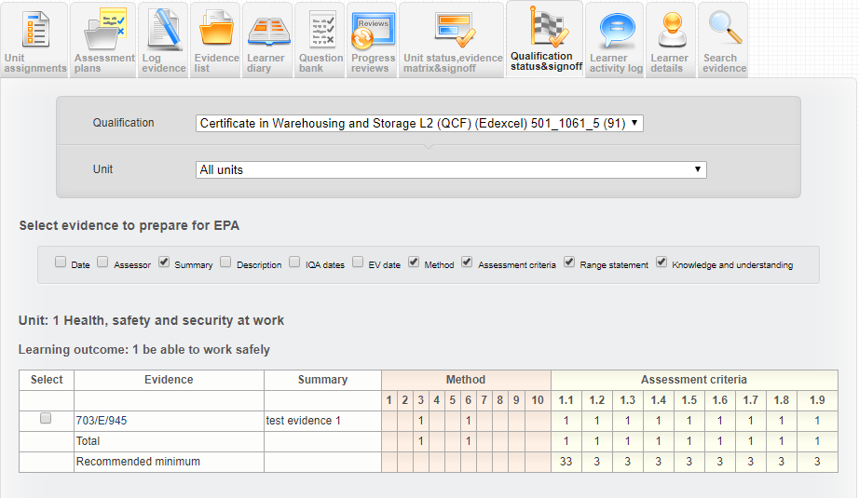
VQManager
By clicking ‘continue’, the assessor will be taken to a view similar to the evidence matrix.
N.B.. Only evidence which has been mapped to criteria will show in the matrix and become available for selection.
Using the tick box on the far left of the matrix, the assessor can select which evidence item(s) they need to make available for EPA.

Slide 8
VQManager
Once the assessor has marked the evidence they want to include, they should scroll to the bottom and click on the ‘Summary of selected evidence’ arrow. This will save the selection.

Slide 9
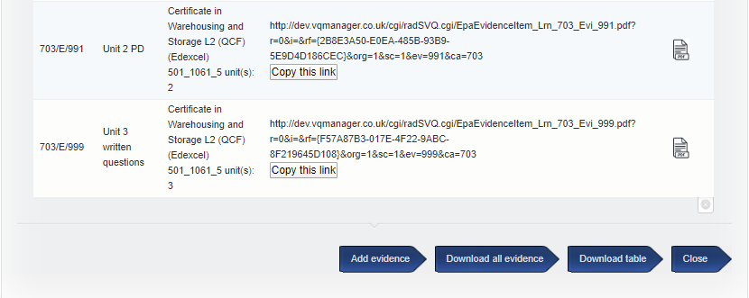
VQManager
Clicking on the ‘summary’ arrow will open a page with a table showing the selected evidence. For each piece of evidence, users will be able to download a PDF (which they can then upload into the EPA system they are required to use), or copy a link to the evidence (which can be pasted into that system) by clicking on the relevant thing in the table.

Slide 10
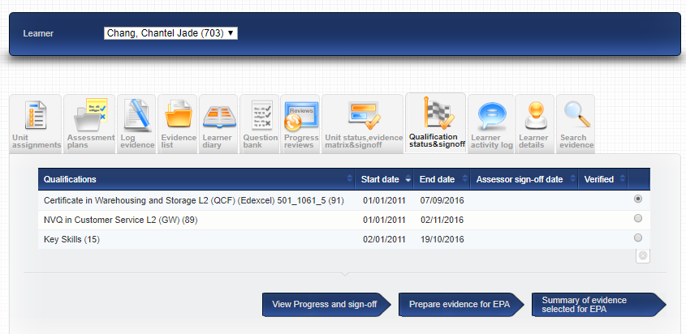
VQManager
A shortcut option, ‘add evidence’, is available to take users back to the matrix page if they wish to edit their selections.
Clicking ‘Close’ will save everything and take the assessor back to the Qualification sign off tab as it appears when you first click on it, i.e. with the list of qualifications and sign off dates.
If the assessor wishes to extract evidence from more than one qualification, they will need to repeat the process from the Qualification Status tab by selecting the new qualification.

Slide 11
VQManager
Evidence selections are saved, and can be reviewed and amended at any time. If the learner has more than one assessor, all assessors will see the same view, and have the same access to edit the selections.
A warning appears at the top of the matrix page, letting users know that if evidence is removed after having already been shared with an EPA, this could cause the EPA to see an error message when viewing the evidence.

Slide 12
VQManager
Reviewing the selected evidence, and sharing it with the EPA
Selected evidence can be viewed and exported from VQManager in several ways. Firstly, users can select “copy this link” and paste that into their browser.
Some browsers will allow you to right-click on the link once it’s highlighted, and select an option to open it in a new tab. Below is a screenshot of how this looks in Chrome.

Slide 13
VQManager
Alternatively, users can click on the icon on the right and open a PDF document showing the evidence. Using either method, the evidence is displayed in the same way as it is within the VQManager system.

Slide 14
VQManager
The qualification tree will show open where criteria are ticked, so it is easy to see what the evidence covers.

Slide 15
VQManager
Attachments to the evidence are displayed in the normal way, and can be opened by clicking on them. There is no need to download these separately for the EPA to be able to view them.

Slide 16
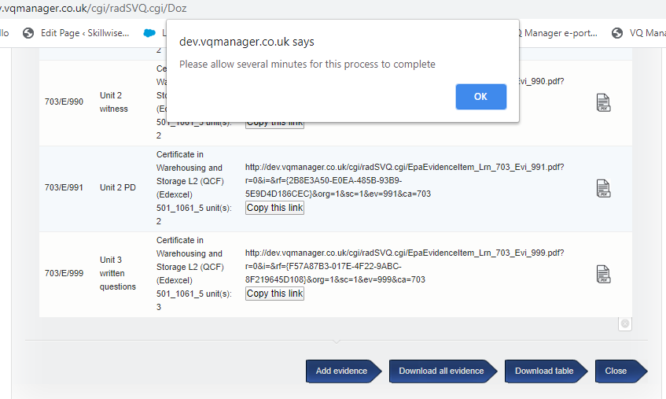
VQManager
Lastly, there is an option to download all the selected evidence as a zip file, containing a set of PDFs of all selected evidence items. On selecting the “Download all evidence” arrow, a pop up appears, letting users know this process may take a little time to complete. Please make sure your popup blocker does not prevent this warning, as that will also stop the download.

Slide 17
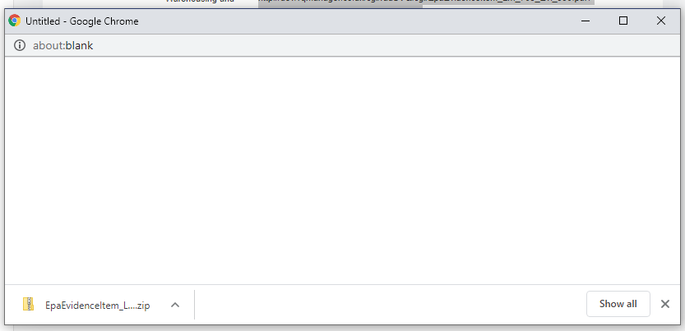
VQManager
Look out for the download at the bottom of your screen
Once downloaded click to open

Slide 18
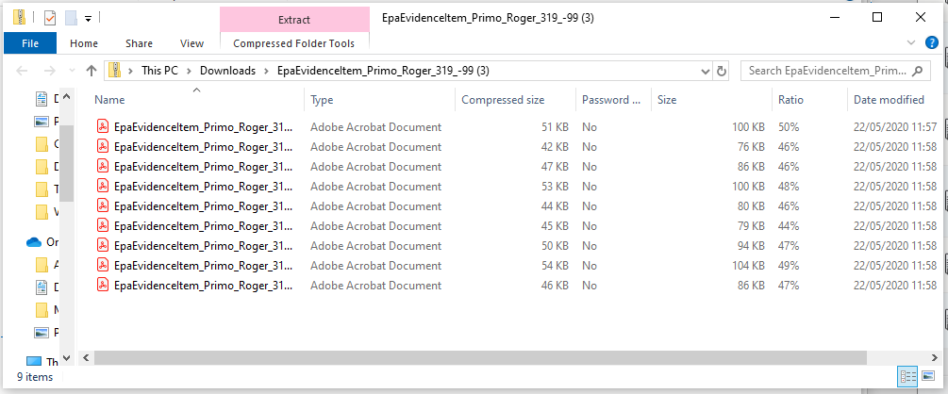
VQManager
All the selected evidence is located in the zip folder and users can open and view each one as required.
The file names of downloaded PDF and Zip files include the learner’s name and VQManager user ID, but assessors can change that before sharing with the EPA if they wish.

Slide 19
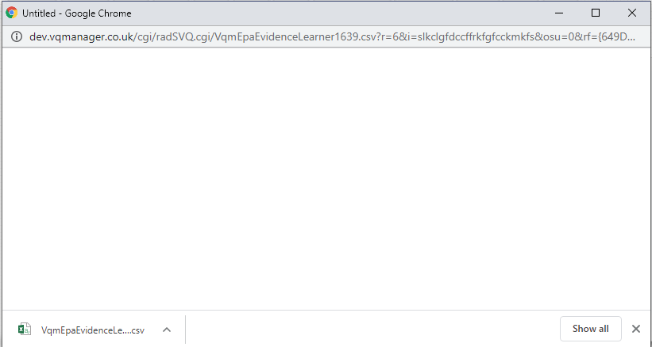
VQManager
Users are also able to export the summary table into Excel if you need to by selecting the “Download table” arrow.
This enables the table to be shared with the EPA, or saved elsewhere as a record of what has been submitted for EPA.
Select to download the Excel file

Slide 20
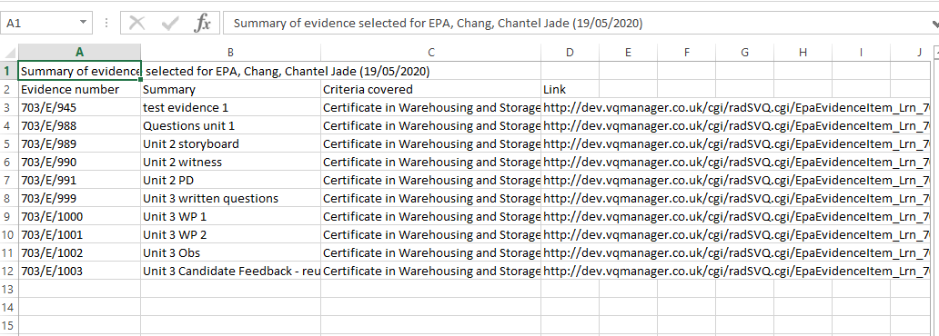
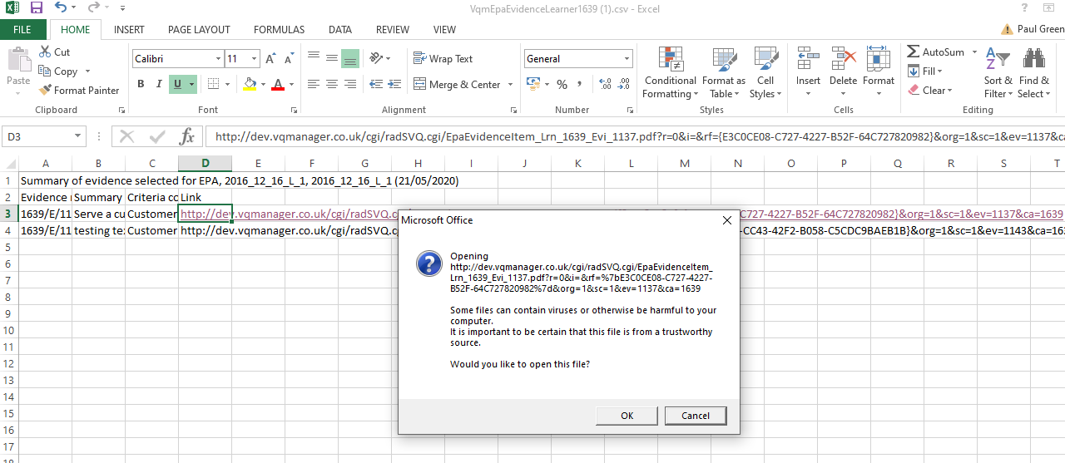
VQManager
The downloaded table includes the links for each piece of evidence (column D), and these can be opened in a browser.

Slide 21
VQManager
EPAO view of evidence
To reiterate, for the End Point Assessor, evidence will display in the same layout as it does in VQManager. A typical evidence item will be 3 – 4 pages long, when extracted into a PDF file, though slightly less if user comments and audit trail are excluded.
File attachments in the evidence will be displayed, and can be opened by clicking on them.

Slide 22
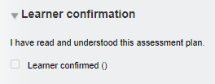
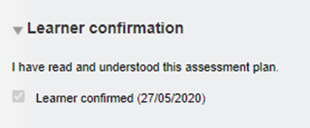
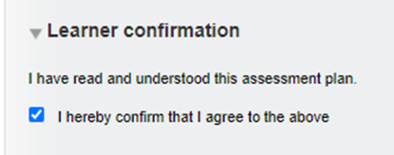
VQManager
Improving information to users around Assessment Plan confirmation
We have added some text around the learner 'assessment plan confirmation' area to make it a little clearer and also added the date confirmed.
Before the learner confirms, assessor view
After the learner confirms, assessor view.
The message the learner sees is also more clear.

Slide 23
VQManager
Change of wording to encourage better AP use
We have made a small change to the wording on screen when users are creating assessment plans. Creating one enormous plan linked to every criteria in a qualification is not ideal. It takes a long time to process and slows the system page loading down. It is far better to create smaller, task or activity driven plans.
The wording has been changed so instead of 'Not linked to any qualification's unit(s)'
It now reads 'Not linked to any specific criteria within a qualification‘

Slide 24
VQManager
Changing user status from Disabled to On hold
We have altered the terminology within VQManager in the user status category. Formally it was labelled 'disabled' and this has now been changed to “on hold”. This does not change the meaning of the status at all.
All of these developments have automatically been added to your centres.

Slide 25
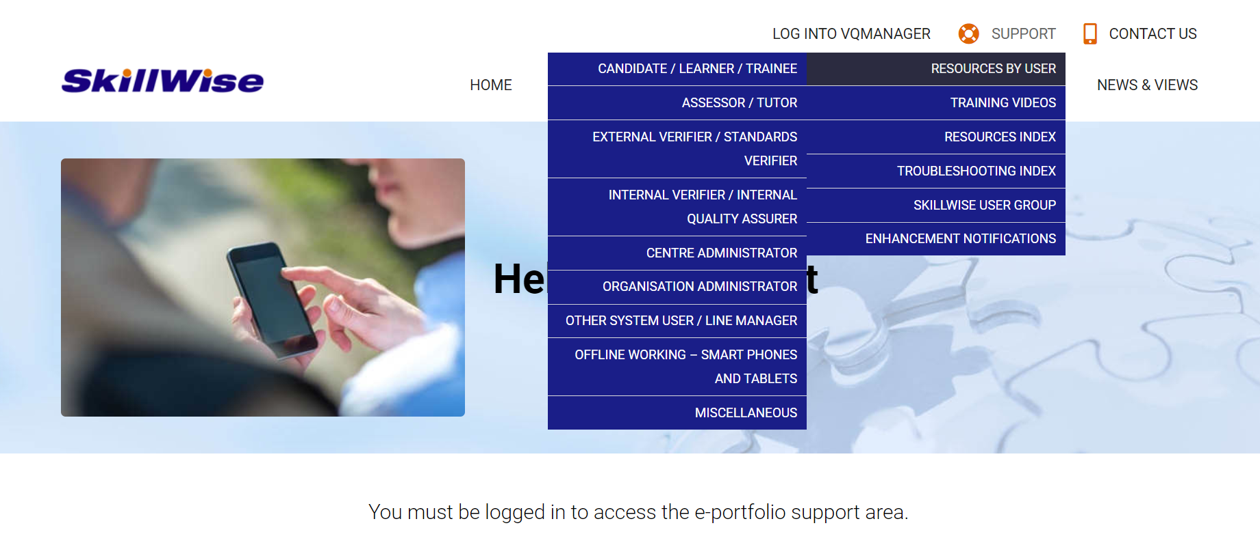
VQManager
www.SkillWise.net/support
We have an extensive support and training area for all users. You will find video and PDF documents to help you use all functionality within VQManager.
The password is solution.
.

Slide 26
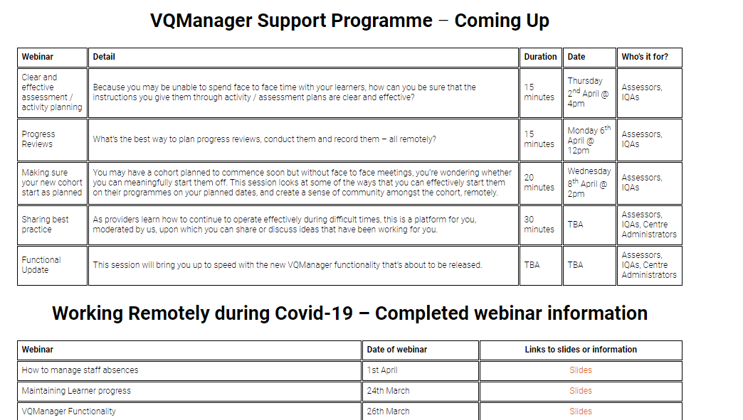
VQManager
www.skillwise.net/support
We have a new page in the support area indicating when we will be holding more webinars to support you.
If you have any webinar requests, please do let us know.
.
https://www.skillwise.net/support/additional-support/

