Slide 1
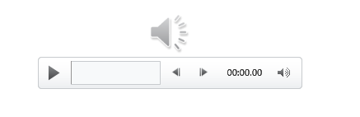
VQManager
Each slide has voice commentary if required.
Select the loudspeaker icon top left corner to reveal the audio control

Slide 2

VQManager
What’s the best way to plan progress reviews, conduct them and record them all remotely?

Slide 3
In the current climate, what’s the benefit of completing reviews remotely?
No personal contact
Keep learner engaged
Keep your progress reports up to date
Immediate re-start when learner can work again
VQManager

Slide 4
Benefits of scheduled versus ad hoc
Scheduled –
- auto reminders, none are missed
- no need to worry
Ad Hoc –
- complete at most appropriate time
- Can do interim reports
VQManager

Slide 5
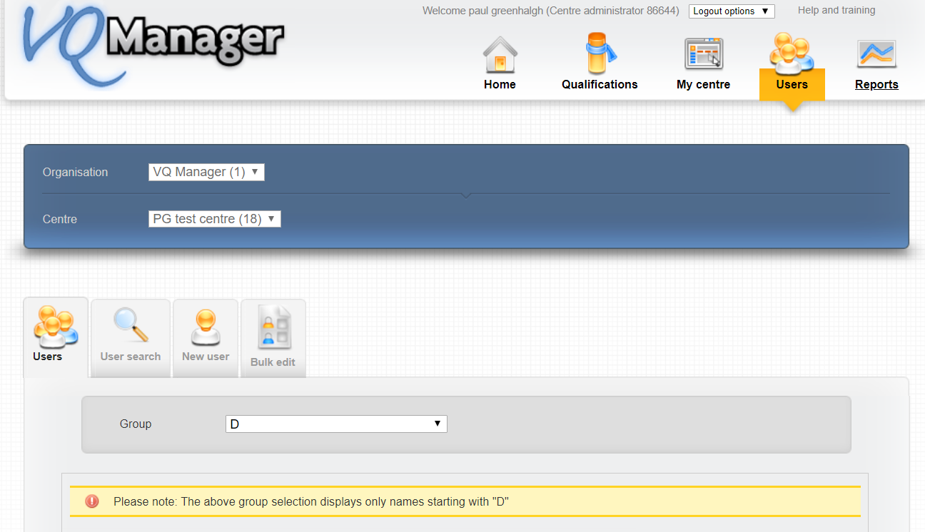
How to schedule a sequence of reviews
VQManager

Slide 6
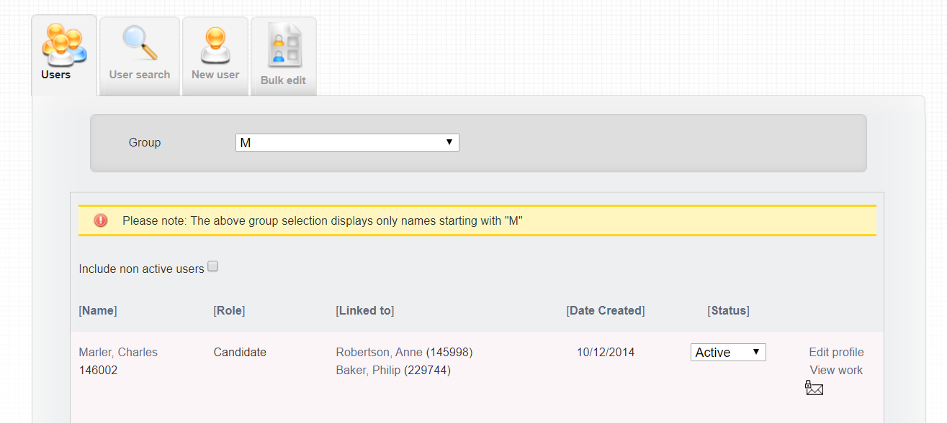
How to schedule a sequence of reviews
VQManager

Slide 7
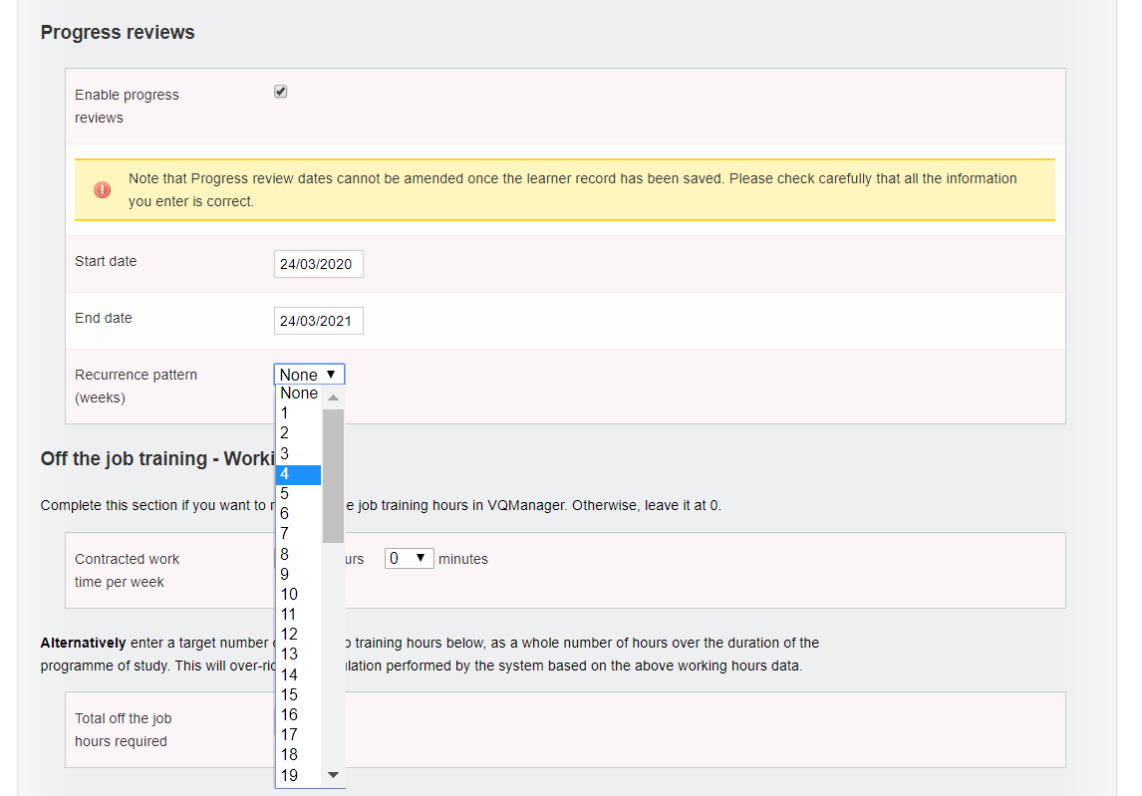
How to schedule a sequence of reviews
VQManager

Slide 8
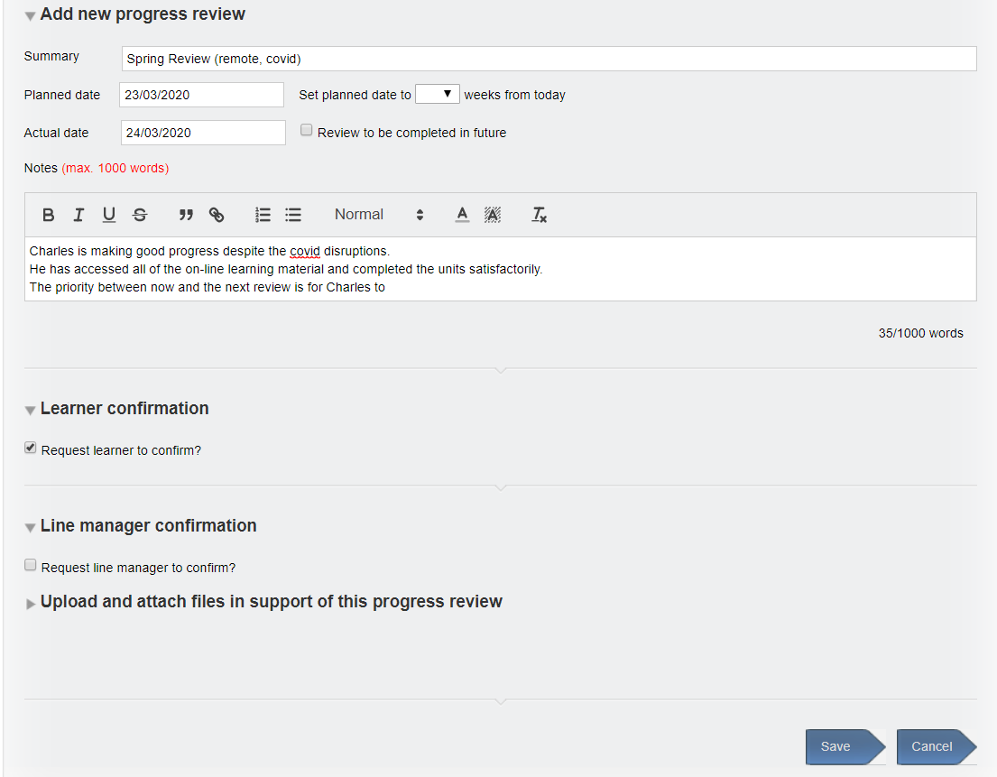
Who gets a reminder and what does it look like?
VQManager

Slide 9
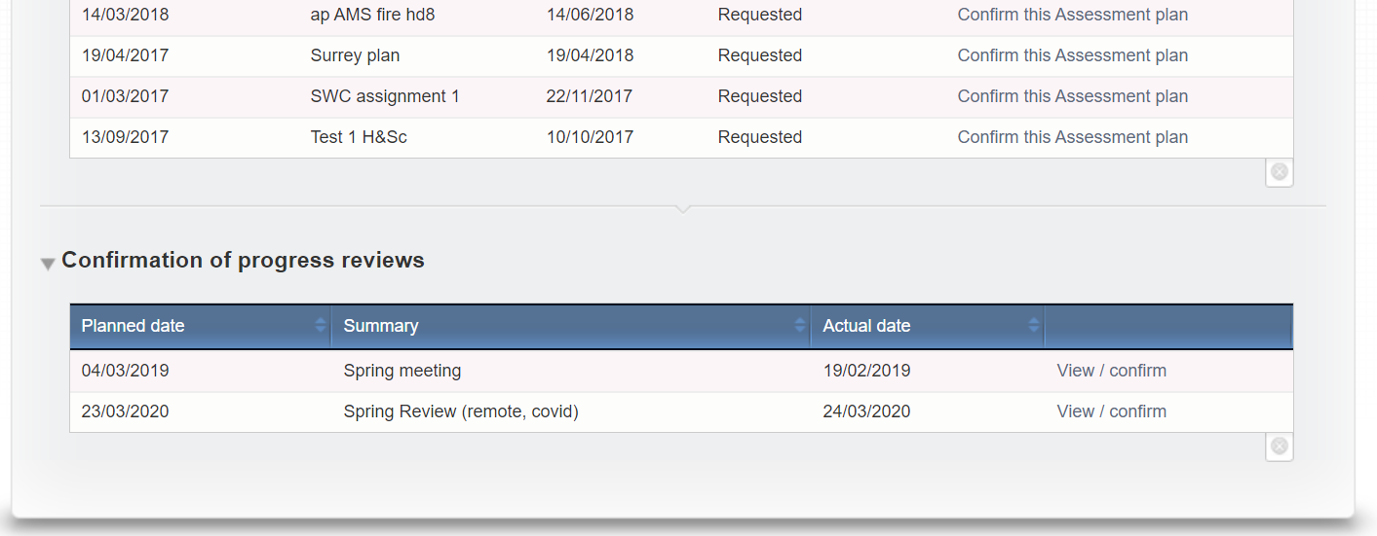
Who gets a reminder and what does it look like?
VQManager

Slide 10
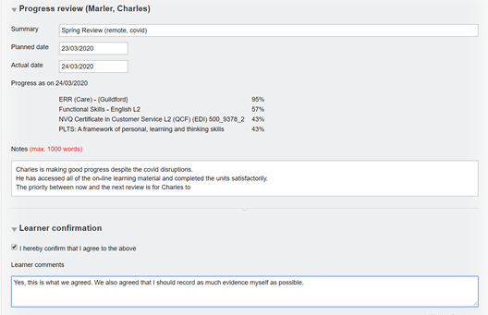
Who gets a reminder and what does it look like?
VQManager

Slide 11
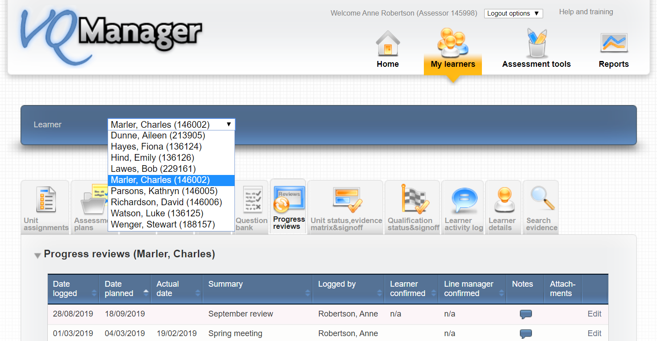
Logging ad hoc reviews
VQManager

Slide 12
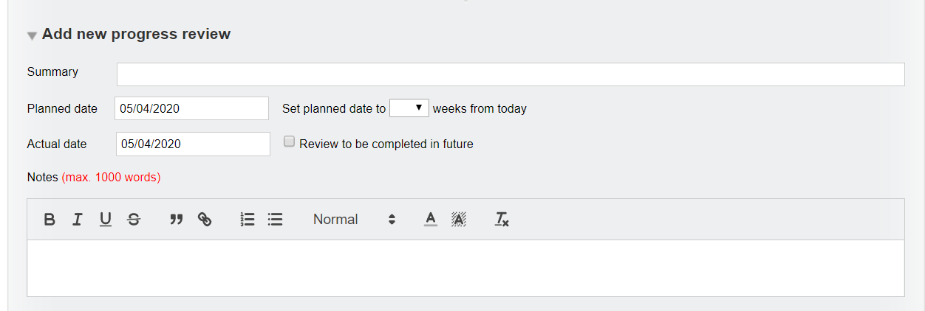
Logging ad hoc reviews
VQManager

Slide 13
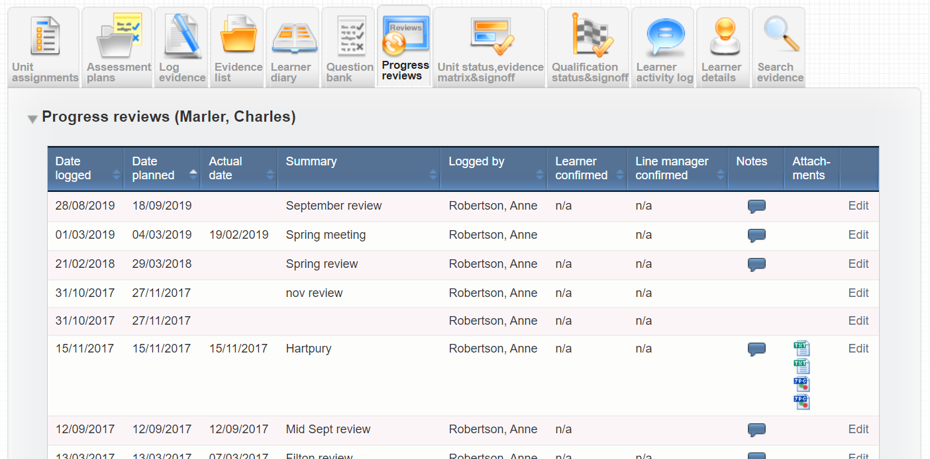
Logging ad hoc reviews
VQManager

Slide 14
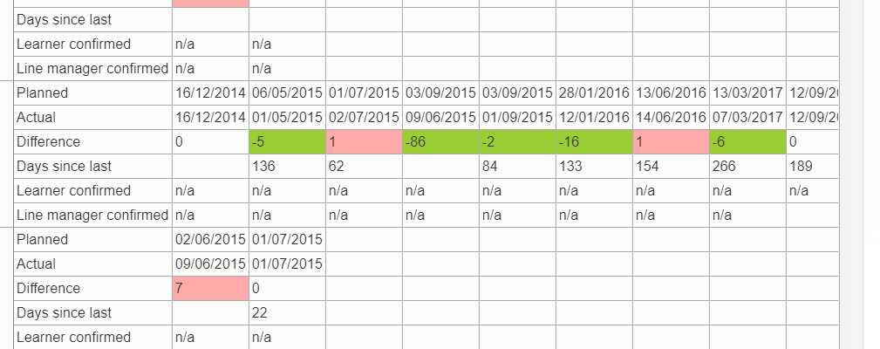
Reporting
VQManager

Slide 15
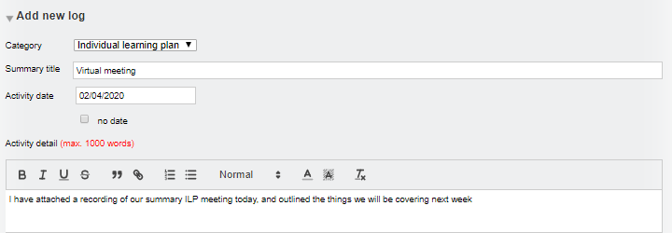
VQManager
Using the Activity Log to Record Informal Learner Reviews
If you need to create summaries of virtual meetings and outline activity for individual learner in an informal way, this can be achieved using the activity log area. Using this area is quick and easy and the learner will get a To Do tab notification to let them know a log has been added and when the learner adds comments etc., the assessor will also receive a To Do tab notification.

Slide 16
VQManager
Using the Activity Log to Record Informal Learner Reviews
The progress review area comes with these advantages over the activity log area:
Pre – planning reviews
Calendar reminder – To Do tab notification
Progress stamps qualification(s) and OTJ Training hours
Invites learner and line manager to contribute
Formally records that the learner has seen the review

Slide 17
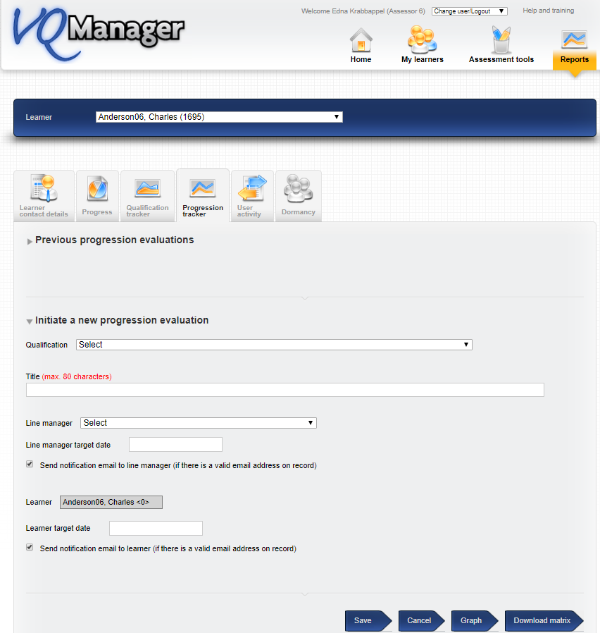
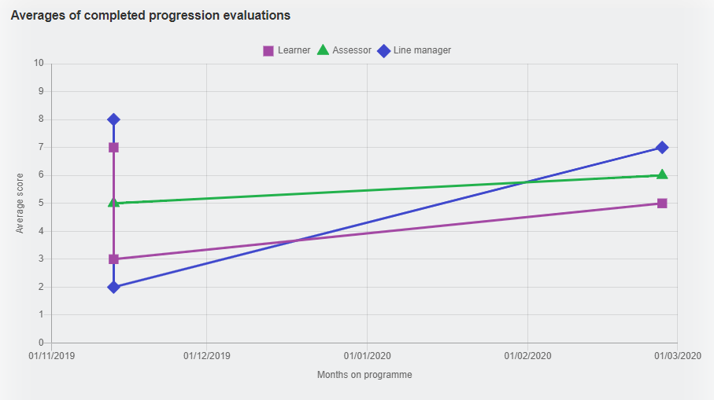
Progress review complete – trigger a Progression Tracker?
VQManager

Slide 18
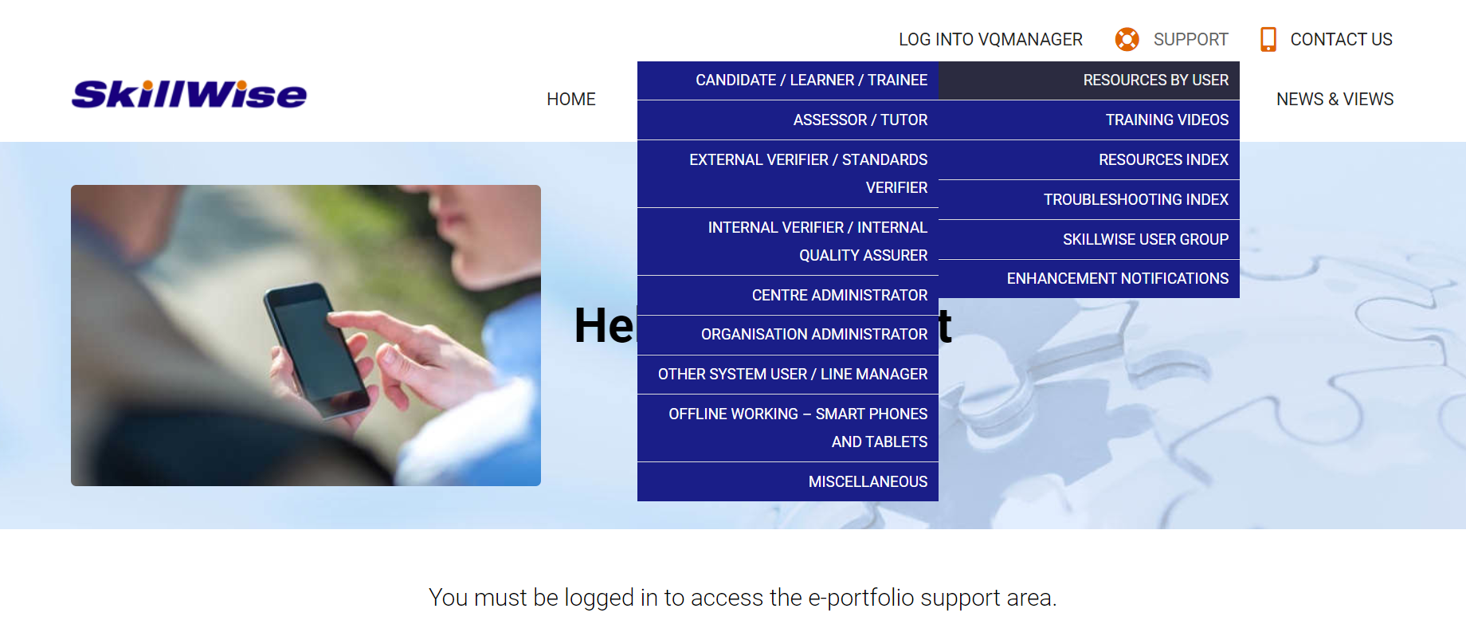
VQManager
www.SkillWise.net/support
We have an extensive support and training area for all users. You will find video and PDF documents to help you use all functionality within VQManager.
The password is solution.
.

Slide 19
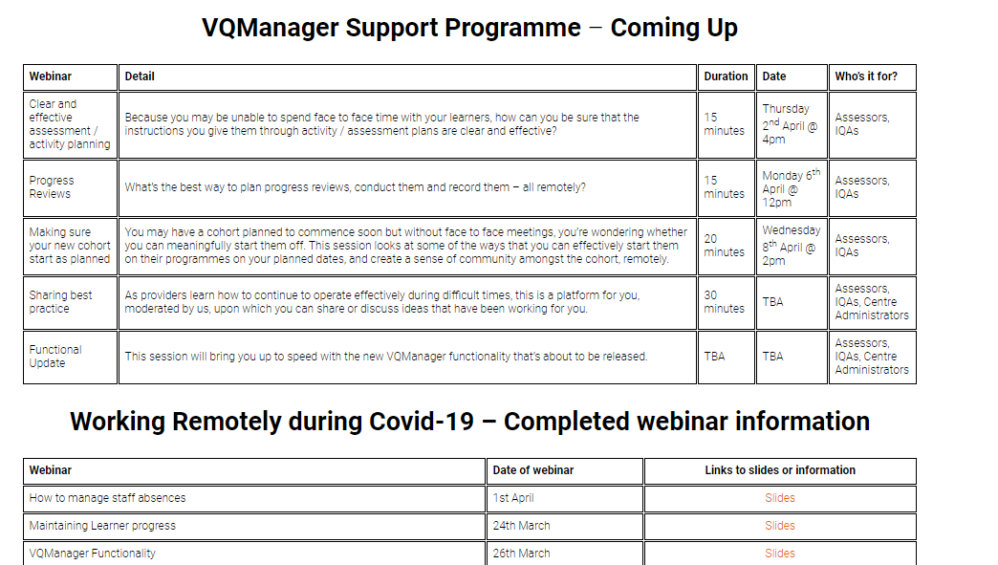
VQManager
www.skillwise.net/support
We have a new page in the support area indicating when we will be holding more webinars to support you.
The next one is on Wednesday at 2pm.
https://www.skillwise.net/support/additional-support/
.

