Slide 1
VQManager
Each slide has voice commentary if required.
Select the loudspeaker icon top left corner to reveal the audio control

Slide 2
VQManager
VQManager Maintaining learner progress during Covid - 19

Slide 3
VQManager
This webinar helps support the using of specific VQManager functionality to ensure that your learners continue to make progress during the Covid- 19 crisis.
We will discuss:
Deployment of learning content through VQManager
Recording of OTJT
Reflective diaries

Slide 4
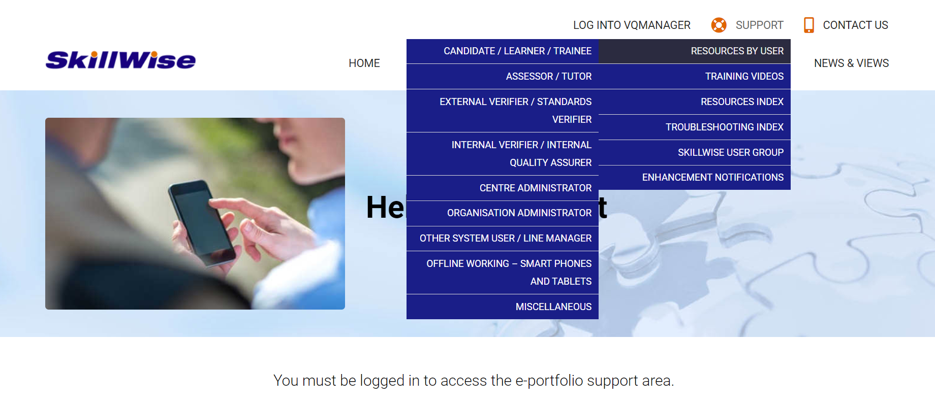
VQManager
www.skillwise.net/support

Slide 5
VQManager
Deploying learning content
Where does content ‘live’?
Best ways to deploy it
assessment plan

Slide 6
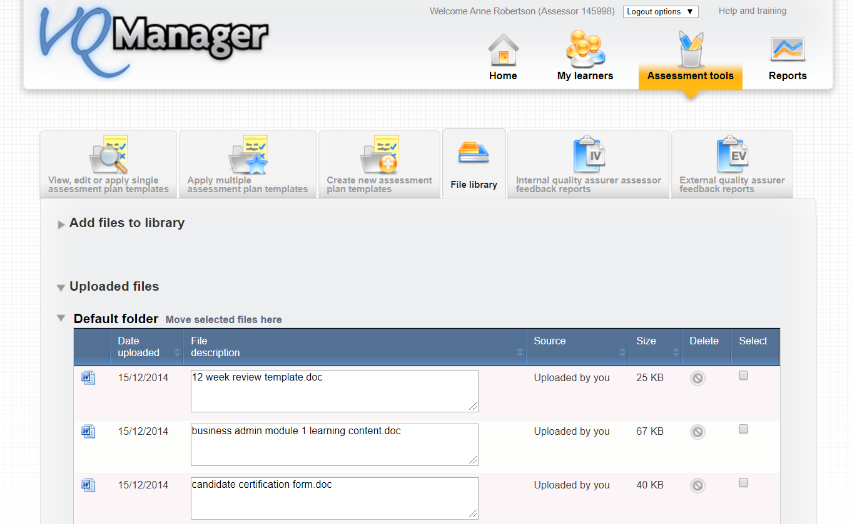
VQManager
The File Library
The file library is a repository for you to upload any documents you need quick access to whilst working in VQManager and deploying to learners. You might use it for:
Templates
Learning materials
Weblinks
Q&A documents

Slide 7
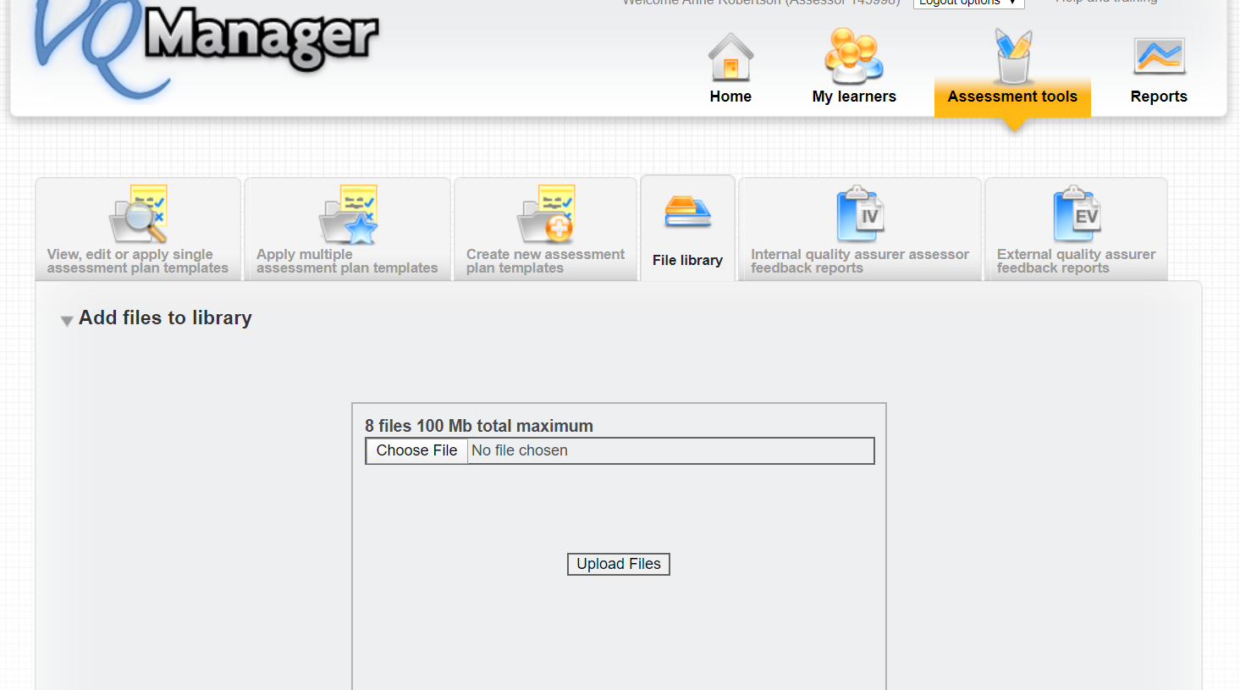
VQManager
The File Library
Upload your files as you would attach a document to an email.

Slide 8
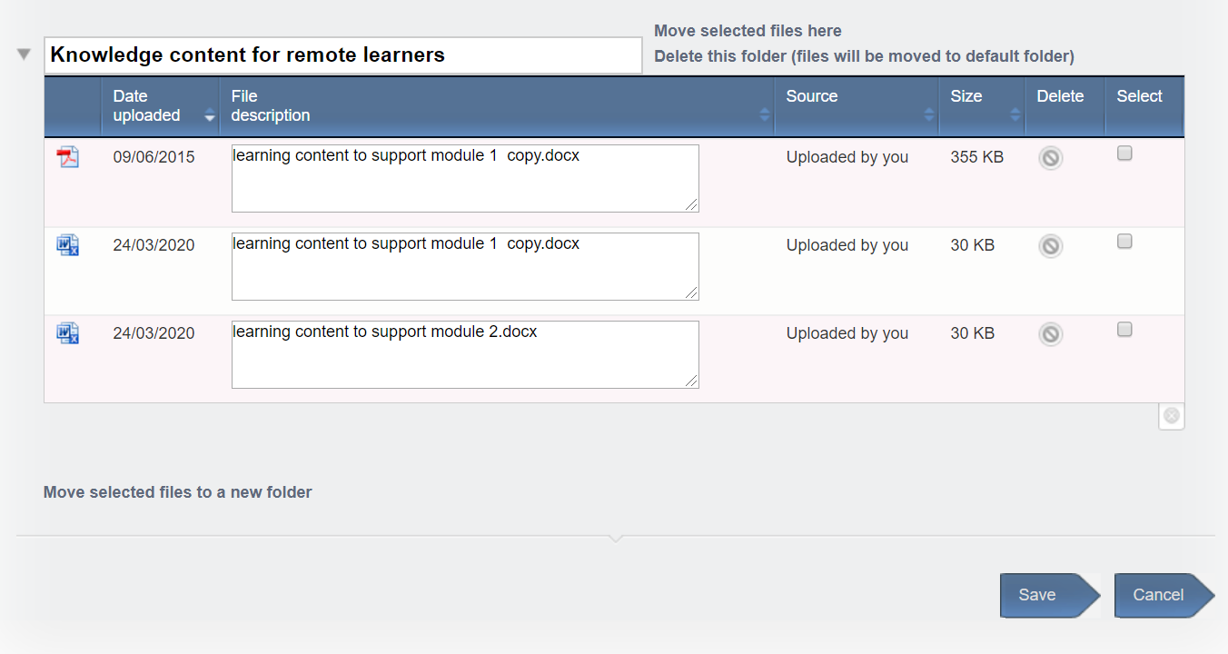
VQManager
The File Library
Sort your files into folders, i.e. qualification, induction etc.

Slide 9
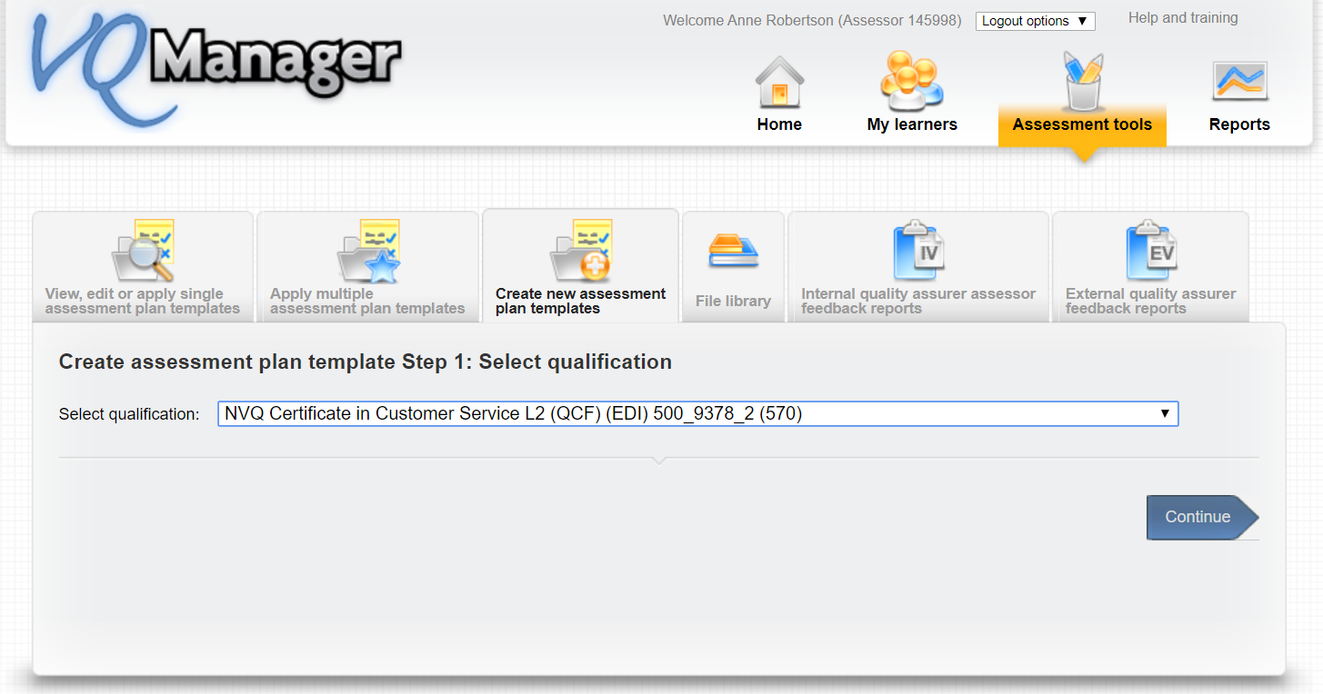
VQManager
Using the File Library with Assessment Plans
Start creating the assessment plan template -

Slide 10
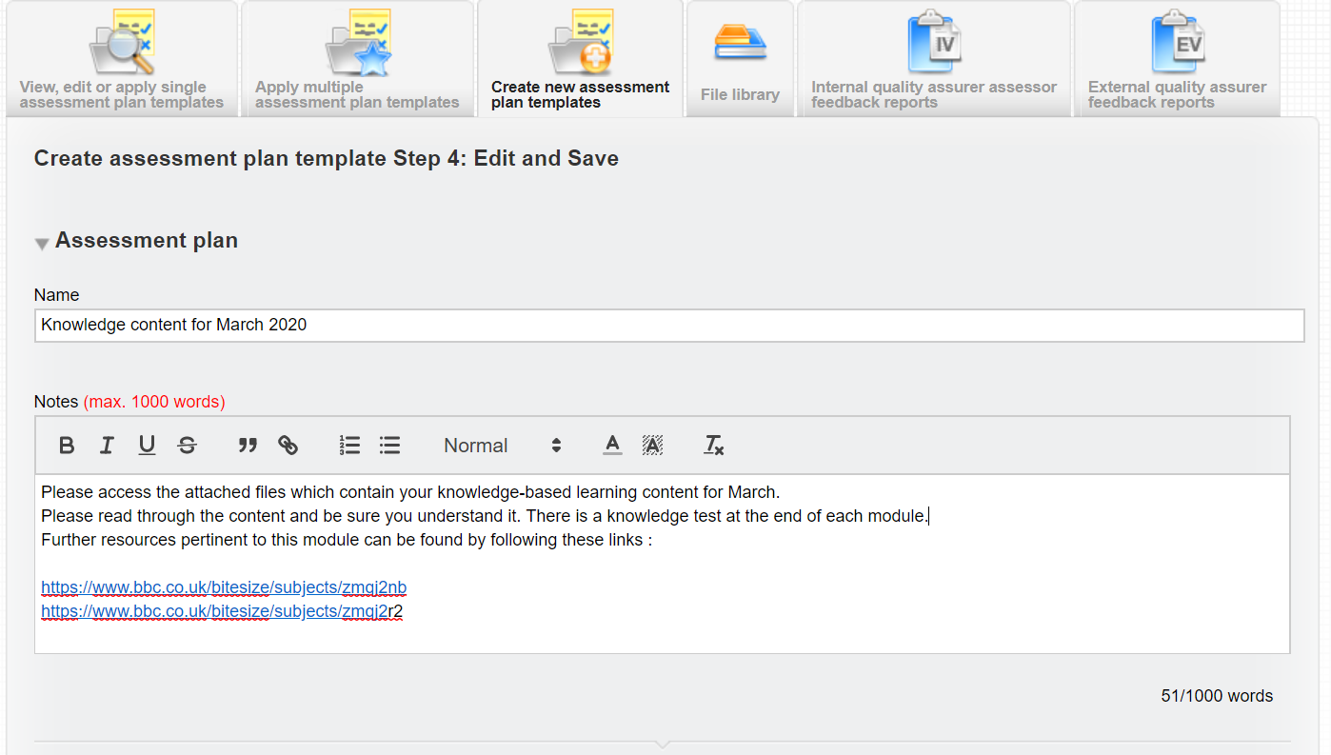
VQManager
Using the File Library with Assessment Plans
Enter template plan details:

Slide 11
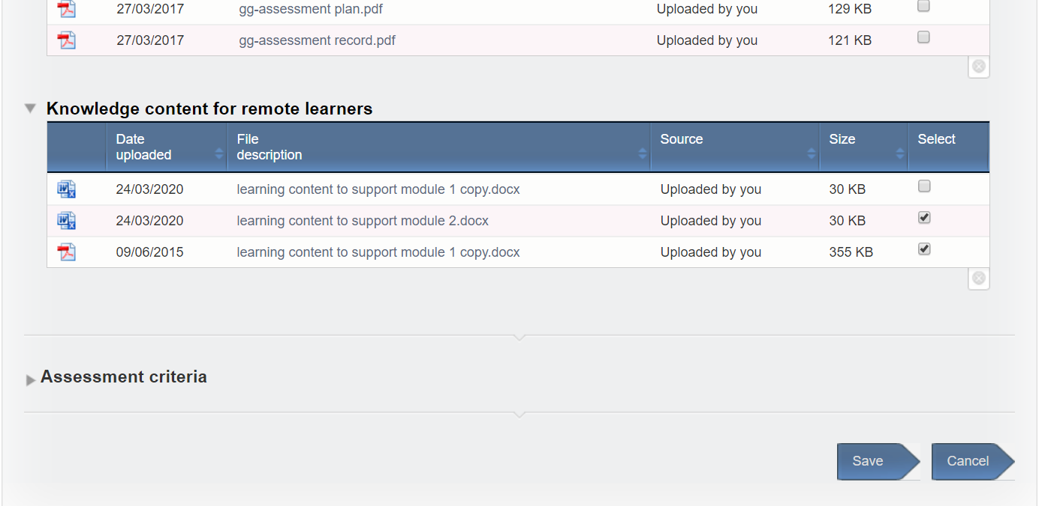
VQManager
Using the File Library with Assessment Plans
Then attach the files you have uploaded to the file library area to your plan template

Slide 12
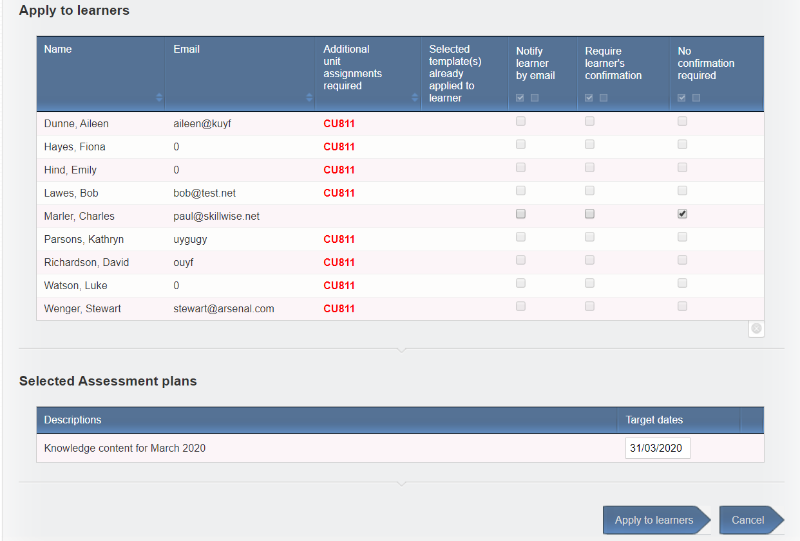
VQManager
Using the File Library with Assessment Plans
You can then share the plan template with as many learners as you wish, one of the whole cohort. The plan can be used editing and re-shared once it has been created. Then share the files you have uploaded to the file library area
NB – any with red writing against them mean either:
They have not been assigned the qualification the plan addresses
They have not been assigned the unit within the qualification the plan addresses

Slide 13
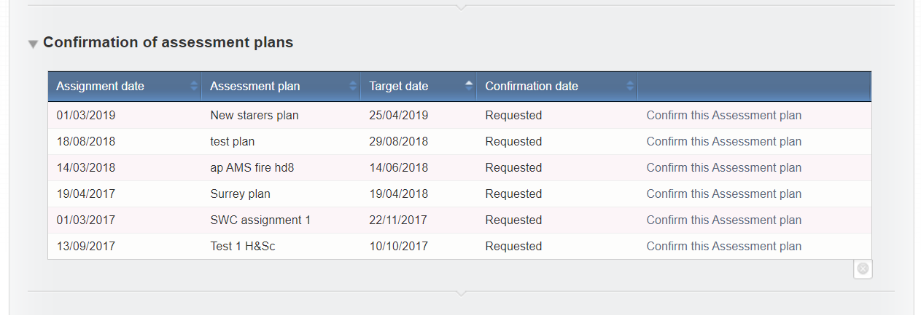
VQManager
Using the File Library with Assessment Plans
Once assigned, the learner will receive a notification of the plan, confirm receipt of the plan and start following the instructions to create the evidence in support of it

Slide 14
VQManager
Using the File Library with Assessment Plans
Once evidence is ready, it can be uploaded by the learner and mapped to the plan in the “Log evidence” page.

Slide 15
VQManager
Off the Job Training
The Apprenticeship Standard learners are required to show they have spent 20% of their paid working time on off-the-job training.
The off the job training fields will only appear in VQManager where the Centre Admin populates “working time” in the field in the learner user profile, i.e. the function is hidden for all users it is not relevant to.
Because a calculated target is not always appropriate (in the case of working irregular hours, absences through illness etc), as an alternative you can simply type in the target for any individual learner.

Slide 16
VQManager
Off the Job Training
The current system uses the working hours, and the start and end dates for the learner, to work out total off-the-job hours required for the learner over the course of their study. (hours per week x 0.2) x no. of weeks between start and end date.
Annual leave is not subtracted from this calculation. This provides a ‘buffer’ to make sure learners are fulfilling the 20% with some time to spare. 20% is a minimum requirement
Target start date for OTJT is the earliest of the start dates for the qualifications assigned, and target end date is the last of the end dates for the qualifications assigned.
Where a learner has both GLH and OTJT set up against their account, users can log GLH and OTJT with different start and end times in the same log, (Activity or Diary), because these functions are completely separate.
.

Slide 17
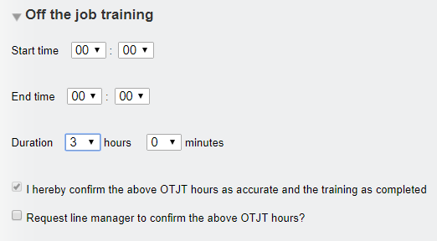
VQManager
Off the Job Training
The Function for recording off the job training is located in both the Diary and Learner Activity Log for the assessor and the learner.
OTJT duration can be recorded in hours and minutes. Start and end times can also be recorded if required, but are not essential.

Slide 18
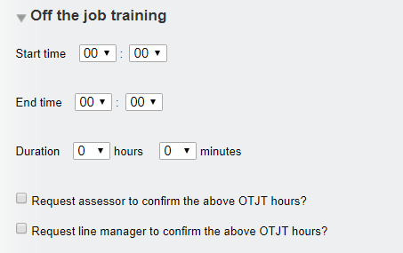
VQManager
Off the Job Training
Learners when completing this section are able to send a request to both the assessor and Line Manager to confirm the hours when they log them.
This request generates a To Do list item for the assessor and the Line Manager and also an email in addition for the Line Manager.

Slide 19
VQManager
Off the Job Training
When an assessor completes the OTJT section, the declaration “I hereby confirm the above OTJT hours as accurate and the training as completed” appears and is automatically ticked. The assessor's confirmation tick implies that the hours are correct and the training is completed and hence the hours can be added to the total.
Where a Line Manager is assigned to the learner, the assessor is able to send a request to the Line Manager to confirm the hours is required by ticking the appropriate box. This request generates an email and a To Do list item for the Line Manager.
As both an assessor and a learner it is possible to go into an existing record and request Line Manager confirmation, if this wasn’t done at the time the record was first created.
The Line Manager confirmation element will be hidden where no Line Manager is assigned to the learner.

Slide 20
VQManager
Off the Job Training
VQManager reports the following throughout the system
Total hours required
Total hours achieved (and confirmed by assessor) to date
Total hours not yet confirmed by assessor
Shortfall hours against target hours

Slide 21
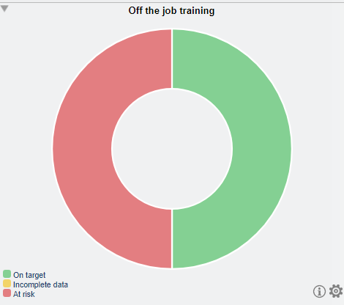
VQManager
Off the Job Training
Activity Log table Diary table My progress summary
Dashboard Learner progress summary

Slide 22
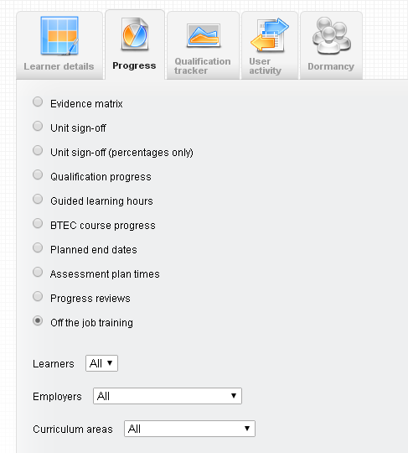
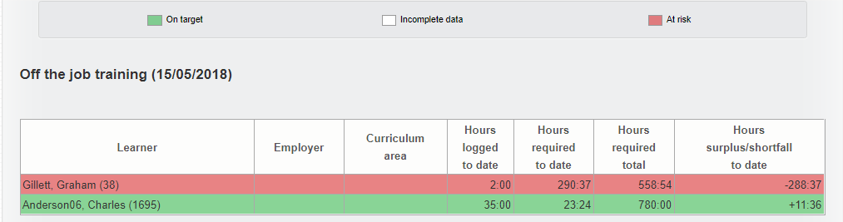
VQManager
Off the Job Training
In the Reports / Progress tab, there is a report for the OTJT. This is available for assessors, IQAs, EQAs, OSUs, Line Managers and Centre Admins. There is a filter for learner, curriculum area and employer.

Slide 23
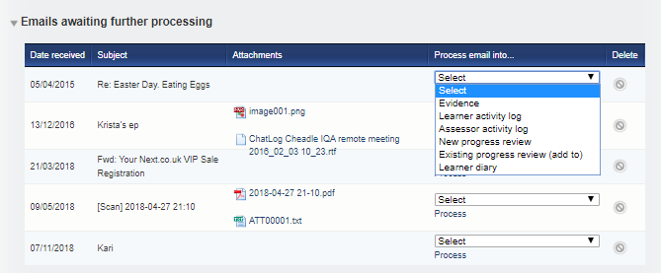
VQManager
Emailing in Off the Job Training
The “emailing in” function can also be used to add OTJT to a new diary or activity log entry
Emails can be sent to VQManager by the assessor or by the learner. The email arrives in a table on the To Do tab entitled: Emails awaiting further processing and can be added to:
Learner activity log
Learner diary.

Slide 24
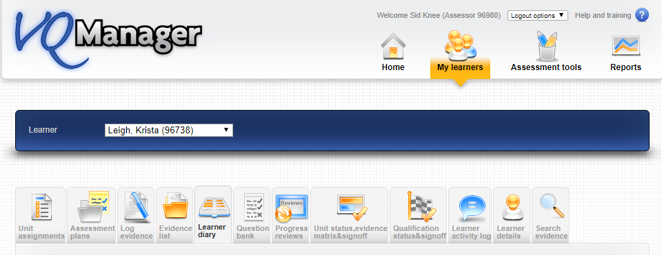
VQManager
Diary / Reflective Account
For the new Standards, users may need to be able to make entries into a diary, similar to the Activity Log to record reflective accounts. It is especially important in the current climate for non “Standard” learners too so they can own the capturing and building up of potential evidence during the periods of absence.
Learner Diary
The diary tab for an assessor is located in the My learners area. This is visible and editable (see details below) to the Learner and the Assessor, and view only for the IQA/ IV and EQA/EV.

Slide 25
VQManager
Diary / Reflective Account
It functions in a similar way to the Activity Log. Entries are displayed in a table, and can be opened up to view the content and edit them if required.
The columns of the table can be sorted using the arrow icon.

Slide 26
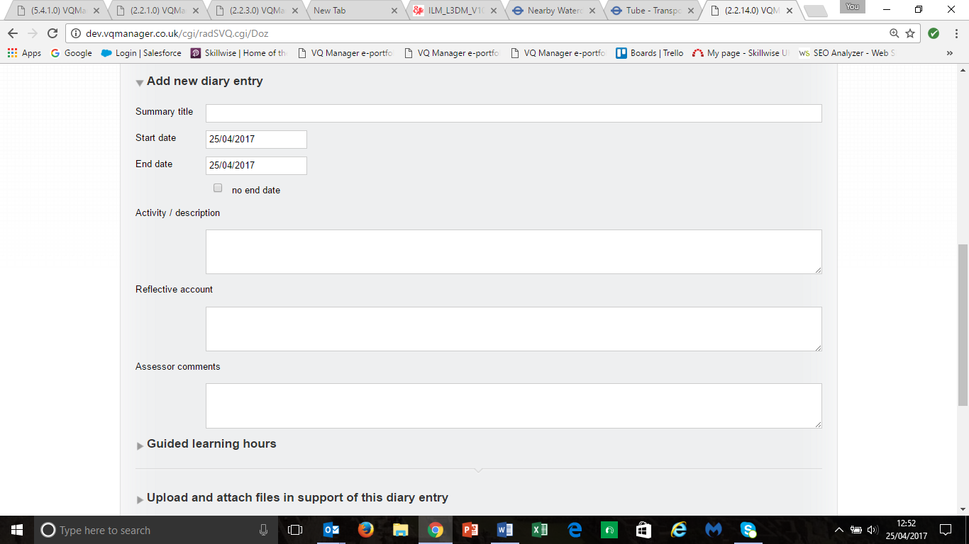
VQManager
Diary / Reflective Account
As with the Activity Log, beneath the table will be a ‘new diary entry’ form. The end date defaults to the same as the start date, but is fully editable by the user so that the diary entry can cover a period of time. Dates are selected from the usual calendar display.
Note that the Reflective Account can only be edited by the learner, and the Assessor Comments can only be edited by the assessor. The rest of the diary record can be edited by either user. This means that assessors can record diary entries on behalf of learners in centres where learners don’t log in to VQManager.

Slide 27
VQManager
Diary / Reflective Account
The diary log is fully editable in the normal way, and with the usual options to save.
When the entry is completed, there are the usual options to save or cancel. There is also an option to save and create evidence.
Clicking this option will save the diary entry, and take the user to the Log Evidence screen.
Some of the information from the diary entry will be pre-completed in the evidence form as follows:
Diary summary title = Summary evidence description
Activity / Description = Description of evidence
Reflective account = Learner comments
Assessor comments = Assessor comments
Files uploaded to the diary entry will also copy across into the evidence.

Slide 28
VQManager
Diary / Reflective Account
You may wish to consider adding Diary entry to your evidence methods, with the proviso that evidence methods are limited to 10, so you can only do this if your centre doesn’t already have 10 evidence method categories.
This function may be hidden from view for your centre. Please speak with Jo or Kari to have this switched on for you.

Slide 29
VQManager
Any questions?
Can you share any best practice with the group?
Are there are special items you need us to cover in a future webinar? Using webinar tools etc.
Do you have any specific learning needs in your organisation you would like us to address?

