Slide 1
VQManager
Each slide has voice commentary if required.
Select the loudspeaker icon top left corner to reveal the audio control

Slide 2
VQManager
Centre Admin functionality webinar

Slide 3
VQManager
This webinar contains functionality information about:
Off the Job Training
Progress Reviews
Trainee Assessors and countersigning
EQA Visits
Forgotten Password Support

Slide 4
VQManager
Off the Job Training

Slide 5
VQManager
Off the Job Training
The Apprenticeship Standard learners are required to show they have spent 20% of their paid working time on off-the-job training.
The off the job training fields will only appear in VQManager where the Centre Admin populates “working time” in the field in the learner user profile, i.e. the function is hidden for all users it is not relevant to.
There is a new development due for release in a couple of weeks’ time. This will allow for total target hours to be added and will therefore not be reliant on the system’s calculation.

Slide 6
VQManager
Off the Job Training
The current system uses the working hours, and the start and end dates for the learner, to work out total off-the-job hours required for the learner over the course of their study. (hours per week x 0.2) x no. of weeks between start and end date.
Annual leave is not subtracted from this calculation. This provides a ‘buffer’ to make sure learners are fulfilling the 20% with some time to spare. 20% is a minimum requirement
Target start date for OTJT is the earliest of the start dates for the qualifications assigned, and target end date is the last of the end dates for the qualifications assigned.
Where a learner has both GLH and OTJT set up against their account, users can log GLH and OTJT with different start and end times in the same log, (Activity or Diary), because these functions are completely separate.
.

Slide 7
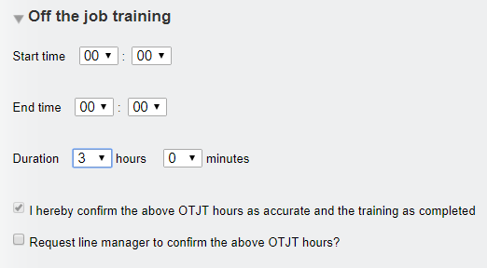
VQManager
Off the Job Training
The Function for recording off the job training is located in both the Diary and Learner Activity Log for the assessor and the learner.
OTJT duration can be recorded in hours and minutes. Start and end times can also be recorded if required, but are not essential.

Slide 8
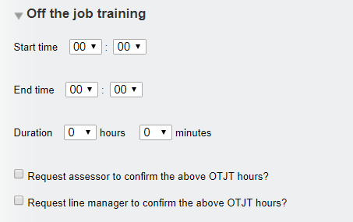
VQManager
Off the Job Training
Learners when completing this section are able to send a request to both the assessor and Line Manager to confirm the hours when they log them.
This request generates a To Do list item for the assessor and the Line Manager and also an email in addition for the Line Manager.

Slide 9
VQManager
Off the Job Training
When an assessor completes the OTJT section, the declaration “I hereby confirm the above OTJT hours as accurate and the training as completed” appears and is automatically ticked. The assessor's confirmation tick implies that the hours are correct and the training is completed and hence the hours can be added to the total.
Where a Line Manager is assigned to the learner, the assessor is able to send a request to the Line Manager to confirm the hours is required by ticking the appropriate box. This request generates an email and a To Do list item for the Line Manager.
As both an assessor and a learner it is possible to go into an existing record and request Line Manager confirmation, if this wasn’t done at the time the record was first created.
The Line Manager confirmation element will be hidden where no Line Manager is assigned to the learner.

Slide 10
VQManager
Off the Job Training
VQManager reports the following throughout the system
Total hours required
Total hours achieved (and confirmed by assessor) to date
Total hours not yet confirmed by assessor
Shortfall hours against target hours

Slide 11
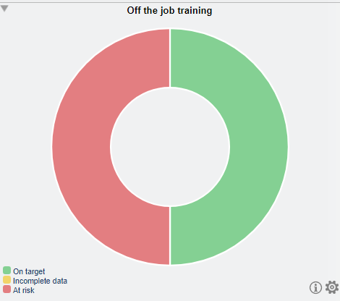
VQManager
Off the Job Training
Activity Log table Diary table My progress summary
Dashboard Learner progress summary

Slide 12
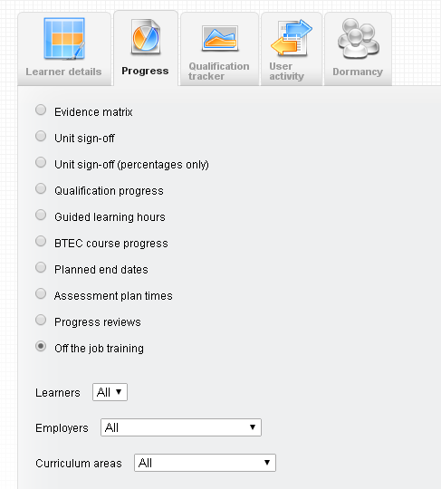
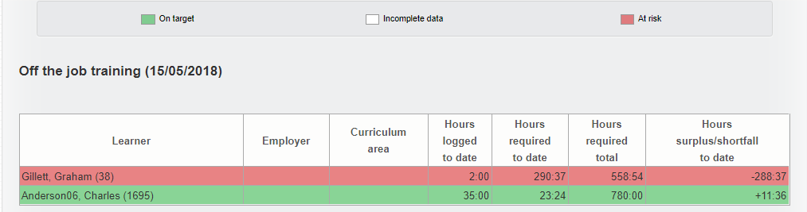
VQManager
Off the Job Training
In the Reports / Progress tab, there is a report for the OTJT. This is available for assessors, IQAs, EQAs, OSUs, Line Managers and Centre Admins. There is a filter for learner, curriculum area and employer.

Slide 13
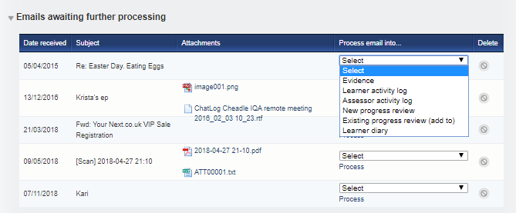
VQManager
Off the Job Training
The “emailing in” function can also be used to add OTJT to a new diary or activity log entry
Emails can be sent to VQManager by the assessor or by the learner. The email arrives in a table on the To Do tab entitled: Emails awaiting further processing and can be added to:
Learner activity log
Learner diary.

Slide 14
VQManager
Progress Reviews

Slide 15
VQManager
Progress Reviews
Progress reviews can be set up several ways in the e-portfolio:
Centre Admin can pre-set reviews
Ad hoc reviews can be added by assessors
Assessors can pre-set reviews

Slide 16
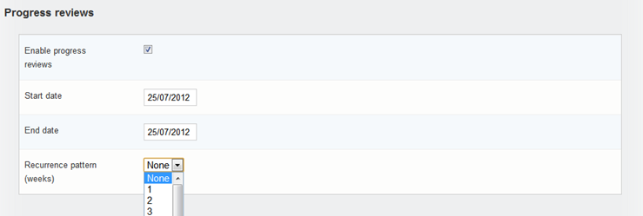
VQManager
Progress Reviews
Centre Admin can pre-set reviews in their own tab when creating a new learner, or editing an existing user. The Centre Admin must tick the “enable progress reviews” box
Ticking this box reveals the other progress review fields, which should then be completed: dates and a recurrence pattern (e.g. 10 weeks)
This will then automatically create Progress Reviews recurring between the learner’s start and end date according to the pattern selected. For example, if a 5-week recurrence pattern is chosen, the first review will be 5 weeks after the learner’s start date, and there will be another review planned every 5 weeks until the learner’s end date. Assessors will be reminded of these progress reviews on their To Do tab which will go red when overdue.

Slide 17
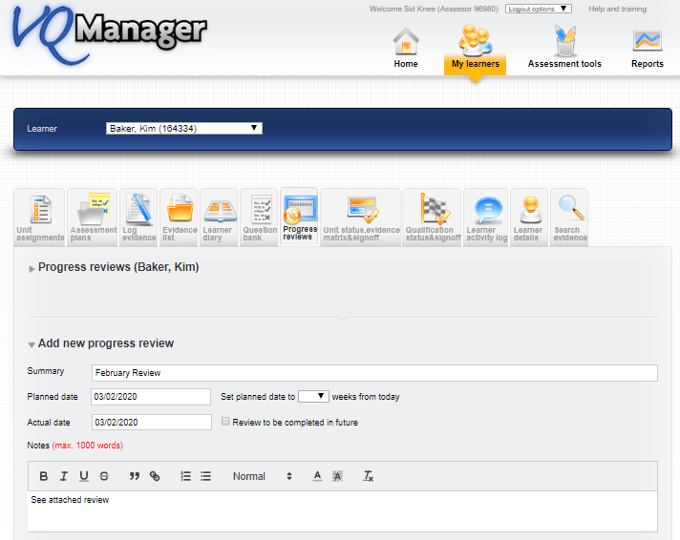
VQManager
Progress Reviews
Ad hoc reviews can be added by assessors
Assessors can add a progress review at any time by using the “Add new progress review” area.

Slide 18
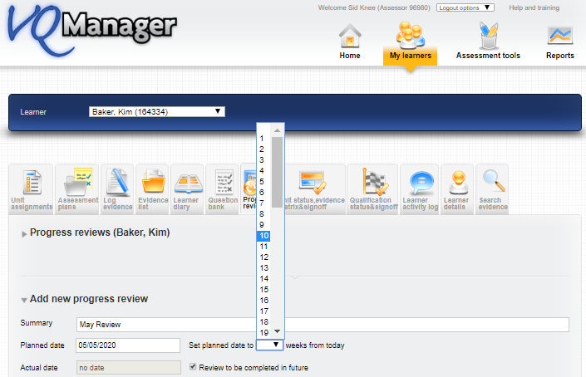
VQManager
Progress Reviews
Assessors can pre-set reviews
An assessor can also create a pre-set Progress Reviews using the “Add new progress review area” again but by adding a planned date for some time in the future. This will trigger the usual notifications in the ‘upcoming Progress Review’ area of the To Do tab. It is critical to tick the field “review to be completed in the future”

Slide 19
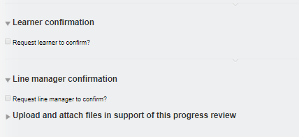
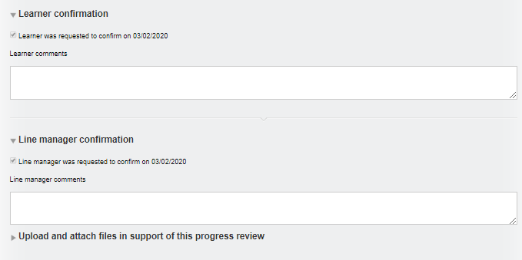
VQManager
Progress Reviews
On the day of the review, open the review and enter the actual date, any notes and upload documents as normal. You are still able to tick the confirmation request for the learner and Line Manager. Don’t forget to click ‘save’ at the bottom.
At this stage, a comments box for the Learner and the Line Manager appear, so both are able to make comments as well as ticking the confirmation box. Note that confirmation can only be requested if the “actual date” of the review is completed. This prevents users from confirming a review that hasn’t happened yet.

Slide 20
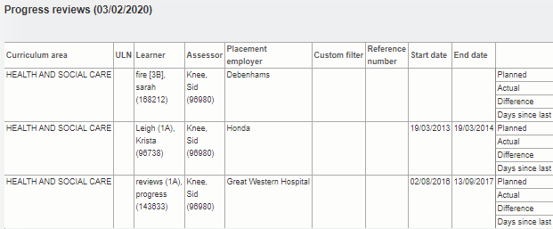
VQManager
Progress Reviews
Progress Review Report
Centre Admins will be able to draw a report which shows the reviews that have been completed and the lag between target and actual dates. Reviews completed early or on time are marked green, and reviews performed behind schedule are marked red.
The information also shows the number of days lapsed between reviews

Slide 21
VQManager
Progress reviews
The “emailing in” function can also be used with progress reviews.
Emails can be sent to VQManager by the assessor. The email arrives in a table on the To Do tab entitled: “Emails awaiting further processing” and can be added to:
New progress review
Existing progress review

Slide 22
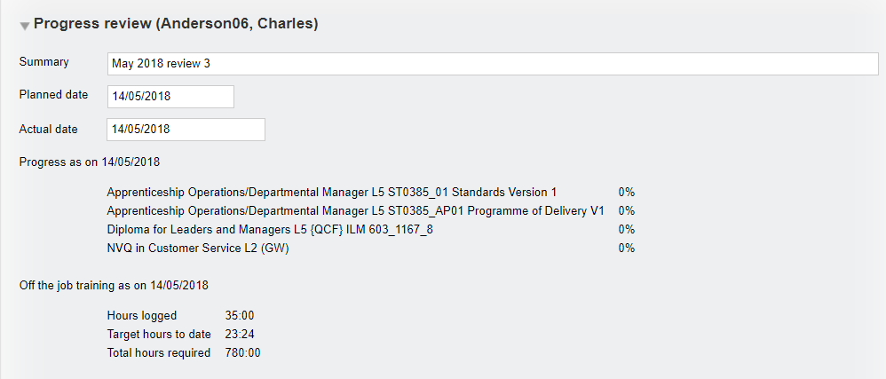
VQManager
Progress Reviews - Off the job training
Progress Reviews showing OTJT progress
This existing view now shows progress against required OTJT at the point the Progress Review is completed.

Slide 23
VQManager
Trainee Assessors and Countersigning

Slide 24
VQManager
Trainee Assessors and Countersigning
Qualified assessors are not linked directly to trainees they are linked to the learner. The system knows who is a trainee and who is qualified based on the role assignment for the trainee.
The workflow should always go from learner to trainee to qualified and back through the trainee to the learner
Any evidence uploaded by the learner will appear in the trainee’s “To Do” tab. The qualified receives a notification that the work has been uploaded too but this appears in their “Info” tab rather than their ”To Do” tab

Slide 25
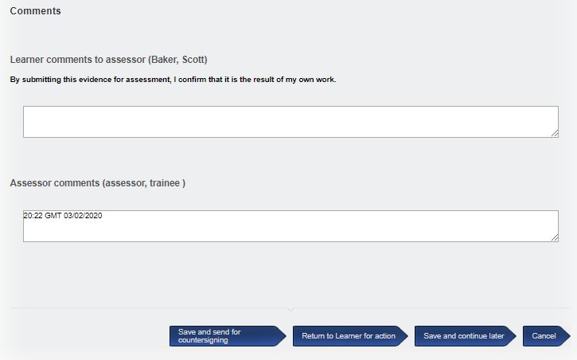
VQManager
Trainee Assessors and Countersigning
The trainee checks off the criteria alongside the learner in the qualification tree
Adds comments for the learner
When the trainee has assessed the work and sent for countersigning, the qualified will see it in his To Do tab

Slide 26
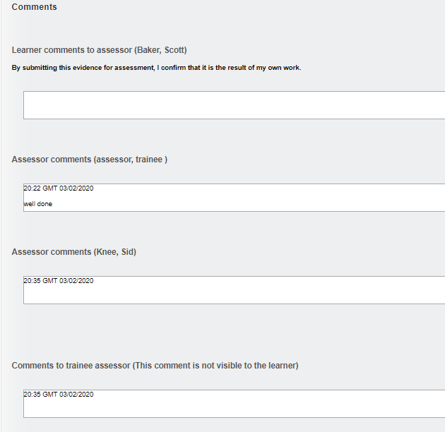
VQManager
Trainee Assessors and Countersigning
To countersign evidence, the qualified assessor must confirm the ticks of the trainee assessor that they agree with. % completion is calculated on qualified assessor ticks only, which is why this is essential.
New comments boxes appear allowing the qualified to feedback not only to the trainee but also to the learner. The learner cannot see the qualified feedback to the trainee

Slide 27
VQManager
Trainee Assessors and Countersigning
Qualified interception of evidence workflow process
Learner submits evidence to trainee assessor
Evidence becomes visible to the trainee in the To Do tab and to the qualified in the Info tab
If the evidence is processed by the qualified from the Info tab rather than waiting for the trainee, the evidence moves to the Evidence list for the trainee (view only) and the qualified (re- assess) thereby cutting the trainee out of the workflow.
If the qualified rejects this evidence by the learner, the evidence goes back to the learner without going via the trainee. When the learner resubmits that piece of evidence, the trainee is still cut out of the loop and it goes straight to the qualified.

Slide 28
VQManager
Trainee Assessors and Countersigning
Change in personnel
Evidence is always routed by role, not by individual user. So for example, removing one qualified assessor and assigning another qualified assessor will have no impact on evidence. The new assessor can just pick up where the old one left off.
The system will compensate when you add or remove a trainee assessor. If you remove a trainee assessor from the process for a particular learner, or add one in, the system will adjust the workflow states accordingly, so that assessors don't lose access to work they need to be able to assess.
If there was a trainee in the loop for a learner, and then you remove that trainee, the evidence will change states so that the qualified assessor will be able to assess it. (This is assuming there is not another trainee associated with the learner, in which case the evidence stays where it is.) Any evidence that has been processed by the trainee waiting for countersignature will still need to be signed off by a qualified assessor. This could be the trainee, after their status is changed; or their current countersigning assessor before the change. We recommend that the pending evidence in countersigning process is countersigned before you change the trainees’ status to avoid confusion.
If

Slide 29
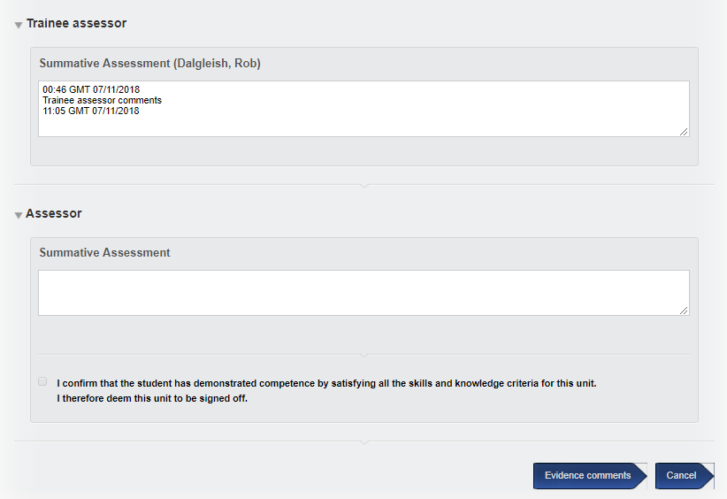
VQManager
Trainee Assessors and Countersigning
Trainee assessor comments box for unit and qual sign off
At unit and qualification sign off there is a trainee comments box. This means that trainee assessors can comment but cannot sign off units and qualifications.
Unlike the qualified assessor area, there is no tick box associated with this comments box. The tick box to sign off is the responsibility of the qualified assessor. The qualification sign off date in all the tabs and reports etc. is associated with qualified assessor sign off not the trainee comments date.

Slide 30
VQManager
EQA visits

Slide 31
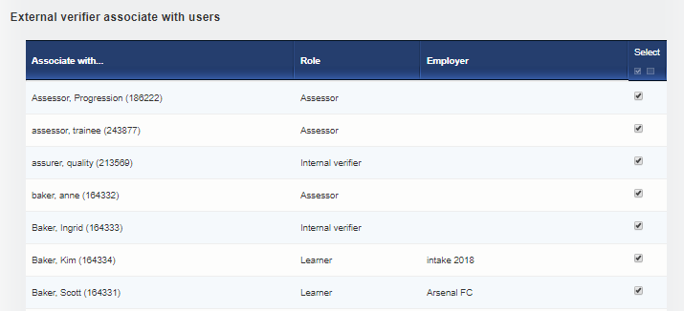
VQManager
EQA/EV Visits
When creating an EQA/EV as Centre Admin in the new user area, make sure that learners, assessors and IQAs are selected. It is not enough to only select the learners in the EQA/EV User profile.

Slide 32
VQManager
EQA/EV Visits
Check that the EQA has the correct qualifications associated with him/her.

Slide 33
VQManager
End Point Assessor Organisations
A new and exciting piece of development is going to be underway shortly which will allow the exporting of evidence in cases where the EPAO will not access VQManager to view the learner’s evidence.
Watch this space!

Slide 34
VQManager
Security and forgotten passwords

Slide 35
VQManager
Passwords
Org Admin and Centre Admin removal of view of passwords
Previously the full username and password was visible to both the Org Admin and also the Centre Admin. This was to help facilitate supporting any user forgetting their password. Since then, three new functions have been added to improve security and comply with GDPR and so we have removed this information from view.

Slide 36
VQManager
Passwords
When a new user is added to the system by the CA, a password is manually created.
At that time both "Force password change" and "Email a password set / reset link to this user" are available to further secure and support the process.
To ensure the new user knows their username and password the CA ticks “email password ….” to trigger an email to the user via the email address recorded lower down that page. The link is valid for 7 days.
Once the user creation is saved, the password is no longer visible when the CA reopens the profile.

Slide 37
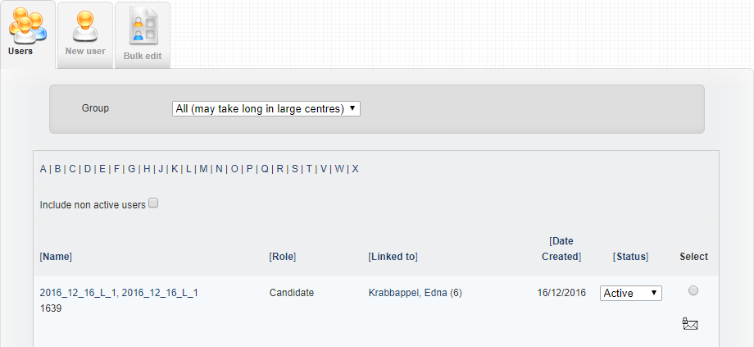
VQManager
Passwords
At any time later the CA can trigger a password re-set message by selecting the envelope icon on the User tab. The user has 24 hours to follow the link in the message before it expires.

Slide 38
VQManager
Passwords
At any time later the user can trigger a password re-set message by selecting the “forgotten your password” link on the VQManager login screen. This triggers an email to the user. The user has 24 hours to follow the link in the email before it expires.

Slide 39
Passwords
A password re-set message looks like this:
Hi Tracey Udall Welcome to VQManager! Your VQManager user name is TRACEY@VQMTEST You may set your VQManager password by clicking this link: http://www.vqmanager.co.uk/cgi/radSVQ.cgi/p?rf=9B950701-A3CA-419D-B544-1E2F0BC5393E This link can be used only once and will expire on 02/03/2018 10:46 Please note that this is a notification email only and any replies to this email address will not be answered. If you have a query regarding this email or any aspect of VQManager, please contact your Assessor or Centre Administrator directly. You can change your email address recorded in VQManager and unsubscribe from, or control which emails you receive on your Personal details page in VQManager. The VQManager team
The message includes the username. If the user misses the deadline, and the link expires, they can use this username and the forgotten password link on the log in page, to request a new password re-set e-mail themselves.
VQManager

Slide 40
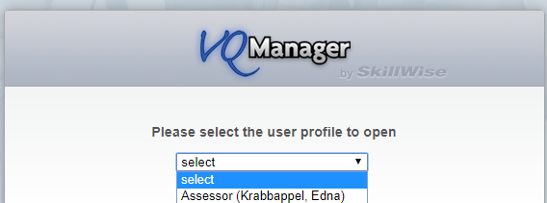
VQManager
Passwords
In the event of a user having forgotten their user name
There is the ability for a user to enter an email address in the instance where a user name has been forgotten. This function will only work if VQManager has a valid email address for the user.
The login screen reads “User name or email”.
Click on the “Forgotten your user name?” link and this pop up appears, click Ok and enter your email address and your password.
When you enter your email address, if you have more than one account, and they have the same password, a drop-down asks you which profile you would like to log into.

Slide 41
VQManager
Passwords
Time allowances in respect of setting/resetting password messages
Creation of user in VQM - 7 days, user name included and wording is “set”.
Centre Admin requested – 24hrs, user name included and wording is “set”.
Self-requested reset – 24hrs, user name not included and wording is “reset”.

