Slide 1
User Group Meeting
November 14th 2019

Slide 2
Welcome
Today’s agenda:
Welcome - today’s aim and housekeeping | Paul
Review of developed functions | Kari
Development in progress | Kari
Future projects | Paul
Suggestions for future development | Jo
Lunch | All
Voting | Jo
Ofsted | Kari & Jo M
Close | Paul

Slide 3
VQManager
VQManager
Enhancements

Slide 4
VQManager
Evidence
Adding user name to all comments boxes in evidence
We have now made sure that the name of the user making the comments will be displayed above the relevant box in the evidence, for clarity. This was already happening in most cases, but there were some exceptions.
Unfortunately, this will only work for new evidence. We were not able to update existing evidence with the names, because this change involves collecting data we didn’t record before.

Slide 5
VQManager
Evidence
Assessor access to delete files they didn't upload themselves
Previously, files could only be deleted by the person who uploaded them. This presented some issues, for example when a learner moved from one assessor to another. We have expanded access so that any user in the same role as the person who uploaded a file will be able to delete it. For example, if qualified assessor A uploaded a file to a piece of evidence, qualified assessor B will have access to delete that file when working on the evidence, should they need to.

Slide 6
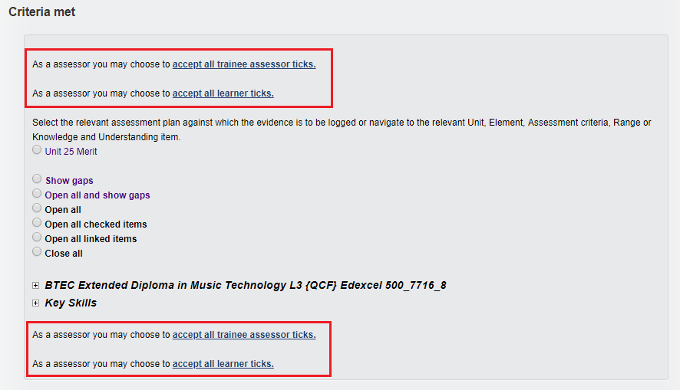
VQManager
Evidence
Adding ‘accept all ticks’ links at the end of the qual tree as well as the start
To make this function easier to use, we have duplicated the ‘accept all’ links below the qual tree as well as above.

Slide 7
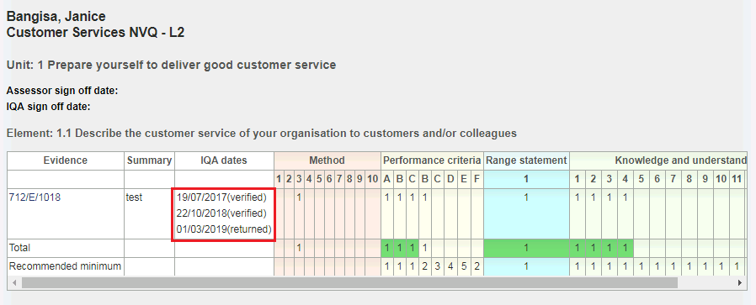
VQManager
Evidence Matrix
Show all IQA dates in Evidence matrix
Previously, only the most recent IQA date showed against evidence in the Evidence matrix. We have altered this so that all IQA interactions with the evidence are listed.

Slide 8
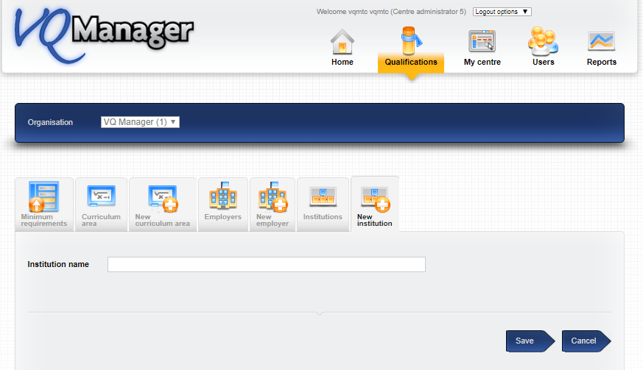
Reports
1
New customisable field and report filter
A new filter field has been added, working in the same way as the Curriculum Area field. Learners, Assessors, IQAs and Line Managers can be assigned to this new category in their user profiles. The name of the field is customisable, but defaults to ‘custom filter 2’. In the example below we have used ‘Institution’. If you want to use this feature, we will ask you to specify what you would like to call it.
Org and Centre Admin can populate a list for the drop-down, as they currently can for Employers and Curriculum Area.

Slide 9
VQManager
Reports
2
In the user profile page you can then assign the new category to your learners, assessors, IQAs and Line Managers.
In the dashboard area a column for this filter has been added to the OSU, Assessor and IQA dashboard pop out reports and downloads.
A new column has also been added for: • Learner Entry Details • User List
A filter and report column have been added for: • Progress – Progress Reviews • Progress – GLH • Progress – Off the Job Training hours • Qualification Tracker • User Activity – Users who logged in
A filter has been added for: • Progress – Qualification progress • Progress – Unit Sign off • Progress – Unit Sign off % only • Progress – BTEC Course progress • User Activity – Learner activity • User Activity – Learner evidence

Slide 10
VQManager
Reports
Listing all assessors in all reports
Some of the reports in VQManager list all assessors in one field, some only show one, and some have different rows for the different assessors. We are standardising this approach so that the reports list all the assessors associated with the learner. Future development will make sure that reports currently showing a separate row for each assessor the learner is assigned to will only show one row per learner.
The following reports have been updated so that, instead of just showing one assessor per learner, they show all the assessors assigned to each learner:
Progress - Qualification Progress
Progress - Off the Job training
Qualification Tracker
User Activity - Learner Activity

Slide 11
VQManager
Reports
Option to download OTJ and GLH reports
We have added the option to download the Guided Learning Hours and Off the Job Training reports, for all users who have access to them.

Slide 12
VQManager
Off the job training
OTJ report - new assessor filter
A new filter has been added to this report so it can now be filtered by assessor.
This is relevant for the OTJ report located in Reports > Progress > Off the job training for Centre Admins, EQAs, IQAs, OSUs and Line Managers.

Slide 13
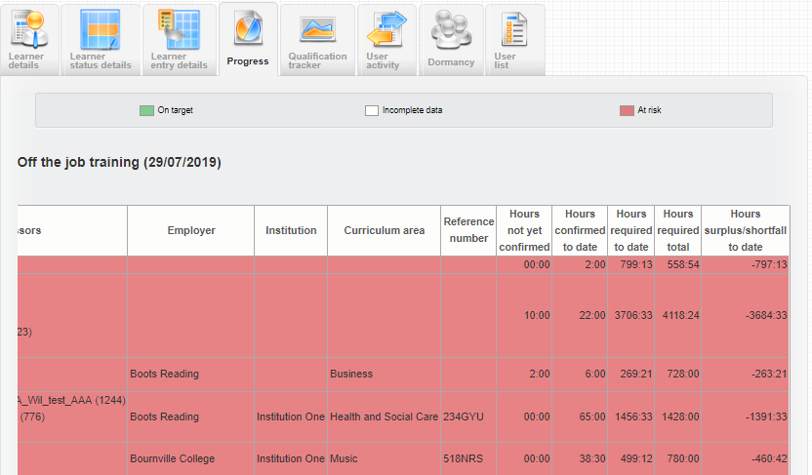
VQManager
Off the job training
New column added to OTJ report for hours claimed by learner but not yet confirmed by assessor
We have added a new column to the OTJ report showing the hours logged by the learner that have not yet been confirmed by the assessor and therefore not yet added to the running total.

Slide 14
VQManager
Off the job training
Discounting OTJ hours logged before first start date
We have made sure that any off the job hours logged before the learner’s earliest qualification start date are not included in the total. This will ensure accurate calculations where a learner has OTJ hours logged for a previous, now de-assigned qualification.

Slide 15
VQManager
Assessment plans
Simplifying the assigning multiple assessment plans with the same target date
When assigning multiple assessment plans, you can now select a link to assign the same date to all of them in one go, rather than setting the dates individually. Enter a date for the first plan in the list, then click on the link and the date will replicate in the date boxes of subsequent plans being assigned.

Slide 16
VQManager
Assessment plans
Sharing files along with assessment plans
This enhancement pertains to where a Centre Admin is copying assessment plans from one assessor to another.
Files uploaded by an assessor and attached to an assessment plan were already being copied to along with the assessment plan. This enhancement ensures that files that were shared by a File Librarian and attached to an assessment plan by an assessor are also copied across to any new assessors with the assessment plan.

Slide 17
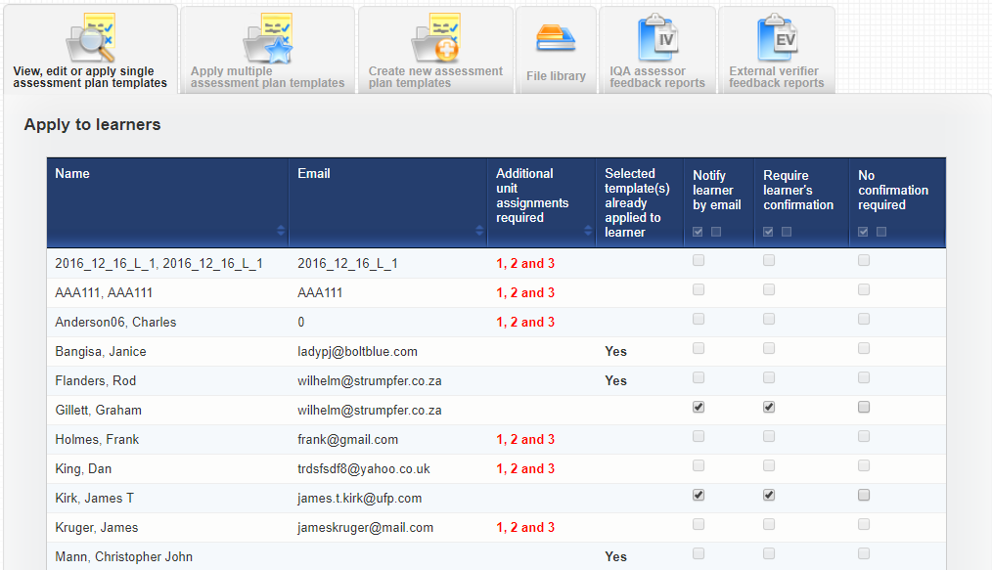
VQManager
Assessment plans
1
New function to prevent same assessment plan being assigned to the same learner more than once
This development prevents the same assessment plan being assigned to the same learner more than once. This is a centre switch, but is defaulted to ON. If you would like this altering, please contact SkillWise.
When applying a single AP template to multiple learners
For those that already had it applied previously – “yes” is shown in a new column “Selected template(s) already applied to learner” and the check box to assign the AP is disabled in the list.

Slide 18
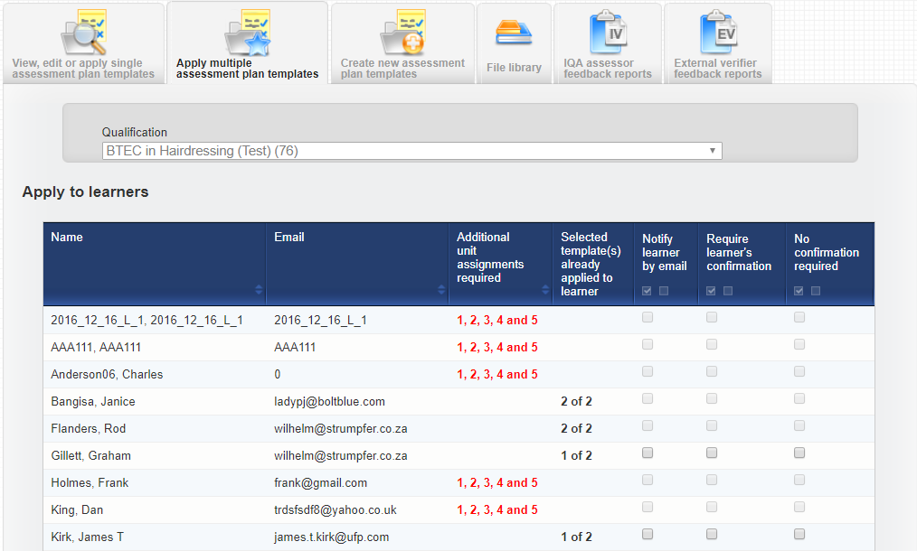
VQManager
Assessment plans
2
When applying multiple APs to multiple learners
If any of the selected APs was previously assigned, the new column shows that all the selected templates are already applied to a learner and the check boxes are disabled. If only some of the templates are already applied the check boxes remain enabled, but only the new templates will be applied.

Slide 19
VQManager
Expert Witness
Blank space issue when completing the Expert witness e-mail address field
We frequently have issues with users copying and pasting e-mail addresses into the Expert Witness fields, and picking up a space as well either at the beginning or the end. This then causes the message to the Witness to fail to be delivered. VQM will now automatically filter out any leading or trailing spaces in emails when the data is received. It will also filter out leading and trailing spaces for any data we already have in the system. It will also do this in user profiles.

Slide 20
VQManager
Email notifications
New default option to set centre default so that e-mails into the system go to the assessor
A while ago, we made a change, requested by the user group, so learners could choose where their emails into the system went, either to themselves or their assessor. The default setting at centre level for all new learners was so that the learner’s emails went to themselves but this could be changed by the learner if required in the Personal Details tab.
We have added a switch which allows for the default for new learners added to the system to be set for either learner emails go to the learner as before, or now the learners emails go to the assessor. The individual learners can still change this preference in the Personal Details tab as before.
Please let SkillWise know if you require your default setting to be changed from:
Learner to learner’s e-portfolio (your current default setting)
To
Learner to assessor’s e-portfolio (the new option)

Slide 21
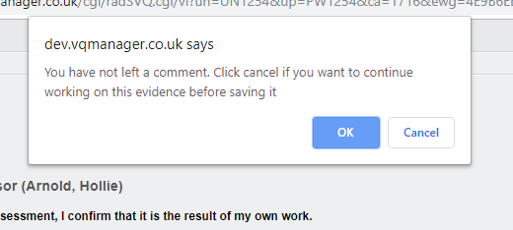
VQManager
Expert Witness
A new pop-up reminder for Expert Witness if they have not left comments
Expert Witnesses now have a pop up reminder, when they are approving or rejecting an evidence item, if they have not left any comments. The message says ‘You have not left a comment. Click cancel if you want to continue working on this evidence before saving it.’

Slide 22
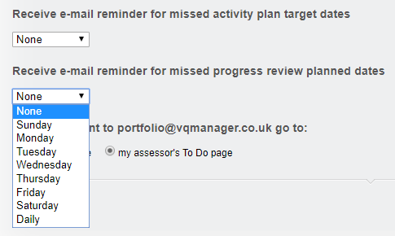
VQManager
Email Notifications
E-mail notification for missed target dates
Learners, assessors and line managers will now be able to opt in to e-mail notifications of missed target dates for assessment plans and progress reviews. They can choose a day of the week, or daily.

Slide 23
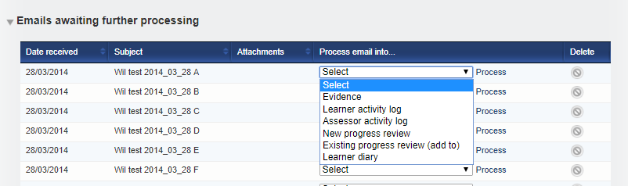
Email Notifications
Add categories to process e-mails sent into VQM
When using the “emailing into the e-portfolio” function you are currently able to process the email in a variety of ways.
As a learner you can add the email as:
Evidence
Learner activity log
As an assessor you the two above and also these additional categories:
Existing progress review (add to)
New progress review
We have now added the following for learners and assessors:
Learner diary
And for assessor alone:
Assessor activity log
Learner view:
Assessor view:

Slide 24
VQManager
Email Notifications
Set e-mail destination preference by user
The emailing into the e-portfolio function has been altered slightly. Traditionally the arrival location of the emails was set at Centre level and the default is set at the first option but can be altered upon request. The options are that the learner’s email either:
was received and processed by the learner
was received and processed by their assessor
Because the learners were so diverse, although the default setting at CA level can be either of these, the learner can now in their “Personal details” tab elect whether they wish to receive the email themselves or send it directly on to their assessor. The learner can change this setting as often as they wish.
The new area looks like this:

Slide 25
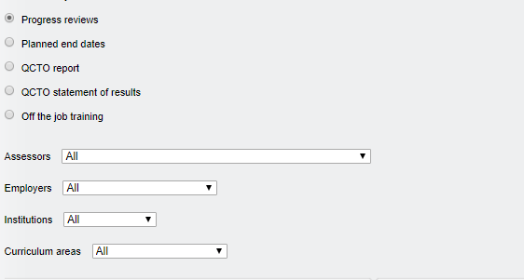
VQManager
Progress review
Progress Review Report – new assessor filter added
You are now able to filter this report by assessor, in the same way you can already filter by Employer and Curriculum Area.
This assessor filter has been applied to Centre Admin, EQA and IQA

Slide 26
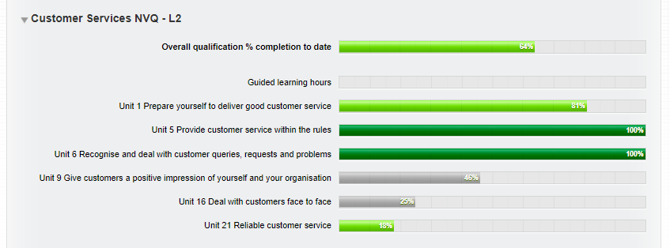
VQManager
Learners and Line Managers (Employers)
Change of colours and wording for 'at risk/off target' for learners and LMs
This development is as a result of an inspection with a client. The wording 'at risk' and the red on the reports was felt to be discouraging or disconcerting to learners and line managers, who don't necessarily know the background of why the reports are showing that. This is especially true when the learners sometimes do not start their qualification in earnest until several weeks after their enrolment date. We have changed the red colouring to light green and changed the wording from ‘At risk’ or 'Off target' to ‘Commenced’
Pages which have been altered are as follows:
Learner:
My Progress Summary
Line Manager:
Dashboard – All learners and Total learners per assessor
Reports – Qualification Tracker and Off the Job Training

Slide 27
VQManager
IQA/IV’s
IQAs linked to trainee assessors to see unit sign off notifications
In a previous update, we added a comments box for the trainee assessor at unit sign off. This change means only qualified assessors can now sign off units. In some cases, different IQAs are assigned to the trainee and the qualified assessor. This update makes sure that all relevant IQAs will see a unit sign off notification for the learner.

Slide 28
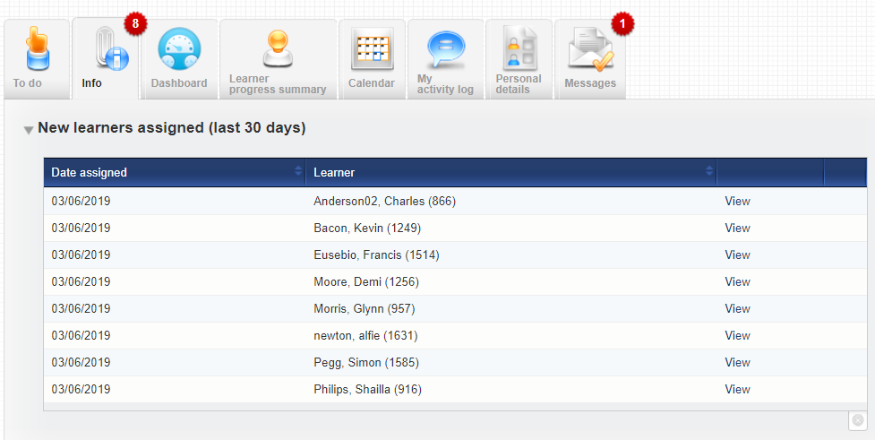
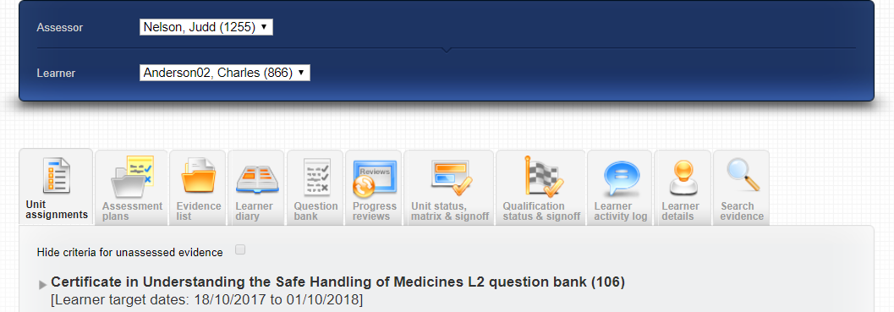
VQManager
IQA/IV’s
New notification in Info tab for IVs of recently added learners
Similar to the notification for assessors, IQA’s will now receive a notification on the IV's Info tab showing recently assigned learners.
Selecting the “View” hyperlink takes you to the Unit assignment page for that learner.

Slide 29
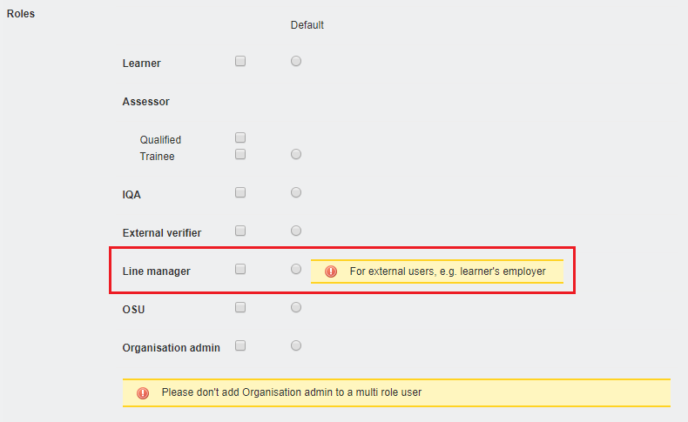
VQManager
Centre Admin
Adding note to Line Manager role for Centre Admins
Over time, the OSU and Line Manager roles have developed from being functionally identical, to a situation where the Line Manager has additional functionality aimed at external users.
To remind Centre Admins of this when they are creating accounts, we have added a note in the User Profile.

Slide 30
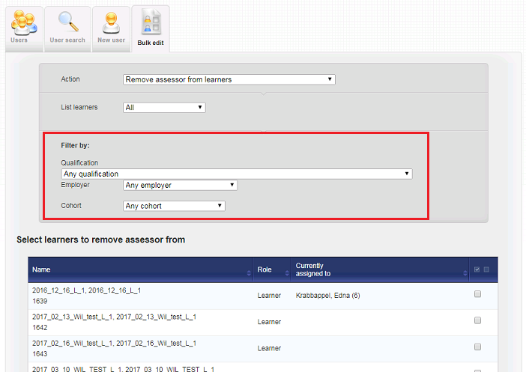
VQManager
Centre Admin
Bulk edit function - adding filters for qual, curriculum area and employer
To help with editing groups of users, we have added filters so admins can select users assigned to a particular qualification, curriculum area and / or employer.

Slide 31
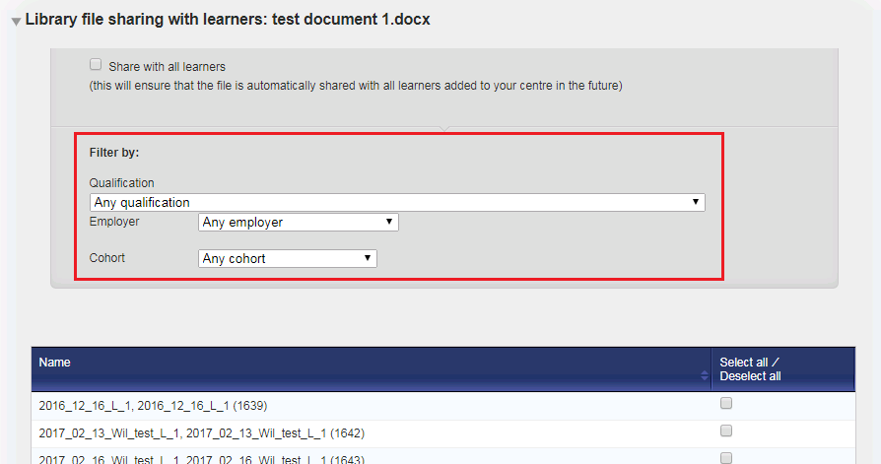
VQManager
Centre Admin
File sharing - adding filters for qual, curriculum area and employer
Similar to the above, we have added filters for admins to filter users when they are sharing files in the File Library.

Slide 32
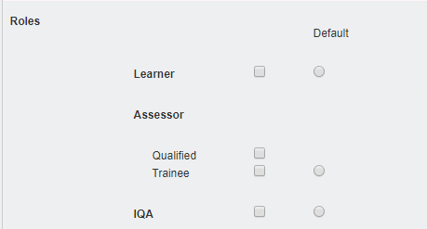
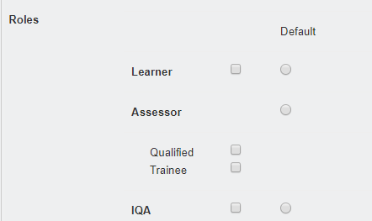
VQManager
Centre Admin
Relocation of the 'default' radio button in the user profile
Currently, the assessor default radio button appears next to the trainee assessor box.
We have now moved it up the page to sit alongside the assessor role tag to avoid confusion.

Slide 33
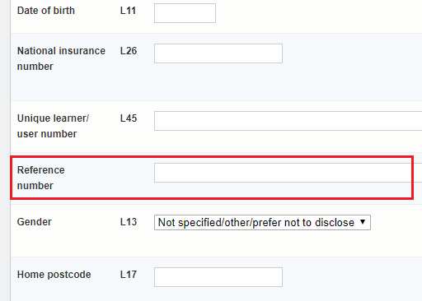
VQManager
Centre Admin
New learner profile field for ‘Reference number
We have added a new field in the learner User profile for a reference number.
This was added specifically for a client wanting to easily match learner records in VQManager with records in their MIS system. A reference number can be added manually, or via integration. If you want to populate this via integration, this will require development by the integration partner so that their system can interact with this new VQManager functionality. We are happy to provide details on request.

Slide 34
VQManager
General
Improving navigation where lists are long
Some pages in VQManager quickly get quite long, and for users, this can mean a lot of scrolling up and down. To reduce the need for this, we have altered some of the page layouts so users don’t need to scroll to the bottom to open or edit after selecting an item in the list.
For example, this is the ‘Apply single assessment plan templates’ tab:
Old view
New view
These changes are applied in the following areas:
Apply single assessment plan template
Assessment plan tab in ‘My Portfolio / My Learners / Verify’
Unit status and sign off
IQA assessor feedback reports
EQA feedback reports

Slide 35
VQManager
Line Manager
Add option to re-name Line Manager role
It is now possible to change the title of the Line Manager role to suit your requirements. Please let us know if you’d like this.

Slide 36
VQManager
In development
Showing confirmed OTJ hours in bold in Diary and AL summary tables- Comp
Adding columns to Assessor Performance report – WIP
New report, quals in centre – Comp
Adding download option to all reports – WIP
Listing all assessors in all reports - Comp
Add target % completion to 2 Centre Admin reports – WIP
Allow Centre Admin to add OTJ hours manually – future
Allow a Line Manager to be selected as Expert Witness - future

Slide 37
VQManager
In development
Progression Tracker – WIP

Slide 38
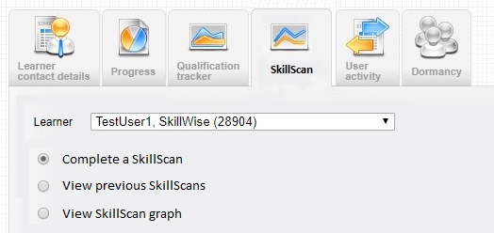
VQManager
Progression Tracker – WIP
Ofsted want clients to track progress and ‘value added’ as they work through their qualification. We are developing a function to allow learners, assessors and line managers to show a ‘rating’ against the criteria for a qualification, to show progression. This will be a new tab in the Reports area
Within the Progression Tracker, scans are done on an ad hoc basis, with the assessor deciding how many to do and when. (Has been renamed to avoid confusion with existing SkillScan completed by provider prior to enrolment).

Slide 39
VQManager
Progression Tracker – WIP
Once a qualification is selected, the assessor will be presented with a field to input a title for the first scan, to identify it.
This will happen for each subsequent scan as well. Only units assigned to the learner will display. Each criterion can only have one option selected.
The scan is complete when every criterion has a value assigned. Users will be able to save a partially completed scan, and return to complete it later. Only a completed scan can be passed from the assessor to the learner and line manager to work on.
Upon completion the assessor will send a notification to the other users to work on the scan, stating a target date. The target date can be the same for both users, or different.
This will post a notification on the target users’ To Do lists and likely trigger an email too.

Slide 40
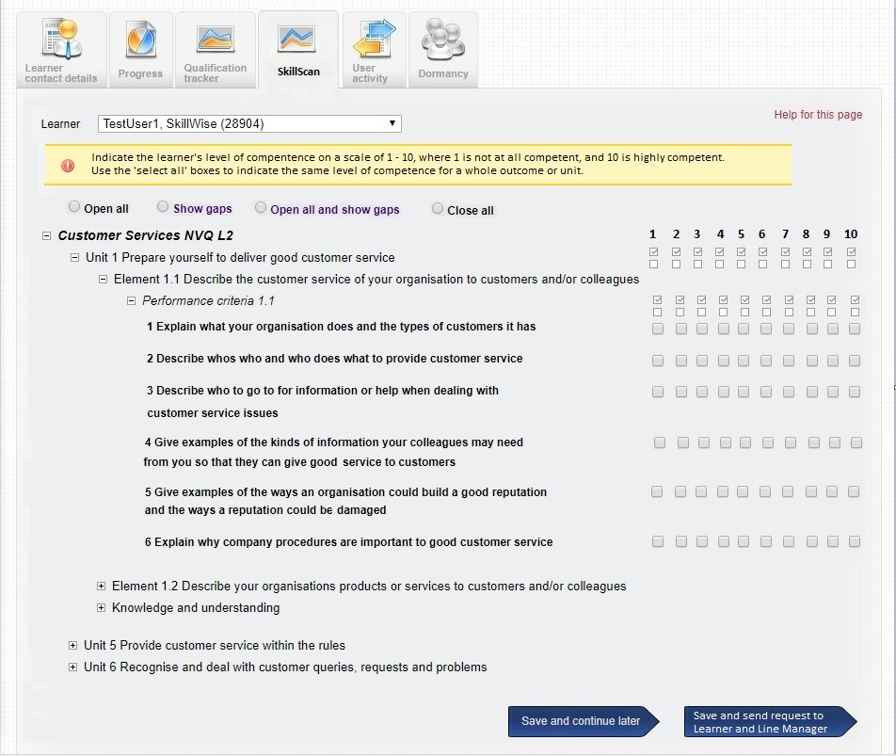
VQManager
Progression Tracker – WIP
Note that anyone completing the scan can either state a confidence level against each criteria, or if the organisation prefers a less granular approach, it can be done at Unit level.

Slide 41
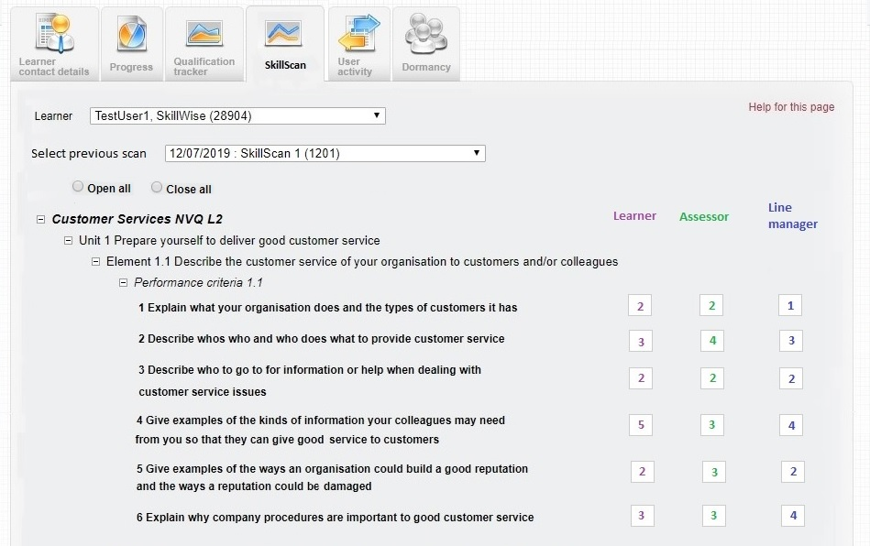
VQManager
Progression Tracker – WIP
Users will not see each other’s work until they have completed their own scan and saved it. Previous scans are visible to all users once the three participants have completed their part. If the scan is not yet completed by all participants, a message will appear on screen advising the users of that.

Slide 42
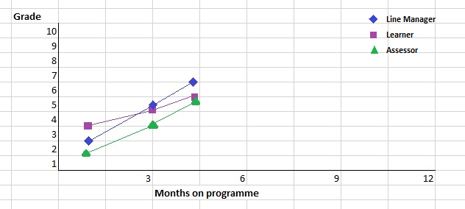
VQManager
Progression Tracker – WIP
The results of the scan will be available in a graph format. It will then be possible to drill down and see the results of a single scan as a graph, again with separate coloured lines for learner, assessor and line manager:
This data will be exportable into an Excel report. This report will show all scans in one report.

Slide 43
VQManager
Next development
Embedding learning content - WIP

Slide 44
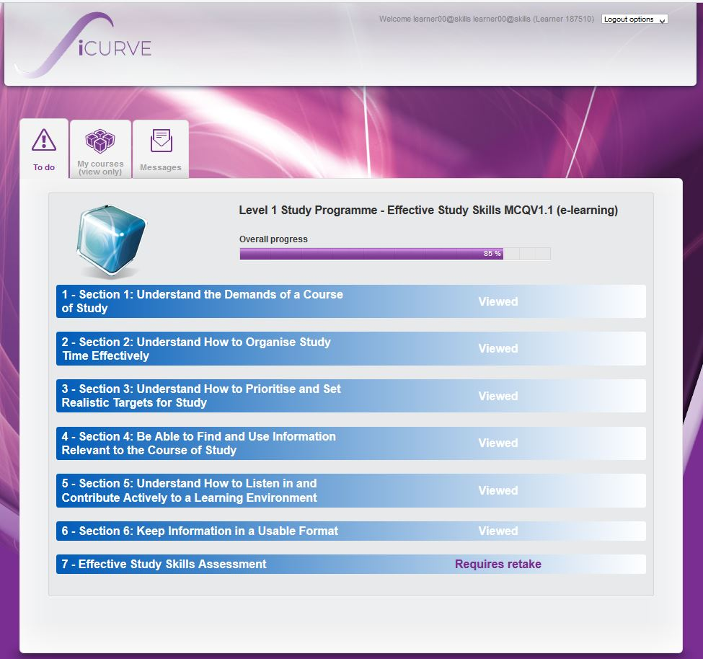
Embedding learning content - WIP
Delivery
The aim is to be able to launch content either a) from a menu structure, or b) from links that can be embedded directly into Assessment Plans so that the learner is fed selected content at the appropriate time. In the case of a menu structure, a new VQM menu item would be created and labelled ‘Learning Content’ or similar.
Clicking on that would launch a new screen that would look something like this:

Slide 45
Embedding learning content - WIP
Form of the Content
The content is specifically authored by individuals trained in educational principles so that it provides a rich, effective and engaging e-learning experience.
Examples might include the following types of slide:

Slide 46
Embedding learning content - WIP
Assessment
It’s possible to assess learners’ competence, through a multiple choice interface allowing
any number of possible answers
multi-correct response formats.

Slide 47
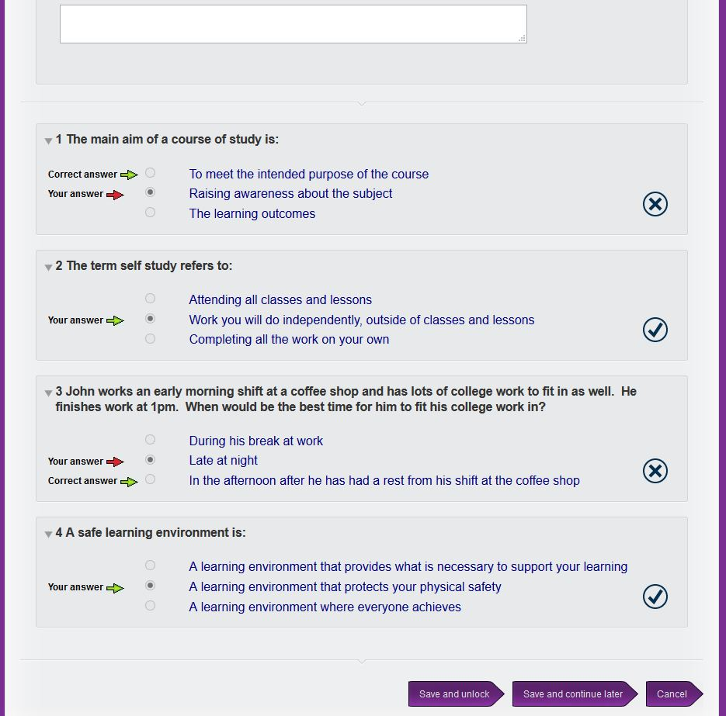
Embedding learning content - WIP
Learner results / feedback can be provided, including the prevention of further attempts after a specified number of failed attempts…...and very detailed feedback can be provided on a question by question basis:

Slide 48
VQManager
Next development
EPA – in design

Slide 49
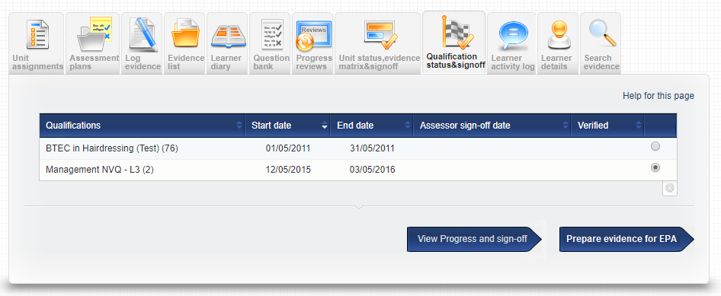
VQManager
EPA – in design mode
Making evidence available for End Point Assessment
To facilitate this new process for Standards, we will provide view-only access to evidence items that don’t require the user to log in to VQManager. This will offer users a choice of downloading a PDF or creating a link they can share.
A new option ‘prepare evidence for EPA’ would be available
The new arrow button will open a new page, similar to the evidence matrix.
This will have filters for qualification and unit, to help users find what they need

Slide 50
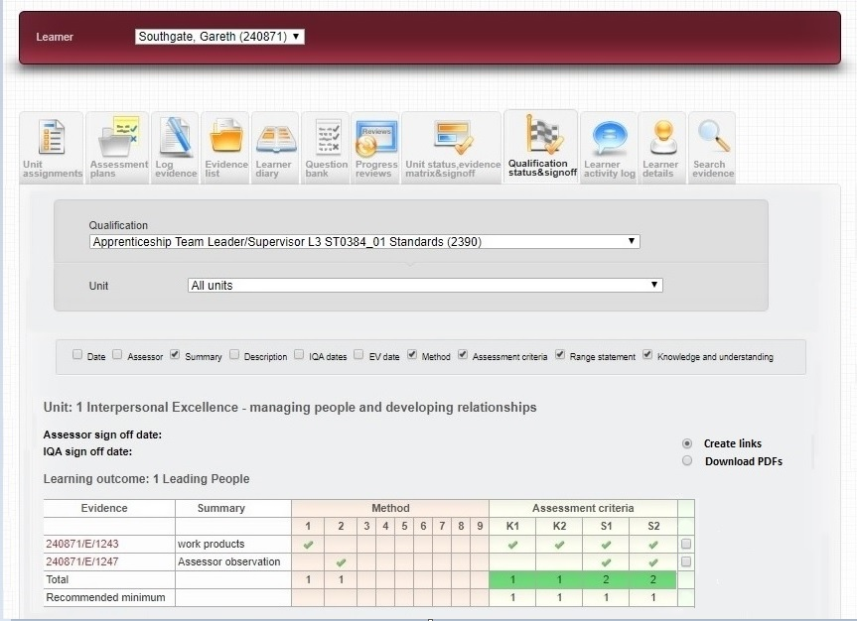
VQManager
EPA – in design mode
In the matrix, they will be able to select which evidence item(s) they need with a tick box.
In the matrix, users will then have an options to either download separate links or PDF files for each evidence item, or collate these into a single document. This will have filters for qualification and unit, to help users find what they need.

Slide 51
VQManager
EPA – in design mode
Download of summary document
This is where there is the option of downloading a summary document. This would list the selected evidence, and provide hyperlinks to a view only copy of the evidence, that anyone receiving the list could click on.
Evidence number | Description | Unit(s) | Criteria covered
18678/E/1158 | Checking expiry dates of meds | 4 | 1k, 2s, 2b, 3s
18678/E/1083 | Managing the storeroom | 6, 10 | 3k, 3s, 3b
18678/E/987 | etc | 2
Clicking on the links whether singular or as part of the link document, the End Point Assessor evidence view will look almost identical to the Expert Witness view, except the EP Assessor does not need to make comments or interact with the evidence other than reading it.

Slide 52
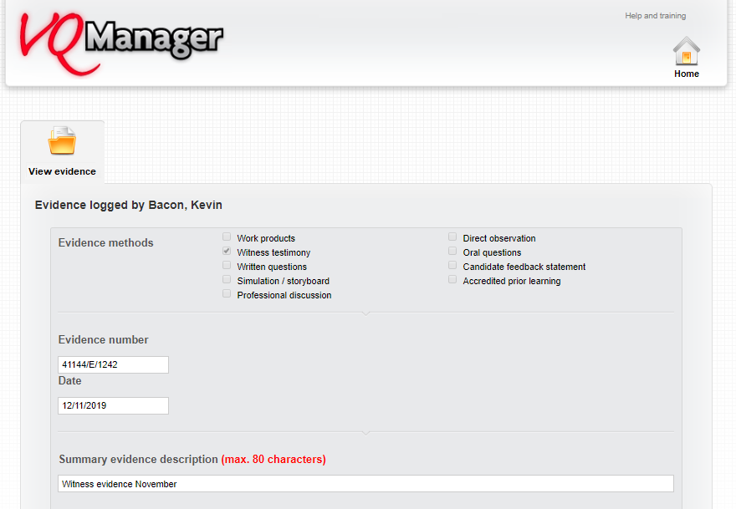
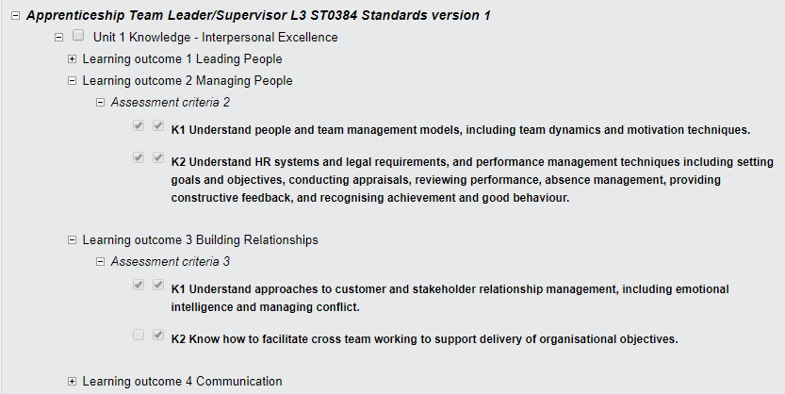
EPA – in design mode
Downloading separate links
All aspects of the evidence will likely be available, as per the EV view now, i.e. documents attached can be opened and viewed.
The qual tree will show open where criteria are ticked, so users can see which criteria are marked as covered in the evidence

Slide 53
EPA – in design mode
Downloading files
A typical evidence item will be 3 – 4 pages long, when extracted into a pdf file. Both the link and the PDF file will show the same view of the evidence (or as similar as possible).
We will likely offer a ‘select all’ shortcut to accommodate some EPAO requirements.

Slide 54
VQManager
Capita Integration release
The following enhancements are being made to the UNIT-e to VQ Manager link to be included in the 4.44 release, which is currently scheduled for 13/12/2019
We are adding the ability to transfer three extra fields, these are:
Student Reference Number
Institution
Tutor
We are also making a change so that when an error message is received back about the transfer of a student, the transfer flag will be unticked, so it won’t keep being sent generating large error logs at SkillWise end.

Slide 55
VQManager
Website updates:
Layout
Password only

Slide 56
VQManager
New development requests

Slide 57
VQManager
Voting

Slide 58
VQManager
Ofsted

Slide 59
VQManager
Thank you
Paul, Jo, Kari and Chris

